Slide 1
🧠
NexusBrain
CONFIDENTIAL · TECHNICAL OVERVIEW
The Operating System for
Organisational Intelligence
A 30-layer, self-learning brain that sits at the centre of every business workflow — orchestrating services, learning from every outcome, and compounding knowledge over time.
🧬 30-Layer Neural Architecture
⚡ Federated Causal Learning
🔁 6 Autonomous RL Loops
🛒 Service Marketplace
30
6
28
9+
Layers
RL Loops
Action Domains
Connectors
Confidential · NexusBrain

Slide 2
01 · THE PROBLEM
Businesses have data everywhere. But no system understands why things happen.
📊
🧩
🔁
Data, but no answers
Siloed intelligence
AI that resets every time
Teams drown in dashboards yet can't answer: Why did churn spike? Why did that sprint fail? Correlation fills the screen. Causation is invisible.
Copilot writes code. Xero tracks money. HubSpot logs deals. Linear plans sprints. Each tool knows nothing about the others. No cross-domain learning. Ever.
Every LLM query starts from zero. No memory of past outcomes. No organisation-specific context. No feedback loop. No compound value.
💡 The Gap — No system learns causal relationships across the full business stack, remembers them, and gets smarter over time — autonomously.
Confidential · NexusBrain

Slide 3
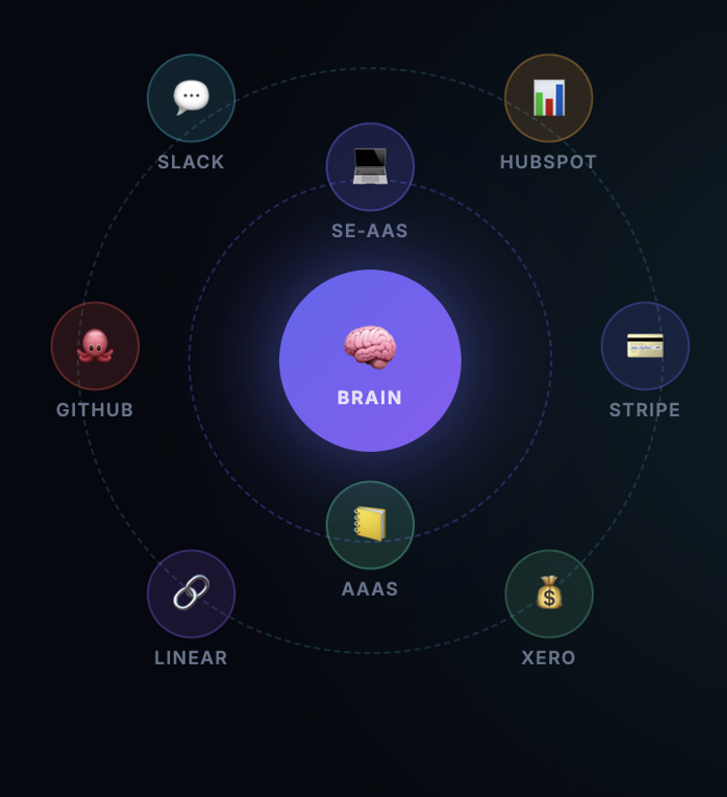
03 · THE INSIGHT
A brain is light at the centre, heavy at the edges.
Service Marketplace
Brain (Orchestration Layer)
🧠
💻
📒
🧠
Lightweight central node · causal knowledge graph · intelligent routing · continuous self-learning
Brain
SE-AAS
AAAS
Orchestration
Engineering
Accounting
Services (Execution Layer)
⚙️
👥
💰
🌐
Heavy-lift domain specialists · SE-AAS · AAAS · HR-AAS · each plugs into the marketplace
HR-AAS
Sales-AAS
3rd Party
People Ops
Revenue
Open Platform
Every execution feeds back
🔁
Signals → causal DAG evolution → RL loops → smarter next query — automatically
Every service feeds signals back to the brain → causal DAG evolves → smarter next time

Slide 4
04 · ARCHITECTURE
30 Layers. Modelled on the Human Neocortex.
L1–L3 · Ingestion & Recognition
L4–L5 · Causal Learning
Multi-modal connectors · Entity resolution · Semantic embeddings · Dedup
Signal collector · Causal graph engine · UCB1 bandit · Granger, VAR, DID, DO-calculus
L6–L8 · Domain Intelligence
L9–L15 · Learning Loops
28 action domains · Multi-hop reasoning · Counterfactual simulator · Temporal forecaster
6 closed RL feedback loops · Credit assignment · Brain sleep consolidation · Outcome oracle
L16–L20 · Reasoning & Context
L21–L25 · Execution & Action
Entity graph persistence · Cross-system linking · Context-aware reasoner · Brain health monitor
Domain action engine · Motor commands · Brain commander · Dispatch assessor · Agent registry
L26–L30 · Observability & Persistence
Brain state · Metrics · Connector bridge · Fast-path compiler (<100ms) · Multi-model routing
🏆 Every query strengthens the causal DAG · Every org improves the CORE brain · The product gets smarter without anyone touching it
Confidential · NexusBrain

Slide 5
05 · REINFORCEMENT LEARNING — THE ENGINE THAT MAKES IT POWERFUL
The brain learns from every outcome. Autonomously.
THE LEARNING CYCLE
WHAT MAKES IT UNIQUELY POWERFUL
1
SIGNAL IN
Federated Learning (Privacy-Preserving)
A connector fires — deal closed, PR merged, GL transaction posted.
🧠
Only effect-size deltas flow to the CORE brain — never raw data. CORE += 0.3 × FedAvg(org deltas), clipped ±0.15, min 10 samples. Org 1,000 benefits from Org 1's learnings without seeing their data.
↓
2
CAUSAL GRAPH UPDATE
Edge weights between domain pairs (X→Y) update in real-time.
↓
3
METHOD SELECTION (UCB1 Bandit)
Brain Sleep (Consolidation Cycle)
Selects best method (Granger, VAR, DID, DO-calculus) — explore vs exploit.
🌙
Every 30 min: recomputes the full causal DAG, calibrates confidence intervals, consolidates patterns into long-term memory — exactly like human memory solidification during sleep. No other AI does this.
↓
4
PREDICTION & EXECUTION
Domain runs with brain context. Prediction recorded: 'If X → Y at Z% confidence'.
↓
Autonomous Outcome Verification
5
OUTCOME ORACLE
Automatically matches prediction to real outcomes. No human labelling.
🎯
The Outcome Oracle matches every prediction to real-world outcomes by scanning subsequent signals. Always self-evaluating, always improving — even when no one is watching.
↓
6
REWARD & WEIGHT UPDATE
Bandit arm + DAG edge weights update. Brain learned. Next query is smarter.
Confidential · NexusBrain

Slide 6
05b · HOW EVERY EXECUTION TEACHES THE BRAIN
Five channels fire on every single query.
📡 Signal Channel
🔄 Evolution Channel
Emits a CrossDomainSignal with domain, severity, and entity context to the event bus.
→
←
Triggers DAG edge-weight updates, recalibrating causal relationships based on execution context.
⚡ Domain Execution
(any SE-AAS or AAAS query, or any service )
🔮 Prediction Channel
📈 Observability Channel
Records the intervention prediction: 'If this action → Y at Z% confidence' for later autonomous verification.
→
←
Logs timing, accuracy, token cost and domain performance metrics for brain health monitoring.
↓
💡 Insight Channel
Broadcasts cross-service insights — e.g. AAAS patterns can inform an SE-AAS incident diagnosis.
Post-execution: ORG→CORE federated delta · Only effect-size deltas, never raw data · CORE brain gets smarter with every org
Confidential · NexusBrain

Slide 7
06 · SERVICE MARKETPLACE
Every domain plugs into the brain. New services add intelligence without changing the core.
SE-AAS
BRAIN ROUTING INTELLIGENCE
✅
LIVE
Software Engineering as a Service
⚡ Fast Query
Cached · <100ms
AAAS
🧠 Action Domain
Brain-augmented · 1–30s
✅
LIVE
Accounting & Analytics as a Service
🤖 Agent Orchestration
Multi-step · 1–5m
HR-AAS
🔜
NEXT
HR & People Operations as a Service
Sales-AAS
28 ACTION DOMAINS
🔜
ROADMAP
forecast · simulate · diagnose · explain · compare
Revenue Operations as a Service
monitor · optimize · recommend · audit · sentiment
3rd Party
scenario-tree · risk-cascade · anomaly · bookkeeper
🌐
VISION
reconcile · calibrate · impact · incident · pr-review
Open marketplace for external providers
architecture · pod-match · tax · data-lineage
performance · dead-code · dependency · design-doc · codebase-qa
Confidential · NexusBrain

Slide 8
07 · SE-AAS — SOFTWARE ENGINEERING AS A SERVICE
Brain-augmented engineering intelligence. 12 capabilities. Every one learns.
🔥
Incident Diagnosis
💥
Impact Analysis
🔍
PR Review
🗺️
Architecture Extractor
Root-cause via causal graph
Blast-radius prediction
Org-context-aware analysis
System map from codebase
👥
Pod Match
📝
Design Doc Gen
⚡
Performance Profiler
🧹
Dead Code Detector
Team skill matching
Architecture docs in mins
Bottleneck ID + patterns
Unused code with context
📦
Dependency Upgrade
🧪
Test Data Generator
🗄️
SQL Analyser
✅
Codebase QA
Safe upgrades, risk-aware
Realistic test datasets
Optimisation + risk detect
Quality, org-specific rules
EXECUTION PIPELINE
① Snapshot weights
→
② CORE→ORG inject
→
③ Brain Context Mesh
→
④ Claude + brain
→
⑤ Save artifact
→
⑥ Feedback Bus
→
⑦ ORG→CORE delta
🔧 Brain Context Mesh — causal edges · org patterns · business rules · entity links · code dependency graph · LEAP reasoning
💰 3–5h saved per PR review · 60% faster incident resolution · Architecture docs in minutes
Confidential · NexusBrain

Slide 9
08 · AAAS — ACCOUNTING & ANALYTICS AS A SERVICE
Seven brain-augmented accounting agents. Every transaction understood, not just recorded.
📚
Brain Bookkeeper
⚖️
Brain Reconciler
Categorise GL accounts + journal entries
Month-end account reconciliation
📊
Brain Statement Gen
🏛️
Brain Tax Compliance
P&L, Balance Sheet, Cash Flow
GST / tax computation (SG · IRAS · SFRS)
📋
Brain Audit Preparer
🔎
Brain Anomaly Detector
Audit readiness + workpapers
Benford's Law · vendor concentration · duplicates
🧬
Brain Causal Accountant V9
WHY did P&L move — not just WHAT it did
🔑 Transaction Narrative — every transaction explained in plain English
💰 Business Value
"Recurring software license revenue of SGD 50,000 — core ARR contribution. Ref: INV-2024-001. Check deferred revenue schedule if multi-period."
✓ Replaces 8–12 accountant hours / month-end
✓ Catches anomalies no human would spot
✓ Real-time SSE streaming with brain metadata
✓ Design partner: Tookitaki (AML / compliance)
Confidential · NexusBrain

Slide 10
09 · ENGINEERING FOUNDATION
Built on world-class, production-grade foundations.
LLM & AI
Data & Infrastructure
Frontend & Platform
🤖 Claude (Anthropic)
🗄️ Supabase (PostgreSQL)
⚛️ Next.js 15 (React 19)
Primary reasoning + generation
Row-level security throughout
Full-stack TypeScript app
🔤 OpenAI text-embedding-3-small
📦 AWS S3
🏗️ Turborepo monorepo
384-dim semantic embeddings
Artifact + model storage
packages/ + platform/
🔀 Multi-model routing
⚡ SSE streaming
📡 REST + SSE APIs
Fast / deep / premium tiers
Real-time result delivery
Sync and streaming endpoints
🧮 UCB1 bandit
🔒 End-to-end encryption
🧪 Vitest + Playwright
Causal method selection
Privacy-first architecture
Unit + e2e test coverage
🔬 6 autonomous RL loops
🌐 Edge-ready
🎨 TailwindCSS + Radix UI
Always learning, no human needed
Low-latency global deployment
Component library
CAUSAL METHODS
CONNECTORS (L1 INGESTION)
Correlation · Granger causality · Multivariate VAR · DO-calculus · DID estimation
GitHub · Linear · Jira · HubSpot · Stripe · Xero · Slack · Google Workspace · Zendesk · Calendly
🔒 Privacy & Federation — Only effect-size deltas shared · FedAvg clip ±0.15 · min 10 samples gate · ORG data always wins conflicts
Confidential · NexusBrain

Slide 11
🧠
THE CORE IDEA
"We are building the causal knowledge graph of how organisations actually work — and it compounds with every org, every signal, every service. This is not a chatbot. This is organisational memory with a feedback loop."
30
6
28
∞
Brain Layers
RL Loops
Action Domains
Compounding Value
nexusbrain.ai · Confidential
Confidential · NexusBrain

