Slide 1
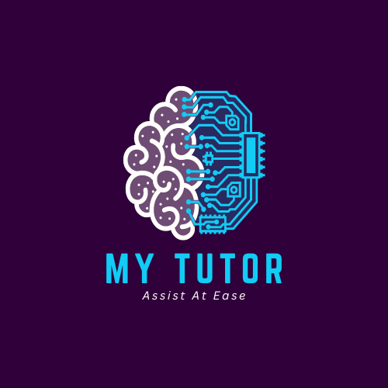
Assist At Ease
An AI – Based Self Studying Platform with Features for making ease of Learning.

Slide 2
My tutor: (lms)
Problem Statement
In today's fast-paced world, traditional study methods often fall short in addressing the diverse learning needs and schedules of students. Many students struggle with time management, understanding complex concepts, and retaining information effectively. Additionally, the lack of personalized learning experiences makes it challenging for students to stay motivated and achieve their academic goals. There's a significant gap in providing a tailored, adaptive learning experience that can cater to individual learning styles and paces, making the need for a smart, AI-driven solution imperative.

Slide 3
My tutor: (lms)
Use Case :
During exam preparation, students often rely on friends, parents, or tutors for quick revision and interactive study methods such as quizzing. This dependency can be challenging due to the varying availability of these third parties and differing study techniques. There is a need for a solution that allows students to efficiently and independently revise their study materials and assess their preparedness through interactive methods, ensuring a reliable and consistent study experience without the need for external assistance.

Slide 4
My tutor: (lms)
FEATURES:
File Uploading Option (MP4,MP3,PDF,DOCX,TXT,PPT).
Summarizing Document content.
Readout Loud of Summarization.
Flash Cards.
Quiz.
Exporting Quiz ,Flashcards and Summary

Slide 5
My tutor: (lms)
User Scenario:
Amy, a college student, is preparing for her final exams. Traditionally, she would study with a friend, quizzing each other on key topics to ensure they both understand the material. However, coordinating with friends can be difficult due to conflicting schedules. With My Tutor, Amy has access to a personal AI-based study assistant that replaces the need for any third person. She can upload her study materials in various formats (MP4, MP3, PDF, DOCX, TXT, PPT), and the platform will automatically summarize the content, highlight key points, and read the summaries aloud. The interactive quiz feature allows Amy to test her knowledge and receive immediate feedback, simulating the peer quiz experience. She can also create flashcards for quick revision and export these materials for further review. My Tutor enables Amy to efficiently and effectively prepare for her exams, enhancing her understanding and retention of the material while reducing her reliance on others.

Slide 6
Workflow
Signup/Login
Homepage
Upload
Summarize
Flashcard
Quiz
Passing the document and prompt to AI Model
Read Out Loud
Export to local
Export to local
Export to local

Slide 7
Product analysis and market overview
Market Overview :
The global Learning Management Systems (LMS) Market size was valued at USD 24,879.82 million in 2023 and is predicted to reach at USD 1,21,789.87 million by 2032, increasing at a CAGR of 19.30% from 2022 to 2032.
The Indian learning management system (LMS) market size was valued at USD 490 million in 2021 and is projected to reach USD 2,931 million by 2030, registering a CAGR of 21.66% during the forecast period (2022 to 2030).
As of June 2024, the number of users for learning management systems (LMS) is estimated at 73.8 million worldwide. This number is expected to continue to increase due to the growing demand for education streamlining solutions. The primary users of LMS are corporate executives (65%) and managers (35%), and 87% of active users use web-based LMS programs

Slide 8







Technologies used

