Slide 1

Apache Kafka

Slide 2

Publish/Subscribe Messaging
Current challenges in industry.

Slide 3
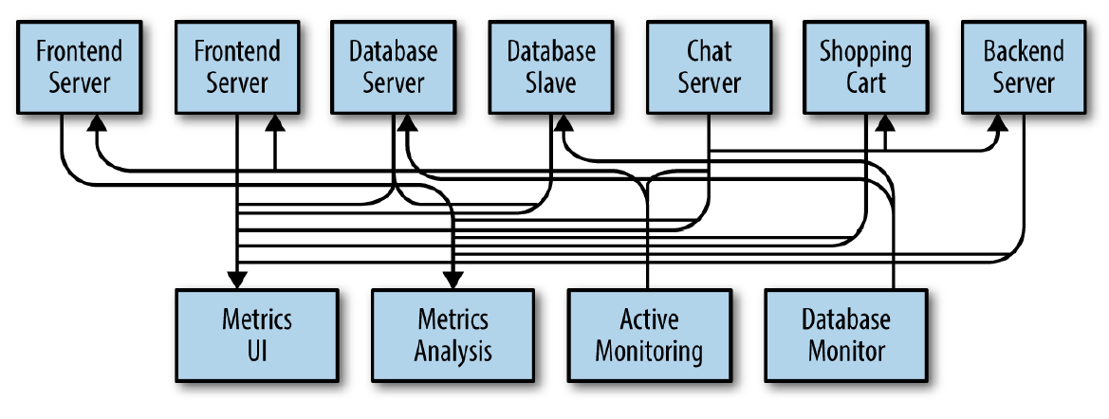

Slide 4
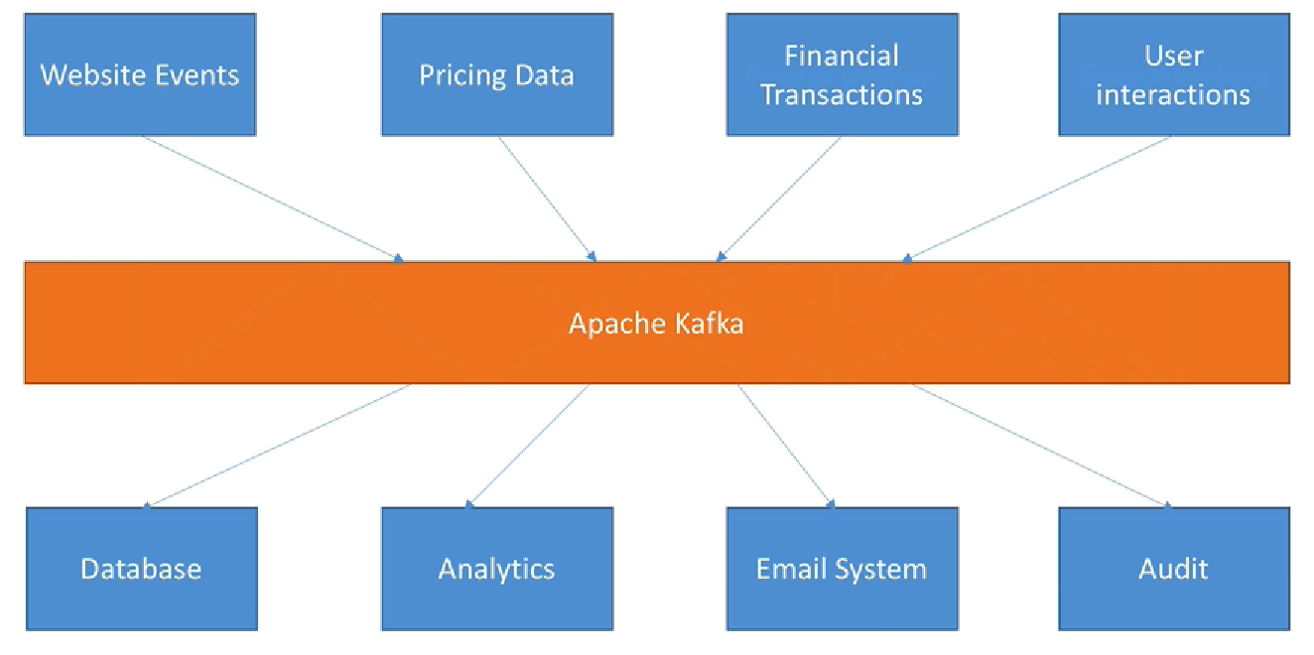

Slide 5

Apache Kafka is an open source, distributed, and replicated commit-log-based publish-subscribe messaging system.
Resilient architecture & fault tolerant
Horizontal scalability
High performance (latency of less than 10ms) –real time
Used by 2000+ firms
(LinkedIn, Netflix, Airbnb, Yahoo, Walmart,etc)

Slide 6
Why Kafka ?
Multiple Producers
Multiple Consumers
Disk-based Retention
Scalable
High performance

Slide 7
Core Concepts
Messages and batches
Topics and Partitions
Brokers
Topic replication factor
Leader for partition

Slide 8
Producers and Consumers
Producers
Write Acknowledgement
Message Keys
Consumers
Consumer Groups
Consumer offsets
Role of Zookeeper

Slide 9

Monitoring Kafka Clusters
Managing Alert Policies
Managing Topics
Monitoring end-to-end latency
Simplifies Troubleshooting
Visualize end-to-end Kafka Stream Flows

Slide 10
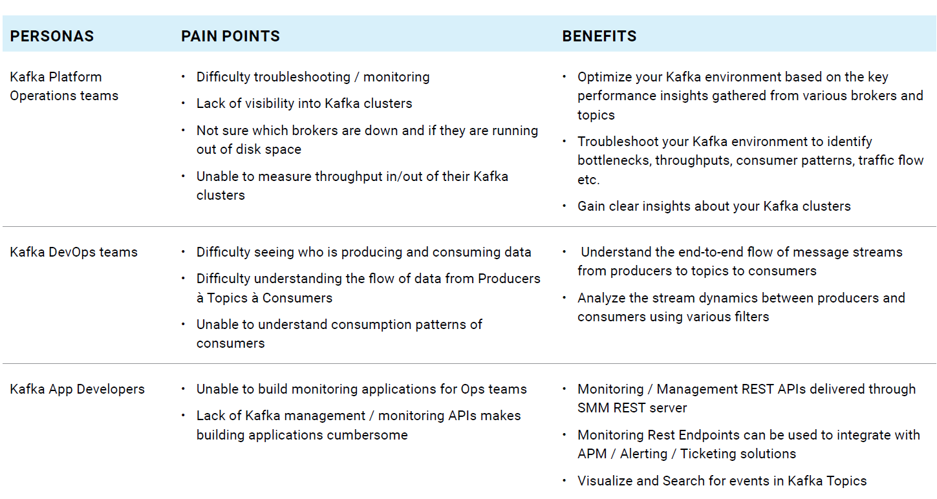
Streams Messaging Manager - SMM

Slide 11

