Slide 1
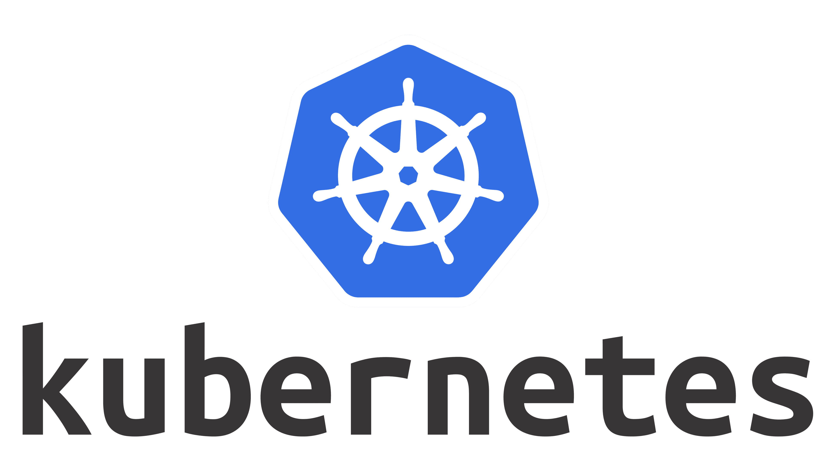


Slide 2

Problem Statement
Containers Everywhere
New Problems
Automation
Lifecycle
Scale up/down
Failure tolerance
High Availability
Cross node communication

Slide 3
What is Kubernetes ?
Container Management Tool
Container Orchestration Tool
K8s
Released by Google in 2015, Now open source

Slide 4
Kubernetes Distribution
Vanilla Upstream
Cloud Managed : EKS, AKS, GKE, etc
Self managed : Canonical Charmed, RedHat OpenShift, Rancher, Docker Enterprise, etc
Vanilla Installers : kubeadm, kops, etc
Local Dev/Test : Docker Desktop, Minikube, etc
CI Testing : kind
https://kubernetes.io/partners/#conformance

Slide 5
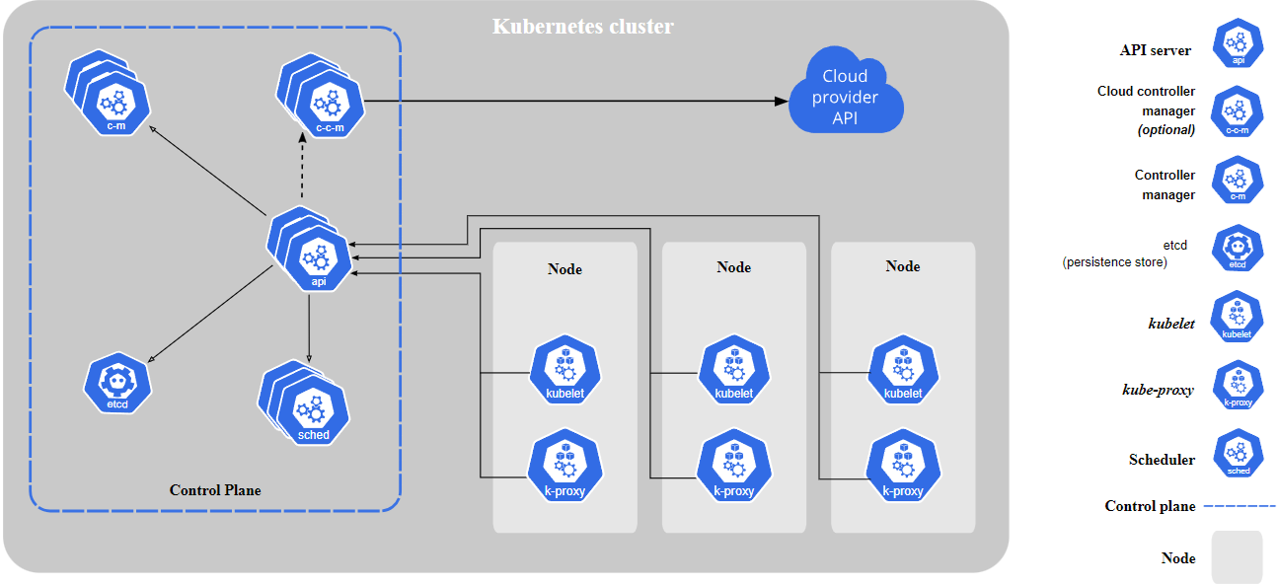

Slide 6
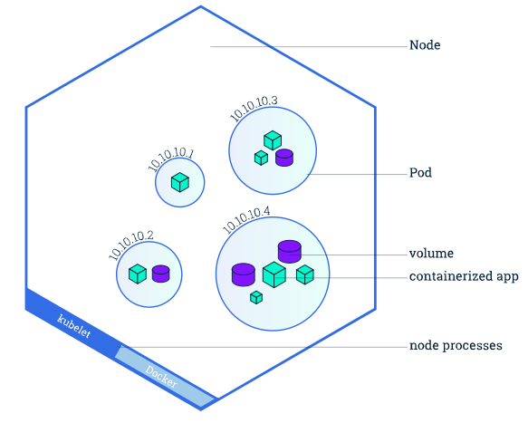
Pod
Runs one or more Containers
Smallest deployable unit in Kubernetes
Its an abstract OR an idea
Ip addresses are for pods and not individual containers
Containers in a pod share localhost
Containers in pod can share volumes
Container engines like Docker doesn’t understand Pods

