Slide 1



Infrastructure As Code - IAC

Slide 2

Terraform
IAC – Automate Infrastructure
Where it fits in ?
Why Terraform?
Declarative Language
HCL – HashiCorp Configuration Language
https://registry.terraform.io/namespaces/hashicorp

Slide 3






Why Terraform ?

Slide 4
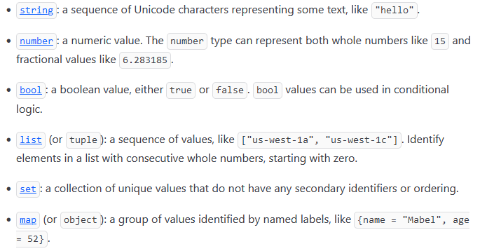
Variable Types

Slide 5
Cloud Formation
Template
Uses Declarative programming language
YAML or JSON
Deploy the Template
Where it fits in ?

Slide 6
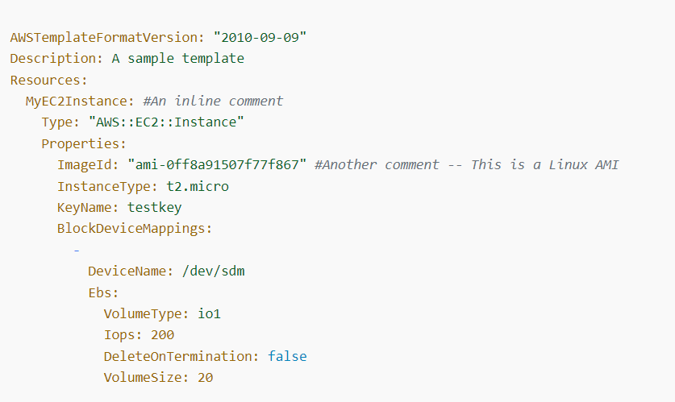
Sample YAML Template

