Slide 1
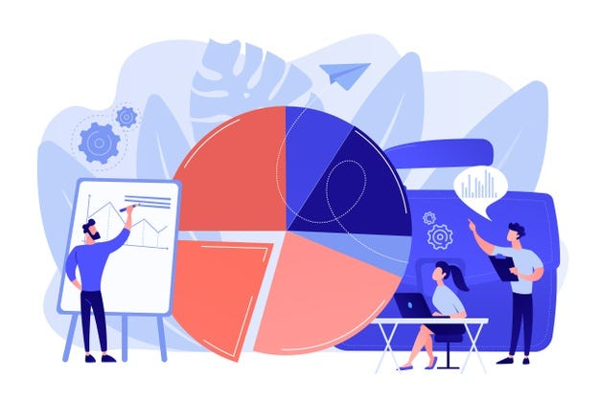
INTERNSHIP STUDIO Final Project
SALES DATA ANALYSIS AND REPORTING FOR A RETAIL CHAIN
Done By: Abhishek Yadav

Slide 2
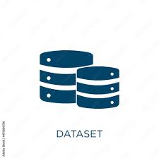
Introduction
About_Dataset: The dataset we will be analyzing is called "Retail_Data_Transactions.csv." It contains transactional data from a retail business.
Objective of the analysis: The primary objective of this analysis is to gain valuable insights and understanding from the retail data transactions. By examining this dataset, we aim to uncover trends, patterns, and actionable information that can assist in making data-driven business decisions. This analysis will help us better understand customer behavior, product preferences, and sales trends, ultimately improving the retail business's performance and strategy.
This introductory slide sets the stage for the presentation, providing context and outlining the purpose of the analysis. It serves as a foundation for the subsequent slides, which will delve deeper into the details of the dataset and the insights derived from it.

Slide 3
Dataset Source
The dataset consists of retail transaction data.
It includes the following columns:
TransactionID: A unique identifier for each transaction
TransactionTime: The time the transaction took place
ItemCode: The code of the item purchased.
ItemDescription:A description of the item purchased
NumberOfItemsPurchased: The number of items purchased in the transaction
CostPerItem: The cost per item
Country: The country where the transaction took place

Slide 4
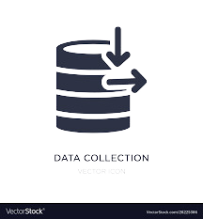

Data Collection
Database Setup
Data Collection: Download the data from Kaggle as a csv file and place it on the proper path
Database Setup: Set up a SQL database to hold the data. Design the database schema, and create the necessary tables using SQL
DDL commands.o.

Slide 5


Data Cleaning
Data Preparation
Data Cleaning: Use SQL queries and Python (pandas) to clean the data. Look for and handle missing or inconsistent data, outliers, etc.
Data Preparation: Prepare the data for analysis. This may involve creating additional calculated fields, such as total sales value, month/year fields for time-based analysis, etc. Again, this can be done using a combination of SQL and Python.

Slide 6

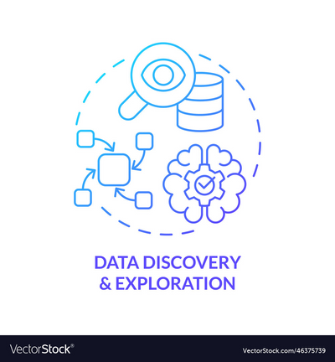
Data Exploration
Advanced Analysis
Data Exploration: Use SQL queries and Python (pandas, matplotlib, seaborn, etc) to explore the data and identify trends and patterns.
Advanced Analysis: Perform more complex analysis as needed. For example, time series analysis for sales trends, cohort analysis for customer behavior, etc. Python's advanced data analysis libraries can
be very useful here.

Slide 7
Data Analysis in Excel using Pivot Table

Slide 8
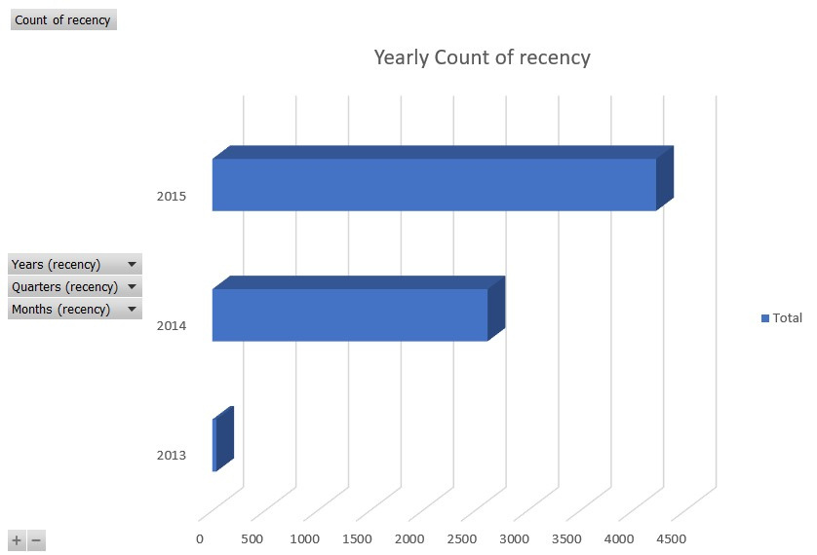
3-D Stacked Bar
This 3D bar chart offers a compelling visual representation of the "Sales Data Analysis and Reporting" for a prominent retail chain. Focused on the recency of customer purchases, this chart provides a yearly breakdown, shedding light on customer buying behaviors over time. The chart's three-dimensional design adds depth and clarity to the data, allowing viewers to quickly discern patterns and trends in customer recency, offering valuable insights for strategic decision-making and future sales planning within the retail chain

Slide 9
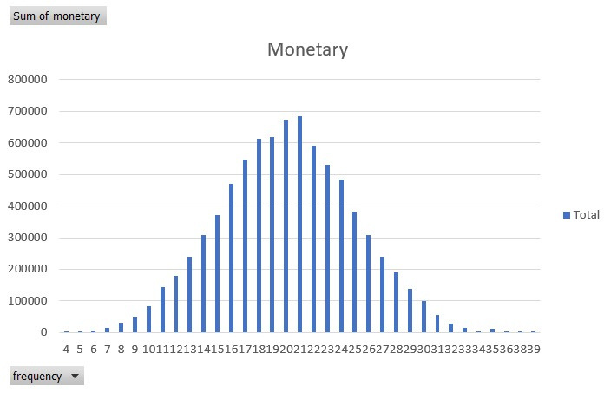
Clustered Column
This clustered column chart is a powerful visualization that delves into the "Sales Data Analysis and Reporting" for a dynamic retail chain. It showcases the distribution of purchases by frequency on the X-axis and the corresponding total monetary value on the Y-axis. Each cluster represents a specific frequency range, providing a clear depiction of customer spending habits within the retail chain. This insightful chart empowers decision-makers to identify high-value customer segments, optimize marketing strategies, and enhance overall sales performance

Slide 10
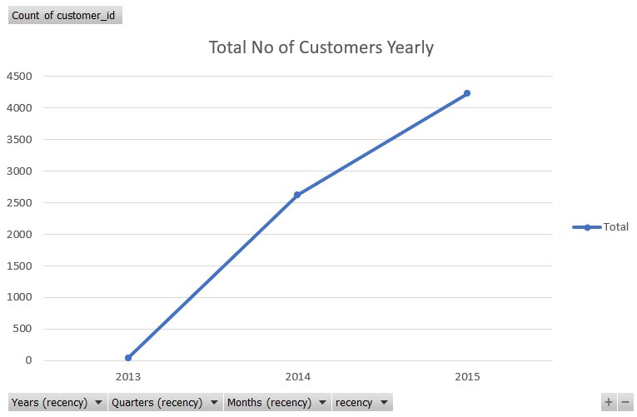
Line Chart - Line with Makers
This line chart with markers presents a compelling view of "Sales Data Analysis and Reporting" for a thriving retail chain. It tracks the journey of customer loyalty by visualizing individual customer IDs across different years. The markers on the line graph provide specific data points, enabling precise insights into customer retention and engagement trends over time. This visualization equips retail decision-makers with the knowledge needed to foster long-term customer relationships, tailor marketing strategies, and drive sustained growth in the competitive retail landscape

Slide 11
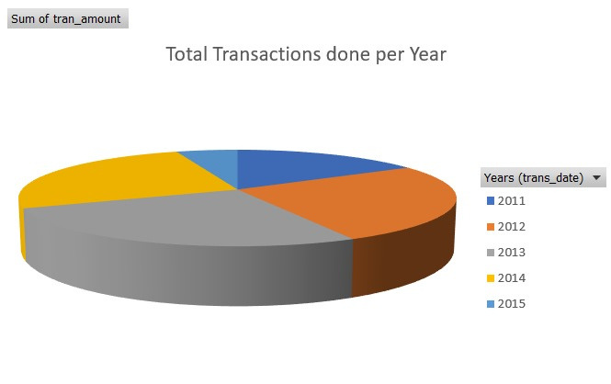
Pie-Chart
This pie chart offers a concise snapshot of "Sales Data Analysis and Reporting" for a dynamic retail chain. It visually represents the distribution of transactions by year, with each slice of the pie corresponding to a specific year's share of the total transactions. This intuitive visualization highlights the evolving transaction patterns and showcases which years were the most impactful in terms of sales. It's a valuable tool for decision-makers looking to make informed strategic choices and allocate resources effectively to drive growth and success in the retail industry

Slide 12
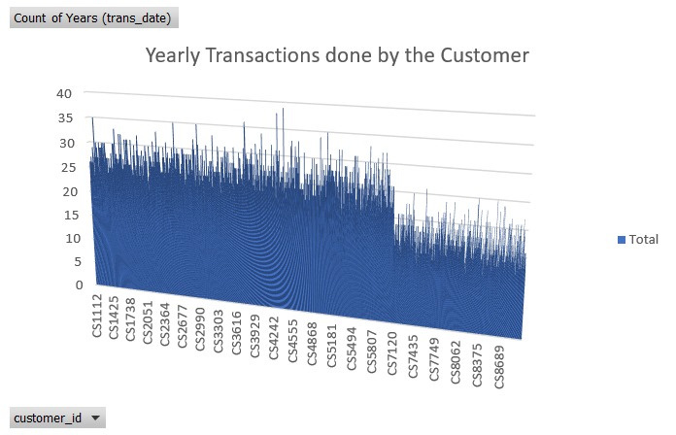
3-D Clustered Column
This 3D clustered column chart is a dynamic representation of "Sales Data Analysis and Reporting" for a prominent retail chain. It provides a comprehensive view of yearly transactions conducted by individual customers. Each column cluster represents a year, with individual columns within the cluster representing different customers. This visualization vividly illustrates transaction trends over time and allows for a deeper understanding of customer behavior. By leveraging this powerful visualization, retail decision-makers can identify top-performing customers, tailor marketing strategies, and optimize customer-centric initiatives to drive growth and enhance customer loyalty in the retail sector.

Slide 13
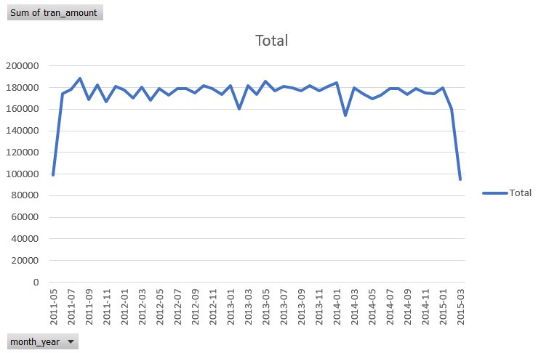
Line Chart
This line chart provides a comprehensive view of "Sales Data Analysis and Reporting" for a dynamic retail chain. It highlights the total sum of transactions conducted on a month-year basis. By visualizing this data over time, this chart unveils valuable insights into seasonal and long-term sales trends. Retail decision-makers can use this visualization to identify peak sales months, plan inventory, and optimize marketing strategies to ensure sustained success in the highly competitive retail industry.

Slide 14
This slide focuses on the visualizations presented in the preceding slides and emphasizes the importance of data visualization in our analysis. In previous slides, we showcased various diagrams and charts that offer a comprehensive view of our findings.
Visual Representation: We have utilized visualizations as a powerful tool to convey complex data insights in a clear and concise manner. By presenting data in graphical formats, we make it easier for stakeholders to grasp key information at a glance.
Enhancing Understanding: Visualizations help us better understand the patterns, trends, and relationships within the dataset. They serve as a bridge between raw data and actionable insights.
Python Visualization: We leveraged Python's data visualization libraries to create these informative visuals. Python's capabilities in this area have allowed us to customize and tailor our visualizations for specific purposes, making them highly effective for decision-making.

Slide 15
THANK YOU

