Slide 1
M.TECH THESIS DEFENSE · INDIAN INSTITUTE OF TECHNOLOGY DELHI
Enhanced Aegis
A Byzantine-Resilient Federated Learning Protocol
Abhishek Kumar Tripathi (2024EET2845)
Advisor: Prof. Harshan Jagdeesh
Department of Electrical Engineering, IIT Delhi
June 2026

Slide 2
AGENDA
Outline
1
Motivation & the Problem
Federated Learning on diverse edge networks; the Byzantine threat under highly skewed data
2
Threat Model & Attacks
Our omniscient, adaptive attacker using six distinct attack strategies
3
The Aegis Protocol
How Aegis evolved, its six mathematical stages, and achieving O(kd) efficiency
4
Experimental Setup
Testing with CIFAR-10, highly Non-IID data, and five baseline defenses
5
Results & Analysis
Final experimental results, including successes, the ALIE/IPM breaches, and sweeps
6
Conclusions & Future Work
Summary of achievements, known limitations, and four future research directions

Slide 3
01
PART ONE
Motivation & the Problem
Why federated learning, and why Byzantine resilience is hard under Non-IID data

Slide 4
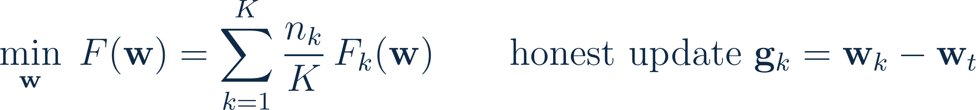
MOTIVATION
Why Federated Learning?
Edge devices like drone swarms and hospitals collaborate to train a shared model. They exchange only gradients, keeping raw data securely on-device.
Bandwidth
Privacy
The catch
▪ Costs scale with model size, not dataset size.
▪ Sending just 4.5 MB per round instead of 21 GB saves immense bandwidth.
▪ The server only sees gradient updates, never raw data or labels.
▪ Compatible with encryption without altering the core protocol.
▪ The server's lack of visibility creates a critical blind spot.
▪ Attackers can submit poisoned gradients that look completely normal.

Slide 5
THE CORE DIFFICULTY
The Compounding Challenge of Highly Skewed Data
▪ Real-world federated nodes are highly specialized.
– In our setup, each client sees only ~40% of the classes.
– This makes honest updates 10–50× more dissimilar than standard IID data.
▪ Most defenses filter out updates far from the center.
– But highly specialized honest updates naturally sit far from the center.
– Filters discard this honest signal while admitting stealthy, centered poison.
▪ The Byzantine Tax
– The accuracy lost just by running the defense under normal conditions.
– For example, Bulyan loses 8.5 percentage points with zero attackers.
The lethal interaction
Honest specialists look like outliers
Stealthy attackers hide near the center
↓
Standard filters reject good data
and accept the poison.
Center Drag (single-pass median)
No prior single-stage aggregator handles Non-IID diversity, IPM, and Sybil simultaneously.

Slide 6
RESEARCH GAP
What Is Missing — and Our Research Question
Our Research Question: Can a linear-time aggregator protect a highly diverse federated network against coordinated attacks
without punishing honest specialists?
Three requirements no existing defence meets together:
✓
Heterogeneity tolerance
✓
Uncontaminated reference
✓
Influence capping
Preserve divergent honest specialists instead of rejecting them as outliers — no accuracy penalty on Non-IID clients.
Score every update against a clean, debiased center that coordinated, stealthy adversaries cannot tilt.
Bound what any single actor can manufacture through duplicated identities or inflated data volume.
→ This gap motivates Aegis.

Slide 7
02
PART TWO
Threat Model & Attacks
An omniscient, adaptive, coordinated adversary at up to 40% of the network

Slide 8
THREAT MODEL
Adversary Capabilities & Assumptions
The adversary CAN
THE ADVERSARY CANNOT
▪ Perfectly understand the aggregation rule and global model.
▪ Estimate the honest network's mean gradient.
▪ Fully coordinate all compromised clients.
▪ Persistently attack in every single round.
✕ Intercept honest updates before they reach the server
✕ Corrupt the central server itself
✕ Take over the majority of the network (f < K/2)
Honest-majority bound
Fixed adversary, random participation
System: K = 30 clients, one honest non-colluding server, m ∈ [15,28] sampled/round. Byzantine fraction swept to f = 0.40 — Aegis defends gracefully through f = 0.30 (collapse at 0.40).

Slide 9
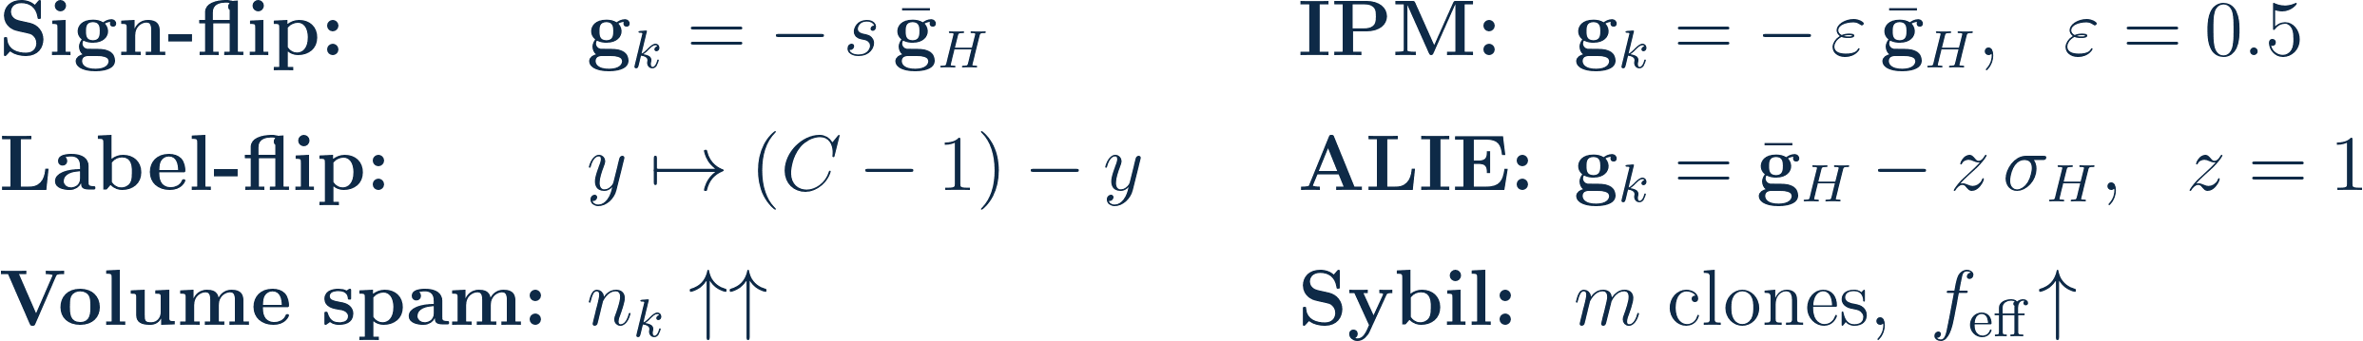
ATTACKS
The Threat Matrix
Attack | Mechanism | Norm evasion | Dir. evasion | Median poison | Identity spoof
Label-Flip | Data corruption | ✓ | ✓ | ✕ | ✕
Sign-Flip | Direction inversion | ✕ | ✕ | ✕ | ✕
IPM | Stealth anti-gradient | ✓ | ✕ | ✓ | ✕
ALIE | In-variance poison | ✓ | ✓ | ✓ | ✕
Sybil | Density flooding | ✓ | ✓ | ✓ | ✓
No single defensive axis defeats all of the above — a robust defence must apply magnitude, direction, and identity checks against a clean, debiased reference.

Slide 10
RELATED WORK
Existing Defences — and Their Limits
Method | Core mechanism | Tolerance | Complexity
Multi-Krum | Select k updates minimising neighbour distance | f < K/2 − 2 | O(K²d)
Coord.-wise Median | Per-coordinate median over all updates | f < K/2 | O(Kd)
Trimmed Mean | Drop extreme f per coordinate, average rest | f < K/2 | O(Kd log K)
Bulyan | Krum selection, then trimmed mean | f < K/4 | O(K²d)
FoolsGold | Down-weight high cosine-similarity (Sybil) | Sybil-only | O(K²d)
Aegis (this thesis) | Two-pass median + dual-metric + EMA reputation | f < K/2 | O(kd)
▪ Bulyan — the strongest prior scheme — needs f < K/4; it is inapplicable at our 40% setting.
▪ Every O(K²d) scheme is prohibitive at scale. Aegis sustains f = 0.30 at O(kd) — past Bulyan's f < K/4 ceiling and far cheaper.
▪ Tolerances above are theoretical (primitive breakdown points); empirically all collapse near f = 0.40 under our Non-IID threat — Aegis stays graceful furthest, to f = 0.30.

Slide 11
03
PART THREE
The Aegis Protocol
From the interim design to the enhanced protocol — six mathematical stages, O(kd)

Slide 12
EVOLUTION
From Initial Aegis to Enhanced Aegis
Aspect | Initial Aegis (interim) | Enhanced Aegis (paper / thesis)
Directional filter | Hard gate: cos < 0 → discard | Soft penalty α·Pₖ (Euclidean-only gate)
Reputation | Not in credit score | EMA Rₖ fused into credit (γ=0.95, λ=20)
Adaptive threshold | Round decay + variance (CV) | + hard floor k_floor = 4.0
Convergence aid | Server momentum (on) | Off → re-scoped as IPM velocity patch
Cosine weight α | 10 | 30
Scale / LR | 40 clients, lr 1e−3 | 30 clients, lr 1e−2
Threats studied | sign, noise, label, orthogonal | + IPM, ALIE, Sybil, vol-spam (+ limits)
The interim protocol proved the concept; the enhanced protocol fixes the false-positive and stealth-attack gaps it exposed.

Slide 13
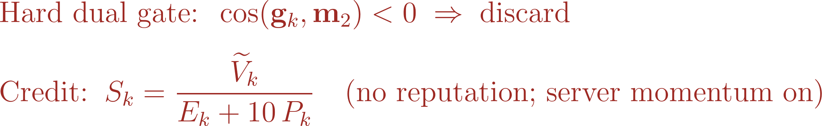
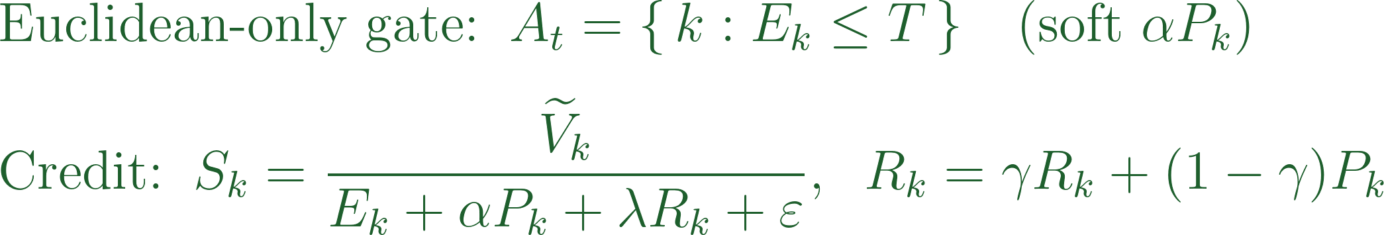
EVOLUTION
Why the Protocol Evolved
Initial Aegis
(interim)
Enhanced Aegis
(final)
A hard cosine gate is a trap
Round-by-round scoring misses stealth
Coupling them caused a death spiral
It allows orthogonal attacks while amputating honest specialists. Our fix: a continuous soft penalty α·Pₖ.
Attacks like ALIE hide within normal variance. Our fix: cross-round EMA reputation λRₖ catches them over time.
Cleaning the pool tightens thresholds, hurting honest clients. Our fix: decouple threshold calculations from the filtered pool.

Slide 14
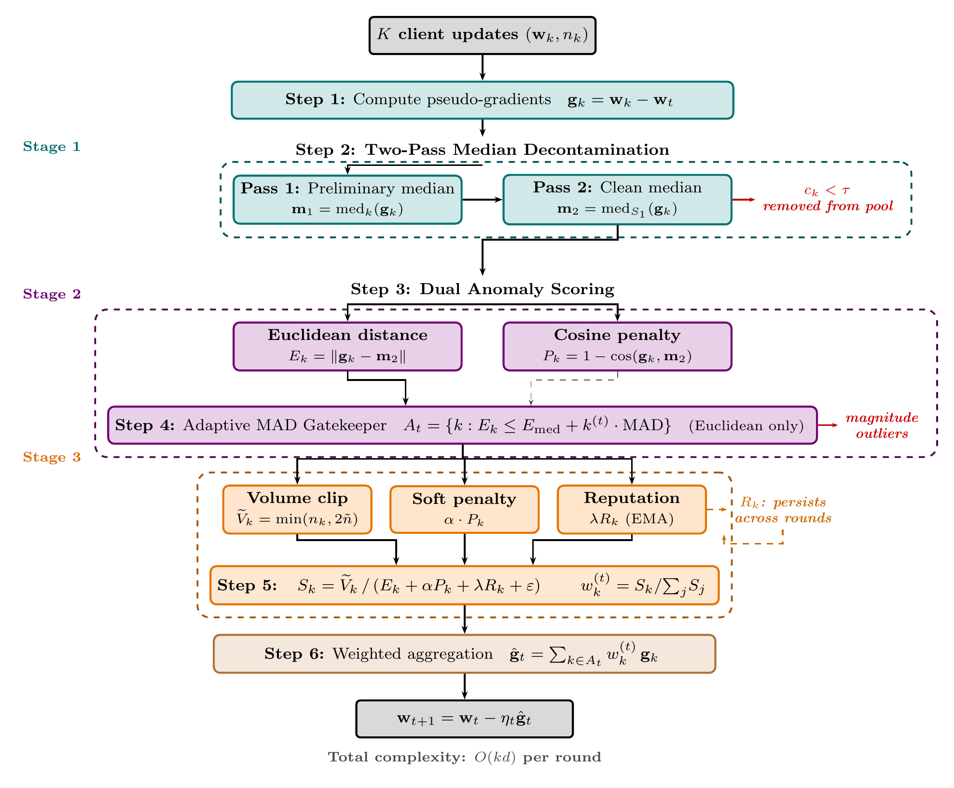
THE AEGIS PROTOCOL
Aggregation Pipeline — Architecture
O(kd)
Stage 1 two-pass cosine-screened median (clean reference).
Stage 2 adaptive MAD Euclidean gate — the only hard filter.
Stage 3 soft credit score fuses volume, cosine penalty α·Pₖ, and reputation λRₖ into the weights wₖ.

Slide 15
THE AEGIS PROTOCOL · STEP 1
Step 1: Local Training & Pseudo-Gradients
O(kd)
▪ Server broadcasts the global model; each client k trains locally and returns weights wₖ and claimed sample size nₖ.
▪ Aegis scores in gradient (delta) space — robust to the shared initialisation — but aggregates the approved clients' weights.

Slide 16
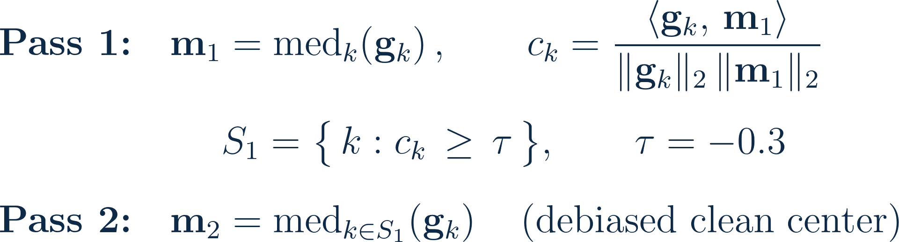
THE AEGIS PROTOCOL · STEP 2
Step 2: Two-Pass Median Decontamination
O(kd)
▪ Pass 1 screens strongly anti-aligned updates (cos < τ) out of the median pool; Pass 2 recomputes a debiased clean center.
▪ Defeats Center Drag: IPM / sign-flip can no longer tilt the reference that every downstream score depends on.
▪ τ = −0.3 is deliberately lenient — honest Non-IID specialists (mildly negative cosine) are retained.

Slide 17
THE AEGIS PROTOCOL · STEP 3
Step 3: Dual Anomaly Scoring
O(kd)
▪ Every client is re-scored against the clean median on two complementary axes: magnitude (Eₖ) and direction (Pₖ).
▪ Magnitude-only filters miss IPM; direction-only filters miss amplitude-scaled Sybil floods. Aegis uses both.

Slide 18
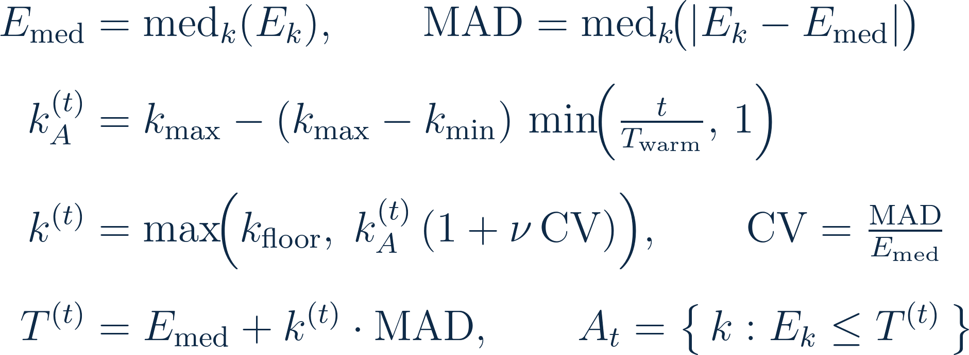
THE AEGIS PROTOCOL · STEP 4
Step 4: Adaptive MAD Thresholding
O(k)
MAD gives a breakdown-point-0.5 scale estimate; the multiplier k⁽ᵗ⁾ decays over warmup and relaxes with round variance (CV).
The floor k_floor = 4.0 prevents over-rejection of honest specialists in persistent Non-IID rounds. Euclidean is the only hard gate.
Each hyperparameter sits at a robustness plateau (Appendix B). For example, the Pass-1 cosine threshold varies accuracy by only 1.36pp across a 10× range, proving Aegis doesn't depend on hand-tuning.

Slide 19
THE AEGIS PROTOCOL · STEP 5
Step 5: Reputation & Credit Scoring
O(m)
▪ Volume clipping caps inflated-dataset spam; an EMA reputation Rₖ accumulates each client's persistent directional penalty.
▪ The cosine penalty is soft (α·Pₖ) — attackers are suppressed in the weight, never hard-excluded. This replaced the interim's hard cosine gate.

Slide 20
THE AEGIS PROTOCOL · STEP 6
Step 6: Weighted Aggregation
O(kd)
▪ The new global model is the credit-weighted average of the approved clients' weights.
▪ No pairwise distance matrix is ever formed — this is what keeps the whole pipeline linear in d.

Slide 21

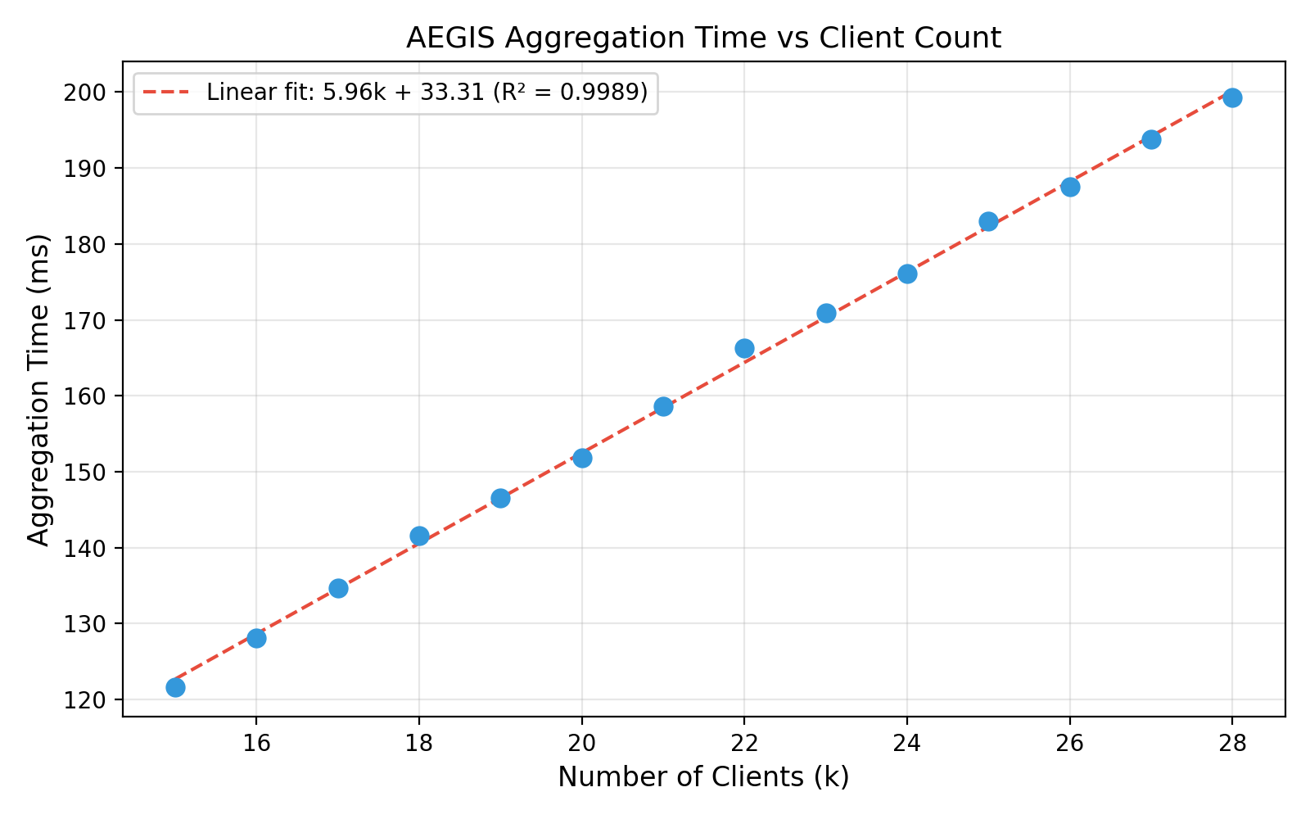
THE AEGIS PROTOCOL
Linear-Time Aggregation: O(kd)
Empirical verification
▪ Aggregation time grows linearly in client count k — linear fit R² = 0.9989.
▪ Introselect medians + no pairwise matrix → O(kd), matching FedAvg's floor.
▪ ≈ 30× faster than Bulyan at K=30, d≈1.12M.
▪ Server state: a 30-float EMA table (240 bytes) — fast failover.

Slide 22
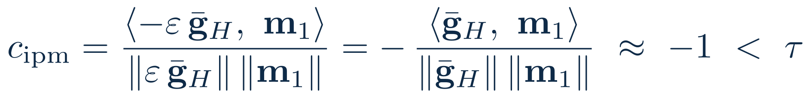
THE AEGIS PROTOCOL
Theoretical Guarantees
Lemma 1 · Pass-1 neutralises IPM
Lemma 2 · Median breakdown point
Breakdown-0.5 (f < K/2) bounds the median reference, not the whole pipeline. End-to-end, Aegis stays graceful to f = 0.30 and collapses at f = 0.40 (detection → 0).
Any IPM vector −ε·ḡ_{H} has cosine ≈ -1 < τ, so it is removed from the median pool — the reference m₂ stays clean.
Guarantee | Aegis bound | Source
Robustness (breakdown) | ≤ 0.30 empirical | median ref. is breakdown-0.5 (f < K/2, Lemma 2); end-to-end collapse at f = 0.40
Complexity (per round) | O(kd) | two-pass median, no pairwise distance matrix
Convergence rate | O(1/√T) | SGD rate + κ_A·V_H heterogeneity + ζ_A residual (next slides)
The 0.5 breakdown point is the median reference's; end-to-end Aegis stays graceful to f = 0.30 (collapse at 0.40) — at the SGD rate and linear O(kd) cost.

Slide 23
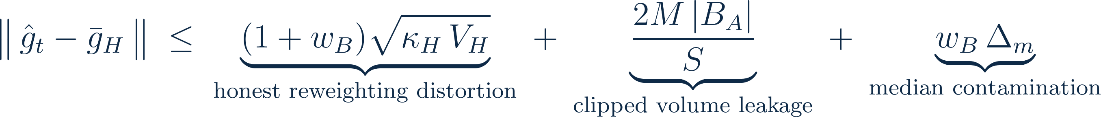
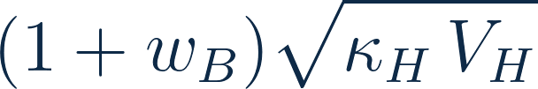
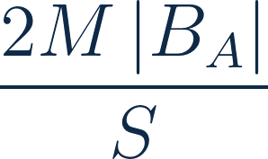

THE AEGIS PROTOCOL
Convergence I — The Robustness Certificate
The per-round aggregation error splits into three sources — each maps to one experimental regime:
Honest reweighting distortion
Clipped volume leakage
Median contamination
Unequal honest weights distort the mean even with zero attackers.
Volume clipping caps every client's share at 2M, so spam cannot dominate.
Surviving Byzantine clients displace the median reference m₂ by Δ_m.
→ Byzantine Tax = 0.08 pp (Aegis 76.08 vs FedAvg 76.16, no attack).
→ Volume-spam fully nullified (≈ 74%, on par with no attack).
→ ALIE drags m₂ ⇒ collapse to 10% (chance).
Score suppression keeps the Byzantine weight w_B small — and bounds all three terms:

Slide 24
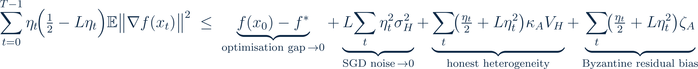
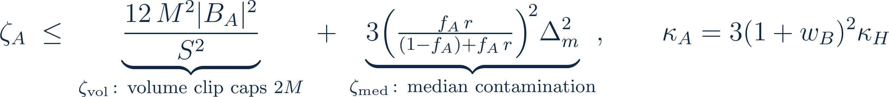
THE AEGIS PROTOCOL
Convergence II — Final Theorem & Residual Bias
Two terms vanish — two are Aegis-specific
Residual bias = two leakages
▪ Optimisation gap + SGD noise → 0 at the standard O(1/√T) rate as η_t decays.
▪ κ_A·V_H — honest-heterogeneity penalty: the price of unequal honest weighting; grows with the Non-IID variance V_H.
▪ ζ_A — residual bias: the ONLY attack-driven, non-vanishing floor. Zero iff no attacker survives the filter.
ζ_vol is bounded by volume clipping (spam nullified); ζ_med explodes when the median is poisoned (ALIE: f_A·r large, Δ_m large).
Corollary — perfect filtering recovers clean SGD:

Slide 25
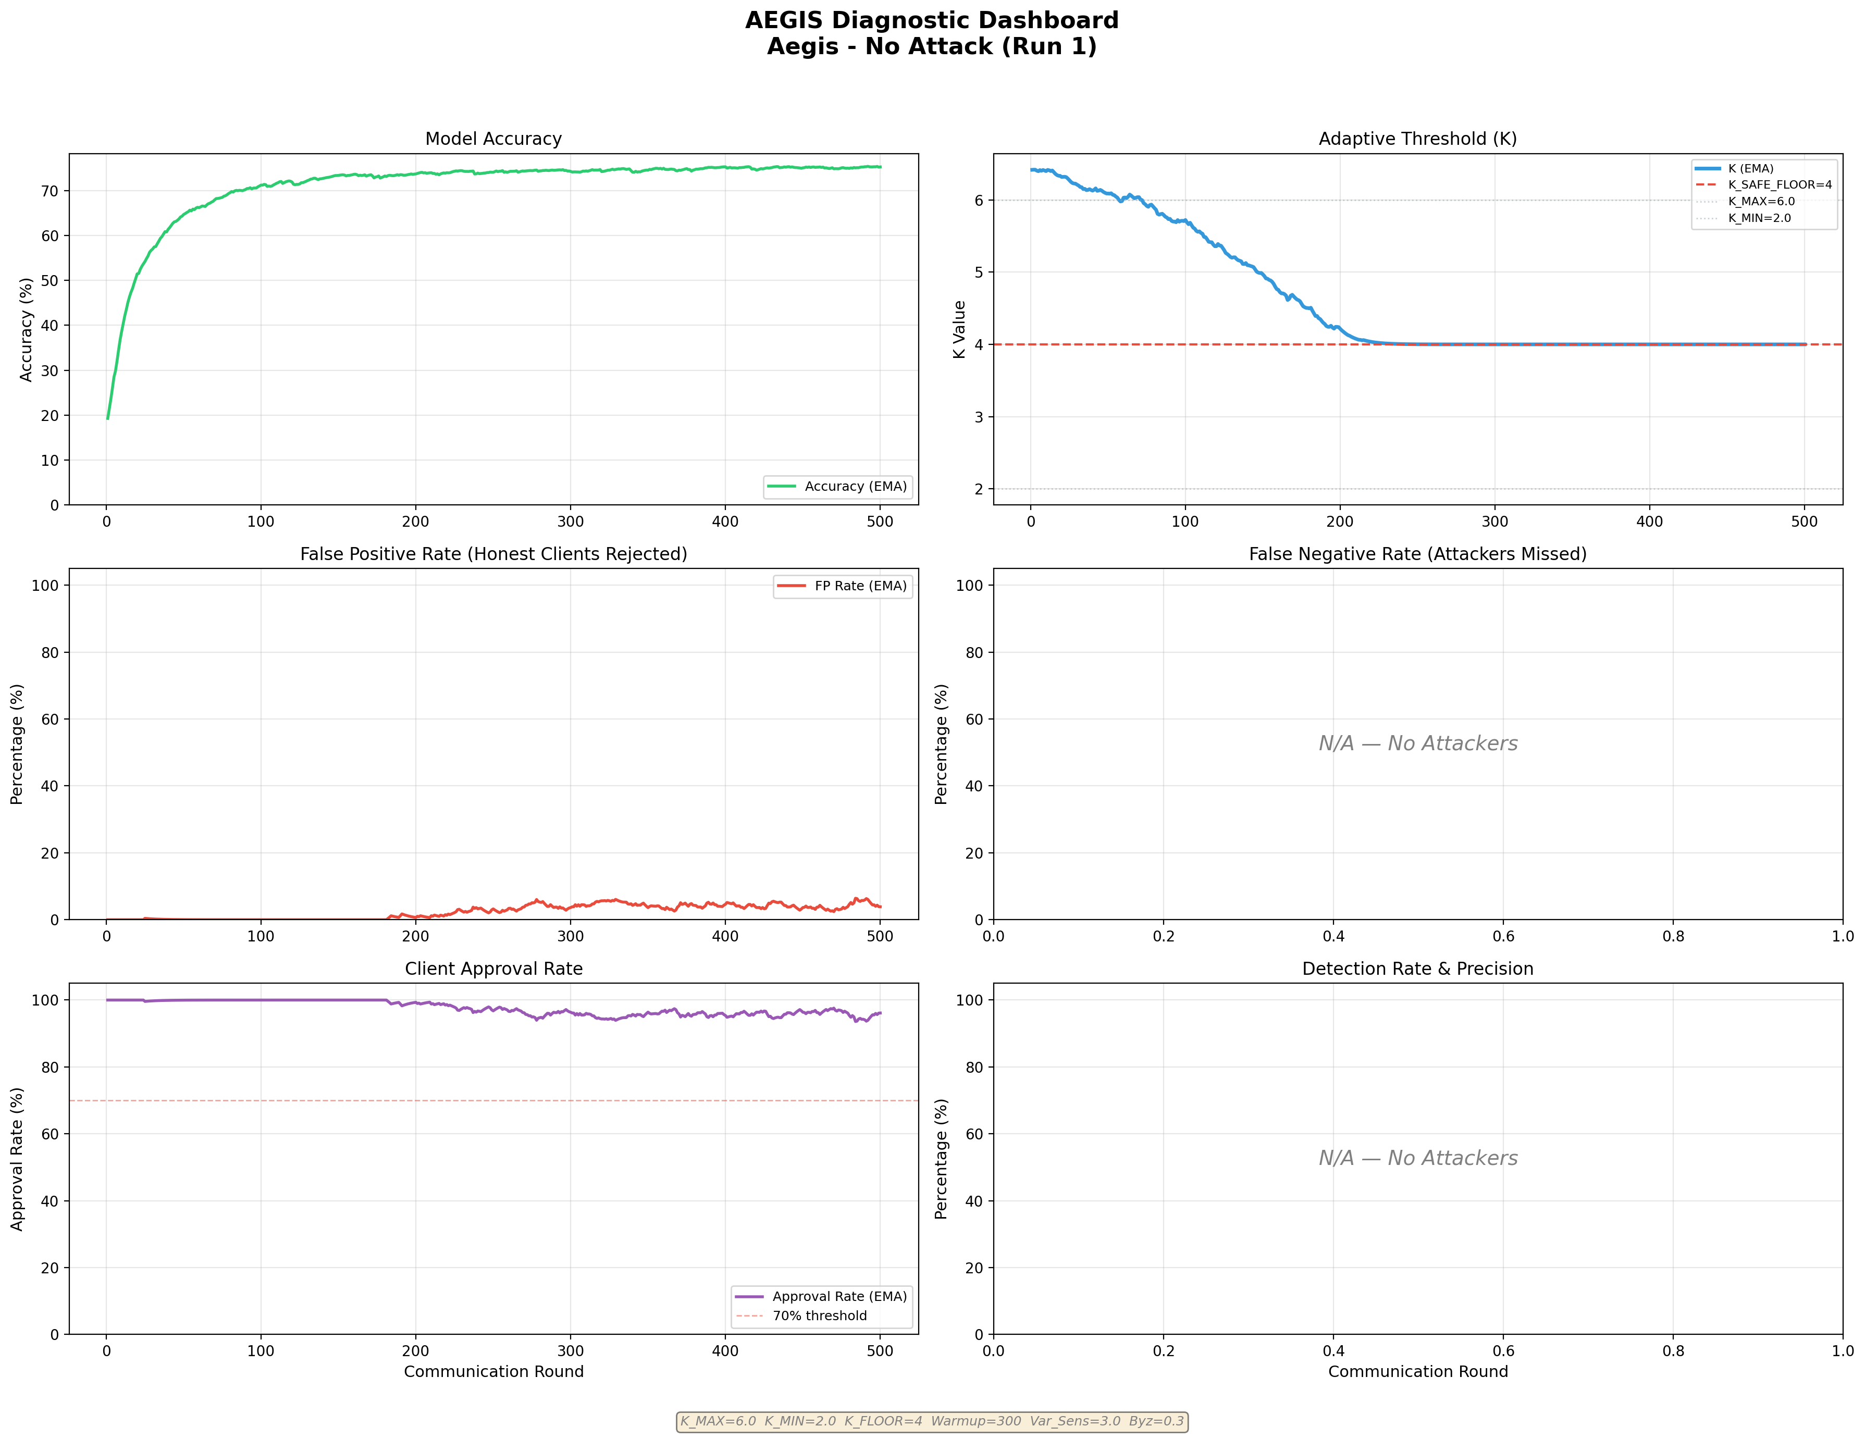
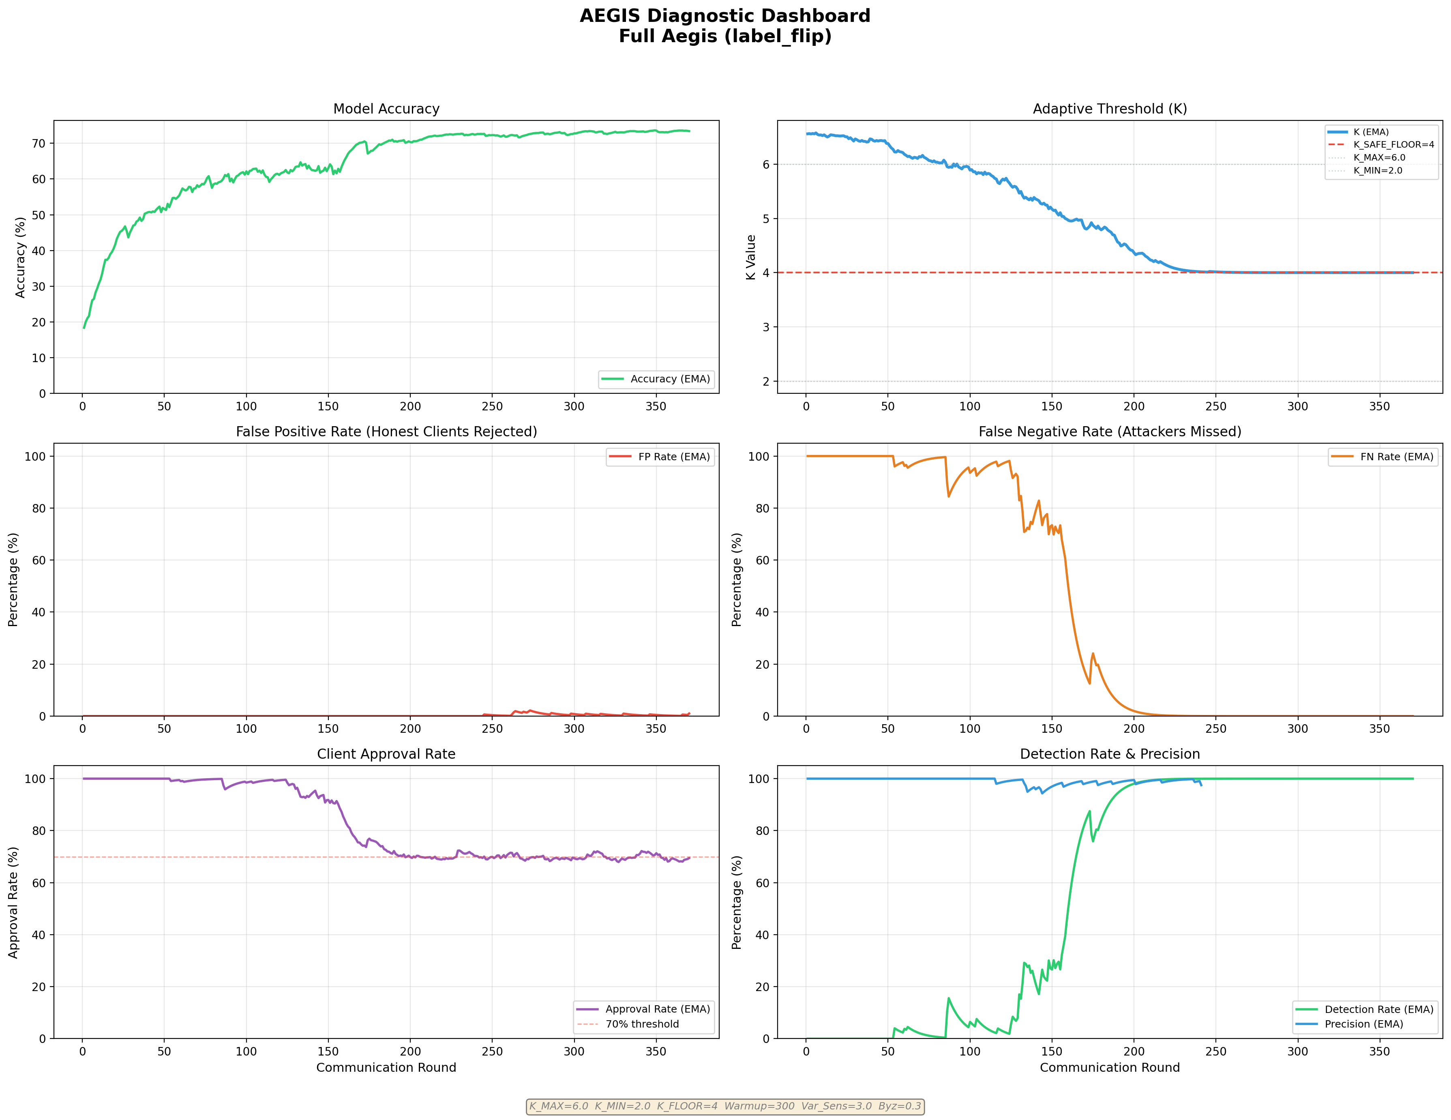
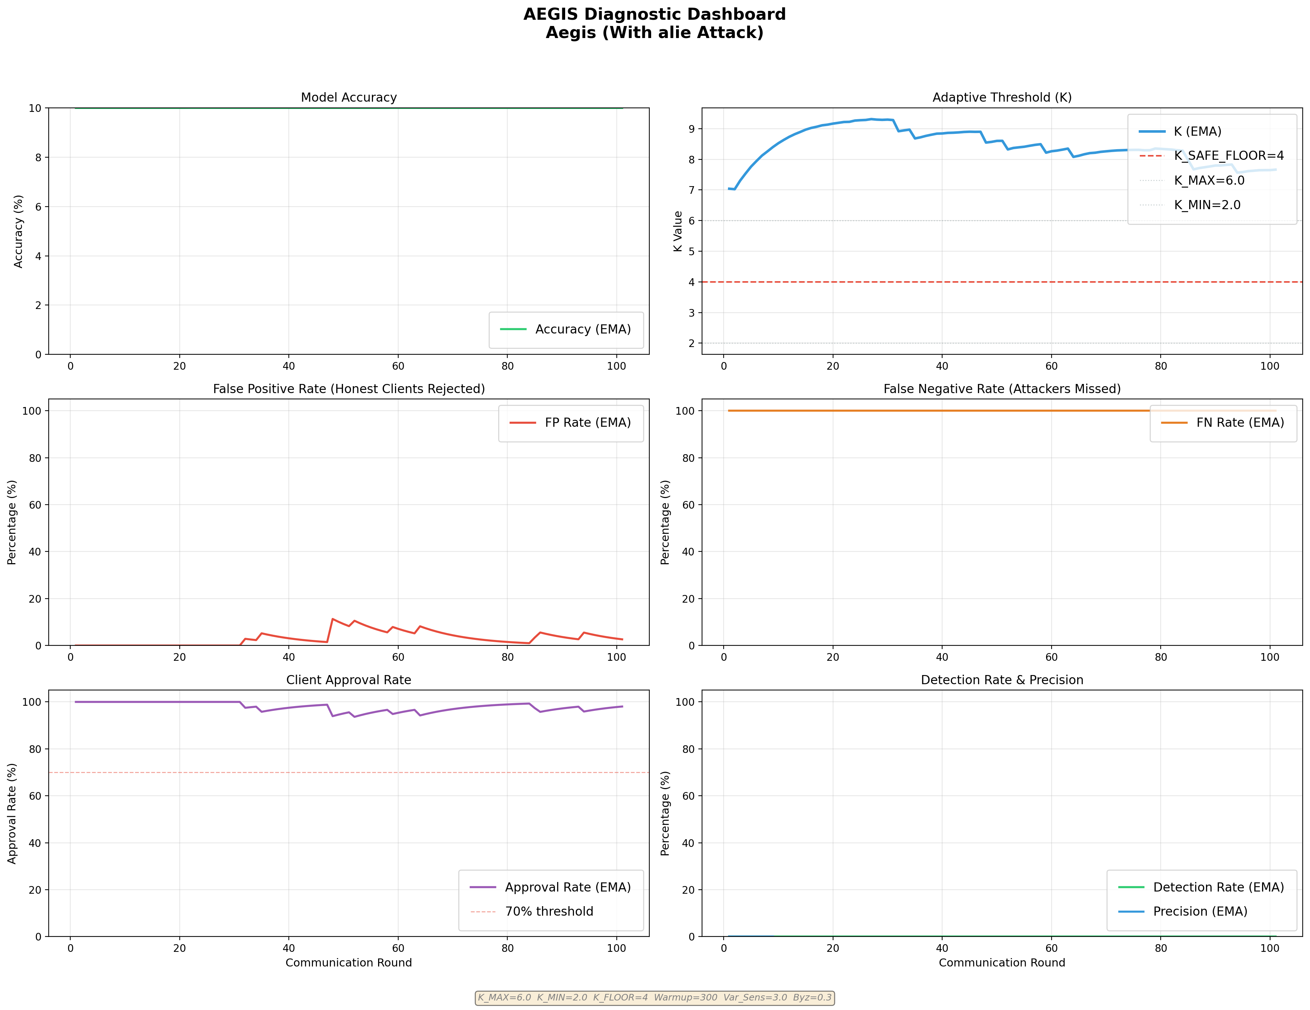
THE AEGIS PROTOCOL
Theory Meets Experiment — Filter Diagnostics
The detection / false-negative panels are the empirical w_B — the convergence verdict tracks ζ_A exactly:
No Attack
Label-Flip
ALIE
FN n/a · ζ_A = 0 → 75% (κ_A = 3κ_H, honest distortion only)
FN 100→0%, detection→100% ⇒ r→0, w_B→0, ζ_A small → 74%
FN stuck at 100%, detection 0% ⇒ r→1, ζ_med large → 10%
Converge iff ζ_A is small — and ζ_A is small iff the filter detects the attack. The theorem predicts every regime the experiments show.

Slide 26
04
PART FOUR
Experimental Setup
CIFAR-10, 4-shard Non-IID, n = 30, f = 0.30, 1000 rounds

Slide 27
SETUP
Experimental Apparatus
Data
Model
CIFAR-10 · 4-shard label sharding · α = 0.5
ImprovedCNN · GroupNorm · Dropout
▪ 30 clients, ~1,664 samples each
▪ ~40% class coverage / client
▪ Γ 10–50× the IID baseline
▪ 4 conv + 2 FC, ~1.12M params
▪ SGD, lr 0.01, momentum 0.8
▪ 1 local epoch, batch 32
Attacks
Baselines
f = 0.30 (9/30), p_attack = 1.0
Five robust aggregators
▪ Sign-flip, Label-flip, Vol-spam
▪ ALIE (z=1), IPM (ε=0.5)
▪ Sybil (2 clones) → f_eff = 0.56
▪ FedAvg, CWMed, Multi-Krum
▪ FoolsGold, Bulyan (f=0.20)
▪ Best accuracy over 1000 rounds
Our mean best across seeds is 75.53 ± 0.22% — the hard accuracy limit set by this extreme Non-IID partition.

Slide 28
05
PART FIVE
Results & Analysis
Per-attack robustness from the finalised experiments — one figure at a time

Slide 29
RESULTS
The Byzantine Tax — Cost of Defence Under No Attack
Aggregator | Best Acc (%) | Best Loss | Byzantine Tax (pp)
FedAvg | 74.78 | 0.7248 | 0.00
Aegis | 74.65 | 0.7255 | 0.13
FoolsGold | 73.80 | 0.7628 | 0.98
CWMed | 69.68 | 0.9064 | 5.10
Multi-Krum | 69.36 | 0.8908 | 5.42
Bulyan | 67.69 | 0.9723 | 7.09
0.13 pp
Aegis overhead vs FedAvg
▪ Aegis is effectively free when there are no attacks.
▪ Bulyan loses 7.09 pp because Krum selection collapses to a single sector.
▪ This proves our adaptive floor successfully preserves honest specialists.

Slide 30
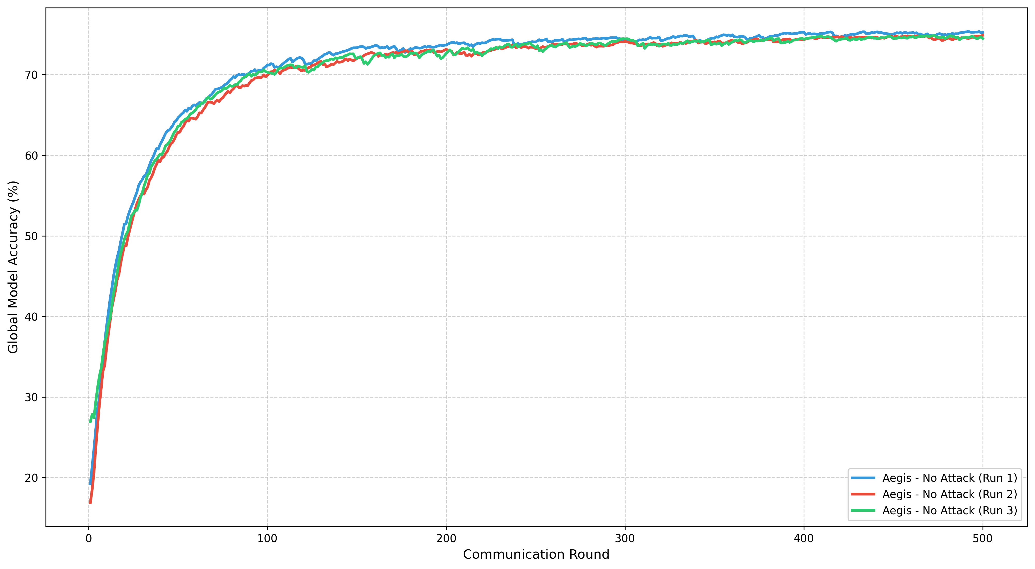
RESULTS · BASELINE
Convergence Stability — Three Seeds, No Attack
Mean 75.53 ± 0.22% across seeds 42 / 123 / 456 — the Non-IID oracle ceiling; single-seed results are representative.

Slide 31
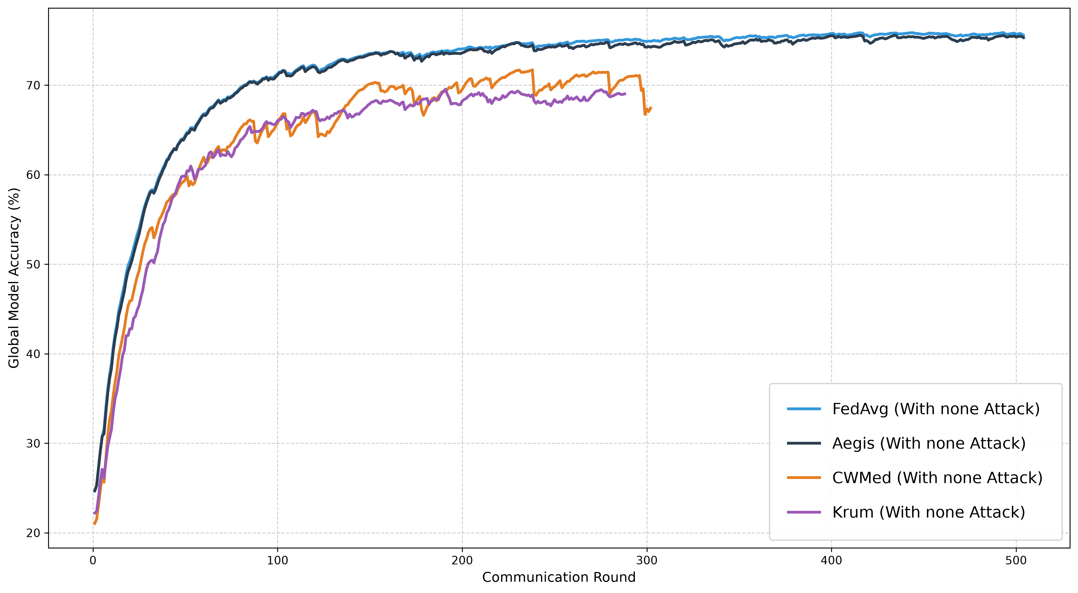
RESULTS · BASELINE
Robust Aggregators vs FedAvg — No Attack
Aegis tracks FedAvg (74.78 vs 74.65); CWMed and Krum plateau 4–5 pp lower — the Byzantine Tax of centroid filters under Non-IID.

Slide 32
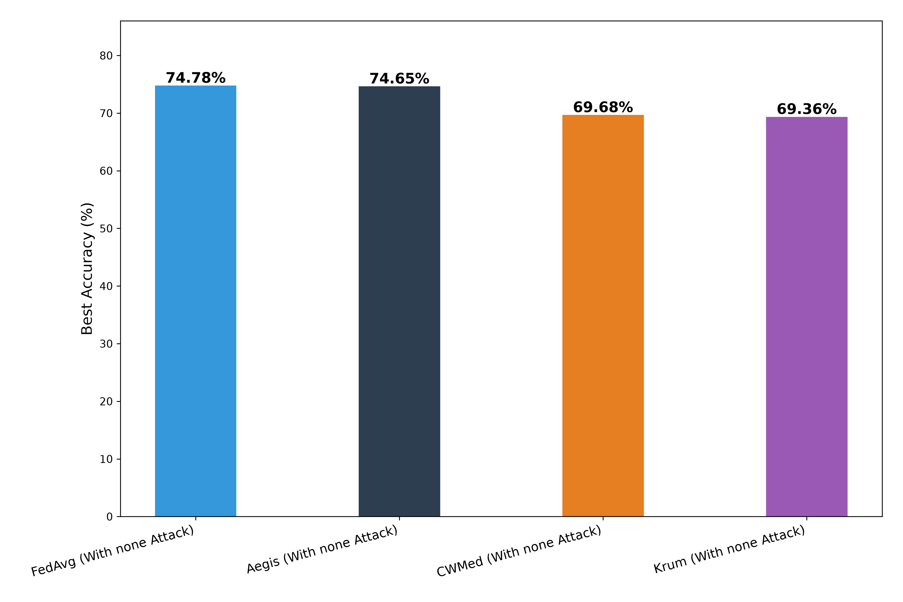
RESULTS · BASELINE
Robust Aggregators vs FedAvg — No Attack
Aegis tracks FedAvg (74.78 vs 74.65); CWMed and Krum plateau 4–5 pp lower — the Byzantine Tax of centroid filters under Non-IID.

Slide 33
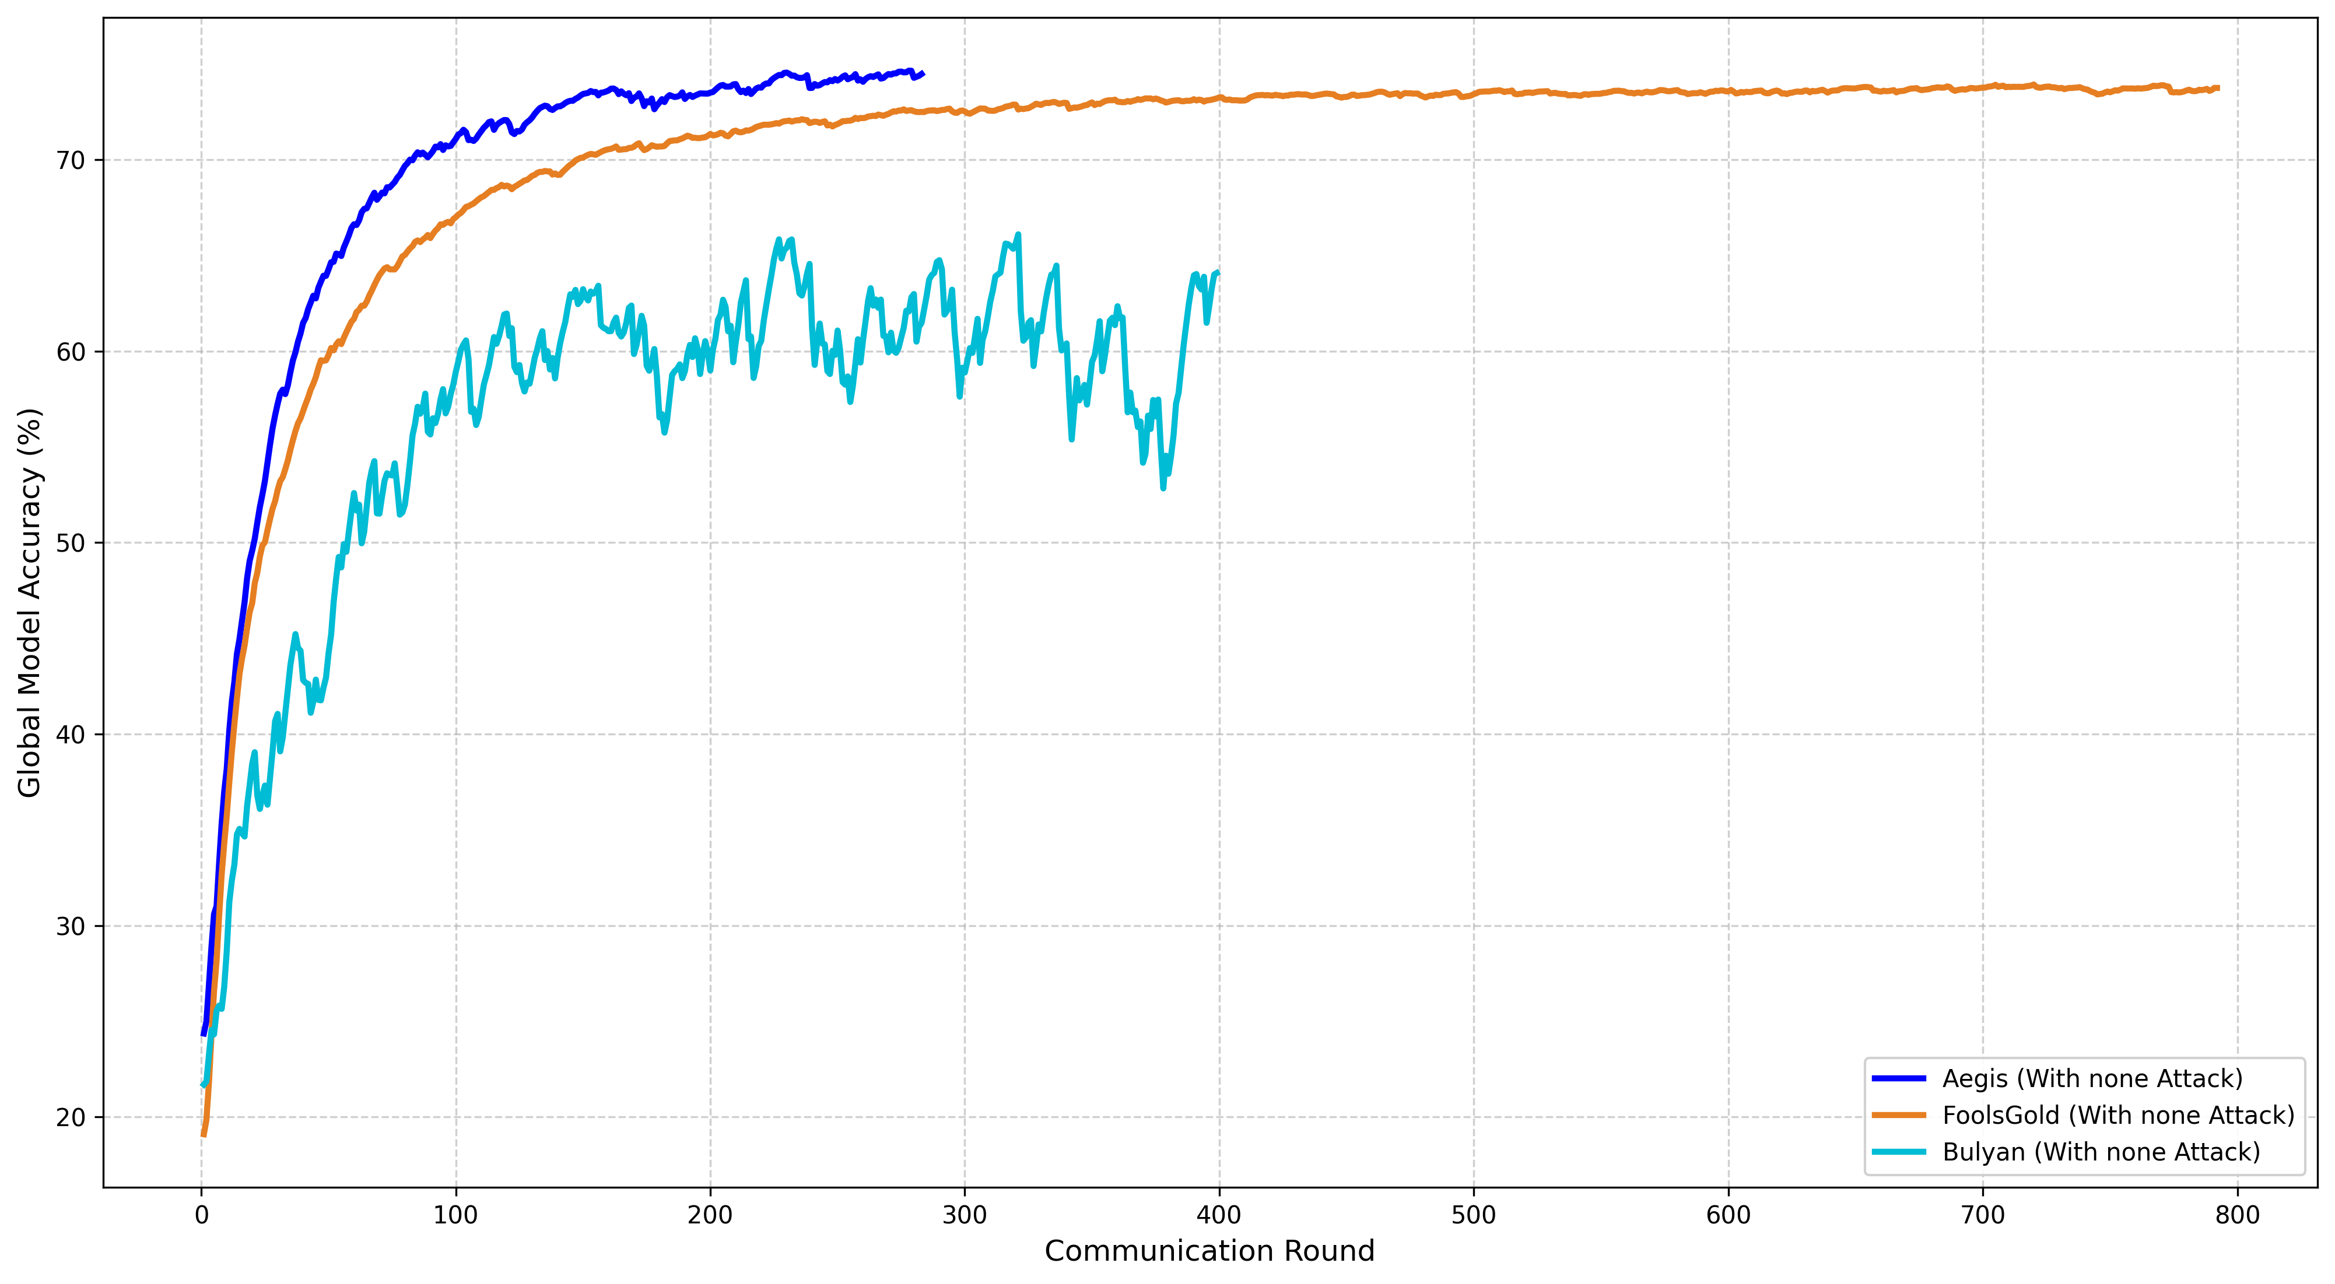
RESULTS · BASELINE
Robust Aggregators vs FedAvg — No Attack

Slide 34
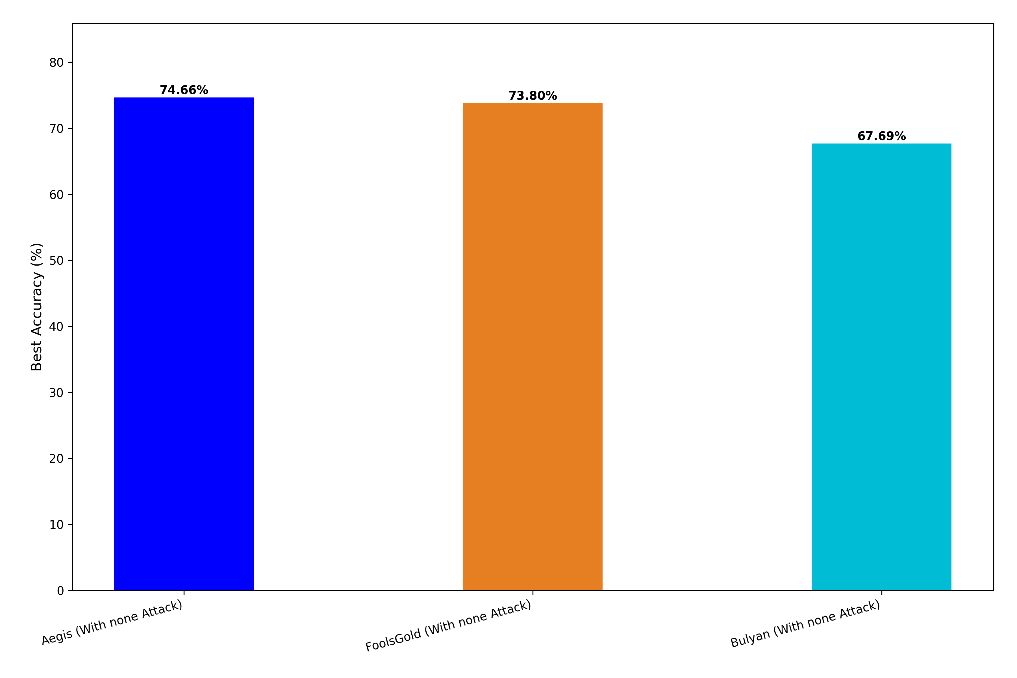
RESULTS · BASELINE
Robust Aggregators vs FedAvg — No Attack

Slide 35
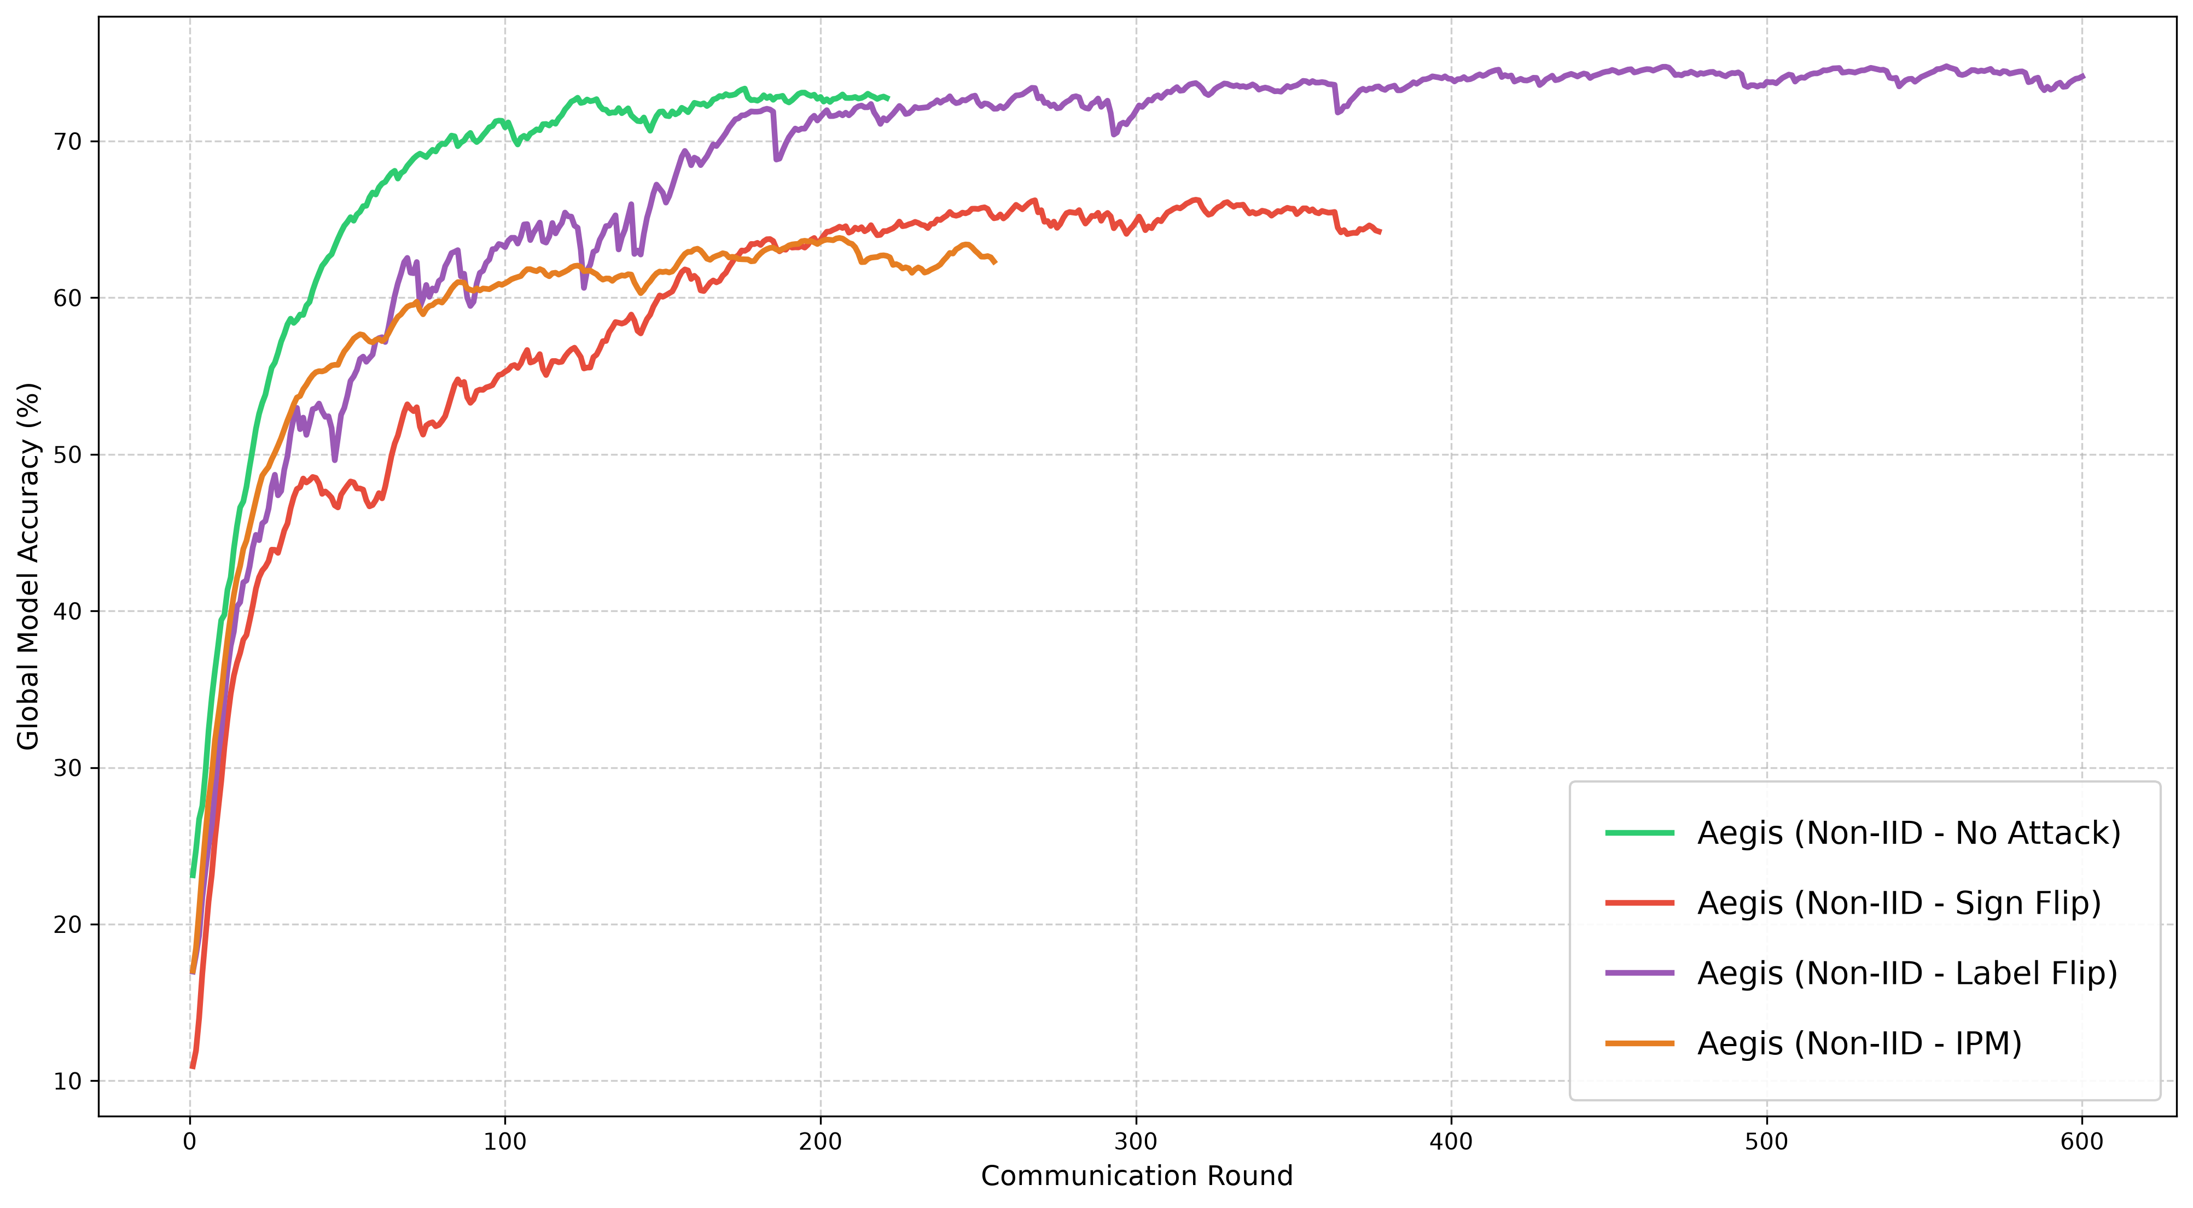
RESULTS · AEGIS
Aegis – No Attack, Sign Flip, Label Flip & IPM
No-attack and label-flip converge together (~74%); sign-flip and IPM are tightly bounded, not collapsed — two-pass median limits the damage.

Slide 36
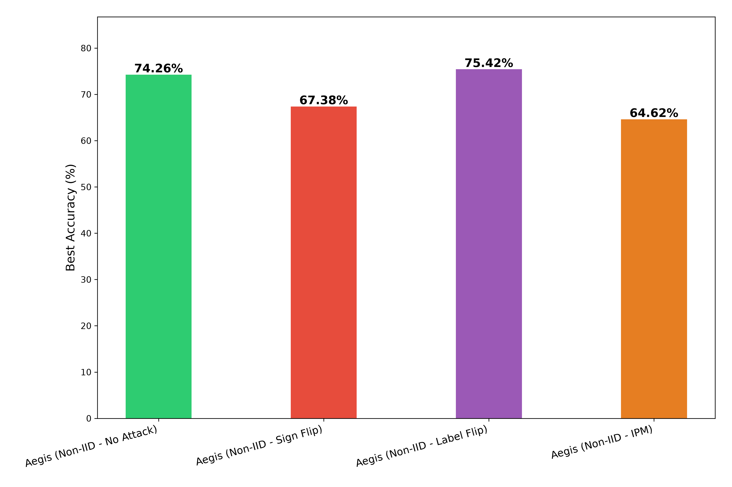
RESULTS · AEGIS
Aegis – No Attack, Sign Flip, Label Flip & IPM
No-attack and label-flip converge together (~74%); sign-flip and IPM are tightly bounded, not collapsed — two-pass median limits the damage.

Slide 37
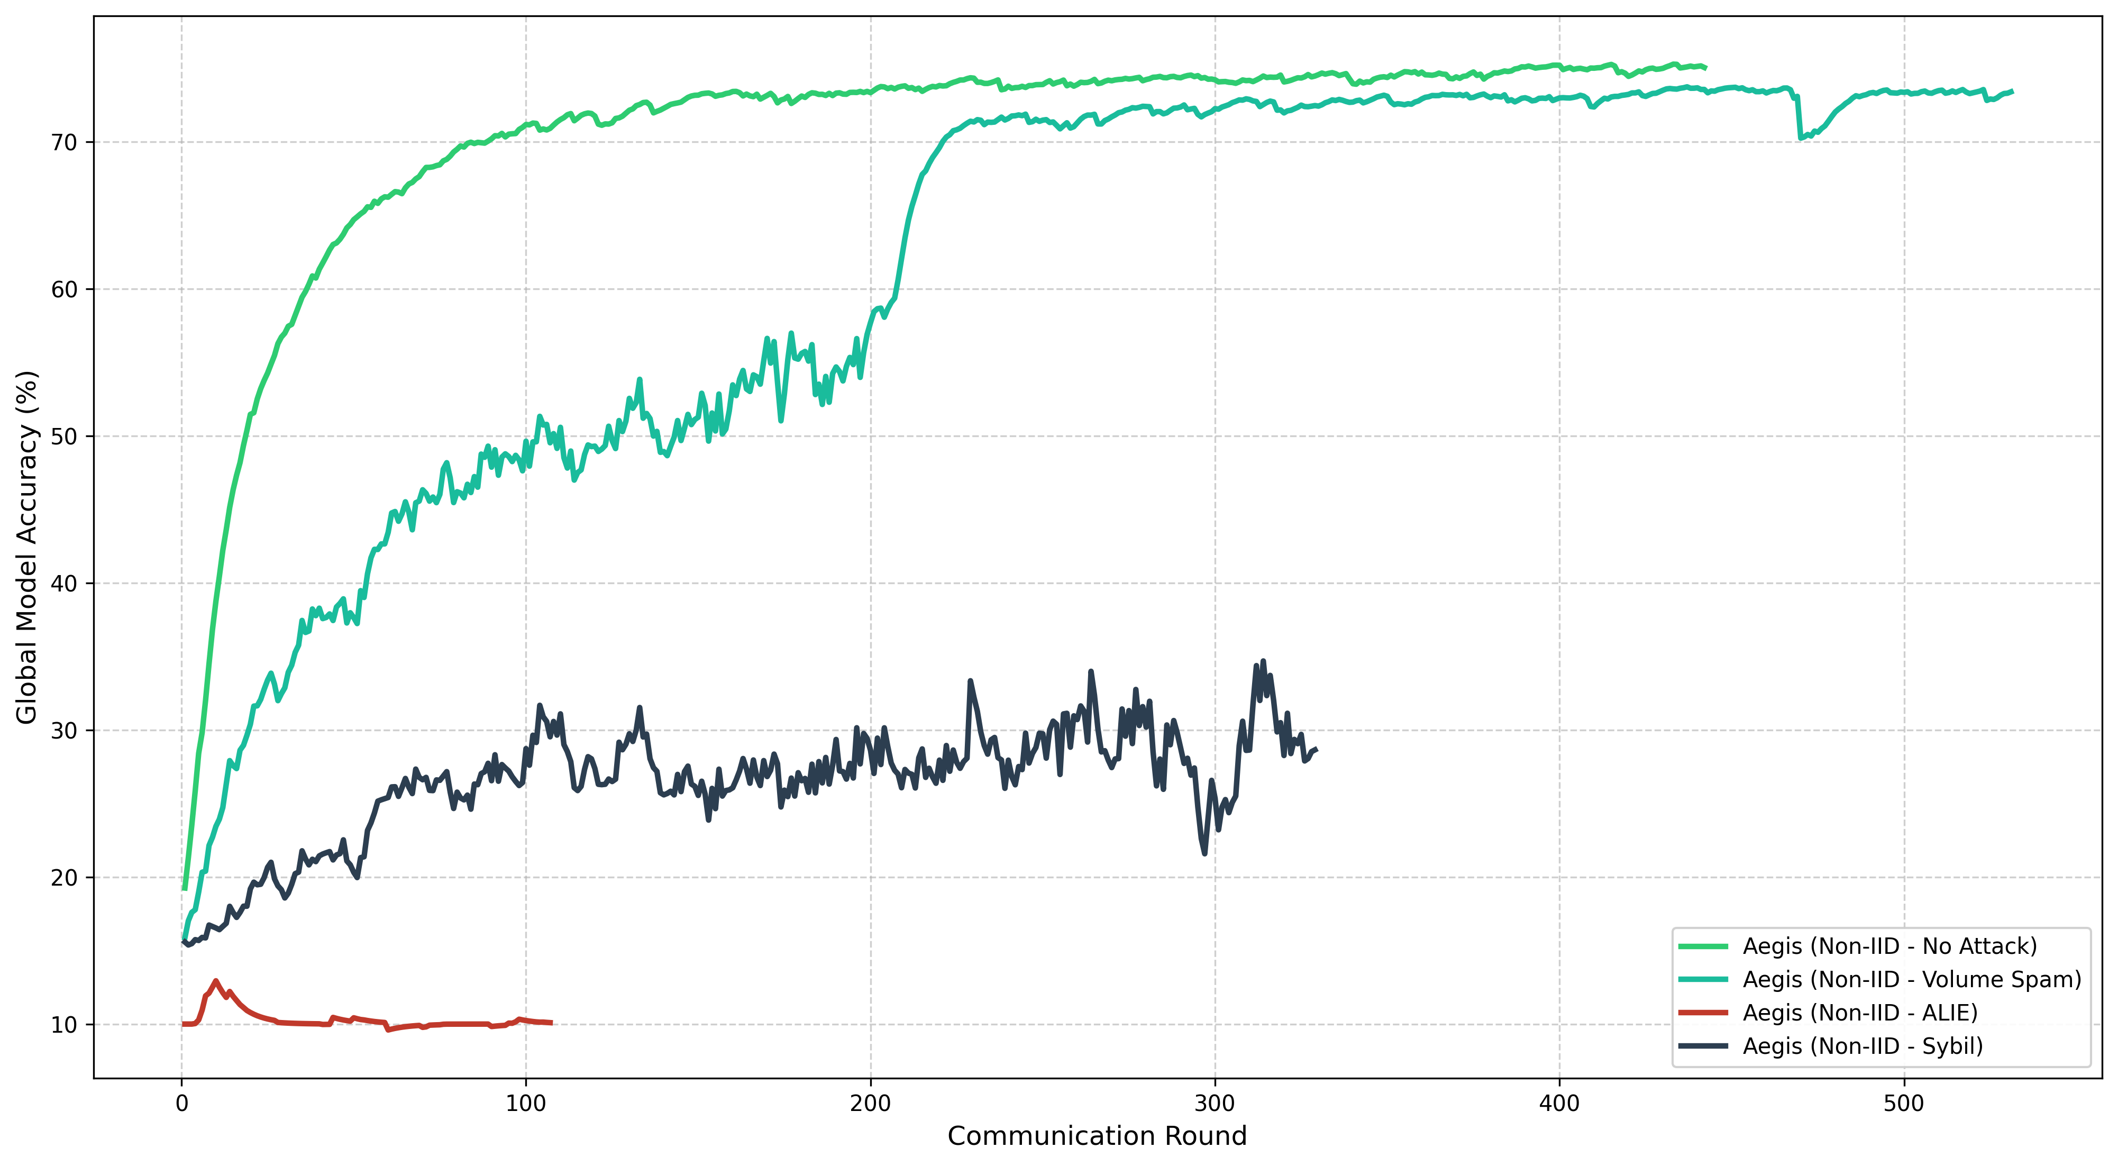
RESULTS ·Aegis
Aegis - Volume-Spam, ALIE & Sybil
Volume-spam is fully nullified (74%) by median clipping; ALIE and dense Sybil clusters overwhelm the median anchor.

Slide 38
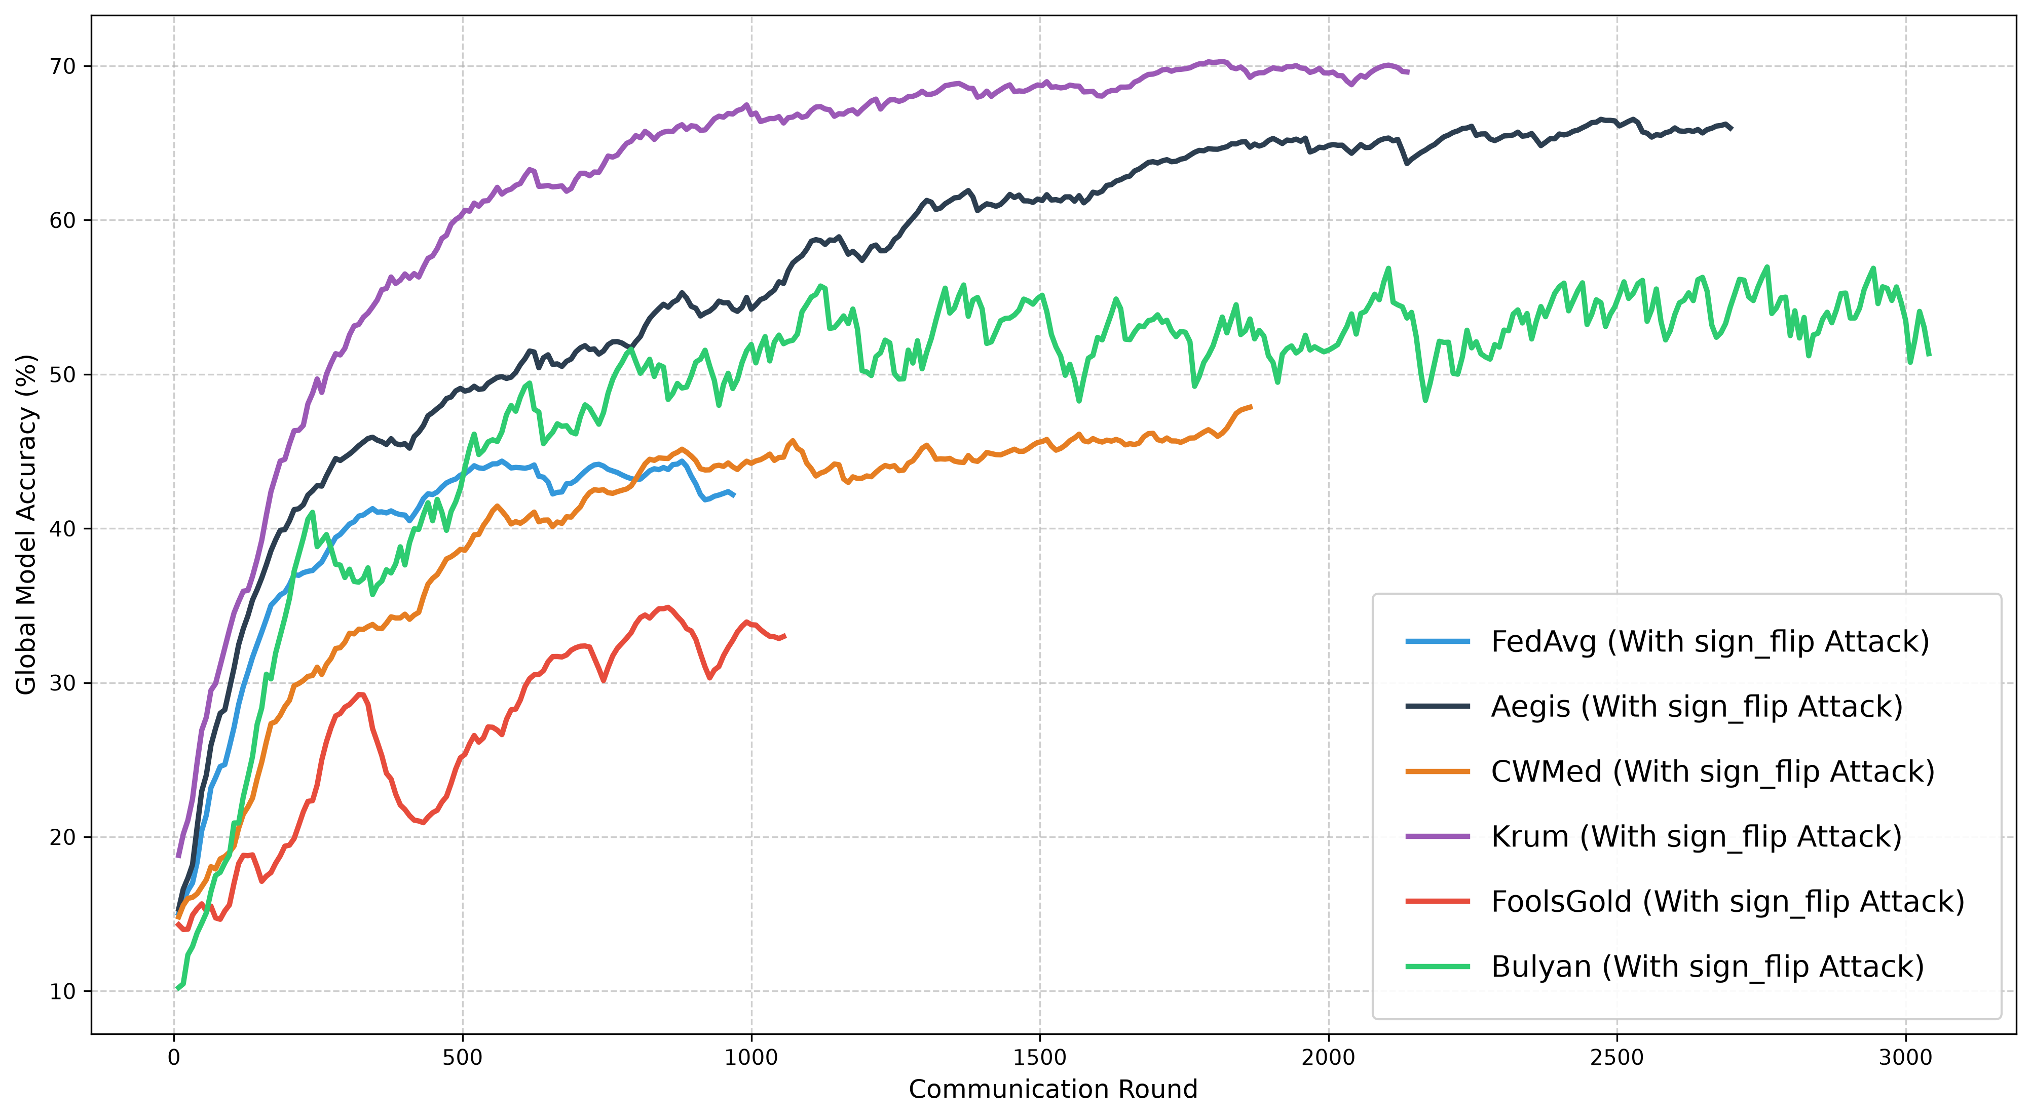
RESULTS · SIGN-FLIP
Sign-Flip — All Aggregators (f = 0.30)
Aegis 66.6% — no early collapse; FedAvg crashes to 40%, FoolsGold to 34%; Krum (70%) leads on this pure-magnitude attack.

Slide 39
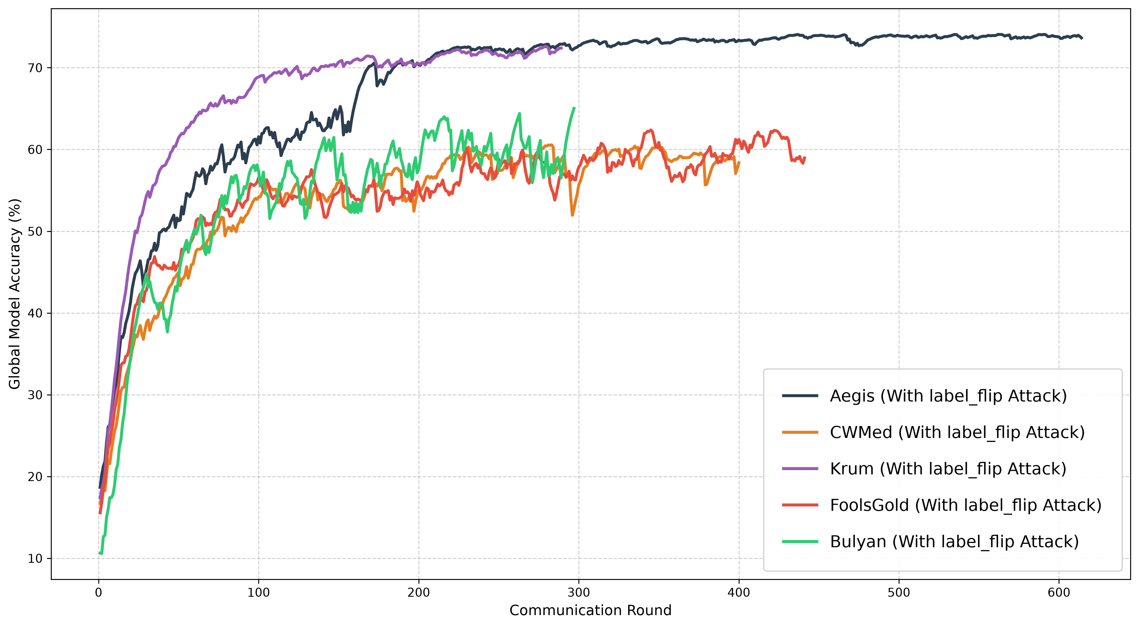
RESULTS · LABEL-FLIP
Label-Flip — All Aggregators (f = 0.30)
Aegis is the strongest defence at 74.34% — within 1.7 pp of the clean ceiling; the MAD gate intercepts the corrupt gradients.

Slide 40
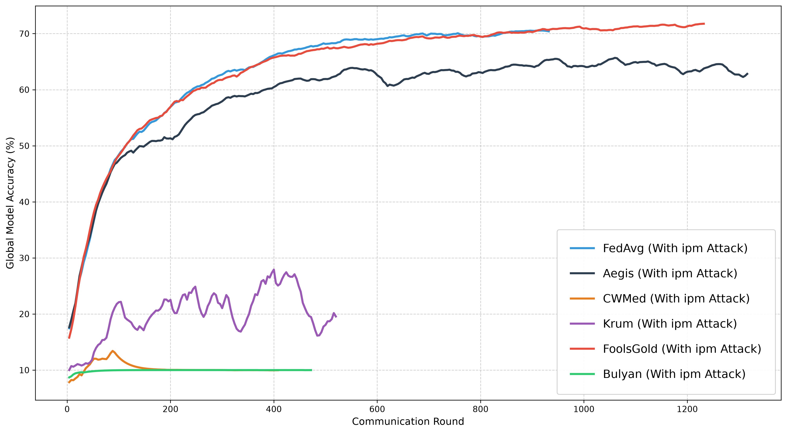
RESULTS · IPM
Inner-Product Manipulation (ε = 0.5, Omniscient) - All Aggregators (f = 0.30)
Aegis holds 63.3% by aggregate dilution while CWMed / Krum / Bulyan collapse to ≤ 17%; only FoolsGold and FedAvg edges ahead (71%).

Slide 41
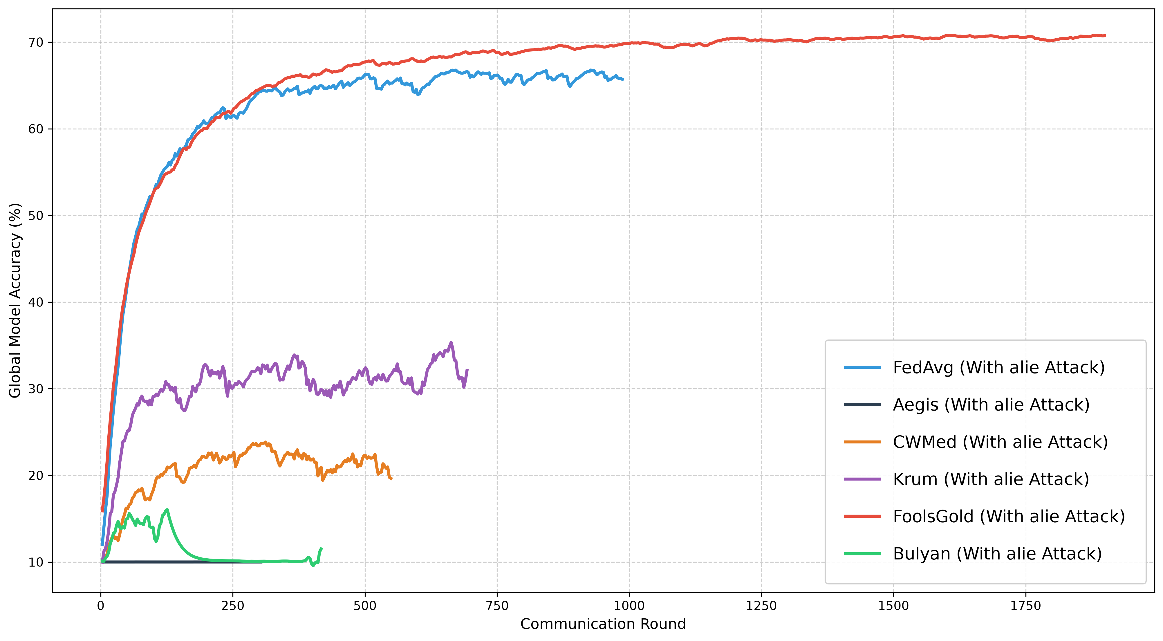
RESULTS · ALIE
A Little Is Enough (Z = 1.0, Omniscient) - All Aggregators (f = 0.30)
Aegis collapses to 10% — ALIE hijacks the median; FedAvg and FoolsGold's history tracking is the only survivor (71%).

Slide 42
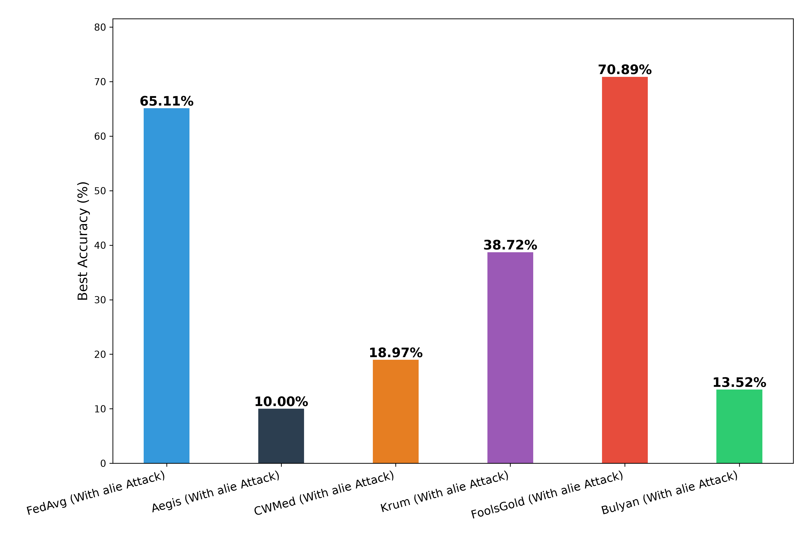
RESULTS · ALIE
A Little Is Enough (Z = 1.0, Omniscient) - All Aggregators (f = 0.30)
Aegis collapses to 10% — ALIE hijacks the median; FedAvg and FoolsGold's history tracking is the only survivor (71%).

Slide 43
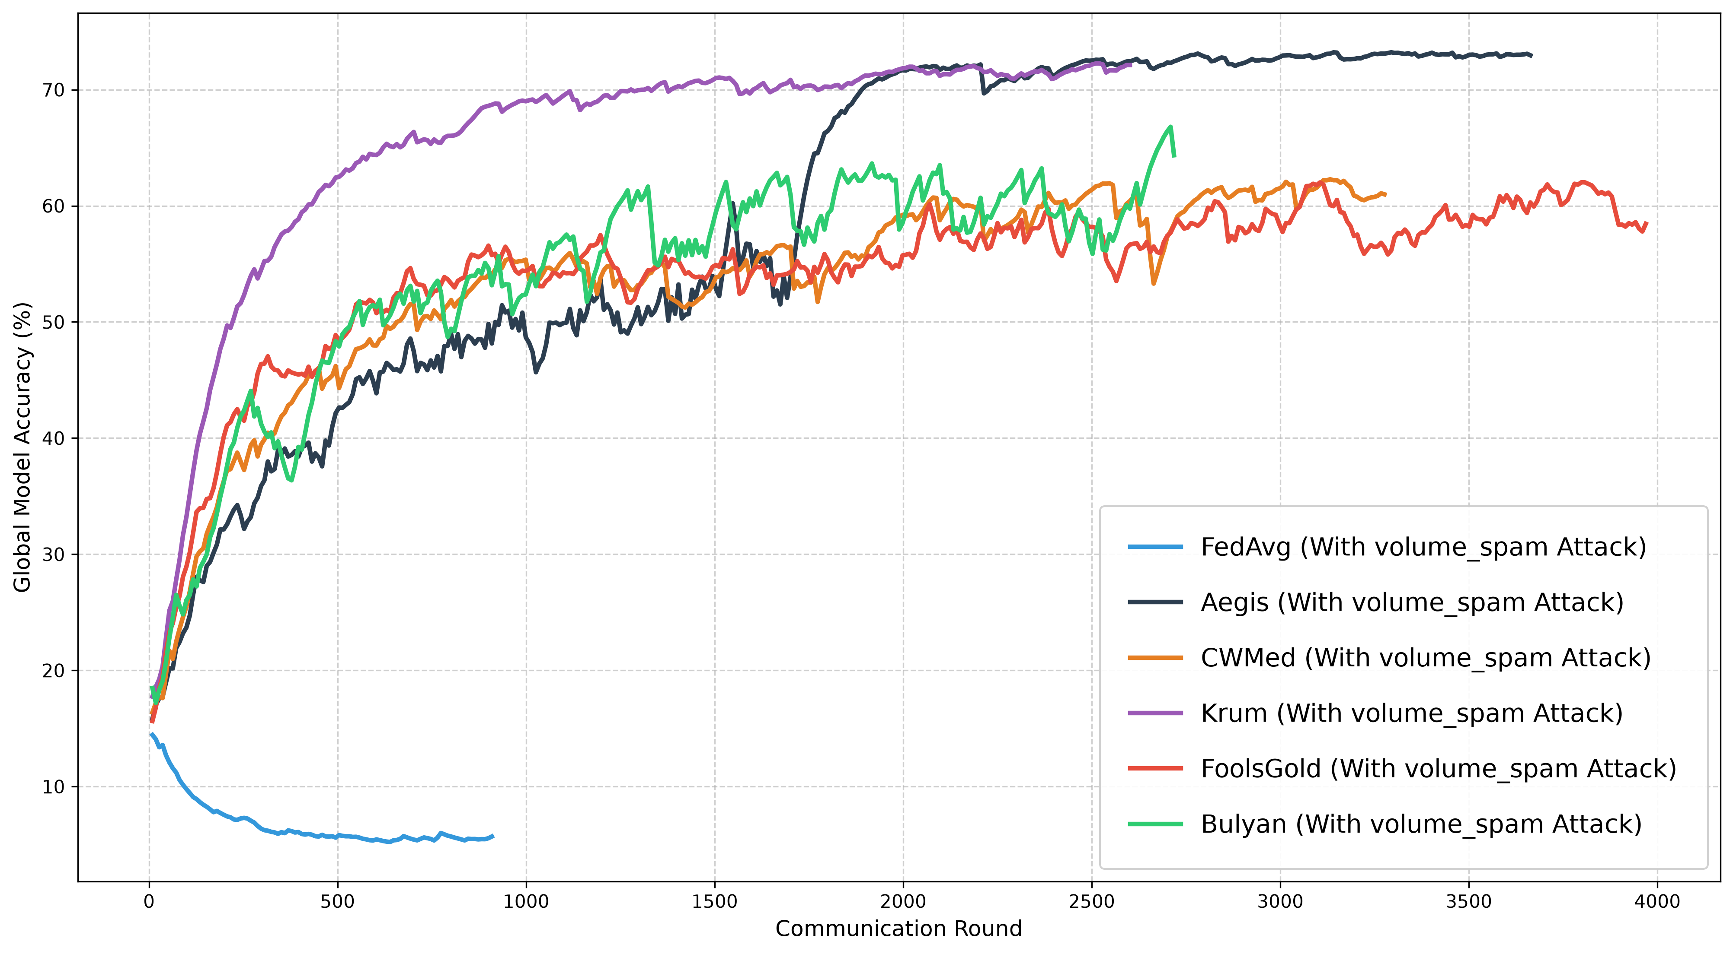
RESULTS · VOLUME SPAM
Volume Spam — All Aggregators (f = 0.30, n_{k} x 10⁹)
Aegis #1 at 72.21% — median volume clipping neutralizes the inflation attack; FedAvg collapses to 6.52%.

Slide 44
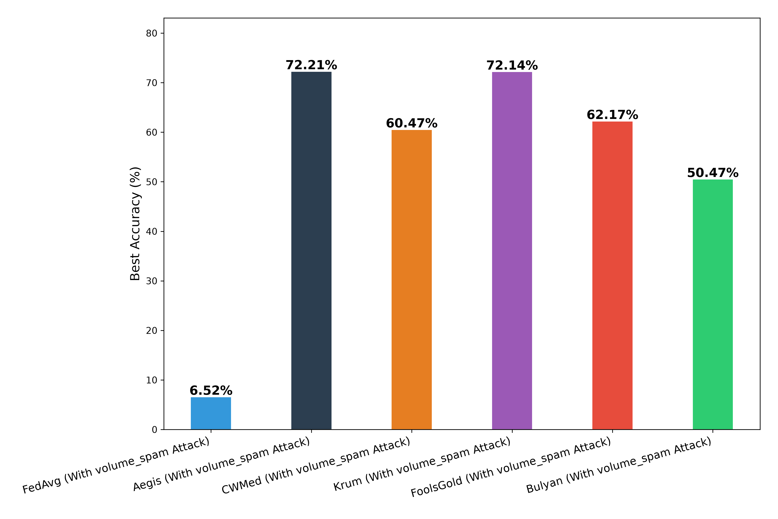
RESULTS · VOLUME SPAM
Volume Spam — All Aggregators (f = 0.30, n_{k} x 10⁹)
Aegis #1 at 72.21% — median volume clipping neutralizes the inflation attack; FedAvg collapses to 6.52%.

Slide 45
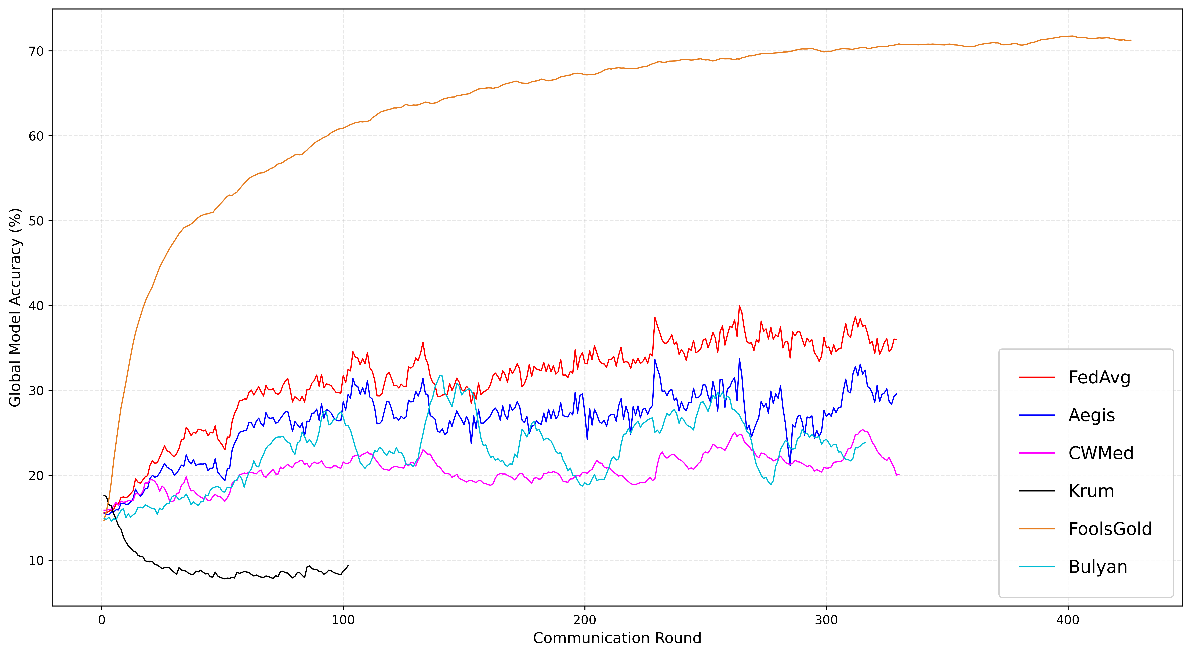
RESULTS · SYBIL
Sybil — All Aggregators (f = 0.30, k = 2 without LR Decay)
FoolsGold #1 (71.27%) via full-history tracking; Aegis #3 at 64.22%. Geometric baselines destroyed (Krum, CWMed).

Slide 46
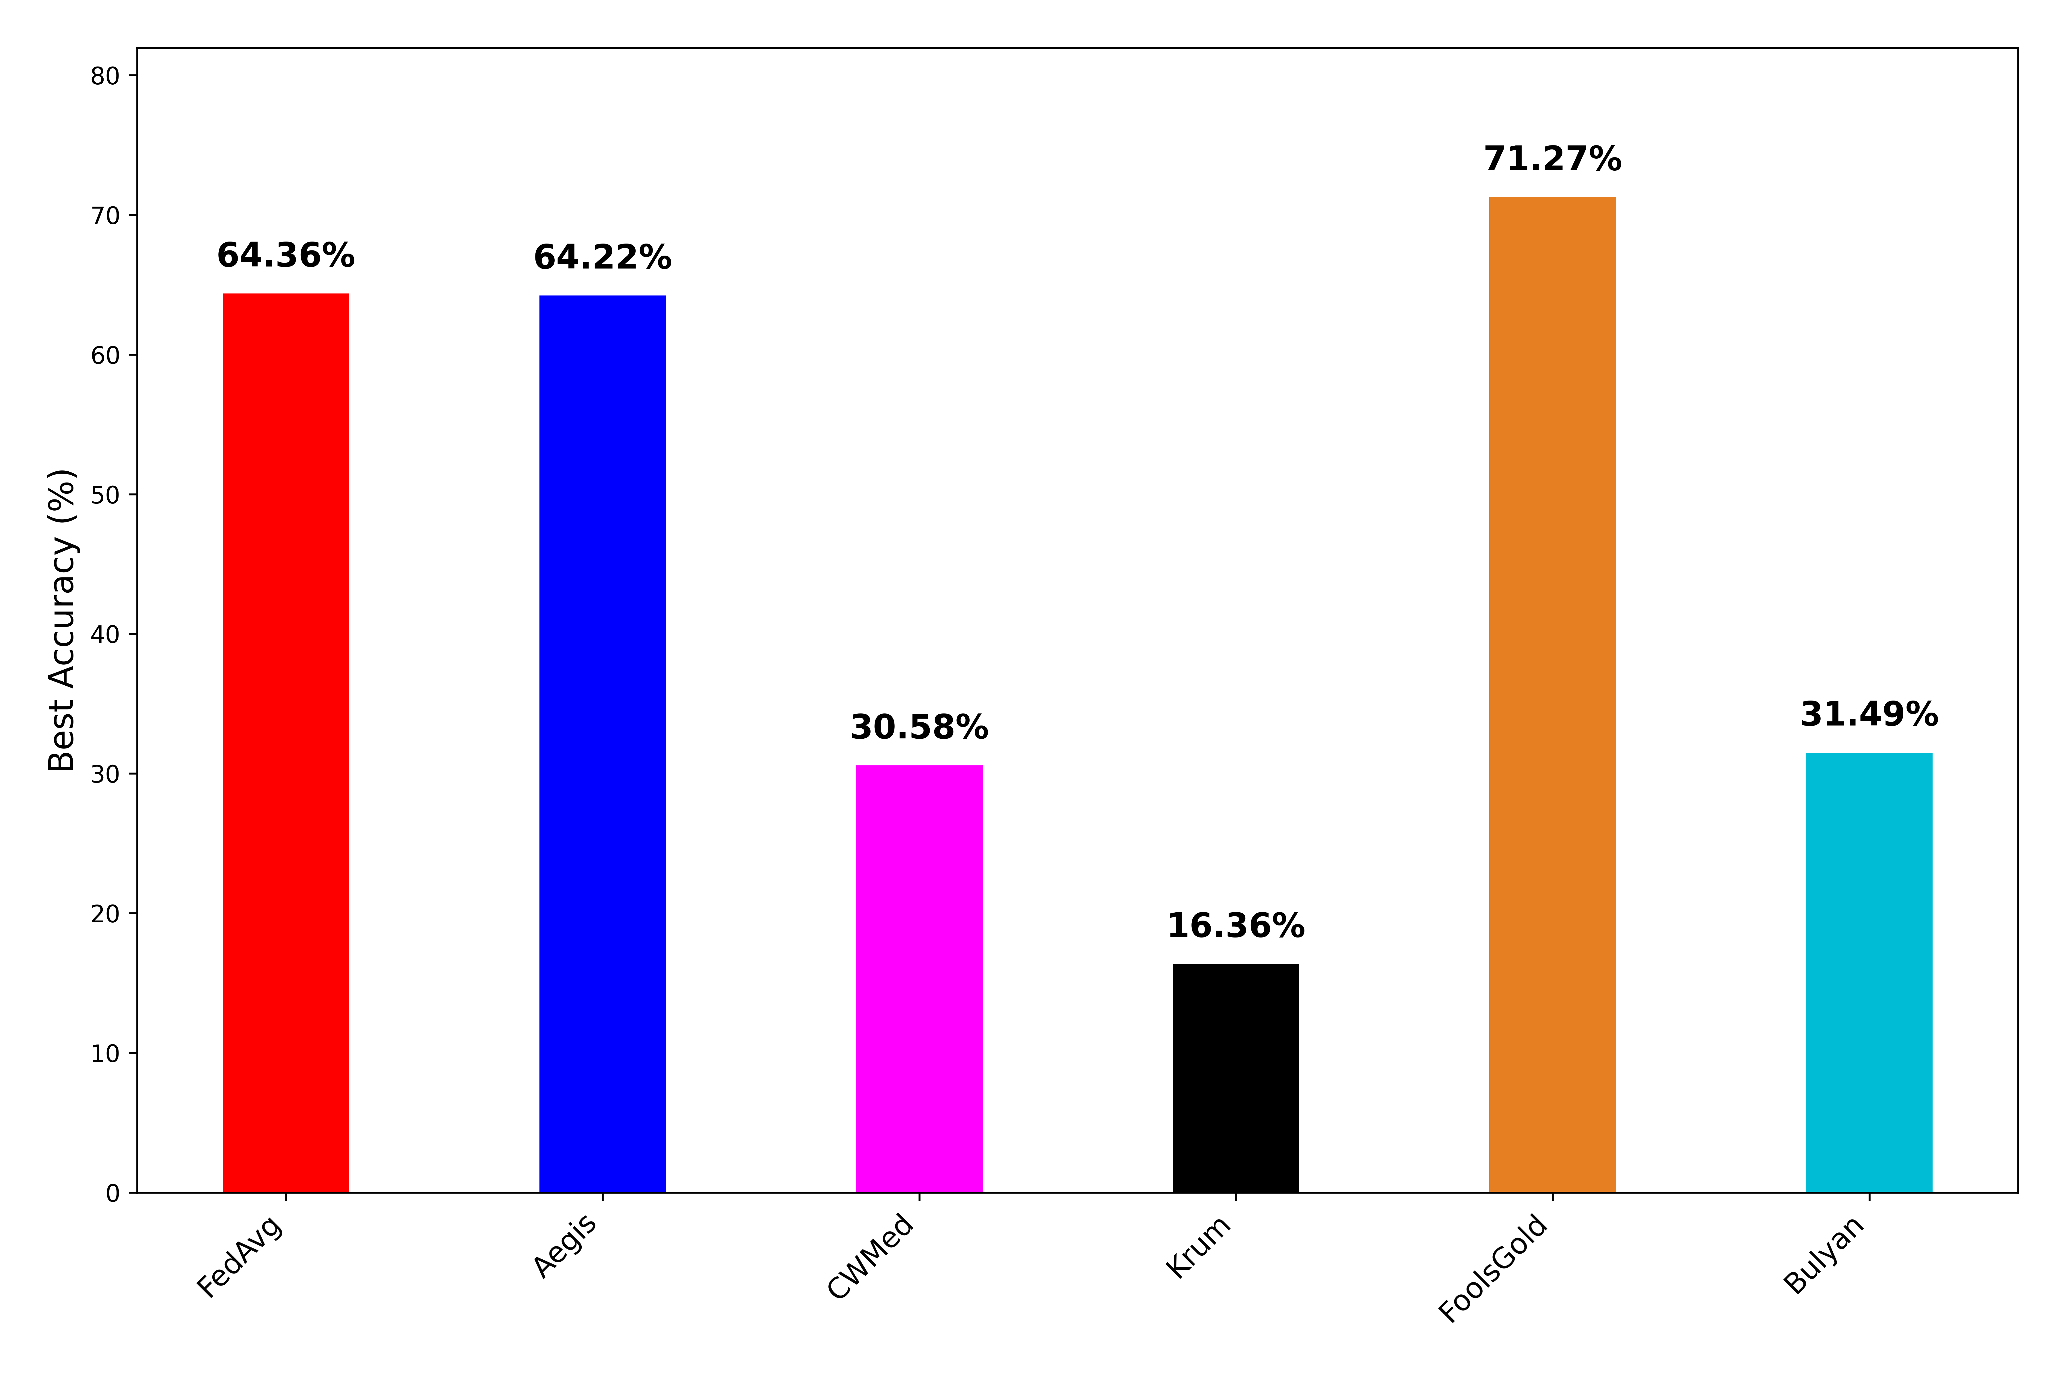
RESULTS · SYBIL
Sybil — All Aggregators (f = 0.30, k = 2 without LR Decay)
FoolsGold #1 (71.27%) via full-history tracking; Aegis #3 at 64.22%. Geometric baselines destroyed (Krum, CWMed).

Slide 47
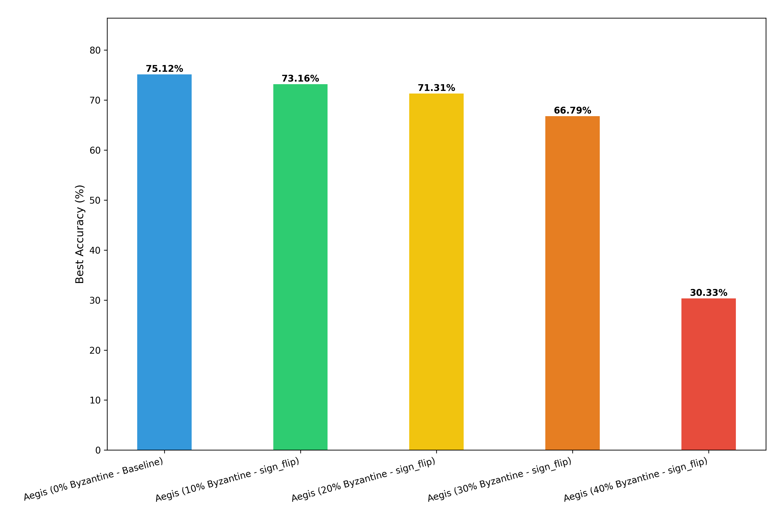
RESULTS · STRESS TEST
Resilience vs Byzantine Fraction (Sign-Flip)
Graceful degradation to f = 0.30 (~2.8 pp / +10 pp); a cliff at f = 0.40 as adversaries become a per-round majority and break the median.

Slide 48
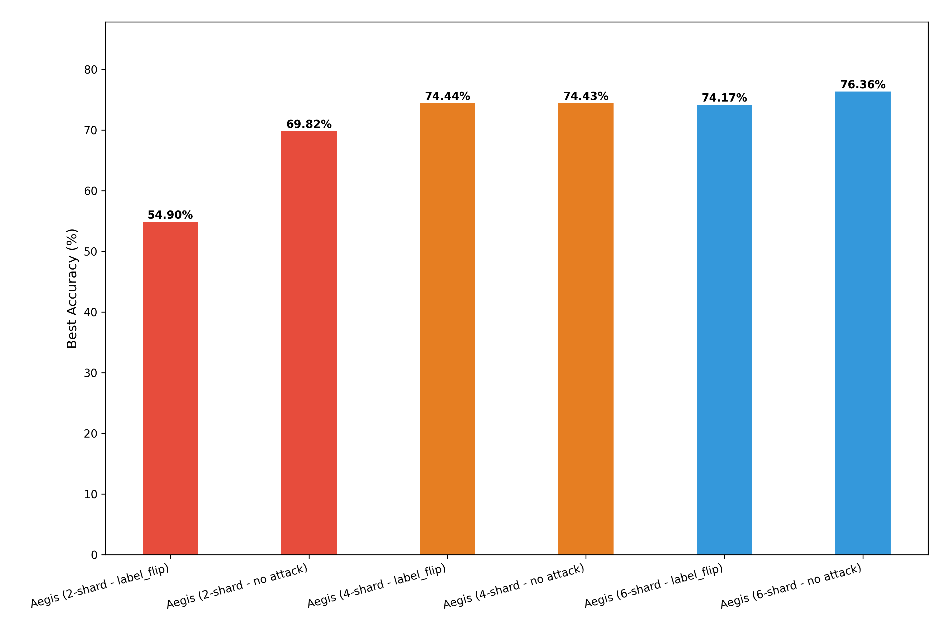
RESULTS · HETEROGENEITY
Sensitivity to Non-IID Degree (Shard Sweep)
At 4 shards the label-flip gap is ≈ 0; extreme skew (2 shards) widens it to ~15 pp as honest variance overlaps the attack.

Slide 49
RESULTS
Ablation: Which Component Carries the Load?
Configuration | Best Acc | Δ Acc | Filter Acc | DR % | Prec %
Full Aegis | 73.77 | — | 87.8 | 60.7 | 99.1
No Adaptive Threshold | 72.47 | −1.30 | 97.2 | 92.0 | 98.7
No Cosine Penalty | 73.73 | −0.04 | 87.4 | 59.5 | 99.4
No Volume Clipping | 74.67 | +0.90 | 92.4 | 76.6 | 98.6
No Median Decontamination | 74.24 | +0.47 | 91.0 | 71.6 | 98.7
No Euclidean Filter | 71.65 | −2.12 | 69.9 | 0.0 | N/A
Reading the table
The Euclidean MAD filter is the load-bearing wall: removing it costs 2.12 pp and zeroes detection.
Cosine penalty is marginal for label-flip (−0.04) — but it is the only signal under IPM.
Filter Accuracy – (TP +TN)/Total clients
DR% - ability to successfully find the attackers
Precision % - percentage of flagged clients that were actually attackers

Slide 50
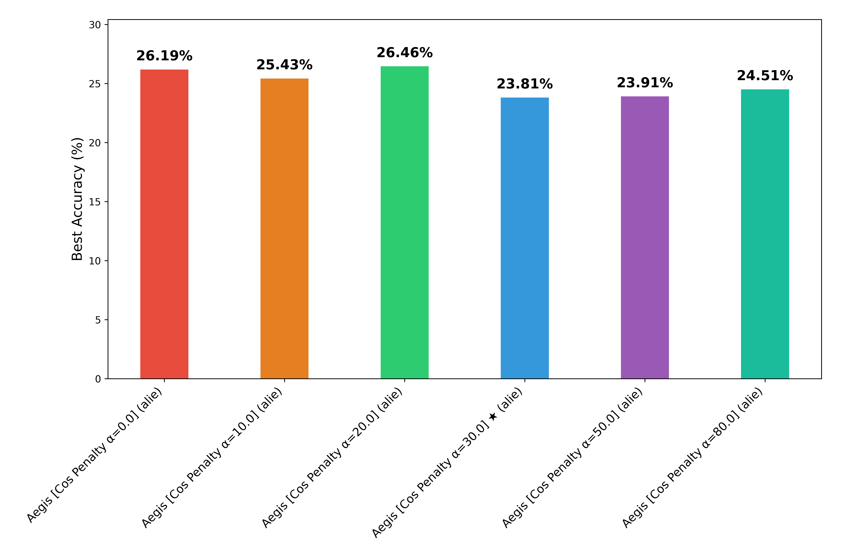
RESULTS · ABLATION
No Hyperparameter Recovers ALIE
Sweeping the cosine-penalty weight α leaves accuracy near chance — ALIE is a structural gap, not a tuning issue.

Slide 51
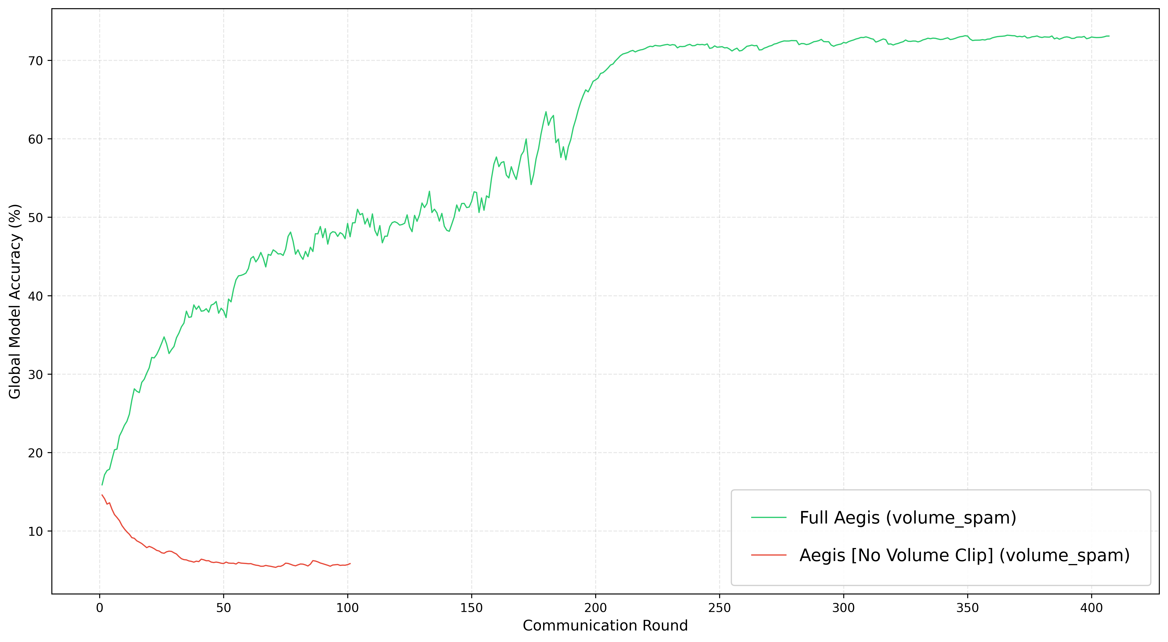
RESULTS · ABLATION
Volume Clipping — The Load-Bearing Wall for Spam
Full Aegis reaches 73.60% under volume spam; removing the clip collapses accuracy to 14.58% — a 59 pp gap proves volume clipping is essential.

Slide 52
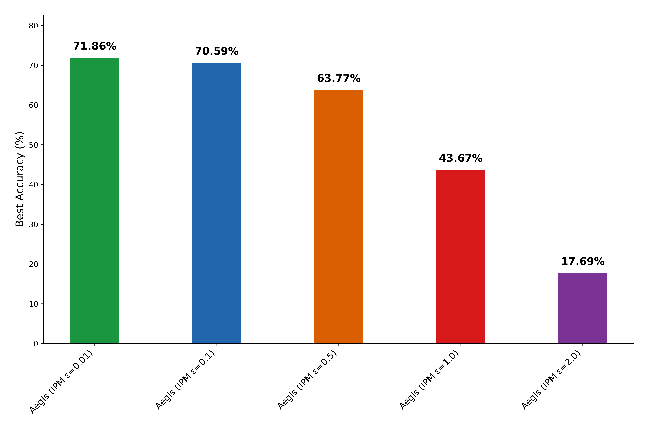
RESULTS · ABLATION
IPM — Different Epsilon values (0.01, 0.1, 0.5, 1.0, 2.0)

Slide 53
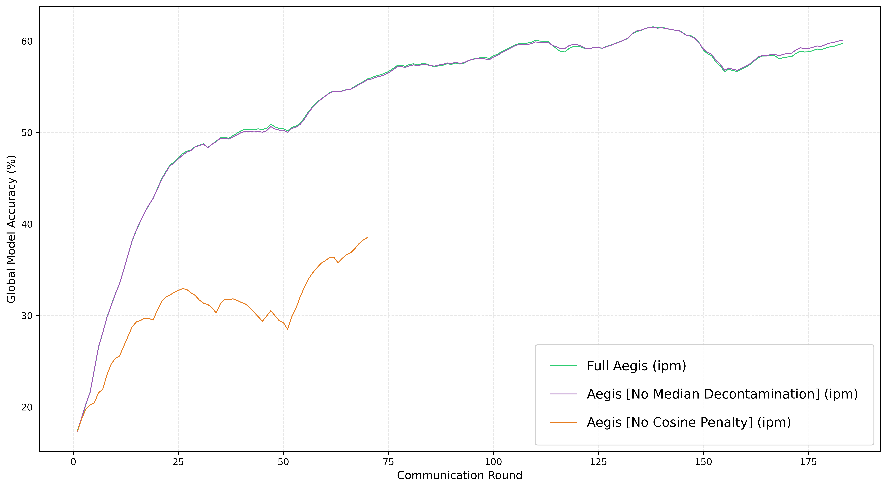
RESULTS · ABLATION
IPM — The Cosine Penalty Is the Load-Bearing Wall
Removing the soft cosine penalty collapses Aegis under IPM (63.4 → 36.8 %, −26.6 pp); removing the two-pass median decontamination has no effect (+0.2 pp) — at f = 0.30 the cosine penalty alone holds the line.

Slide 54
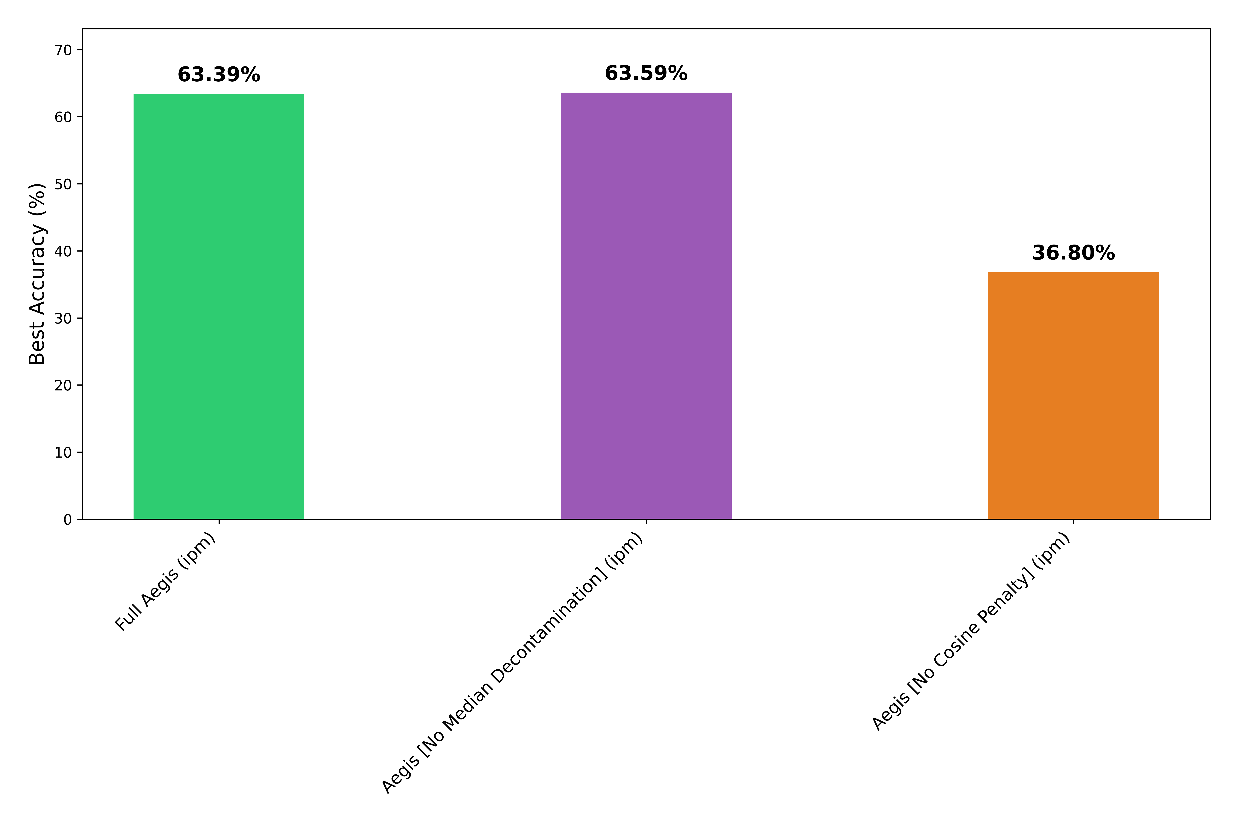
RESULTS · ABLATION
IPM — The Cosine Penalty Is the Load-Bearing Wall
Removing the soft cosine penalty collapses Aegis under IPM (63.4 → 36.8 %, −26.6 pp); removing the two-pass median decontamination has no effect (+0.2 pp) — at f = 0.30 the cosine penalty alone holds the line.

Slide 55
RESULTS · ABLATION
Sybil— Sybils per client (1, 2, 3, 4, 5)

Slide 56
RESULTS · ABLATION
ALIE— Different ALIE values

Slide 57
RESULTS
Head-to-Head Under Active Attack (f = 0.30)
Aggregator | No Attack | Label Flip | Sign Flip | Volume Spam | ALIE | IPM | Sybil
FedAvg | 74.78 | 70.80 | 40.04 | 6.52 | 66.78 | 70.25 | 64.36
CWMed | 69.68 | 62.07 | 49.64 | 60.47 | 23.21 | 10.43 | 30.58
Multi-Krum | 69.36 | 72.85 | 70.05 | 72.14 | 34.18 | 17.30 | 16.36
FoolsGold | 73.80 | 67.06 | 34.20 | 62.17 | 71.15 | 71.07 | 71.27
Bulyan † | 67.69 | 68.51 | 62.58 | 50.47 | 20.39 | 10.00 | 31.49
Aegis | 74.65 | 74.34 | 66.61 | 72.21 | 10.00 | 63.32 | 64.22
▪ Three regimes: dominant (label-flip), competitive (sign-flip, IPM, Sybil), failed (ALIE). Per-attack figures follow.
▪ † Bulyan evaluated at f = 0.20 (its n ≥ 4f+3 constraint is violated at f = 0.30).

Slide 58
RESULTS
Summary Across All Attacks
Attack | Aegis Acc | Best Baseline | Gap (pp) | Regime
Label Flip | 74.34 | Krum 72.85 | +1.49 | I
Volume Spam | 72.21 | Krum 72.14 | +0.07 | I
No Attack | 74.65 | FedAvg 74.78 | −0.13 | II
Sign Flip | 66.61 | Krum 70.05 | −3.44 | II
IPM | 63.32 | FoolsGold 71.07 | −7.75 | II
Sybil | 64.22 | FoolsGold 71.27 | −7.05 | III
ALIE | 10.00 | FoolsGold 71.15 | −61.15 | III
▪ FoolsGold wins ALIE, IPM & Sybil — its full-history tracking outresolves the 20-round EMA.
▪ No aggregator dominates everywhere → motivates an attack-type-aware routing layer (future work).

Slide 59
06
PART SIX
Conclusions & Future Work
What survives the experimental critique — and what comes next

Slide 60
CONCLUSION
Achievements & Honest Boundaries
What survives the critique
Stated boundaries
▪ Near-zero Byzantine Tax: 0.08 pp vs FedAvg under no attack.
▪ Dominant label-flip resilience: 74.34%, 98.8% precision.
▪ O(kd) linear-time aggregation — ~30× faster than Bulyan (R²=0.999).
▪ Two-pass median prevents Center Drag — a structural contribution.
▪ IPM partial evasion: 63.3% by dilution, 0% detection — velocity patch proposed.
▪ ALIE catastrophic failure: 10% — EMA window too short; remains open.
▪ f = 0.40 collapse: provable limit of any median-based scheme (0.5 breakdown).
The failure modes are structural gaps requiring architectural extensions — not implementation defects.

Slide 61
FUTURE WORK
Four Research Directions
1
Server-Velocity for IPM
2
Kalman Reputation for ALIE
Screen against a momentum buffer V⁽ᵗ⁻¹⁾ — a pre-debiased reference IPM cannot poison. (Re-activates the interim's server momentum.)
Replace fixed-window EMA with a Kalman-filtered estimator — adaptive memory at O(Kd), not FoolsGold's O(K²d).
3
Asynchronous Aegis
4
Dynamic EMA Decay
Staleness-weighted cosine penalty to suppress deliberately delayed Byzantine updates over disrupted links.
Tie γ to network churn — shrink memory in volatile rounds, keep long memory when stable.

Slide 62
REFERENCES
Selected References (1/2)
[1] H. B. McMahan et al., “Communication-Efficient Learning of Deep Networks from Decentralized Data,” AISTATS, 2017.
[2] P. Blanchard et al., “Machine Learning with Adversaries: Byzantine-Tolerant Gradient Descent (Krum),” NeurIPS, 2017.
[3] D. Yin et al., “Byzantine-Robust Distributed Learning: Towards Optimal Statistical Rates,” ICML, 2018.
[4] E. M. El Mhamdi et al., “The Hidden Vulnerability of Distributed Learning in Byzantium (Bulyan),” ICML, 2018.
[5] G. Baruch et al., “A Little Is Enough: Circumventing Defenses for Distributed Learning (ALIE),” NeurIPS, 2019.
[6] C. Xie et al., “Fall of Empires: Breaking Byzantine-tolerant SGD by Inner Product Manipulation (IPM),” UAI, 2019.
[7] C. Fung et al., “The Limitations of Federated Learning in Sybil Settings (FoolsGold),” RAID, 2020.
[8] X. Cao et al., “FLTrust: Byzantine-Robust Federated Learning via Trust Bootstrapping,” NDSS, 2021.

Slide 63
REFERENCES
Selected References (2/2)
[9] T. D. Nguyen et al., “FLAME: Taming Backdoors in Federated Learning,” USENIX Security, 2022.
[10] C. Xie et al., “Zeno: Distributed SGD with Suspicion-based Fault-tolerance,” ICML, 2019.
[11] S. P. Karimireddy et al., “Learning from History for Byzantine Robust Optimization,” ICML, 2021.
[12] V. Shejwalkar, A. Houmansadr, “Manipulating the Byzantine (DnC),” NDSS, 2021.
[13] S. Awan et al., “CONTRA: Defending Against Poisoning Attacks in Federated Learning,” ESORICS, 2021.
[14] K. Pillutla et al., “Robust Aggregation for Federated Learning (RFA),” IEEE Trans. Signal Process., 2022.
[15] U. Shahul, J. Harshan, “FORTA: Byzantine-Resilient FL Aggregation via DFT-Guided Krum,” arXiv:2507.14588, 2025.
[16] T.-M. H. Hsu et al., “Measuring the Effects of Non-Identical Data Distribution for Federated Visual Classification,” NeurIPS-W, 2019.

Slide 64
Thank You
Questions & Discussion
Enhanced Aegis: A Byzantine-Resilient FL Protocol for Drone Swarms
Abhishek Kumar Tripathi · 2024EET2845 · Advisor: Prof. Harshan Jagdeesh
Department of Electrical Engineering, IIT Delhi

