Slide 1

Web scraping and generating dataset
Presented by Abhishek Chauhan
Under the mentorship of Dr.Sharon christa

Slide 2

Introduction
Web scraping is the process of extracting the data from web sources in an automated manner .It can be used to gather data for research ,analysis or other purposes however it is important to ensure that the data is being used ethically and legally and that the website terms of service are followed.
Web scraping can be done by various programming languages such as java ,python and ruby .There also some libraries available to make the process easier , such as Beautiful Soup , Scrapy and selenium. We can extract any type of data such as image , text and videos.

Slide 3

METHODOLOGY

Slide 4

IDENTIFYING TARGET WEBSITE
Select the site whose data you want to scrap and identify the website frontend structure and find important elements that contains the data(for example-classes , tags ,id etc.

Slide 5
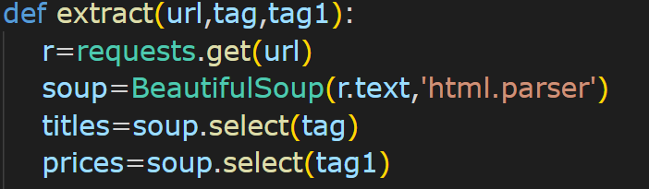

DEVELOPING SCRAPING SCRIPT
Developing the scraping script using python programming language.
Python contains a great library called Beautiful soup for parsing the html document and have functions to access any elements of the html code.

Slide 6

CREATE A STRUCTURED DATATSET
After scraping the data from a particular website we have to store the data in a desired format here we use excel format to store the scraped data.

Slide 7

RESULT AND DISCUSION
So after using the script we scrap the data from two ecom sites flipkart.com and amazon.com of laptop brands and store the data in excel file format . Later we can use the data for price analysis

Slide 8
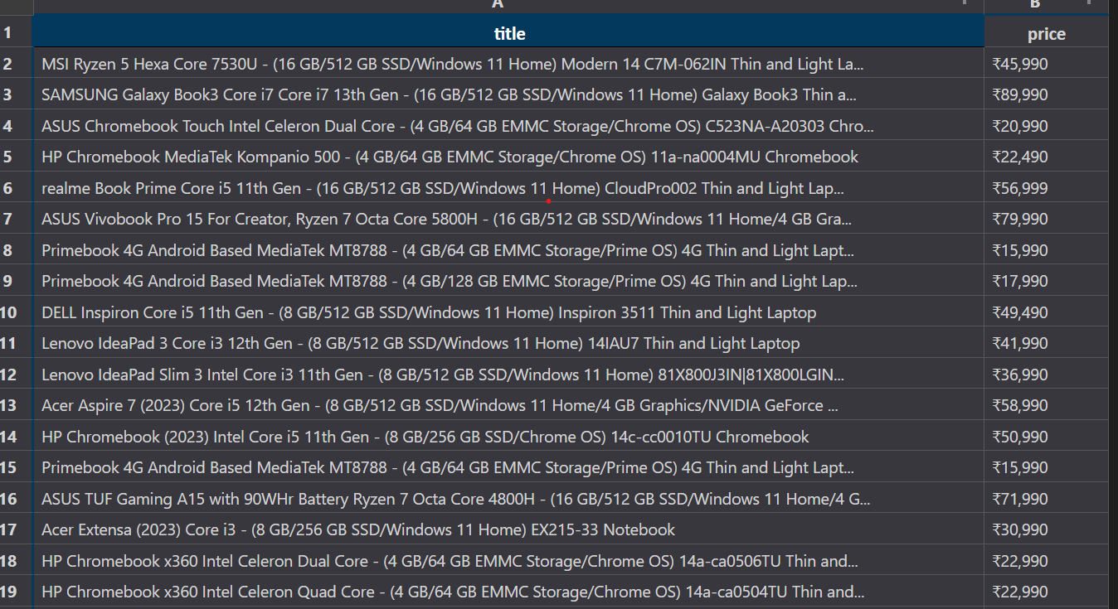
Data extracted from flipkart.com

Slide 9
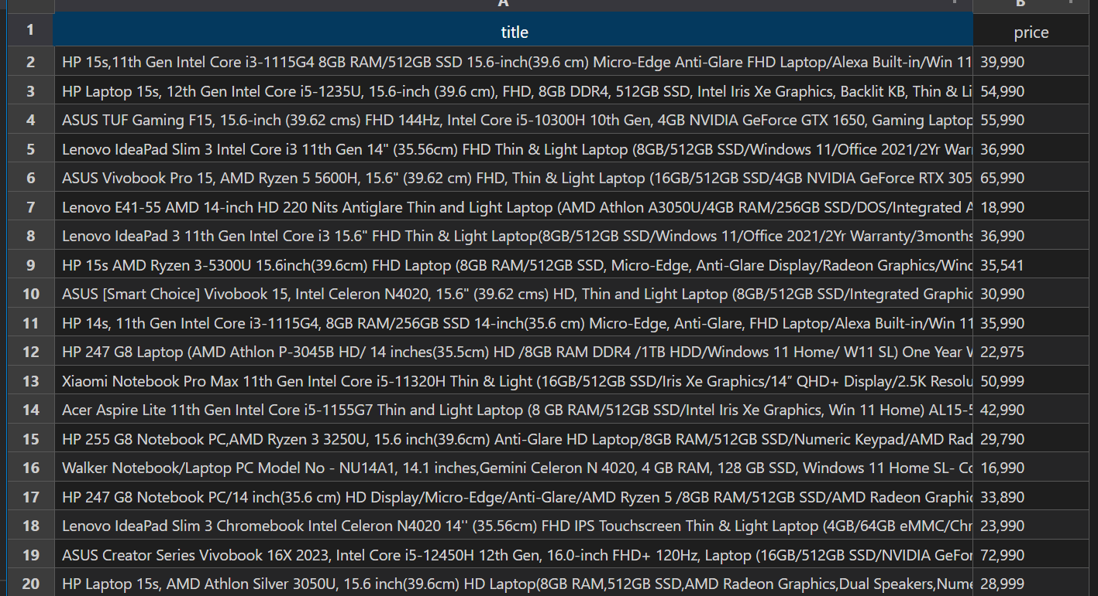
Data extracted from amazon.in

Slide 10
Conclusion and future work
We extract the data from two different sites and then later we can use it for price analysis .So we see web scraping is a very important method for saving a lot of time. Some potential areas for future work in web scraping and dataset generation including of Exploring advanced scraping techniques like dynamic web scraping using headless browsers or API-based data extraction. Developing automated scraping pipelines to regularly update datasets from selected web sources. Conducting further analysis and visualization on the generated dataset to extract meaningful insights. Investigating ethical considerations and legal implications of web scraping, including obtaining necessary permissions and adhering to data privacy regulations.

