Slide 1
Odoo Hackathon · Sales Operations Platform
DealFlow360
An intelligent, self-governing B2B quote-to-cash platform.
It explains the consequences of a deal, governs its approval, and carries the accepted terms through stock allocation and billing.
Discount governance
Live recommendations
Multi-warehouse split
Hybrid billing
Portal negotiation
Deal health
Team of 6 · Java 21 / Spring Boot 4 · React 19 + Vite · PostgreSQL · Supabase Auth

Slide 2
THE PROBLEM
B2B sales doesn't fit in a quote-to-invoice form
Six places where a real deal falls out of a simple sales tool
01
Discount leakage
Ceilings differ by customer tier AND product category. A rep can breach a category limit while the order-level number still looks fine.
02
Invisible approvals
Managers find out a deal is stuck after the momentum is already gone. Nobody owns the queue.
03
Inventory fiction
Stock is spread across warehouses. Quotes promise quantities that no single depot can actually ship.
04
Hybrid orders
One-time hardware and recurring subscriptions sit on the same order. Proration and credits get done by hand.
05
Email negotiation
Customers negotiate in threads. The agreed terms drift away from the document that gets approved.
06
Static PDFs
The quotation is a dead file, not a living, negotiable document both sides can act on.
Brief: “Most simple sales tools handle the basics well. Real B2B teams operate in messier conditions.”
DealFlow360 · Odoo Hackathon
2

Slide 3
PROBLEM STATEMENT
What the brief actually demanded
Seven responsibilities — all of them business logic, not screens
Responsibility | Required outcome | Where it lives
Multi-tier discount governance | Ceilings per customer tier and per category, automatic Manager → Finance routing, full audit history | policy · quotes · approvals
Live recommendations | Ranked upsell / cross-sell from co-purchase history, with real-time margin impact | recommendations
Multi-warehouse fulfillment | Stock-aware split across depots, manual override, backorder, consolidation on receipt | fulfillment
Hybrid billing | One-time and recurring lines on one order; schedules, proration, cancellation credits | billing
Portal negotiation | Genuinely separate restricted portal: line comments, counter-discounts, one-click confirm | portal
Deal monitoring | Stalled quotes, discount anomalies, promise slippage, nudges and escalations | health
Configuration & reporting | Working setup forms, report filters, PDF and XLS export | catalog · reporting
Non-negotiable constraints we designed against:
Core rules (approval routing, discount governance, warehouse splitting, billing proration) must be real application logic — not hardcoded or faked. The customer portal must be a real, separate, restricted view.
DealFlow360 · Odoo Hackathon
3

Slide 4
THE SOLUTION
One workspace that governs a deal from quote to cash
“A sales workspace that explains the consequences of a deal, governs its approval, and carries the accepted terms through stock allocation and billing.”
Build
Catalog + line editor with live pricing, margin and policy evaluation as you type.
Explain
Every evaluation returns structured reasons — why this approver, why this split, why this total.
Govern
Sequential Manager → Finance routing from a blended risk score; nothing inherits an approval.
Negotiate
Customer deal room with line comments, counters and exact-version acceptance.
Fulfil
Deterministic warehouse split with override, backorder and consolidation.
Bill
One-time and recurring on one order, with proration, credits and a real payment record.
DealFlow360 · Odoo Hackathon
4

Slide 5
UNIQUE SOLUTIONS
Six things we built beyond the checklist
These are the parts a CRUD demo cannot fake
Blended risk score, not a single threshold
Evaluates the worst line, value-weighted excess, total excess money, overall discount and margin — then routes to the highest level any of them demands. Splitting a line cannot lower the route, because a compliant line never offsets a breach (max(0, …) per line).
Three independent gates, and nothing inherits an approval
Approval, seller adoption and customer acceptance are separate gates in either order. Editing submitted terms supersedes the revision and retires its pending steps.
Finalisation is one database transaction
Order creation, stock reservation under row locks, and the first invoice commit together or not at all. Under in-stock-only terms a shortage rolls the whole thing back.
Explainability is a data structure, not a marketing word
Every engine emits structured reasons[] — “Finance is needed because the service discount exceeds its category ceiling by 8 points” — all of it rendered from real engine output.
Deterministic engines instead of ML theatre
Four pure-function engines (pricing, risk, allocation, proration) with no I/O. No trained model is required and none is claimed.
The portal is separate by construction
Portal responses use different DTO types with no field for cost, margin or policy thresholds. Out-of-scope reads return 404, not 403, so a probing client cannot map records.
DealFlow360 · Odoo Hackathon
5

Slide 6
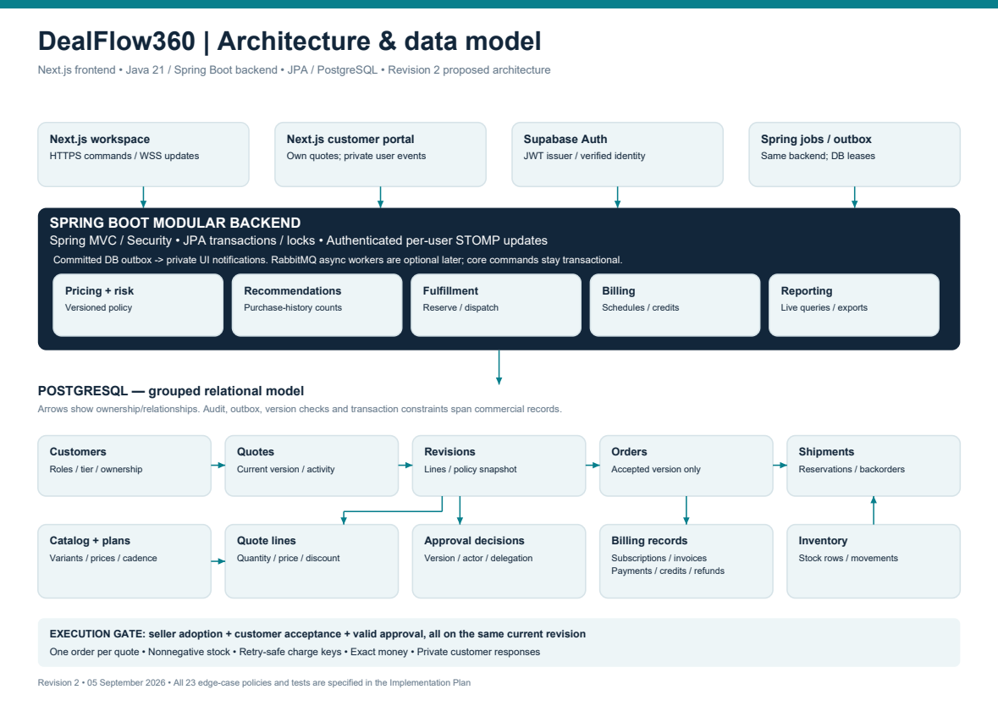
SYSTEM DESIGN
How the pieces connect
One modular Spring service, one React SPA, one PostgreSQL database
Diagram note: this architecture sheet predates the frontend swap — the delivered client is a Vite + React 19 SPA, not Next.js. The module boundaries, engines and data layer are as built.
DealFlow360 · Odoo Hackathon
6

Slide 7
SYSTEM DESIGN · BACKEND
One modular service, four pure engines
16 domain modules
auth · catalog · policy · quotes · approvals · portal · orders ·
fulfillment · billing · recommendations · health · reporting ·
outbox · notifications · jobs · assistant
220 Java files · 198 main + 22 test
7 Flyway migrations (V1–V7), Hibernate set to
ddl-auto=validate — Flyway owns the schema.
Controllers validate and authorise. Services own
transactions. The four engines are pure functions.
THE FOUR ENGINES
PricingEngine
Line + order discounts, tax, rounding
RiskEngine
Blended score → approval route
AllocationEngine
Warehouse split, shipping cost
ProrationCalculator
Calendar-based credits & adjustments
THE TRANSACTION THAT MATTERS
OrderFinalizationService.tryFinalize
Called from every path that can complete a gate. It locks the quotation, re-checks every gate, then creates the order, reserves stock and raises the first invoice — in one transaction.
Duplicate creation is blocked three ways: aggregate lock, explicit existence check, and a UNIQUE constraint on orders.quote_id.
Money: BIGINT minor units, computed in BigDecimal, rounded HALF_UP exactly once. Line residual is redistributed so lines always reconcile to the total.
DealFlow360 · Odoo Hackathon
7

Slide 8
SYSTEM DESIGN · INTEGRITY
The parts that break demos — and how we handled them
Failure mode | Our mechanism | Proven by
Two reps sell the last unit | Finalisation re-reads stock under (variant, warehouse)-ordered row locks; IN_STOCK_ONLY fails the whole transaction | ConcurrencyAndIdempotencyIT
Retry creates a second order or invoice | Aggregate lock + existence check + UNIQUE(orders.quote_id); recurring charges keyed by a global charge_key | ConcurrencyAndIdempotencyIT
Double-click on approve / pay / accept | Idempotency-Key header on every mutating endpoint — replay returns the original result, key reuse with a different body is refused | BillingLifecycleIT
Stale client overwrites a newer version | Optimistic row versions + exact-revision acceptance; stale writes rejected | FlowBNegotiationIT
Portal leaks cost, margin or policy | Separate portal DTOs with no such fields; out-of-scope reads return 404, not 403 | FlowAEndToEndIT
A missed WebSocket frame loses an update | Transactional outbox → private per-user STOMP queue → REST refetch, plus a durable notifications inbox | WebSocketSecurityIT
DealFlow360 · Odoo Hackathon
8

Slide 9
SYSTEM DESIGN · REAL TIME
Live updates without lying to the user
01
Mutation commits
Every important mutation writes an outbox_events row inside the business transaction.
02
Dispatcher claims
A 1-second dispatcher claims rows with FOR UPDATE SKIP LOCKED and resolves recipients against current ownership.
03
Private push
A minimal frame (id, type, entity, version) goes to each user's private STOMP queue — never a broadcast.
04
Client refetches
The browser refetches through REST. Reconnect triggers an authorised refresh, because frames can be missed.
›
›
›
Security posture
Token in the CONNECT frame, not the URL. Subscriptions are per-user and authenticated; an anonymous CONNECT is refused and a foreign subscription closes the session. The WebSocket is never the source of truth — a committed outbox row is.
Jobs run in the background, not in the browser
A leased minute sweep raises due recurring charges (one transaction per subscription), runs deal-health rules and expires stale quotations. POST /internal/job-runs triggers the same code by hand — useful on stage.
DealFlow360 · Odoo Hackathon
9

Slide 10
TECH STACK
What we actually shipped it on
Layer | Choice | Why this and not the alternative
Frontend | React 19 + TypeScript, Vite 8, Tailwind v4, React Router 7 | SPA with a dev proxy for /api and /ws. Role-based layouts for REP, MANAGER, FINANCE, ADMIN and CUSTOMER.
Backend | Java 21, Spring Boot 4.1, Spring MVC | Practical team experience, and a runtime that supports persistent WebSockets and scheduled jobs without extra infrastructure.
Persistence | PostgreSQL + Spring Data JPA / Hibernate 7, HikariCP, Flyway | Explicit locking, real constraints and versioned migrations. Flyway owns the schema; Hibernate only validates it.
Identity | Supabase Auth JWTs verified by Spring Security OAuth2 resource server | The token proves who signed in; the database decides what they may do. Roles are read from the DB on every request.
Real time | STOMP over native WebSocket (/ws) + @stomp/stompjs, transactional outbox | Authenticated per-user frames after commit, with REST refetch and a durable inbox as the safety net.
Money & time | BigDecimal + BIGINT minor units, java.time, BusinessClock | Exact rounding, calendar-correct proration, and an overridable clock for demos.
Exports | Apache PDFBox and Apache POI | Server-authoritative PDF, XLSX and legacy XLS — real bytes, not a print dialog.
AI | Sarvam chat completions (sarvam-105b), server-side only | Conversational explanation and review routing. No tools, no writes, and it never decides a price or an approval.
Verification | JUnit 5 + Testcontainers PostgreSQL, Playwright + axe | Rules are unit-tested; concurrency and auth are exercised against a real PostgreSQL.
DealFlow360 · Odoo Hackathon
10

Slide 11
PRODUCT SURFACE
25 routes, five role workspaces, one shared backend
Role | Landing route | What they can do there
Sales rep | /admin/sales/quotes | Pipeline list + kanban, and the Quote Builder: catalog, lines, live margin, recommendations, submit for approval
Manager | /admin/manager/approvals | Step-1 approval queue with the blended risk score and reasons; approve, reject or return for revision
Finance / Ops | /admin/finance/approvals | Step-2 commercial sign-off, warehouse allocation and backorders, billing and refunds
Admin | /admin/system/catalog | Master catalog, variants, price rules, discount policies, warehouses, plans, governance, jobs
Customer | /customer/quotes | A separate portal: their quotes only — comment per line, counter a discount, accept exact terms
Demo-day advantage: one-click persona switching
Eight seeded personas — admin, two reps, two managers, finance, and two customers (Alpha Traders / Bronze, Beta Systems / Gold). Switch role in one click and land on the right workspace, so a five-minute demo can show all five journeys without a single logout.
DealFlow360 · Odoo Hackathon
11

Slide 12
LIVE DEMO · FLOW A
The ordinary sale — no approval needed
Proves the happy path is genuinely automatic, not a shortcut
1
Rep builds the quote
Pick laptop + dock, apply a within-policy discount. Live margin updates on every keystroke.
2
Accept a recommendation
The panel ranks cross-sell from real confirmed-order co-purchases. Add it — the totals and margin move immediately.
3
No approval triggered
Risk engine finds nothing over ceiling, so the quote goes straight to share. No manager is disturbed.
4
Customer accepts
Exact-version acceptance in the portal. Gates are re-checked before anything is created.
5
Stock reserved, invoice raised
One transaction reserves across depots and raises the first invoice. Record a payment — status flips to paid.
DealFlow360 · Odoo Hackathon
12

Slide 13
LIVE DEMO · FLOW B
The messy deal — approval, negotiation, backorder
Seeded stock: Main 4 laptops / 10 docks, East 1 laptop
1
Mixed quote breaches a category ceiling
Hardware 12% (ceiling 15%) is fine; Setup Service 18% against a 10% ceiling is 8 points over — the whole quote is flagged.
2
Manager, then Finance
Sequential routing. Finance cannot be skipped and cannot act before the Manager step.
3
Customer counters in the portal
They propose a bigger discount on a line. That creates a candidate revision — it does not silently change the deal.
4
Approvals are invalidated
The counter re-enters the approval flow from step one. Nothing inherits the earlier sign-off.
5
Split across two depots + backorder
5 laptops against 4 in Main and 1 in East. Order 6 and it ships what exists, backorders the rest, then consolidates on receipt.
6
Hybrid billing
One-time lines invoice now; the subscription becomes a calendar-month schedule with a preserved anchor day. Change quantity mid-cycle → prorated adjustment.
DealFlow360 · Odoo Hackathon
13

Slide 14
SCREEN WALKTHROUGH · 1
Quote Builder — the rep's cockpit
127.0.0.1:3000/admin/sales/quotes/1042
POINT AT THIS
1
Catalog + line editor
Hardware, services and subscriptions in one picker; quantities and per-line or order-level discounts.
Quotation #1042 · Beta Systems
Quotations
Pipeline
Subtotal
₹1,84,000
Margin
18.4%
Approval
Finance
2
Live margin indicator
Recomputed by PricingEngine on every change — not on save.
Approvals
Fulfilment
Product
Qty
Price
Disc
Total
Billing
Laptop Pro 14
5
₹92,000
12%
₹4,04,800
3
Required approval + reasons
Shows which role is needed and exactly why, before the rep submits.
Docking Station
5
₹18,500
10%
₹83,250
Setup Service
1
₹35,000
18%
₹28,700
Support Plan (mo)
1
₹3,000
—
₹3,000/mo
4
Recommendation cards
Each offer previews customer price, deal net change, margin change, stock and required approval.
RECOMMENDED
Add USB-C Monitor — appeared in 4 of 6 similar orders
Margin +1.8pp · In stock: Main 12 · No new approval
5
Fulfilment availability
Preview only — reserving nothing until the gates pass.
DealFlow360 · Odoo Hackathon
14

Slide 15
SCREEN WALKTHROUGH · 2
Approvals and the customer deal room
Two screens that prove the governance is real
127.0.0.1:3000/admin/manager/approvals
127.0.0.1:3000/customer/quotes/1042
Pending approvals
Your quotation #1042
Queue
Beta Systems · ₹5,19,750
Blended risk: Finance required
Setup Service discount 18% vs 10% ceiling → 8pp over
My quotes
Pending internal approval — you can still comment
Health
Invoices
Reviews
Profile
Laptop Pro 14
5
₹92,000
Acme Corp · ₹92,000 · No approval needed
Docking Station
5
₹18,500
Setup Service
1
₹35,000
Gamma Ltd · ₹3,10,000 · Awaiting Manager
Your prices only — no cost or margin shown
Approve
Return
Reject
Request 22% on Setup
Accept terms shown
Manager approval queue
Blended risk score, the exact submitted revision, and the policy reasons. Approve, reject or return — every action attributed and time-stamped.
Customer deal room
Their quotations only — no cost, no margin, no thresholds. Comment per line, propose a counter, and accept the exact displayed version.
Say this out loud: an acceptance with outstanding approvals is conditional — it cannot release stock or create a billable order.
DealFlow360 · Odoo Hackathon
15

Slide 16
INTELLIGENCE
Recommendations and the assistant — with the brakes on
Recommendations
No trained model
• Cross-sell ranks on real confirmed-order co-purchases, promotion boost and contribution.
• Upsell proposes variants inside an explicitly configured compatibility group.
• Below five historical anchor orders it falls back to an explicitly labelled catalog result instead of inventing confidence.
• Applying requires the exact current revision and row version, so a stale offer is rejected.
Dismissals persist for the revision; unsaved edits block recommendation mutations.
Ask DealFlow assistant
Server-scoped, read-only, no tools
• The server decides identity and scope from the database; the browser cannot supply a role.
• A customer's context excludes internal costs, margins, policy ceilings and review notes.
• Plain-text answers. No executable tools. It cannot write to the database.
• It never creates a counteroffer, grants a discount, or accepts a quotation.
• Errors stay visible and retryable — there are no fake fallback answers.
The line we hold: AI explains the deal and routes questions. It does not price it, approve it, reserve stock or send anything on your behalf.
DealFlow360 · Odoo Hackathon
16

Slide 17
VERIFICATION
Evidence, not adjectives
112
JUnit test methods
across 20 test classes
7
Flyway migrations
V1–V7, validated
4
Engines unit-tested
pricing · risk · allocation · proration
5
Roles covered
rep, manager, finance, admin, customer
Concurrency
Two simultaneous acceptances produce one order. A last-unit race cannot oversell. Replayed idempotency keys return the original result.
Billing lifecycle
A prorated adjustment is created once on replay; backdating is refused; cancellation credits by segment and never refunds unpaid money.
Portal isolation
Another customer's quotation is inaccessible. A forged history role is rejected by the server, not the client.
Browser journeys
Playwright covers recommendation application, review routing, handoff, provider errors, keyboard focus and 320–1440px layouts, with axe a11y checks.
Counts above are measured from the source tree. Integration tests run against a real PostgreSQL via Testcontainers — a skipped Docker suite is not a pass.
DealFlow360 · Odoo Hackathon
17

Slide 18
WHAT WE'D BUILD NEXT
Honest roadmap
Deliberately cut to protect correctness — listed in priority order
01
Deal Lab
Generate and evaluate up to three valid alternatives for a stuck quote — approval-ready, margin-focused, delivery-focused — using the same engines. Structured reasons already exist.
02
Payment gateway
Payments and refunds are recorded receipts today. A real gateway is the obvious next integration.
03
Cadence changes
Quantity changes and cancellation are exposed; switching monthly → yearly is not.
04
Multi-currency & multi-company
Price records are currency-aware. The hackathon runs in INR with no FX conversion.
05
Distributed real time
The STOMP broker is in-process and single-instance. A second replica needs a broker relay first.
06
Email transport
Sharing a quotation returns a portal path today; it does not send mail.
Known gaps we will state before a judge finds them: no email transport, no payment gateway, Deal Lab not implemented, single backend instance. All documented in backend/README.md.
DealFlow360 · Odoo Hackathon
18

Slide 19
DealFlow360
Quote → Approval → Negotiation → Fulfilment → Billing → Reporting
Real business logic, real transactions, real audit trail.
Questions?
DealFlow360 · Odoo Hackathon · Team of 6

