Slide 1
Sample Report Summary
Generated by SmartSlideGen ✨

Slide 2
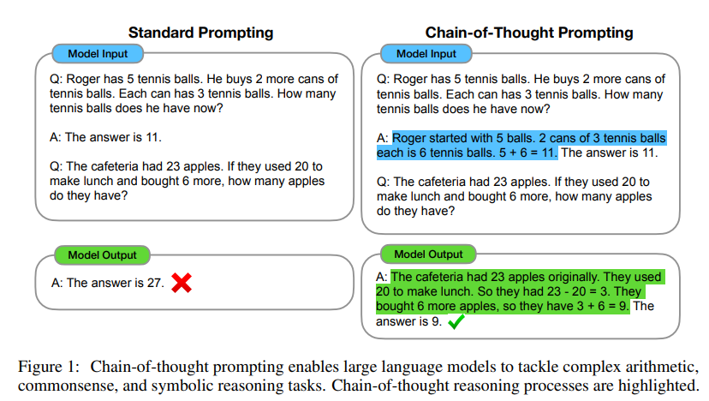
Overview
This presentation covers insights from the uploaded document.

Slide 3
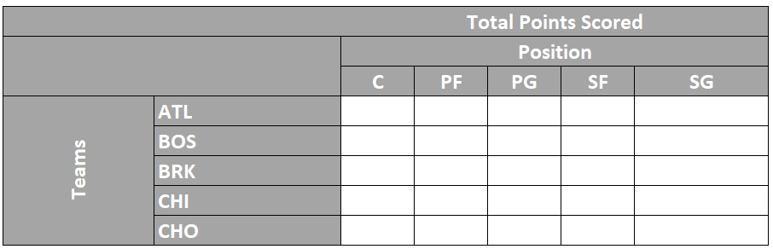
Key Takeaways
1. Point one
2. Point two
3. Point three

Slide 4
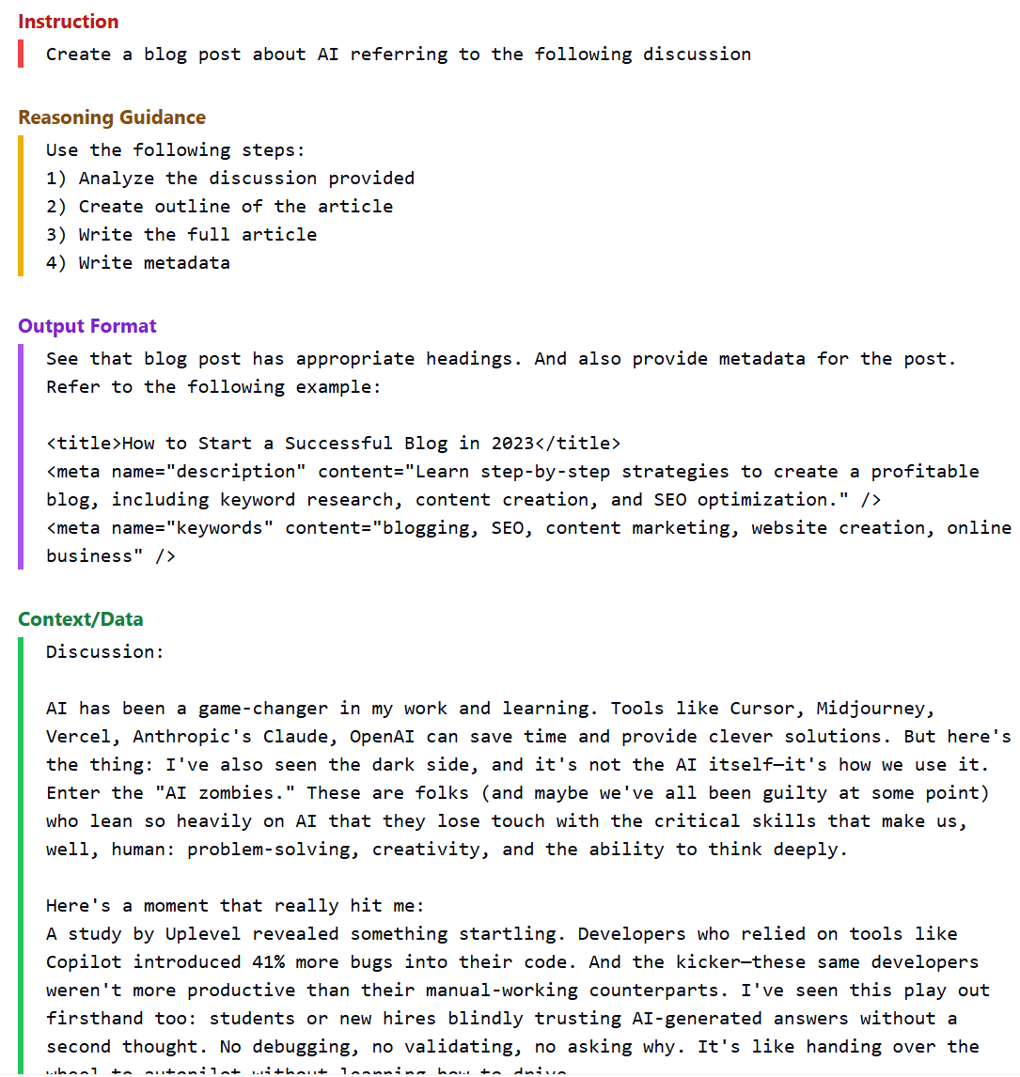
Conclusion
The document highlights several important trends...

Slide 5
Table 1
 | Alternative 1 - Yue Sai for Modern Young Women | Alternative 2 - Yue Sai For All
Target Audience | 18-35 affluent women | 18-59 women and men
Positioning | Luxury | - Yue Sai (YS) Select - luxury - Yue Sai (YS) Essentials - value
Messaging | - Downplay link with L’Oreal (distinctive colors and brand identity) - Combining benefits of TCM and modern science for the modern Chinese woman - Supermodels / famous actresses as brand ambassadors | Downplay link with L’Oreal across the board - YS Select - Luxury - Combining benefits of TCM and modern science, supermodels as ambassadors - YS Essentials - Value - Benefits of TCM for all, less famous models
Product Line(s) | Skincare Premium price points | Skincare and make-up Multiple price points
Channels | - E-commerce - Standalone stores in tier - 1 cities | - YS Select - E-commerce, standalone stores in tier - 1 cities - YS Essentials - class - 2 department stores, small local shops

Slide 6
Table 2
 | Alternative 1 - Target Modern Young Women | Alternative 2 - Yue Sai for All
Sales | High Potential of Sales and Profitability via premium skincare, aligned with modern lifestyle aspirations. | High Potential of Sales and Profitability as broad coverage across segments.
Product Market Fit | Excellent fit with modern, urban women seeking authenticity, TCM benefits, and digitally engaging luxury. | Moderate fit - covers more segments, but risks brand identity.
Strategic Fit | Strong fit - Reinforces L’Oreal’s luxury strategy with culturally rooted skincare innovation via TCM. | Fits L’Oreal’s inclusive “beauty for all” vision.
Attrition Risk | Moderate Risk - alienates older loyalists, highly competitive digital space with strong local rivals i.e., Herborist, Chando. | Low - appeals to a wider demographic; smoother retention path but risks dilution of brand prestige.
Execution | Moderate - Requires focused digital campaigns, TCM R&D and expansion in premium tiers. | Very High - managing multiple channels increases complexity and cost substantially.

