Slide 1
Airbnb: The First Five Years
By the Abhisheks

Slide 2

The Founding of Airbnb and Early Success
In May 2023, Brian Chesky reflects on Airbnb's journey and vision for the future.
Airbnb founders offered airbeds in their San Francisco apartment to fund rent in October 2007.
Addition of Nathan Blecharczyk as technical lead marked a significant milestone in February 2008.
Launch at the South by Southwest Festival in March 2008 garnered positive reviews.
Early success showcased a new way for hosts to earn money and guests to enjoy unique travel experiences.

Slide 3
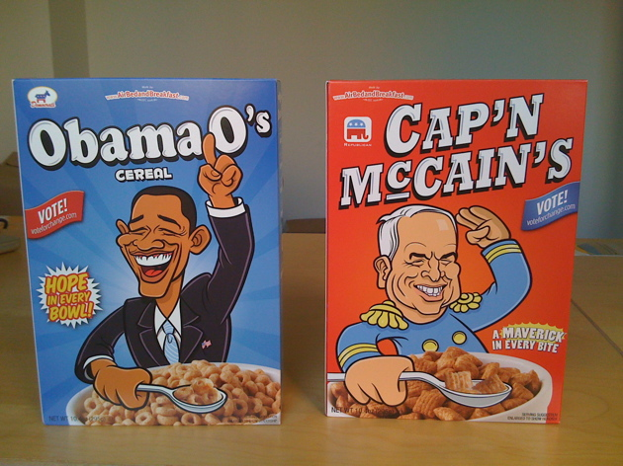
Airbnb's Innovative Fundraising Strategies
In 2008, Airbnb founders designed and sold Obama O's and Cap'n McCain's cereal boxes to generate revenue.
Securing funding was challenging due to investor skepticism and lack of tech expertise.
Pivotal decision to give the startup three more months with full dedication led to growth.
In January 2009, Airbnb saw growth with 1,000 listings and 150 bookings.
Strategic focus on the NYC market and addressing hosts' challenges with property photos.

Slide 4

Sequoia Capital's Investment and User Experience Focus
In April 2009, Airbnb secured $600,000 seed funding led by Sequoia Capital.
Investment driven by recognition of Airbnb's disruptive business model and network effects.
Focus on enhancing user experience led to increased conversion rates and doubled revenues in NYC.
Introduction of a free professional photography service to enhance listing quality.
Emphasis on 'do things that don't scale' strategy for prioritizing quality over scalability.

Slide 5

Greylock Partners and Series A Funding
Airbnb secures a $7.2 million Series A funding round from Greylock Partners and Sequoia Capital.
Reid Hoffman's investment decision reflects mixed reactions within Greylock.
Announcement of a million cumulative bookings in February 2011.
Competitive landscape shifts with the launch of Wimdu in March 2011.
Chesky's reaction to competition and the need for differentiation in the market.

Slide 6
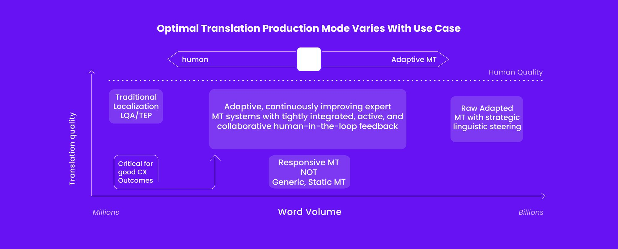
Critical Juncture and Strategic Decisions
Airbnb faces intense competition from Wimdu, prompting strategic reevaluation.
Decision-making process between acquiring Wimdu (Plan A) or pursuing an alternative (Plan B).
Opting for Plan B reflects commitment to core values and mission.
Significant funding round in May-June 2011 raises $115 million at a valuation of $1.3 billion.
Acquisition of Accoleo in Germany to establish a foothold in Europe and expand globally.

Slide 7
Service Evolution and Global Expansion
In July 2011, a host incident prompts TechCrunch report questioning Airbnb's reliability.
Launch of international professional photography service in October 2011.
Evolution from commission-based model to enhance property listings with high-quality photos.
Aggressive international expansion with offices in multiple countries and multilingual support.
Three-quarters of reservations being international, indicating Airbnb's global reach.

Slide 8

Business Growth and Market Differentiation
Airbnb operated on a commission-based model, offering unique travel experiences at affordable rates.
Preference over traditional hotels driven by cost-effectiveness and diverse accommodation options.
Focus on community, product quality, and mission-driven ethos sets Airbnb apart.
Global expansion includes establishing offices in various countries and supporting multiple currencies.
Strategic move towards enhancing visual appeal of listings to attract more bookings.

