Slide 1

Targeting Modern, Health-Conscious Young Women in China
• Developing products tailored to health and wellness trends
• Utilizing digital marketing channels to reach the target demographic
• Emphasizing natural ingredients and sustainability in product offerings

Slide 2
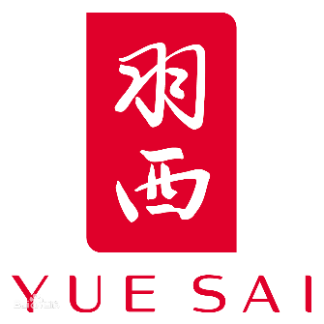
Yue Sai's Relevance Decline
• Multiple unsuccessful attempts to reposition the brand
• Failing to adapt to changing consumer preferences
• Losing market share to competitors with more innovative strategies

