Slide 1

Brief Assessment
• Yue Sai's repositioning efforts failed, leading to lost relevance.
• Intensifying competition from emerging local brands.
• Digital platforms provide superior customer engagement.

Slide 2
Decision Problem
• Capitalize on established heritage and reputation
• Implement cutting-edge marketing techniques
• Offer customized product solutions

Slide 3
Criteria
• Analyze projected sales data trends.
• Summarize key market research findings.
• Align strategies with customer preferences.

Slide 4
Strategic Fit
• Evaluate options through the lens of brand values
• Prioritize alternatives that align with our core principles
• Assess the strategic impact of each choice

Slide 5

Risk of Attrition
• Analyze customer retention metrics
• Study purchase behavior patterns
• Assess impact of demographic changes

Slide 6

Execution Complexity
• Evaluate cost implications
• Optimize resource distribution
• Address logistical hurdles

Slide 7
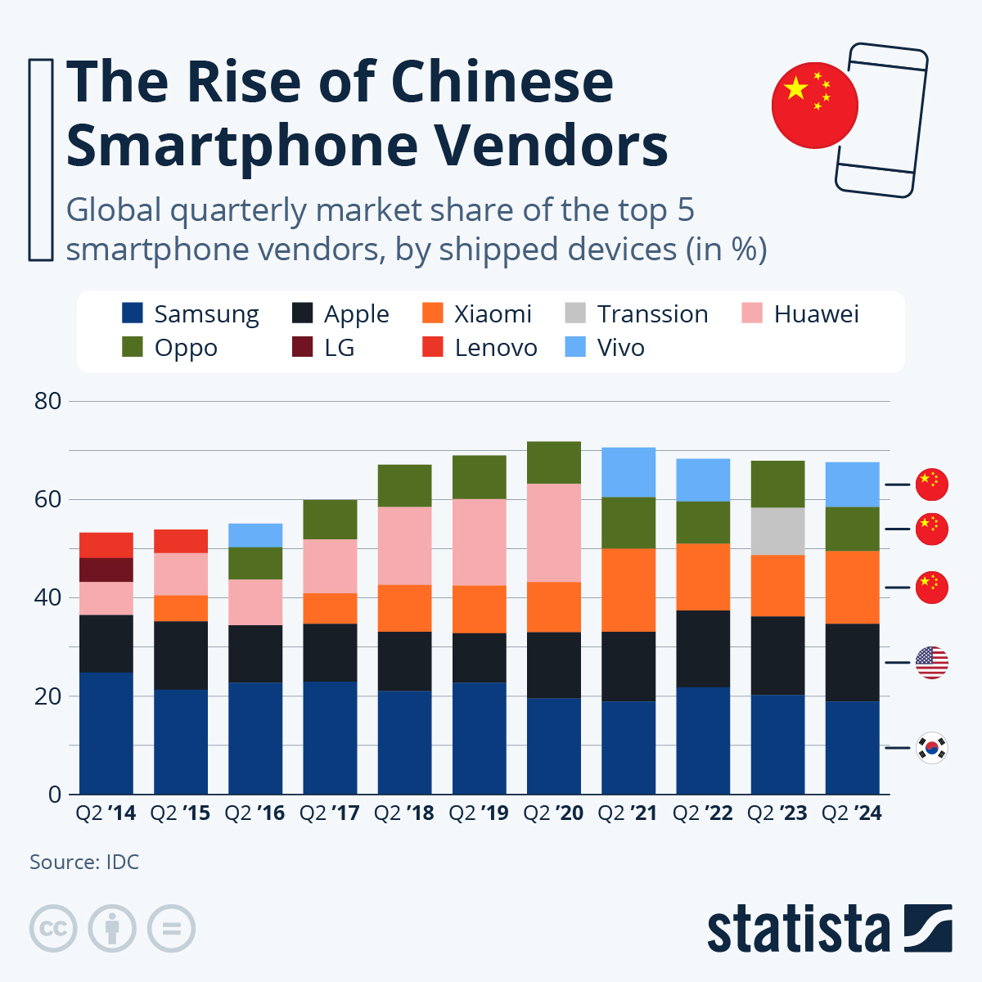
Moderate Risk
• Intense competition in the digital space
• Challenges from local competitors
• Risk of alienating older loyal customers

Slide 8
Attrition Risk
• Focus on strategies to boost employee retention.
• Address potential impacts on brand prestige.

Slide 9

Execution
• Launch targeted digital marketing campaigns.
• Invest in Traditional Chinese Medicine (TCM) research.
• Expand the premium product tier.

Slide 10

Very High
• Handling diverse communication channels
• Navigating increased operational complexity
• Managing rising costs of operations

Slide 11

Recommendation
• Revitalize brand with a focus on luxury appeal.
• Target health-conscious young female consumers.
• Differentiate from existing luxury brands.

