Slide 1

Brief Assessment
• Yue Sai struggled with brand repositioning.
• Local competitors are gaining market share.
• Digital platforms enhance customer engagement.

Slide 2

Decision Problem
• Utilize heritage and reputation for brand strength
• Implement innovative marketing strategies
• Offer products tailored to customer needs

Slide 3
Criteria
• Analyze projected sales data trends.
• Summarize key market research findings.
• Align strategies with customer preferences.

Slide 4
Strategic Fit
• Evaluate alternatives against brand values
• Prioritize options that align with strategic goals
• Assess potential impact on brand perception

Slide 5
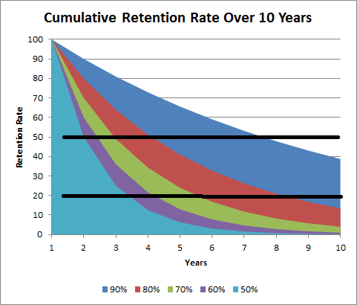
Risk of Attrition
• Analyze customer retention metrics
• Evaluate purchase behavior trends
• Assess impact of demographic changes

Slide 6

Execution Complexity
• Evaluate cost implications
• Optimize resource distribution
• Address logistical hurdles

Slide 7
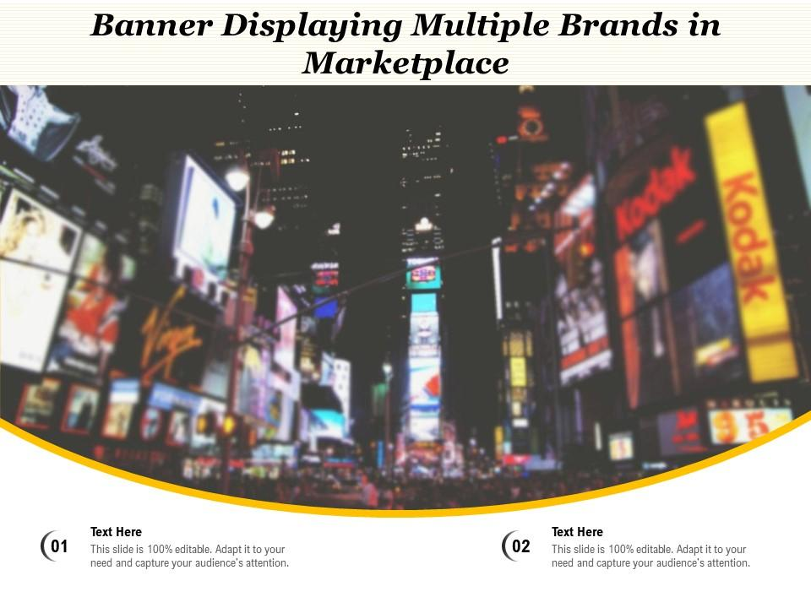
Moderate Risk
• Intense competition in the digital space
• Challenges from local competitors
• Risk of alienating older loyal customers

Slide 8

Attrition Risk
• Focus on strategies to boost employee retention.
• Address potential risks to brand reputation.
• Analyze factors contributing to attrition.

Slide 9
Execution
• Implement targeted digital marketing campaigns.
• Invest in Traditional Chinese Medicine (TCM) research.
• Expand the premium product tier.

Slide 10
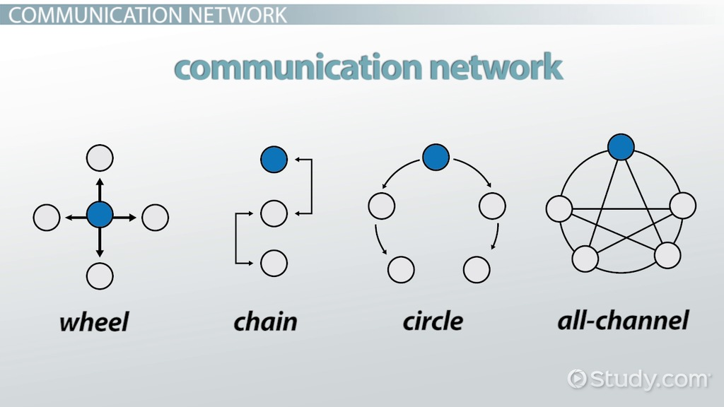
Very High
• Challenges of managing multiple communication channels
• Increased operational complexity
• Rising costs associated with channel management

Slide 11
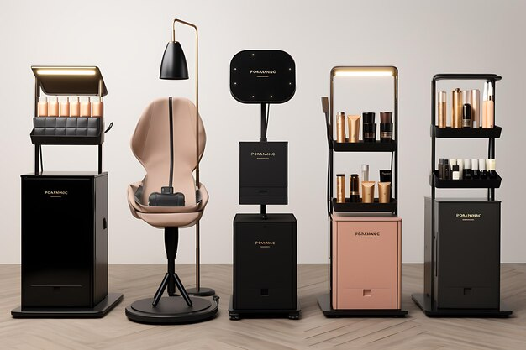
Recommendation
• Rebuild brand with a focus on luxury appeal
• Target health-conscious young women
• Differentiate from other luxury brands

