Slide 1
Scientific discovery
Aidyn Zhanbolat

Slide 2

Early Days of Airbnb: Revolutionizing Travel

Slide 3
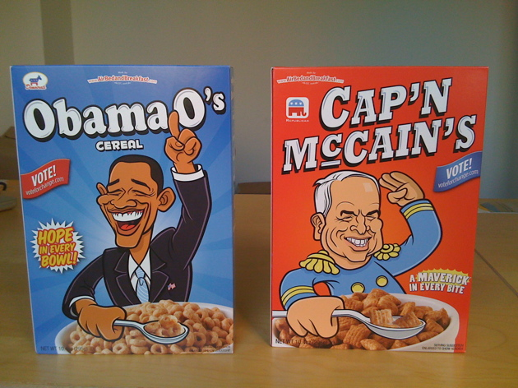
Financial Creativity and Growth Challenges
Designed and sold Obama O's and Cap'n McCain's cereal boxes in 2008
Struggles to secure funding due to skepticism and economic downturn
Renewed commitment after contemplating quitting in 2008

Slide 4

Ramen Profitability and Market Strategy

Slide 5

Innovative User Experience Strategies
Capturing high-quality photos to drive conversion rates in NYC
Securing a seed round of $600,000 in April 2009
Focus on 'doing things that don't scale' to create the perfect user experience

Slide 6
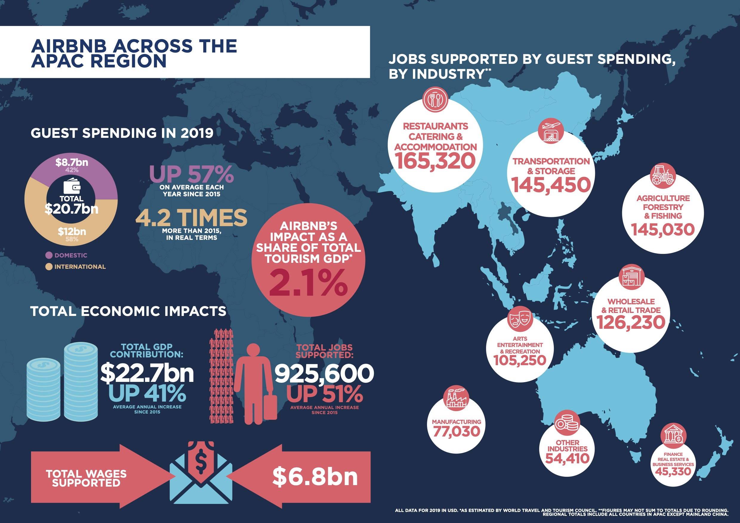
Strategic Funding and Competitive Dynamics

Slide 7
Global Expansion and Localization Strategy
Major funding round in May 2011 for international expansion
Establishing local offices and hiring local teams for diverse markets
Acquisition of Accoleo in Germany to solidify presence

Slide 8

Sustaining Growth and Strategic Vision
Emphasis on community-centric values and long-term sustainability
Navigating competitive landscape and strategic decision-making
Commitment to unique identity and mission-driven focus

