Slide 1
Scientific discovery
Aidyn Zhanbolat

Slide 2
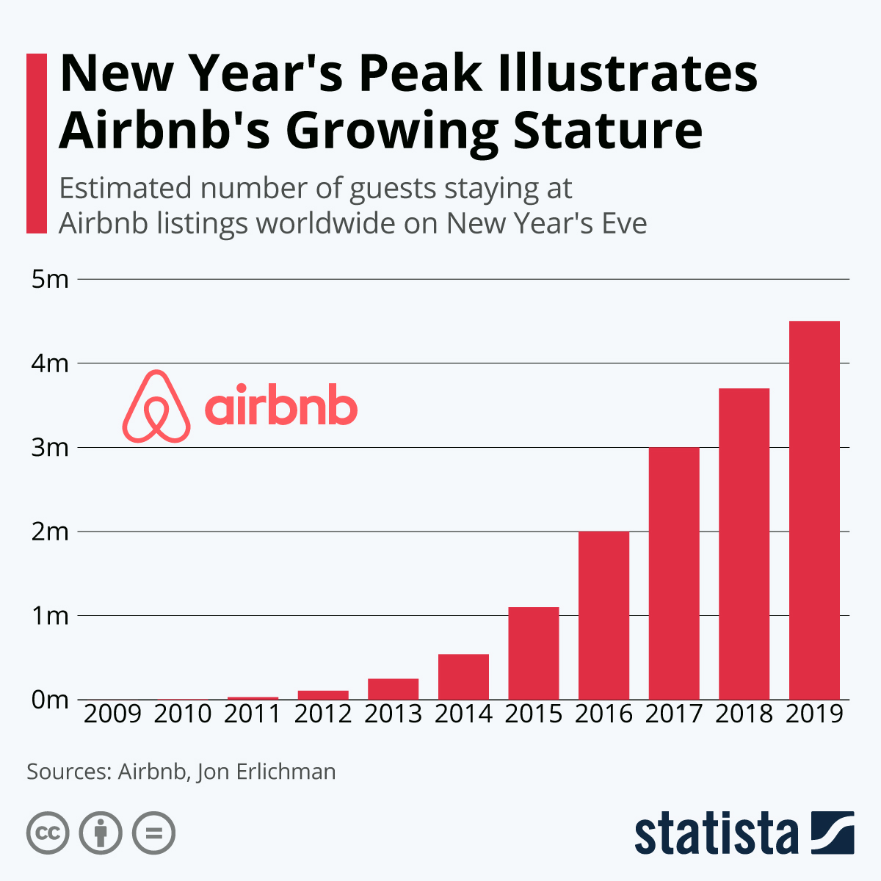
The Founding Vision
Brian Chesky reflects on Airbnb's journey emphasizing curiosity and self-challenge
Airbnb becomes the leading lodging marketplace with millions of hosts and listings worldwide
Profitable quarters despite Covid-19 challenges and successful IPO

Slide 3

Innovative Beginnings
Inflating airbeds in their apartment to fund rent led to Airbnb's inception
Unique experience at AirBed&Breakfast attracted guests during the Democratic National Convention
First three guests' experience transformed initial assumptions

Slide 4
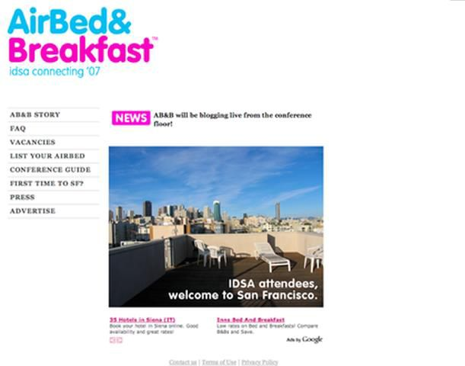
Financial Creativity
Generating revenue through cereal boxes during financial struggles
Initial challenges in securing funding due to skepticism
Commitment to growth leads to a pivotal moment in Airbnb's trajectory

Slide 5

Strategic Pivot
Focus on achieving 'ramen profitability' during Y-Combinator program
Enhancing property visuals in NYC to kickstart growth
Personalized approach leads to significant revenue growth

Slide 6

Investment Milestone
Securing $7.2 million Series A funding from Greylock Partners and Sequoia Capital
Facing competition from Wimdu and strategic decisions to maintain competitive edge
Balancing growth and mission-driven focus

Slide 7
Global Expansion
Significant funding round for international expansion and German market entry
Establishing local offices and hiring local teams for global success
Strategic decisions to retain identity amidst competition

Slide 8
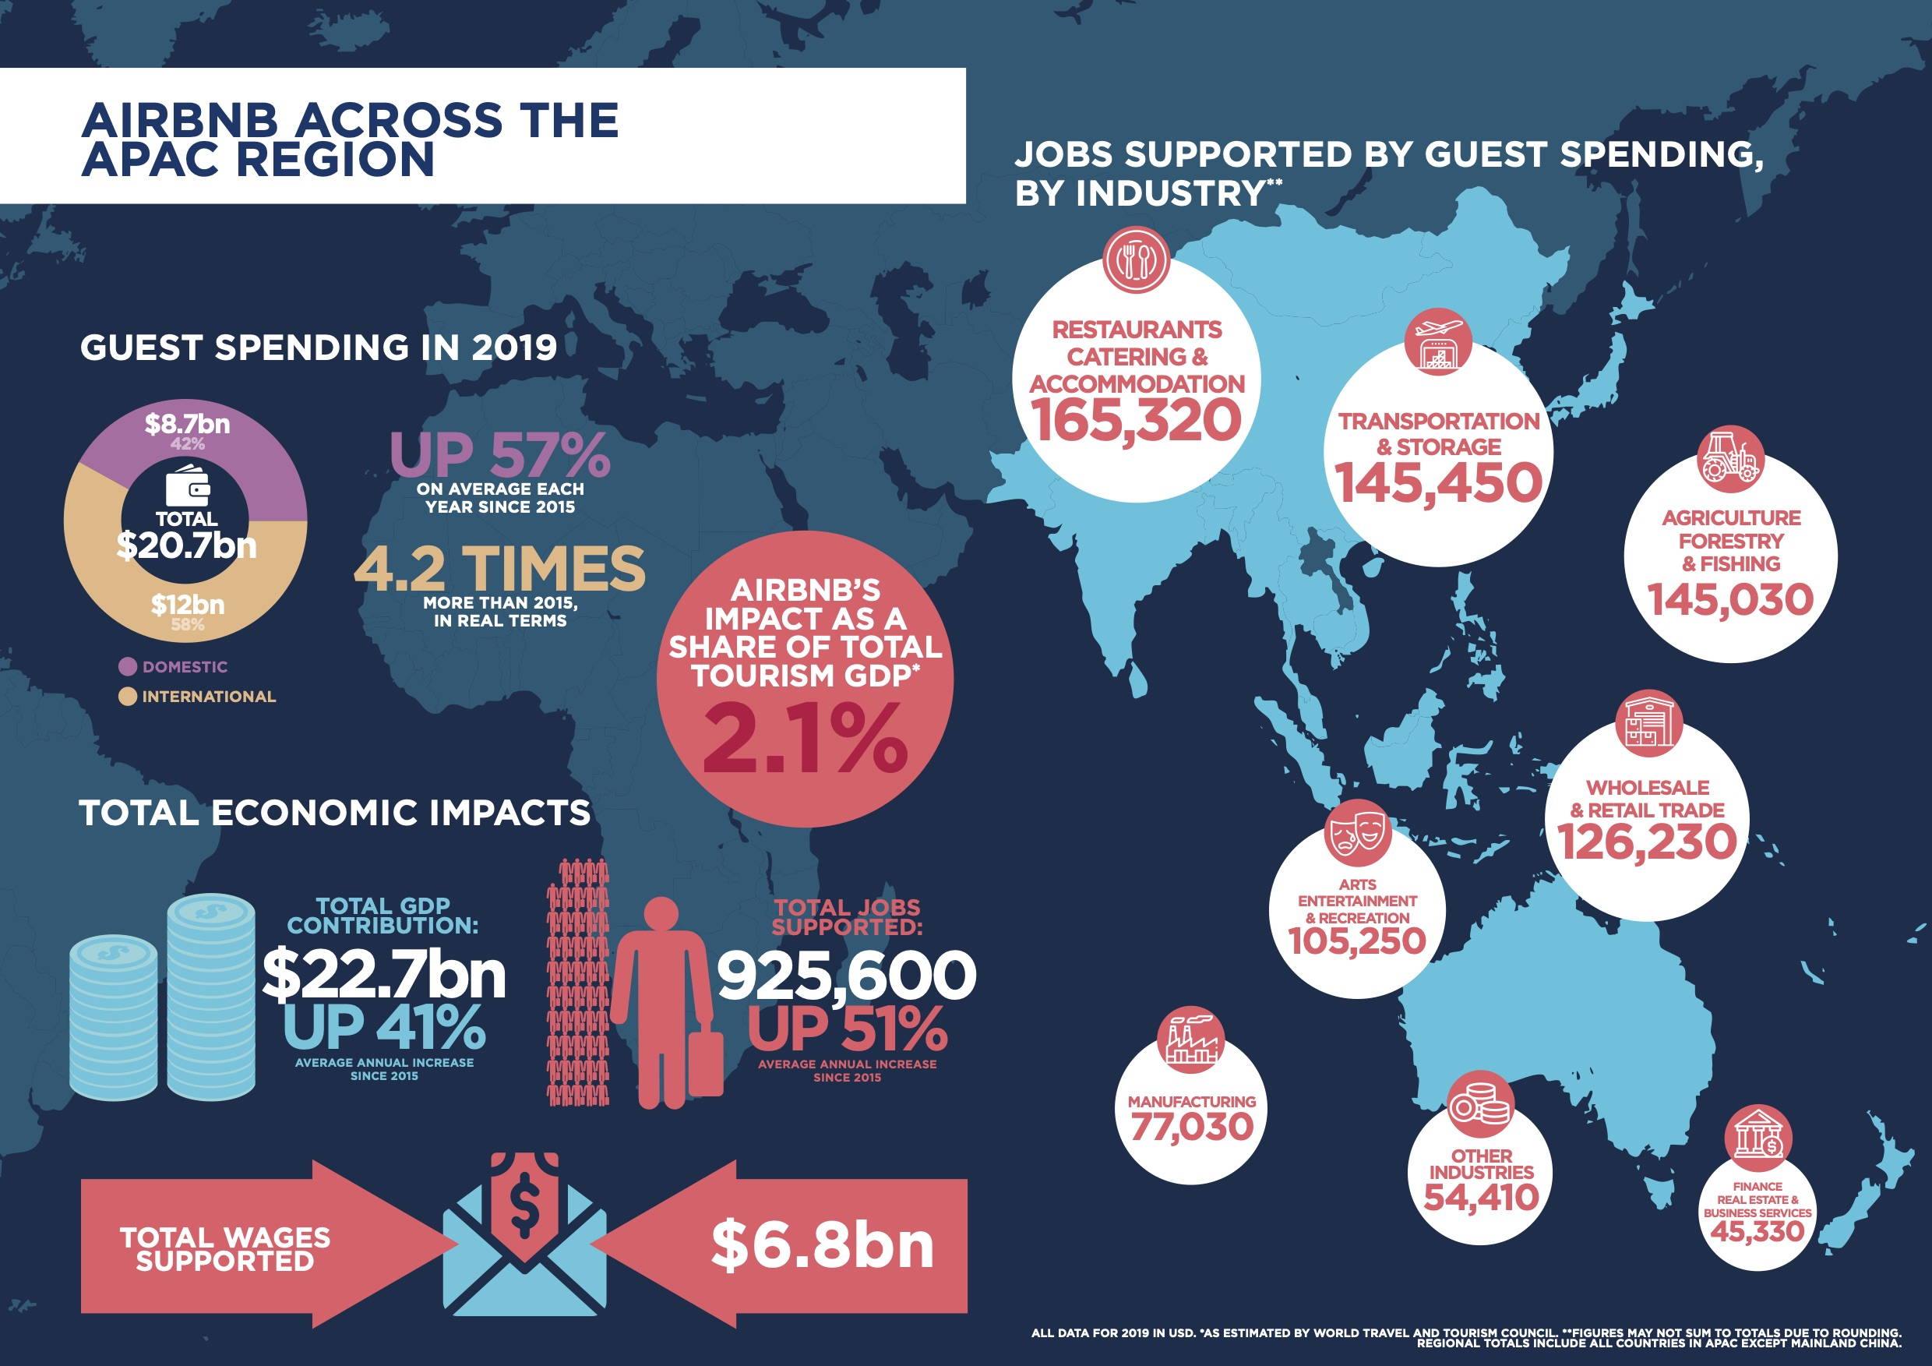
Sustaining Growth
Ongoing success post-funding round and strategic maneuvers
Navigating competitive landscape with a focus on long-term sustainability
Community-centric values driving strategic decisions

