Slide 1
Turning around Yue Sai - A Star Wars Story
By the Abhisheks

Slide 2

Brief Assessment
Yue Sai struggled with brand repositioning.
Local competitors are gaining market share.
Digital platforms enhance customer engagement.

Slide 3
Decision Problem
Utilize heritage and reputation for brand strength
Implement innovative marketing strategies
Offer products tailored to customer needs

Slide 4
Criteria
Analyze projected sales data trends.
Summarize key market research findings.
Align strategies with customer preferences.

Slide 5
Strategic Fit
Evaluate alternatives against brand values
Prioritize options that align with strategic goals
Assess potential impact on brand perception

Slide 6
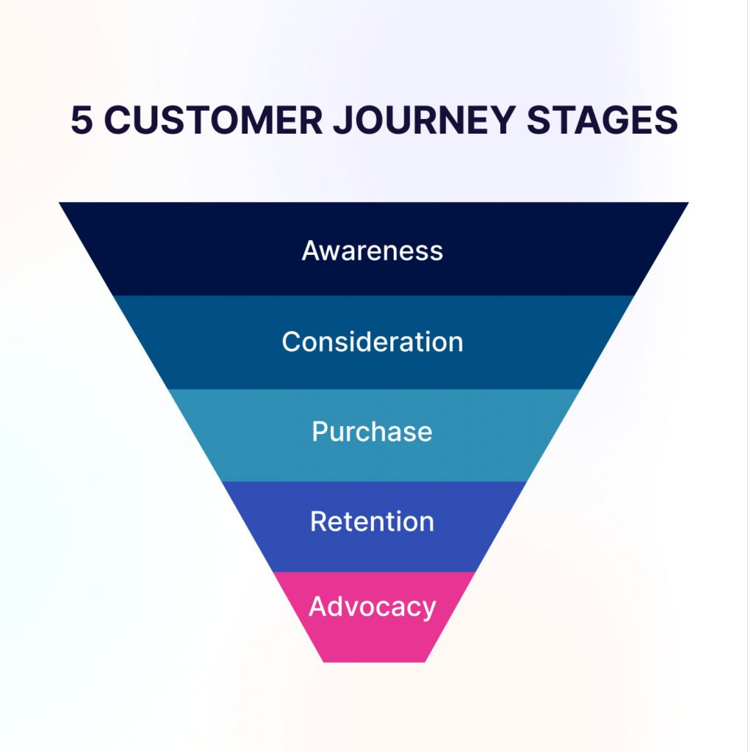
Risk of Attrition
Analyze customer retention metrics
Evaluate purchase behavior trends
Assess impact of demographic changes

Slide 7

Execution Complexity
Evaluate cost implications
Optimize resource distribution
Address logistical hurdles

Slide 8

Moderate Risk
Intense competition in the digital space
Challenges from local competitors
Risk of alienating older loyal customers

Slide 9
Attrition Risk
Focus on strategies to boost employee retention.
Address potential risks to brand reputation.
Analyze factors contributing to attrition.

Slide 10
Execution
Implement targeted digital marketing campaigns.
Invest in Traditional Chinese Medicine (TCM) research.
Expand the premium product tier.

Slide 11
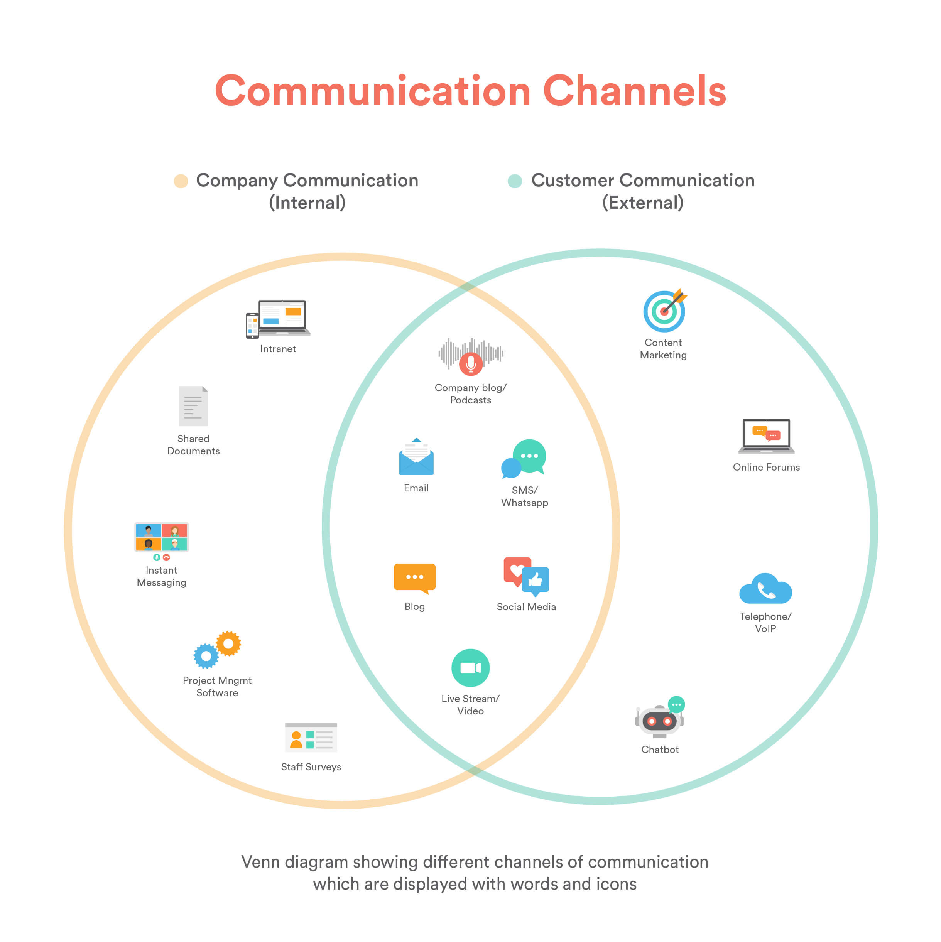
Very High
Challenges of managing multiple communication channels
Increased operational complexity
Rising costs associated with channel management

Slide 12

Recommendation
Rebuild brand with a focus on luxury appeal
Target health-conscious young women
Differentiate from other luxury brands

