Slide 1

Brief Assessment
• Yue Sai's brand struggled with relevance due to failed repositioning efforts.
• Local competitors are gaining strength in the market.
• Digital platforms provide superior engagement opportunities.

Slide 2
Decision Problem
• Capitalize on brand heritage and reputation
• Implement innovative marketing strategies
• Offer tailored products to meet customer needs

Slide 3

Criteria
• Analyze projected sales data trends.
• Summarize key market research findings.
• Align strategies with customer preferences.

Slide 4

Strategic Fit
• Evaluate options against core brand values
• Prioritize alternatives that align with brand identity
• Use a scoring system to assess strategic fit

Slide 5
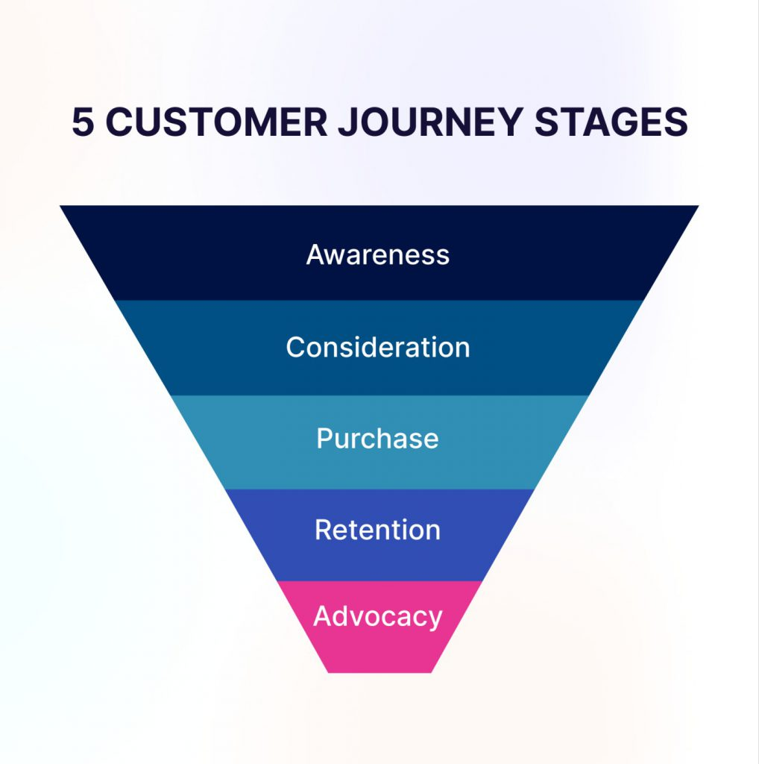
Risk of Attrition
• Evaluate customer retention metrics
• Analyze purchase behavior patterns
• Assess impact of demographic changes

Slide 6
Execution Complexity
• Evaluate cost implications
• Optimize resource distribution
• Address logistical hurdles

Slide 7

Moderate Risk
• Intense competition in the digital marketplace
• Impact of local competitors
• Risk of alienating older loyal customers

Slide 8
Attrition Risk
• Focus on strategies to boost employee retention.
• Address factors contributing to brand prestige dilution.

Slide 9
Execution
• Implement targeted digital marketing strategies
• Invest in Traditional Chinese Medicine (TCM) research
• Expand premium product tiers

Slide 10
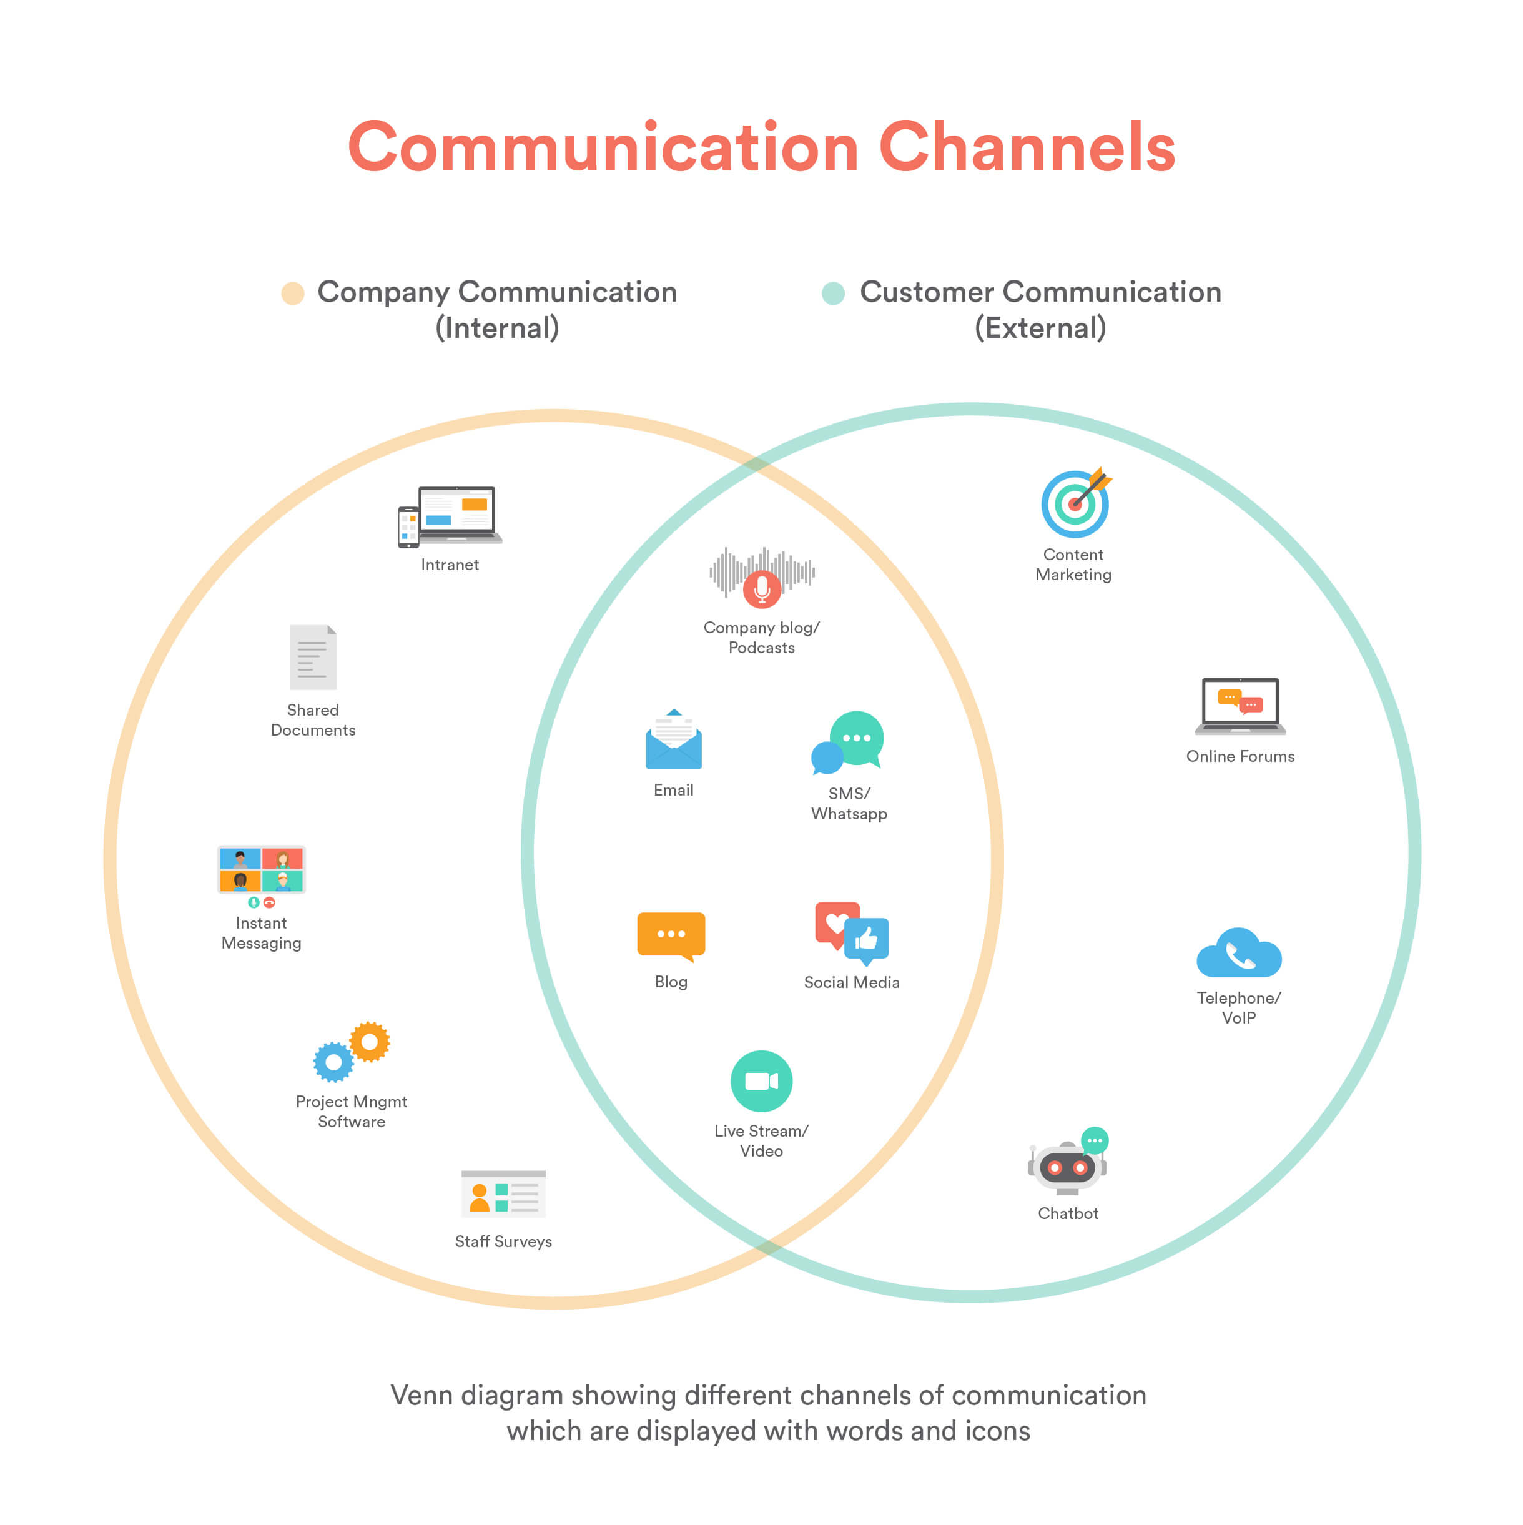
Very High
• Handling diverse communication channels
• Navigating increased operational complexity
• Managing rising operational costs

Slide 11
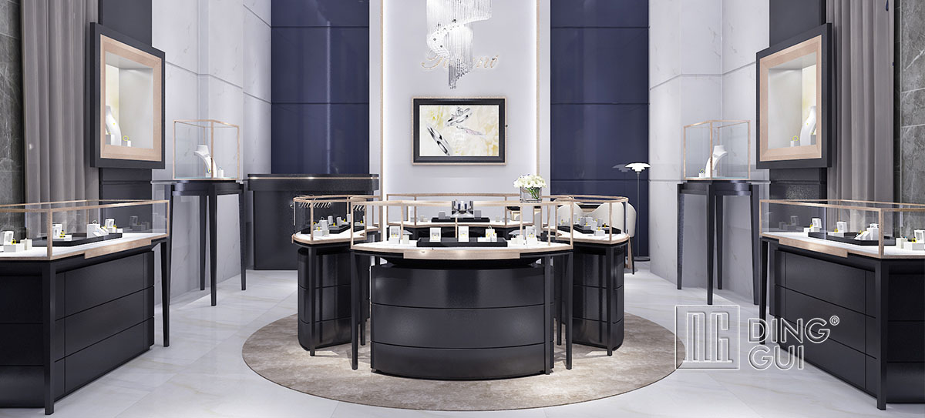
Recommendation
• Revitalize brand with a luxury focus
• Appeal to health-conscious young women
• Differentiate from existing luxury brands

