Slide 1

Brief Assessment
• Yue Sai's repositioning attempts led to lost relevance.
• Local competitors are gaining market share.
• Digital platforms enhance customer engagement.

Slide 2
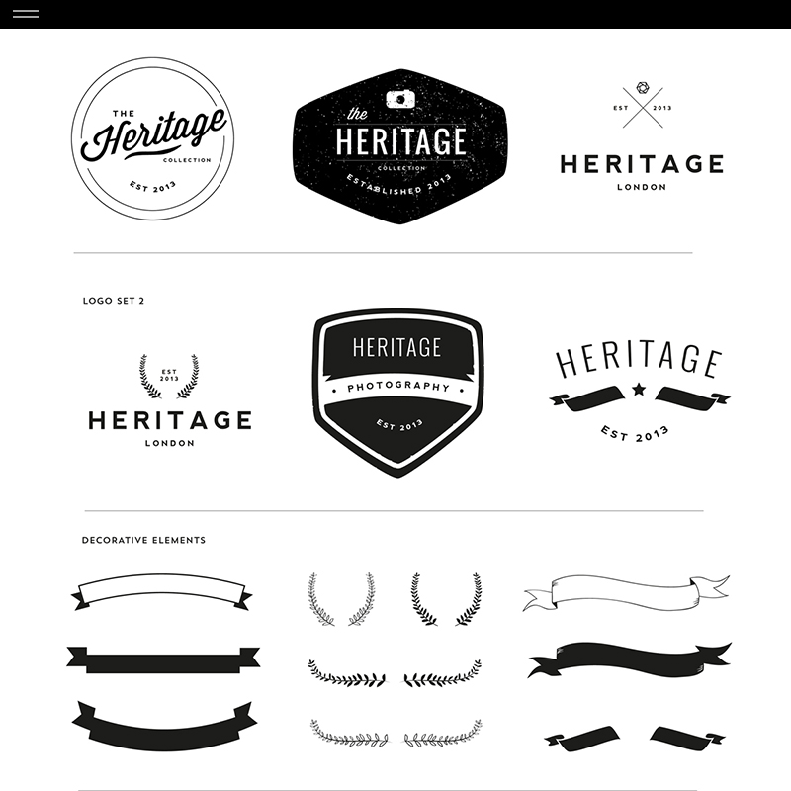
Decision Problem
• Capitalize on brand heritage and reputation
• Implement innovative marketing strategies
• Offer customized products to meet diverse needs

Slide 3
Criteria
• Analyze future sales trends.
• Summarize key market research findings.
• Align strategies with customer preferences.

Slide 4
Strategic Fit
• Evaluate options against core brand values
• Prioritize alternatives that align with brand identity
• Ensure consistency with brand mission and vision

Slide 5

Risk of Attrition
• Analyze customer retention metrics
• Evaluate purchase behavior patterns
• Assess impact of demographic changes

Slide 6

Execution Complexity
• Evaluate cost implications
• Optimize resource distribution
• Address logistical hurdles

Slide 7

Moderate Risk
• Intense competition in the digital space
• Challenges from local competitors
• Risk of alienating older loyal customers

Slide 8
Attrition Risk
• Focus on strategies to improve retention rates.
• Address potential brand prestige dilution.
• Evaluate factors contributing to attrition risk.

Slide 9
Execution
• Launch targeted digital campaigns
• Invest in TCM research
• Expand premium product tier

Slide 10
Very High
• Challenges in managing multiple communication channels
• Complexity increases with each added channel
• Rising costs associated with channel management

Slide 11
Recommendation
• Revitalize brand with a luxury focus
• Appeal to health-conscious young women
• Differentiate from other luxury brands

