Slide 1

Brief Assessment
• Yue Sai struggled with brand repositioning.
• Local competitors are gaining market share.
• Digital platforms enhance customer engagement.

Slide 2

Decision Problem
• Capitalize on heritage and reputation
• Implement innovative marketing strategies
• Offer customized products to meet consumer needs

Slide 3

Criteria
• Analyze projected sales data trends.
• Summarize key market research findings.
• Align strategies with customer preferences.

Slide 4
Strategic Fit
• Evaluate alternatives for alignment with brand values
• Prioritize options based on strategic importance
• Assess potential impact on brand reputation

Slide 5
Risk of Attrition
• Evaluate customer retention rates.
• Analyze purchase behavior trends.
• Assess impact of demographic shifts.

Slide 6
Execution Complexity
• Evaluate cost implications for execution
• Strategize effective resource allocation
• Address logistical challenges proactively

Slide 7
Moderate Risk
• Intense competition in the digital space
• Impact of local competitors
• Risk of alienating older loyal customers

Slide 8

Attrition Risk
• Focus on strategies to boost employee retention.
• Address potential risks to brand reputation.
• Evaluate the impact of attrition on company culture.

Slide 9

Execution
• Launch targeted digital marketing campaigns
• Invest in Traditional Chinese Medicine (TCM) research
• Expand premium product tiers

Slide 10
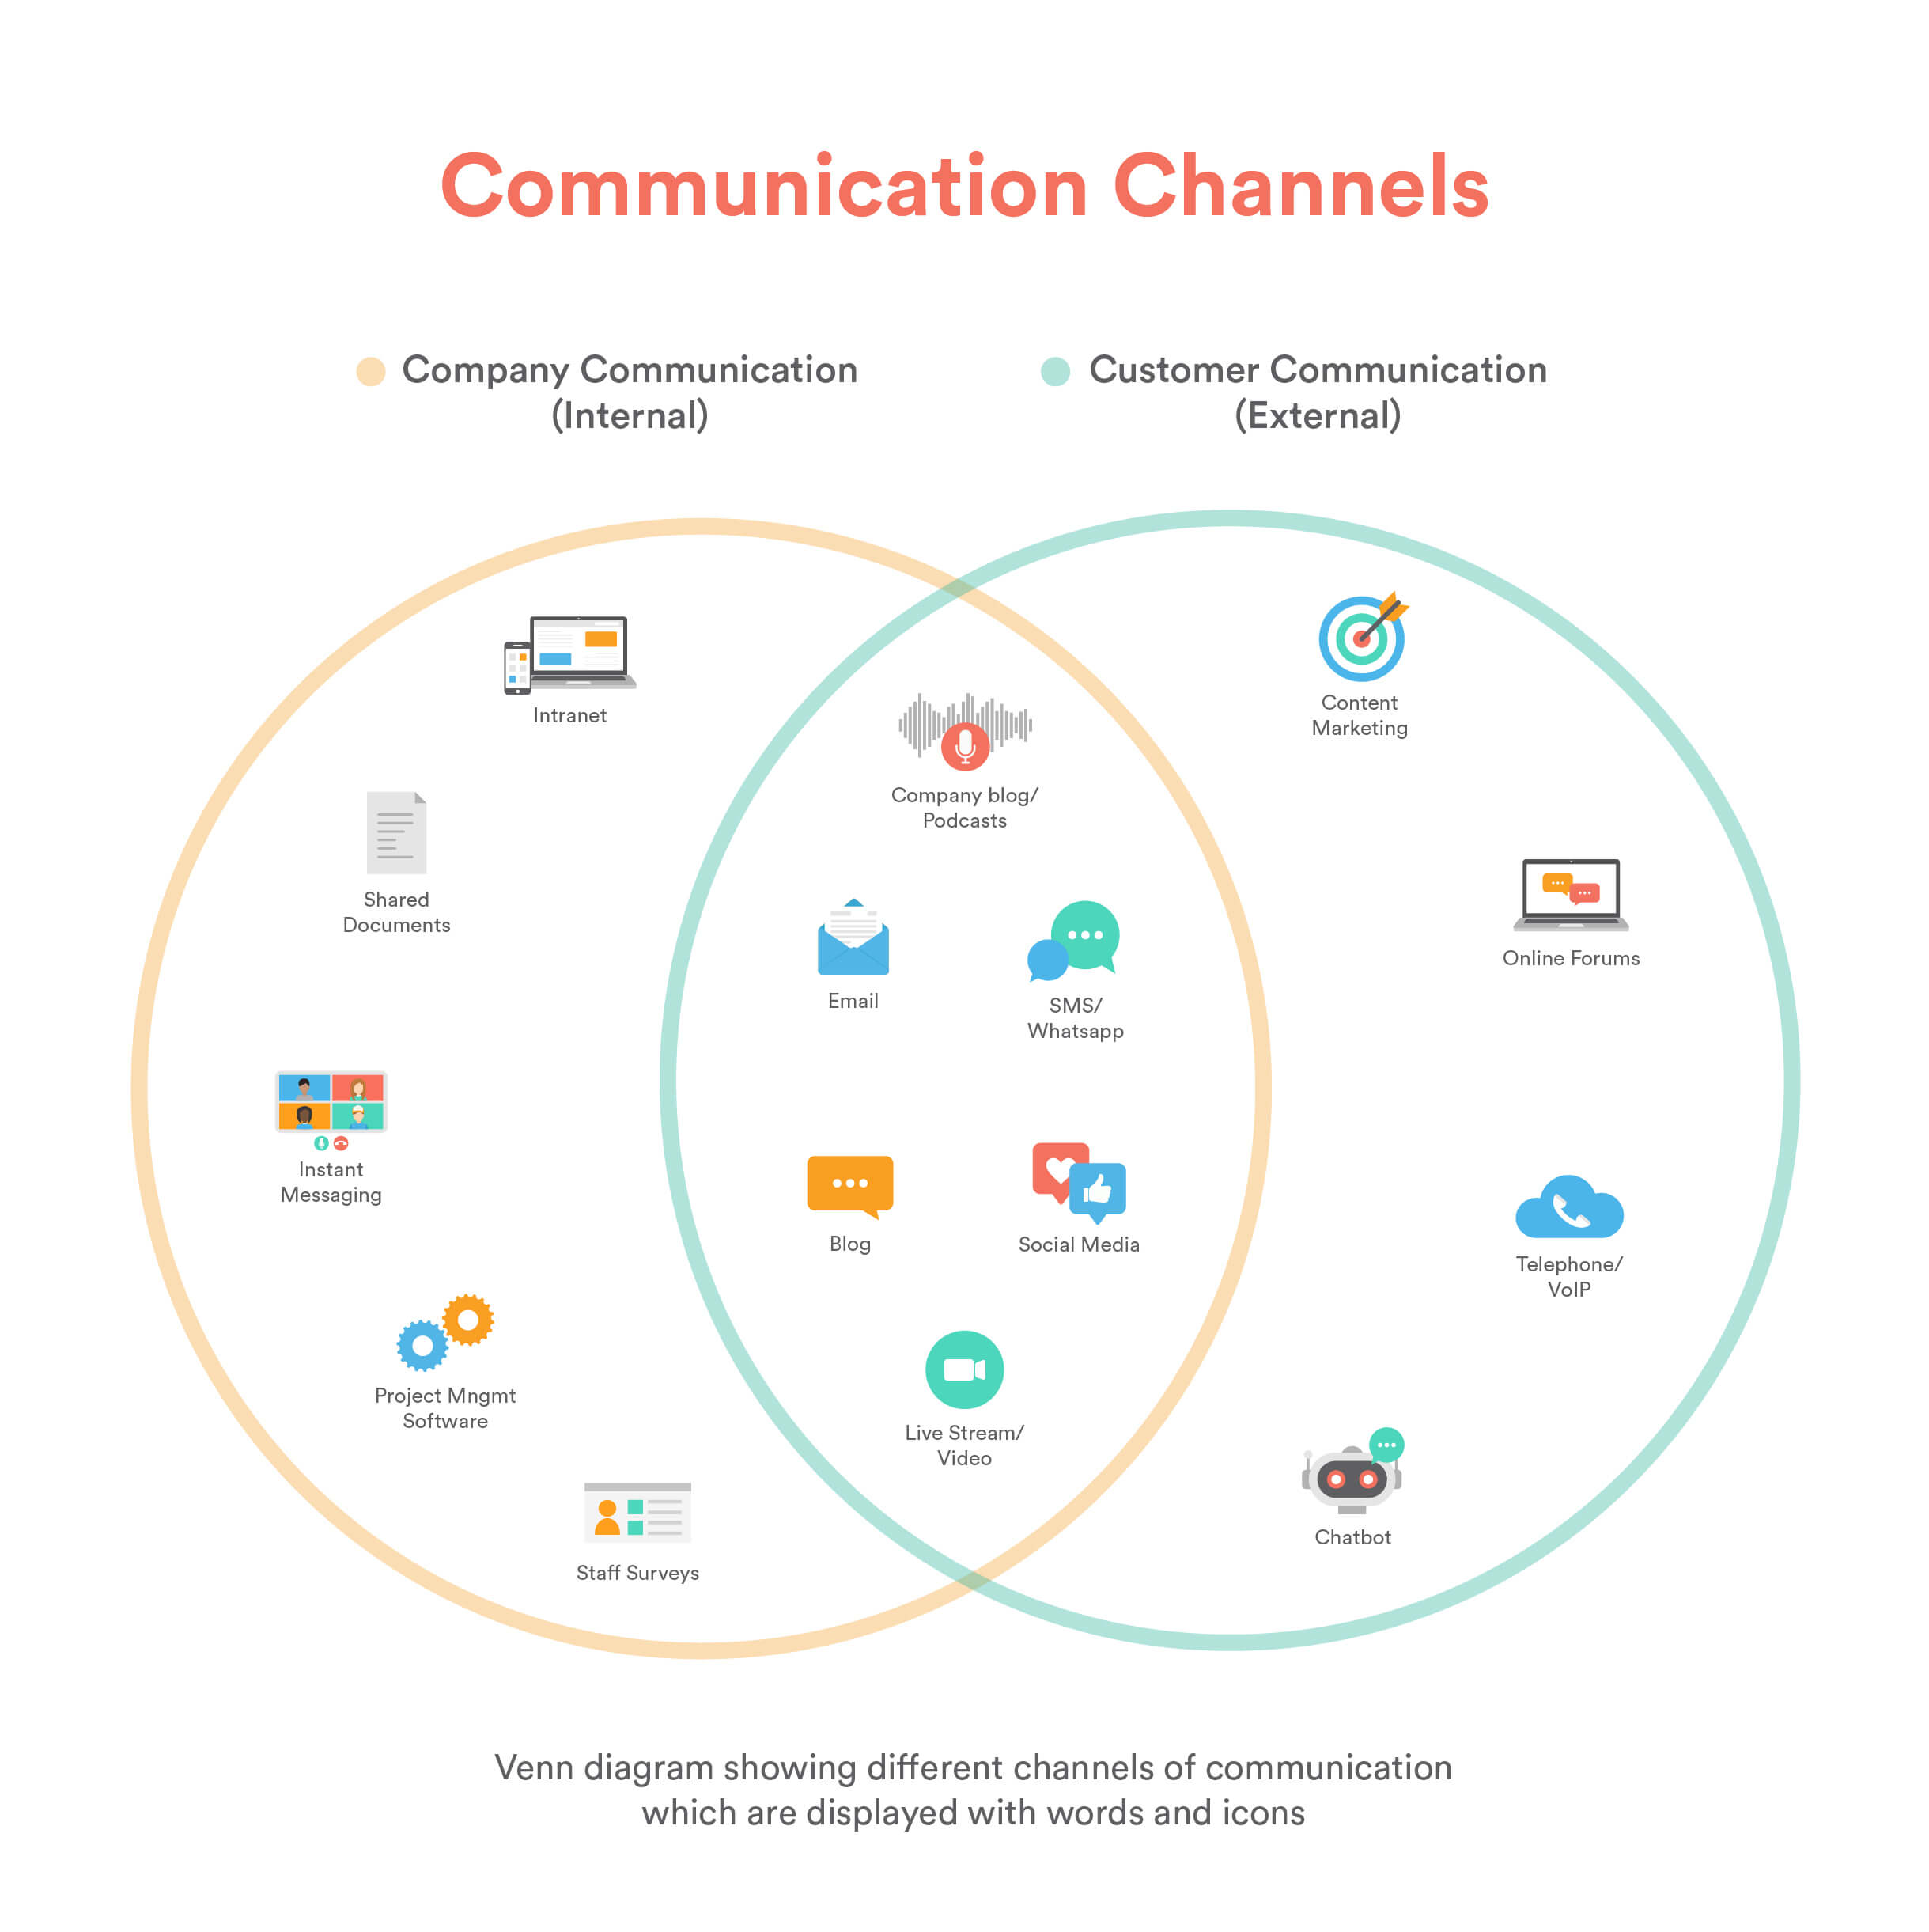
Very High
• Challenges in managing multiple communication channels
• Increased operational complexity
• Rising costs associated with channel management

Slide 11
Recommendation
• Rebuild brand with a focus on luxury appeal
• Target health-conscious young women
• Differentiate from other luxury brands

