Slide 1
The story OF AIRBNB
Generated by the slide whisperer

Slide 2

Early Days of Airbnb: Revolutionizing Travel
Founded in 2007 by Brian Chesky, Joe Gebbia, and Nathan Blecharczyk
Launch of AirBed&Breakfast in August 2008 at the Democratic National Convention
Unique experience of staying with locals and lower prices compared to hotels

Slide 3
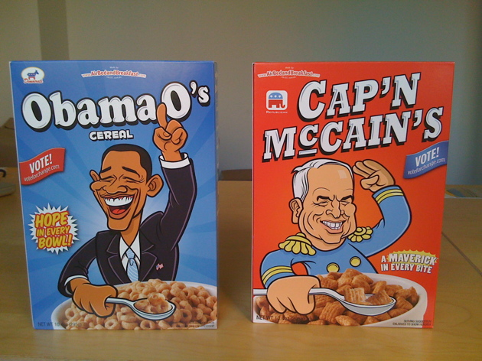
Financial Creativity and Growth Challenges
Designed and sold Obama O's and Cap'n McCain's cereal boxes in 2008
Struggles to secure funding due to skepticism and economic downturn
Renewed commitment after contemplating quitting in 2008

Slide 4

Ramen Profitability and Market Strategy
'Ramen profitability' goal in Y-Combinator program
Focus on New York City market for growth
Improving property visuals to enhance user experience

Slide 5

Innovative User Experience Strategies
Capturing high-quality photos to drive conversion rates in NYC
Securing a seed round of $600,000 in April 2009
Focus on 'doing things that don't scale' to create the perfect user experience

Slide 6
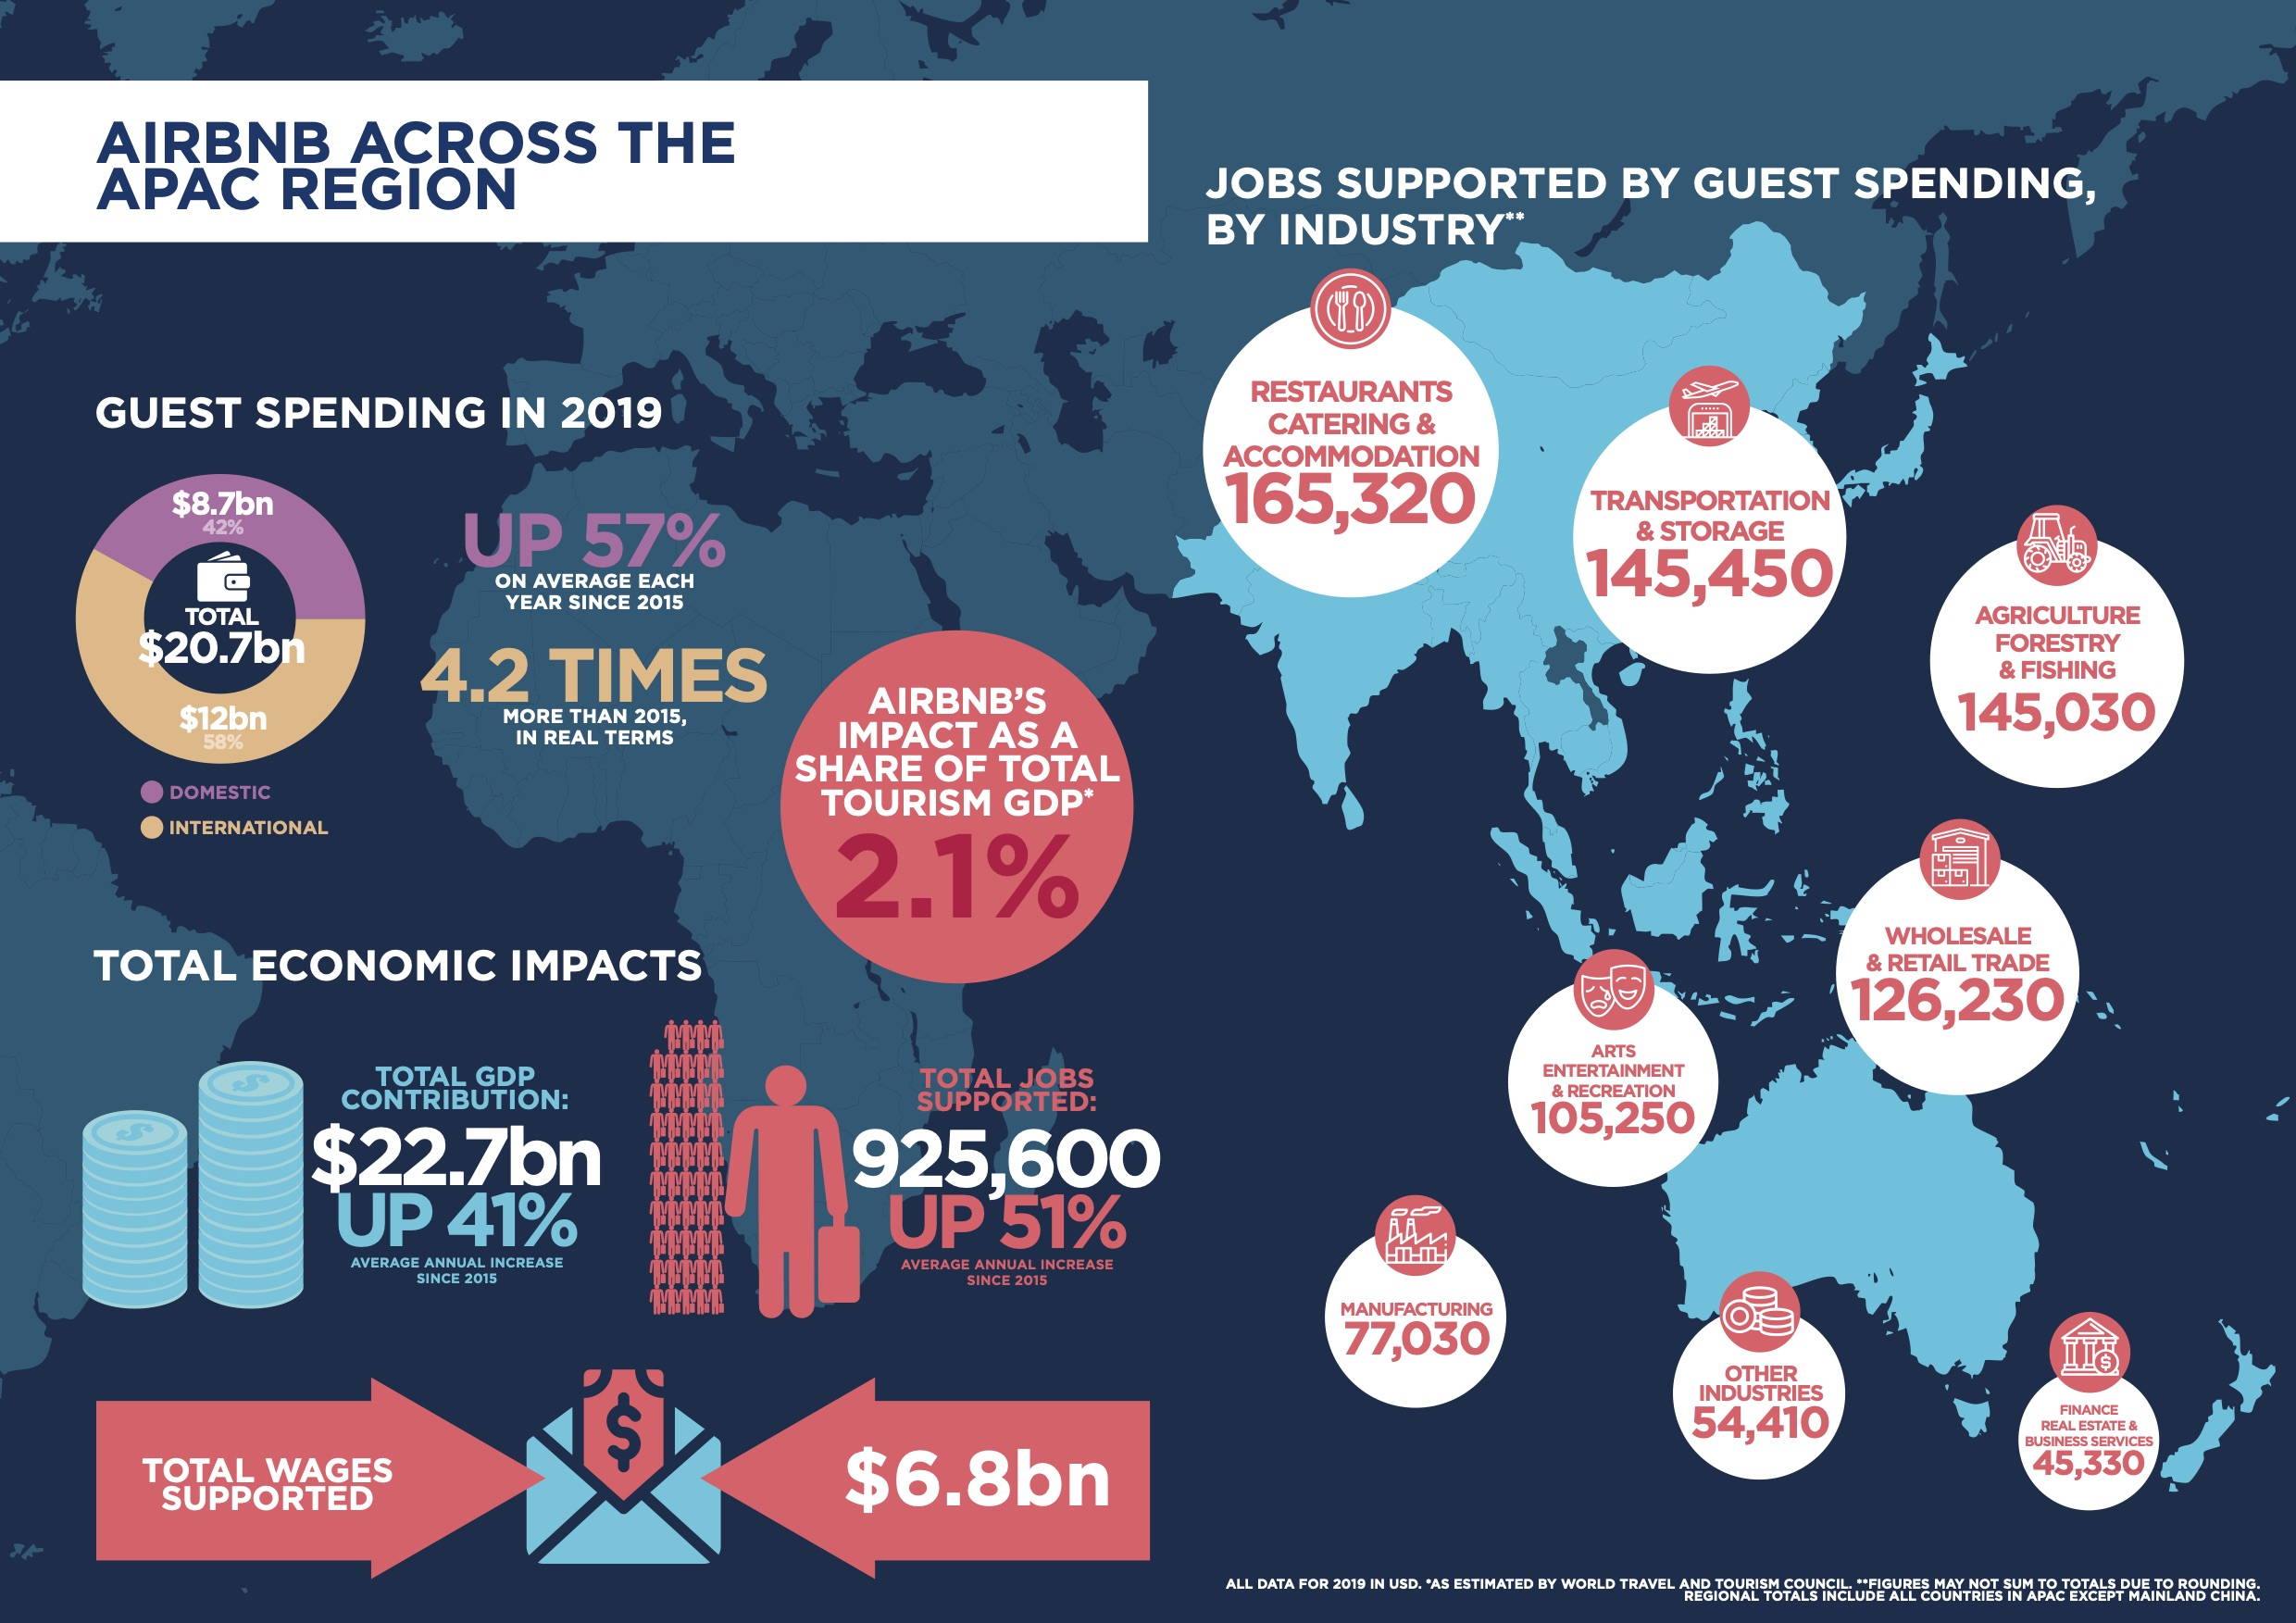
Strategic Funding and Competitive Dynamics
Securing $7.2 million Series A funding in a crucial growth stage
Challenges from competitors like Wimdu and strategic decisions
Focus on long-term sustainability and mission-driven approach

Slide 7
Global Expansion and Localization Strategy
Major funding round in May 2011 for international expansion
Establishing local offices and hiring local teams for diverse markets
Acquisition of Accoleo in Germany to solidify presence

Slide 8

Sustaining Growth and Strategic Vision
Emphasis on community-centric values and long-term sustainability
Navigating competitive landscape and strategic decision-making
Commitment to unique identity and mission-driven focus

