Slide 1
G-Shock GPR-B1000-1 Rangeman
By: Abhishek b.

Slide 2
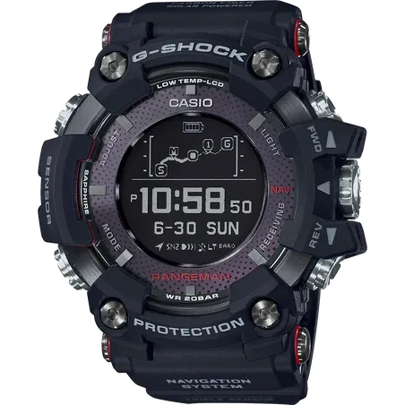
The Watch Itself

Slide 3
Features and Sensors
GPS Location, with a specific frequency of 1575.42 MHz
Standard Bluetooth Communication
Compass
Barometer
Thermometer
Altimeter

Slide 4
Other Notable Hardware Features
Water Resistant up to 300 meters
Auto-Time and Local Time Switching
Temperature Range of -20 ̊C to 60 ̊C
Can display a tide graph and moon data
Maximum Battery Life: 29 months
Battery Life at highest level of consumption: 20 hours

Slide 5
Interesting Facts
G-Shock has a Guinness World Record for heaviest vehicle to drive on top of a watch
Average Battery Life for G-Shocks is 10 years
Almost every G-Shock is subject to withstand US Military Requirements for toughness and durability
G-Shock makes watches that are certified for deep-sea diving (ISO Ratings)
Notes:
25-ton vehicle, 300 below surface of ocean

Slide 6


