Slide 1
Forecasting Hourly Power Consumption using XGBoost
--- Abhishek Bedarkar

Slide 2
Agenda
Introduction
XGBoost
Exploratory Data Analysis
Model Development & Evaluation
Forecasting & Analysis

Slide 3

Introduction
Predicting power consumption accurately is crucial for efficient energy management and grid stability.
By forecasting power consumption, companies can optimize generation, distribution, and pricing strategies, leading to cost savings and reduced environmental impact.
Reliable predictions also aid in infrastructure planning.

Slide 4
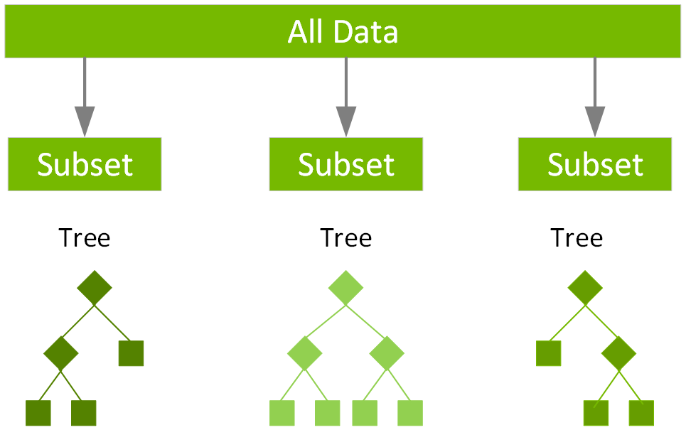
eXtreme Gradiant Boosting
XGBoost sequentially builds an ensemble of weak learners, correcting errors at each step to improve predictions.
Utilizing parallelization and optimization techniques to handle large datasets and complex models.
Regularization techniques like shrinkage and pruning prevent overfitting, ensuring robust performance.
Provides insights into feature importance.

Slide 5
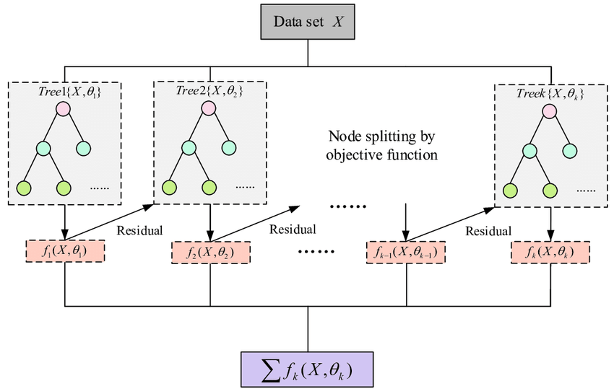
How XGBoost Works
Minimizes a loss function by iteratively fitting new trees to the negative gradient of the loss function.
Utilizes tree pruning and shrinkage to control model complexity and prevent overfitting.
Leverages parallelization to distribute computations across multiple cores or machines, speeding up training for large datasets.
Combines predictions from individual trees using weighted sums, where weights are determined based on their contribution to minimizing the objective function.

Slide 6
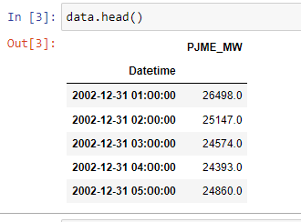
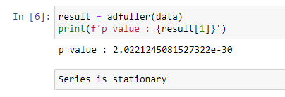
EDA
Sample :
ADF test:

Slide 7
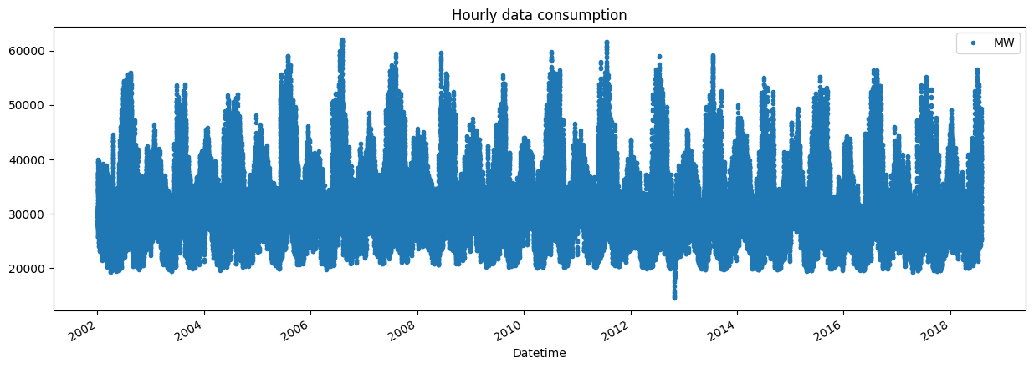
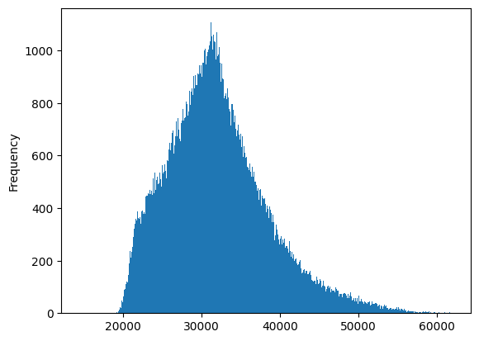
EDA
Hourly data consumption :
Histogram :

Slide 8
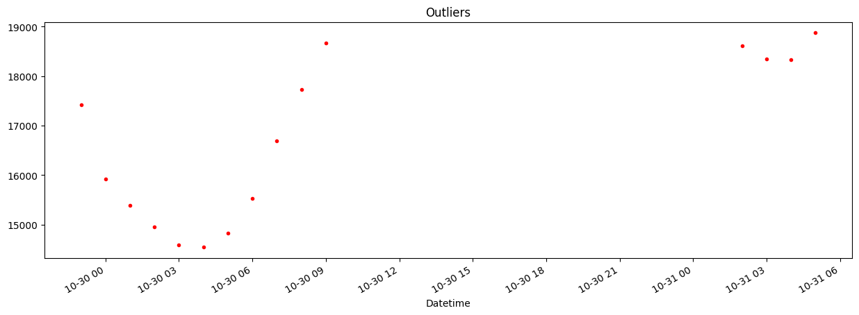
EDA
Outliers:

Slide 9
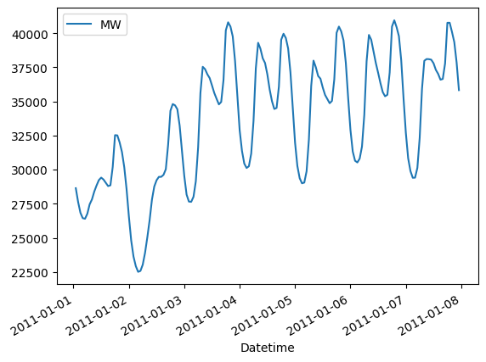
EDA
Weekly analysis:

Slide 10
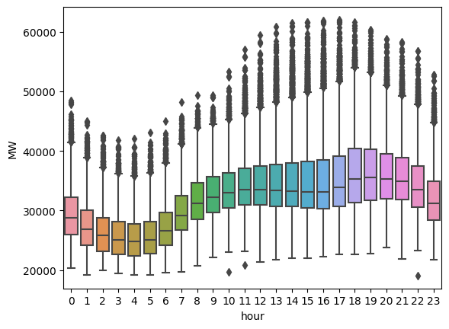
EDA
Daily analysis:

Slide 11
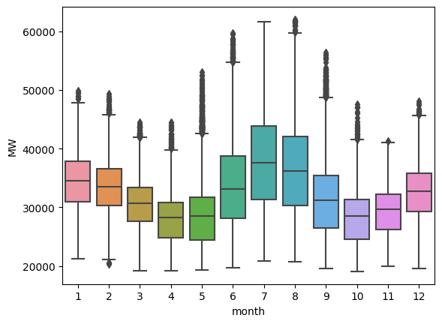
EDA
Monthly analysis:

Slide 12
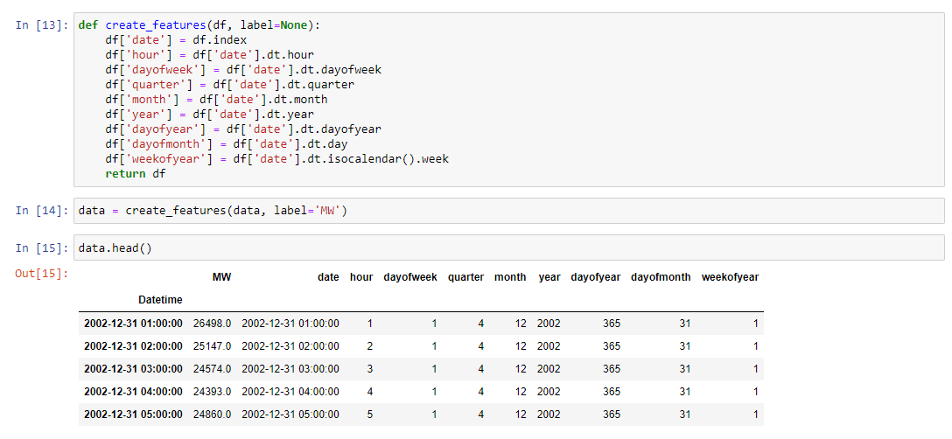
Feature Engineering

Slide 13
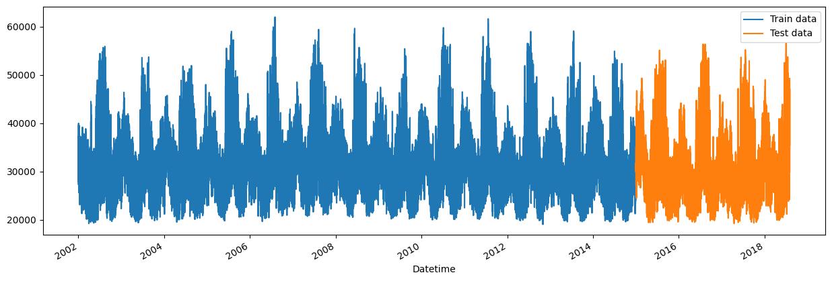
Train test split

Slide 14
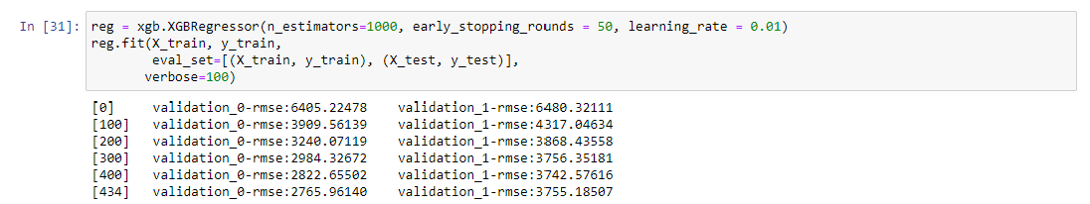
XGBoost Implementation
n_estimators: specifies that the model will create 1000 decision trees during training
early_stopping_rounds: means that if the performance doesn't improve after 50 rounds, training will stop.
Learning_rate: the learning rate controls the step size at each iteration during gradient descent

Slide 15
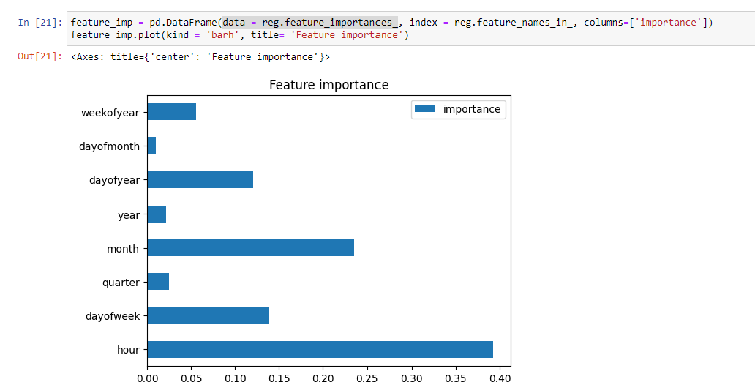
Feature Importance

Slide 16
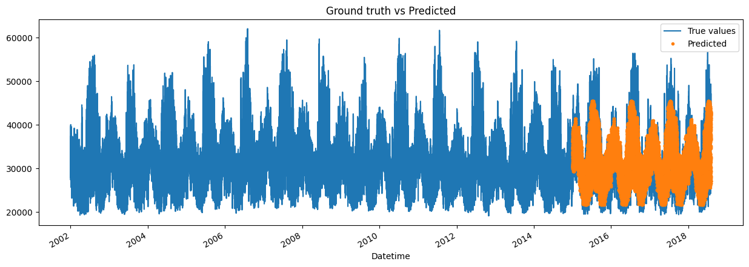
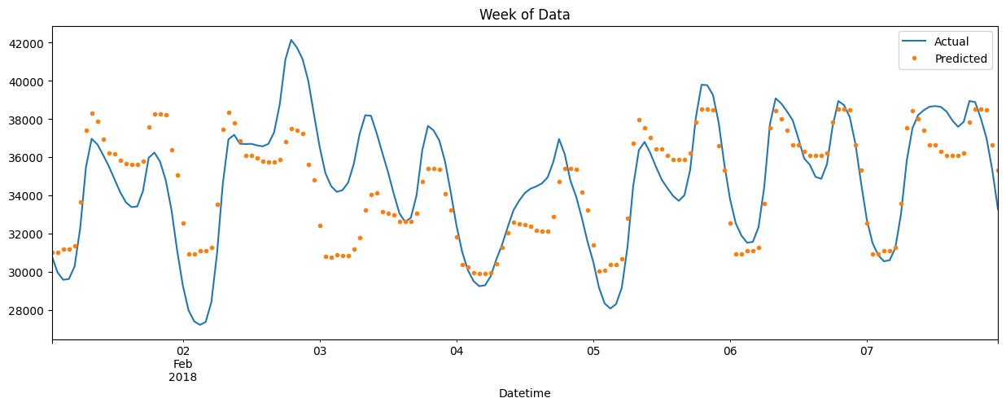
Predictions
Mean Absolute Error: 2895.85
Root Mean Squared Error: 3737.83

Slide 17
Thank you

