Slide 1
Arrays
by:-Mr. Chirag Joshi Assistant Professor,CSE
chirag.joshi@dituniversity.edu.in DIT UNIVERSITY DEHRADUN

Slide 2
Declaration of Array in C#
Arrays in C# is declared as follows:-
type [] arrayname;
Example:-
int [] A;//declare int array reference
float [] b;//declare float array reference
int [] x,y ;//declare two int array reference
Note:- We do not enter size of Array in Declaration

Slide 3
Creation of Array in C#
C# allows us to create arrays using new operator only, as shown below:-
arrayname = new type[size] ;
Example :-
number=new int [6];/create a 6 element int array
average=new float [5]; // create a 5 element float array
It is also possible to combine the two steps, declaration and creation, into one as shown below:-
int [ ] number= new int [ 5]; //declare and create 5 element int array.

Slide 4
Initialization of Arrays
arrayname[subscript]=value;
Example :-
number[0]=89;
number[1]=34;
.
.
.
number[n]=67;
int [ ] number= {6,7,8};

Slide 5
Two Dimensional Array
For , creating two dimensional arrays, we must follow the same steps as that of simple arrays.
Creating two – dimensional array:-
int [,] TDArray;
TDArray=new int [4,5];
OR
int[,] TDArray=new int [4,5];
Two-Dimensional Array can be initialized as:-
int[,] x= {{0,0,0},{1,1,1}};
OR
int[,] x= {{0,0,0},
{1,1,1}};

Slide 6
Two Dimensional Array(Example)
using System;
class tdarray
{
static int ROWS=20;
static int COLUMNS= 20;
public static void Main()
{
int [,]product=new int[ROWS,COLUMNS];
Console.WriteLine("Multiplication Table");
Console.WriteLine(" ");
int i,j;
for(i=10;i<ROWS;i++)
{
for(j=10;j<COLUMNS;j++)
{
product[i,j]=i*j;
Console.Write(" " +product[i,j]);
}
Console.Write(" ");
}
}
}

Slide 7
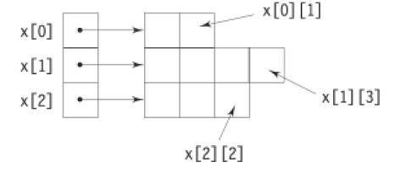
Variable Size Arrays
C# treats multidimensional arrays as ‘arrays of arrays’. It is possible to declare two-dimensional array as follows:-
int[][] x= new int [3][];//three rows arrays
x[0]= new int[2];// first row has two elements
x[1]=new int[4];//second row has four elements
x[2]=new int[3]; //third row has three elements
These statements create a two-dimensional array having different lengths for each rows :-

Slide 8
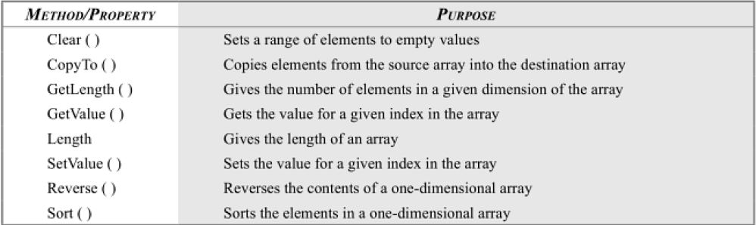
The System.Array Class
Use Copy() instead of CopyTo()

Slide 9
ArrayList Class
System.Collections namespaces defines a class known as Array List that can store a dynamically sized array of objects.
The ArrayList class includes a number of methods to support operations such as sorting, removing and enumerating its contents.
It also supports a property Count that gives the number of objects in an array list and a property Capacity to modify or read the capacity.
ArrayList is similar to an array, except that it has the ability to grow dynamically.
ArrayList cities=new ArrayList(30);
ArrayList cities=new ArrayList( );//if empty,its capacity is 16.

Slide 10
ArrayList Class(Contd..)
We can add elements to the list by using add:-
cities.Add(“Bombay”);
cities.Add(“Delhi”);
We can also remove an element:-
cities.RemoveAt(1);
This will remove object in position 1.
We can modify the capacity of the list using the property Capacity:
cities.Capacity=20;
We may obtain the actual number of objects present in the list using the property Count as follows
int n=cities.Count;

Slide 11
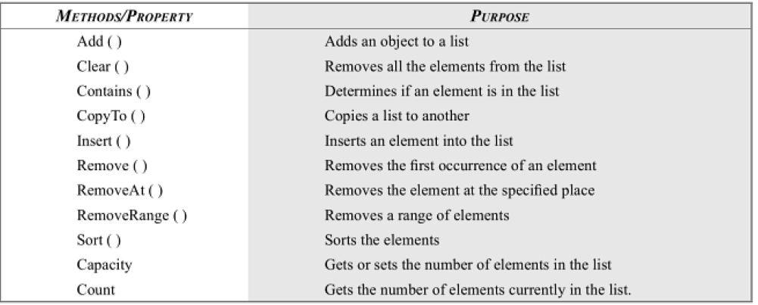
ArrayList Class(Contd..)

Slide 12
ArrayList Class(Contd..)
using System;
using System.Collections;
class city
{
public static void Main()
{
ArrayList n= new ArrayList();
n.Add("Madras");
n.Add("Bombay");
n.Add("Kolkata");
n.Add("Dehradun");
n.Add("89");
Console.WriteLine("Capacity= "+n.Capacity);
Console.WriteLine("Elemets present="+n.Count);
n.Sort();
for(int i=0;i<n.Count;i++)
{
Console.WriteLine(n[i]);
}
Console.WriteLine();
n.RemoveAt(4);
for(int i=0;i<n.Count;i++)
{
Console.WriteLine(n[i]);
}
}
}

