Slide 1
The Entity-Relationship Model
Notes:
1
The slides for this text are organized into chapters. This lecture covers Chapter 2, on the Entity-Relationship approach to database design.
The important issue of how to map from ER diagrams to relational tables is deferred until the relational model and the integrity constraints it supports have been introduced. ER to relational mapping, together with a discussion of the related SQL commands, is discussed in Chapter 3.

Slide 2
Data Model
Move from informal description of what user wants to
Precise description of what can be implemented in a DBMS

Slide 3
Steps in developing a database
Requirements analysis →
Conceptual Database design →
Logical Database design →
Schema refinement →
Physical Database design
Applications and security

Slide 4
Conceptual design: (ER Model is used at this stage.)
What are the entities and relationships in the enterprise?
What information about these entities and relationships should we store in the database?
What are the integrity constraints or business rules that hold?
A database `schema’ in the ER Model can be represented pictorially (ER diagrams).
Can map an ER diagram into a relational schema.
Notes:
2

Slide 5
ER Model Basics
name
ssn
lot
Employees
Entity: Real-world object distinguishable from other objects. An entity is described using a set of attributes. Each attribute has a domain.
Entity Set: A collection of similar entities. E.g., all employees.
  All entities in an entity set have the same set of attributes. (Until we consider ISA hierarchies, anyway!)
  Each entity set has a key.
Notes:
3
The slides for this text are organized into several modules. Each lecture contains about enough material for a 1.25 hour class period. (The time estimate is very approximate--it will vary with the instructor, and lectures also differ in length; so use this as a rough guideline.) This covers Lectures 1 and 2 (of 6) in Module (5).
Module (1): Introduction (DBMS, Relational Model)
Module (2): Storage and File Organizations (Disks, Buffering, Indexes)
Module (3): Database Concepts (Relational Queries, DDL/ICs, Views and Security)
Module (4): Relational Implementation (Query Evaluation, Optimization)
Module (5): Database Design (ER Model, Normalization, Physical Design, Tuning)
Module (6): Transaction Processing (Concurrency Control, Recovery)
Module (7): Advanced Topics

Slide 6
Type of Attributes
Simple(atomic)- age of employee entity
Composite- first_name and last_name
Single-ID number
multivalued-phone number
Stored-DOB
Derived- age

Slide 7
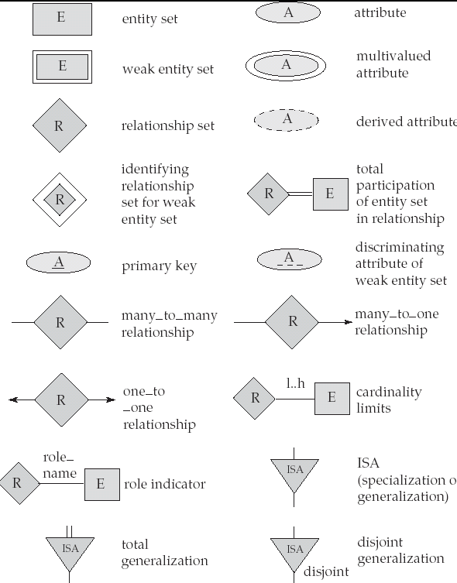
symbols

Slide 8

Attributes Types
Types of Attributes | Definition | Example
Simple attribute | Cannot be divided into simpler components | Gender of the employee
Composite attribute | Can be split into components | Address of the employee
Single valued | Can take on only a single value for each entity instance | Age of the employee
Multi-valued | Can take up many values | Skill set of the employee
Stored Attribute | Attribute that need to be stored permanently | Date of joining of the employee
Derived Attribute | Attribute that can be calculated based on other attributes. | Years of service of the employee

Slide 9
Degree of a Relationship
Degree of a relation is the number of entity types involved in the relation
      One Unary
      Two Binary
      Three Ternary
    e.g.:
    Unary → employee manager-of employee
    Binary → employee works-for department
    Ternary → Customer purchases items from a shop keeper

Slide 10
Cardinality
Relationships can have different connectivity
  one-to-one (1:1)
  one-to-many (1:N)
  many-to-one (M:1)
  many-to-many (M:N)
  e.g.:
  one-to-one → Employee head-of department
  one-to-many → Lecturer offers course (assuming a course is taught by a single lecturer)
  many-to-many → Student enrolls course

Slide 11
Relationship Participation
Total : if every instance of the entity must participate in the relationship with an instance of other participating entity type
Partial: if all instances need not participate
    e.g.: Employee Is Heading Department
    Employee: partial
    Department: total

Slide 12





ER Modeling -Notations
 | An Entity can be defined as an object or concept about which user wants to store information.
 | A weak Entity requires another Entity for it’s existence.
 | Properties or characteristics of an Entity is called Attributes of entity
 | If an attribute is the unique or distinguishing characteristic of the Entity it is called Key Attribute
 | If an attribute can have more than one value then it is called multi-valued attribute.

Slide 13
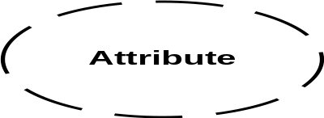

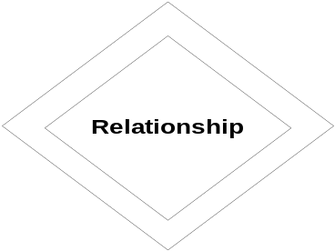
ER Modeling -Notations
 | If the value of an attribute can be derived from another attribute it is called derived attribute.
 | Relationships in ER Diagram illustrate how two entities of database share information.
 | We connect a weak entity through a strong entity using a weak relationship notation.

Slide 14
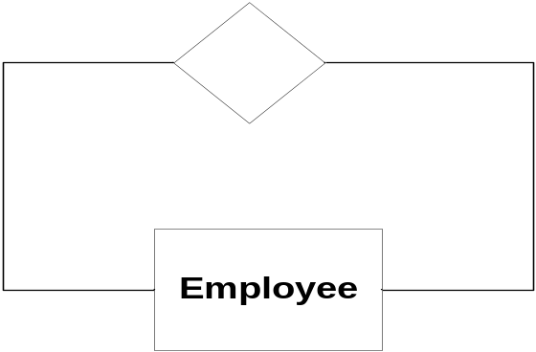
ER Modeling -Notations
Customer
_x000b__x000b_ | Cardinality of relationship tells how many instances of an Entity type is relate to one instance of another Entity Type. M,N both represent ‘MANY’ and 1 represents ‘ONE’ Cardinality
1
N
1
M
Account
Transaction
 | An entity can be self linked.

Slide 15
Composite attribute
floor
building
DOB
Name
Address
E#
Designation
Employee
Notes:
It is represented by an ellipse from which other ellipses originate to represent the component attributes. E.g Address

Slide 16
Unary Relationship
Manages
Employee
Notes:
The relationship depicts that , some instances of employee manage other instances of Employee.

Slide 17
Role names
Role names are added to make the meaning more explicit
M
1
subordinate
Manages
Employee
Manager

Slide 18
Ternary Relationship
Medicine
Doctor
Prescription
Patient
Notes:
A relationship connecting three entity types.

Slide 19
Attributes of a Relationship
Medicine
Number of days
dosage
Doctor
Prescription
Patient
Notes:
These attributes best describe the relationship prescription rather than any individual entity Doctor, Patient or Medicine.

Slide 20
Steps in ER Modeling
Entities are identified
Relationships are identified along with cardinality and participation
Key attributes and other relevant attributes are identified
E-R diagram with all attributes including Key attributes are drawn
E-R diagram is reviewed with business users

Slide 21
Case Study – ER Model For E&R Database
Assumptions :
E&R trains the trainees in various streams //E&R training is conducted in various streams
Each stream has number of modules //Each stream has many unique modules
Every stream can have more than one educator //Each module can be taught by one or more educator
At any time an educator can belong to only one stream//and each stream will have more than one educator
Each stream is headed by one educator
An educator can deliver one or more modules//An educator can deliver more than one module
A trainee is assigned to one stream//Every trainee will be allocated to a stream and a stream can have many such trainees

Slide 22
Steps in ER Modeling
Entities are identified
Relationships are identified along with cardinality and participation
Key attributes and other relevant attributes are identified
E-R diagram with all attributes including Key attributes are drawn
E-R diagram is reviewed with business users

Slide 23
Steps in ER Modeling
Step 1: Identify the Entities
STREAM
EDUCATOR
TRAINEE
MODULE

Slide 24
Steps in ER Modeling
Step 2: Find the relationships
One trainee is belongs to one stream, but a stream can have many trainees. Hence the cardinality is Many to One
1 N
One stream can contain many modules. Hence the cardinality between stream and Module is One to Many.
1 M
One stream has multiple educators and one educator belongs to one and only one stream, hence the cardinality between stream and educator is One to Many.
1 M
BELONGS TO
TRAINEE
STREAM
HAS
STREAM
MODULE
HAS
EDUCATOR
STREAM

Slide 25
Steps in ER Modeling
Step 2: Find the relationships(Cont..)
or each stream there is a “Head” and one Educator is the “Head”, hence the cardinality is One to One .
1 1
One module is delivered by one or many educators, and the educator teaches many modules, hence the cardinality between module and educator is Many to One.
M 1
HEADED BY
STREAM
EDUCATOR
DELIVERED BY
MODULE
EDUCATOR

Slide 26
Steps in ER Modeling
Step 3: Identify the key attributes
Stream name is the key attribute for the Entity “Stream”, as it identifies the
Stream uniquely.
Module Code is the key attribute for “Module” Entity.
Trainee ID is the key attribute for “Trainee” Entity.
Employee ID is the key attribute for “Educator” Entity.
Step 4: Identify other relevant attributes
For the stream entity, the relevant attribute is duration//headed by
For module entity, module name, credit points
For educator entity, cabin#, telephone#
For trainee entity, trainee name, CGPA

Slide 27
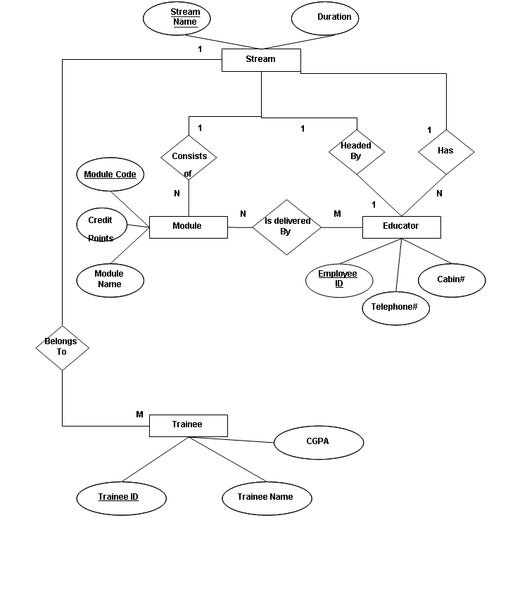

Slide 28
Keys
Minimal set of attributes which uniquely identify an instance of a entity
Many candidate keys choose one to be a primary keys
SSN vs Name … key must be unique

Slide 29
ER Model Basics (Contd.)
name
ssn
lot
since
Employees
name
dname
super-visor
subor-dinate
ssn
lot
did
budget
Works_In
Reports_To
Employees
Departments
Relationship: Association among two or more entities. E.g., Attishoo works in Pharmacy department.
Relationship Set: Collection of similar relationships.
  An n-ary relationship set R relates n entity sets E1 ... En; each relationship in R involves entities e1 E1, ..., en En
  Same entity set could participate in different relationship sets, or in different “roles” in same set.
Notes:
4

Slide 30
Key Constraints
Consider Works_In: An employee can work in many departments; a dept can have many employees.
So many to many

Slide 31
Key Constraints
since
name
dname
In contrast, each dept has at most one manager, according to the key constraint on Manages.
* arrow indicates that given a dept it uniquely determines the Manages relationship in which it appears
ssn
lot
did
budget
Employees
Manages
*
Departments
*
1-to-1
1-to Many
Many-to-1
Many-to-Many
Notes:
6

Slide 32
Participation Constraints
Does every department have a manager?
  If so, this is a participation constraint: the participation of Departments in Manages is said to be total (vs. partial).
Every Department entity must appear in an instance of the relationship Works_In (have an employee) and every Employee must be in a Department
Both Employees and Departments participate totally in Works_In
name
name
dname
since
dname
ssn
did
did
budget
lot
budget
Employees
Manages
Departments
Works_In
since
Notes:
8

Slide 33
Weak Entities
A weak entity can be identified uniquely only by considering the primary key of another (owner) entity.
  Owner entity set and weak entity set must participate in a one-to-many relationship set (one owner, many weak entities).
  Weak entity set must have total participation in this identifying relationship set.
name
ssn
lot
cost
pname
age
Employees
Policy
Dependents
Notes:
10

Slide 34
ISA (`is a’) Hierarchies
name
ssn
lot
Employees
hourly_wages
hours_worked
ISA
contractid
Hourly_Emps
Contract_Emps
As in C++, attributes can be inherited.
If we declare A ISA B, every A entity is also considered to be a B entity.
Upwards is generalization. Down is specialization
Notes:
12

Slide 35
Constraints in ISA relation
Overlap constraints: Can Joe be an Hourly_Emps as well as a Contract_Emps entity? (Allowed/disallowed)
Covering constraints: Does every Employees entity also have to be an Hourly_Emps or a Contract_Emps entity? (Yes/no)
Reasons for using ISA:
  To add descriptive attributes specific to a subclass.
  To identify entitities that participate in a relationship.

Slide 36
Aggregation
name
ssn
lot
Employees
Used when we have to model a relationship involving (entitity sets and) a relationship set.
Monitors
until
started_on
since
dname
pid
pbudget
did
budget
Projects
Sponsors
Departments
  Aggregation allows us to treat a relationship set as an entity set for purposes of participation in (other) relationships.
Notes:
2

Slide 37
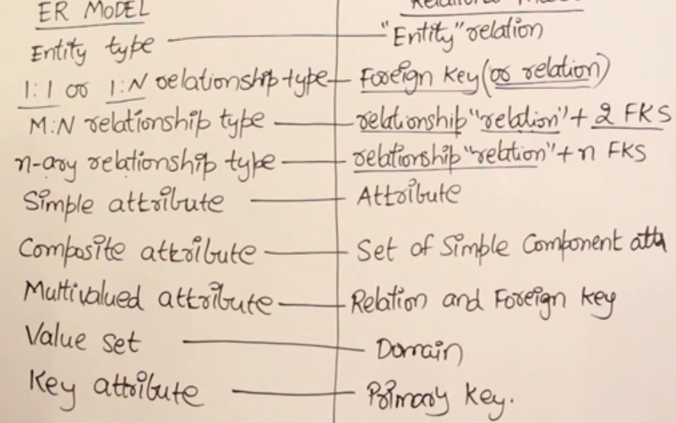


Slide 38
Aggregation vs. ternary relationship:
Monitors in last example is a distinct relationship, with a descriptive attribute.
Also, can say that each sponsorship is monitored by at most one employee.

Slide 39
Conceptual Design Using the ER Model
Design choices:
  Should a concept be modeled as an entity or an attribute?
  Should a concept be modeled as an entity or a relationship?
  Identifying relationships: Binary or ternary? Aggregation?
Constraints in the ER Model:
  A lot of data semantics can (and should) be captured.
  But some constraints cannot be captured in ER diagrams.
Notes:
3

Slide 40
Entity vs. Attribute
Should address be an attribute of Employees or an entity (connected to Employees by a relationship)?
Depends upon the use we want to make of address information, and the semantics of the data:
    If we have several addresses per employee, address must be an entity (since attributes cannot be set-valued).
    If the structure (city, street, etc.) is important, e.g., we want to retrieve employees in a given city, address must be modeled as an entity (since attribute values are atomic).

Slide 41
Entity vs. Attribute (Contd.)
from
to
name
dname
Works_In4 does not allow an employee to work in a department for two or more periods.
Similar to the problem of wanting to record several addresses for an employee: We want to record several values of the descriptive attributes for each instance of this relationship. Accomplished by introducing new entity set, Duration.
ssn
lot
did
budget
Employees
Works_In4
Departments
name
dname
ssn
lot
did
budget
Employees
Works_In4
Departments
from
Duration
to
Notes:
5

Slide 42
Entity vs. Relationship
since
dbudget
name
dname
ssn
lot
did
budget
Employees
Manages2
Departments
ER diagram OK if a manager gets a separate discretionary budget for each dept.
What if a manager gets a discretionary budget that covers all managed depts?
  Redundancy: dbudget stored for each dept managed by manager.
  Misleading: Suggests dbudget associated with department-mgr combination.
Notes:
6

Slide 43
This fixes the problem!
name
ssn
lot
since
dname
Employees
did
budget
Manages2
Departments
ISA
Managers
dbudget

Slide 44
Binary vs. Ternary Relationships
name
ssn
lot
pname
age
Employees
Covers
Dependents
Bad design
Policies
policyid
cost
If each policy is owned by just 1 employee, and each dependent is tied to the covering policy, first diagram is inaccurate.
What are the additional constraints do we need?
Notes:
7

Slide 45
Better design
name
pname
age
ssn
lot
Dependents
Employees
Purchaser
Beneficiary
Policies
policyid
cost
Key constraint
Total participation of policies in purchaser relationship

Slide 46
Binary vs. Ternary Relationships (Contd.)
Previous example illustrated a case when two binary relationships were better than one ternary relationship.
An example in the other direction: a ternary relation Contracts relates entity sets Parts, Departments and Suppliers, and has descriptive attribute qty. No combination of binary relationships is an adequate substitute:
  S “can-supply” P, D “needs” P, and D “deals-with” S does not imply that D has agreed to buy P from S.
  How do we record qty?
Notes:
9

Slide 47
Summary of Conceptual Design
Conceptual design follows requirements analysis,
  Yields a high-level description of data to be stored
ER model popular for conceptual design
  Constructs are expressive, close to the way people think about their applications.
Basic constructs: entities, relationships, and attributes (of entities and relationships).
Some additional constructs: weak entities, ISA hierarchies, and aggregation.
Note: There are many variations on ER model.
Notes:
11

Slide 48
Summary of ER (Contd.)
Several kinds of integrity constraints can be expressed in the ER model: key constraints, participation constraints, and overlap/covering constraints for ISA hierarchies. Some foreign key constraints are also implicit in the definition of a relationship set.
  Some constraints (notably, functional dependencies) cannot be expressed in the ER model.
  Constraints play an important role in determining the best database design for an enterprise.
Notes:
12

Slide 49
Summary of ER (Contd.)
ER design is subjective. There are often many ways to model a given scenario! Analyzing alternatives can be tricky, especially for a large enterprise. Common choices include:
  Entity vs. attribute, entity vs. relationship, binary or n-ary relationship, whether or not to use ISA hierarchies, and whether or not to use aggregation.
Ensuring good database design: resulting relational schema should be analyzed and refined further. FD information and normalization techniques are especially useful.
Notes:
13

Slide 50
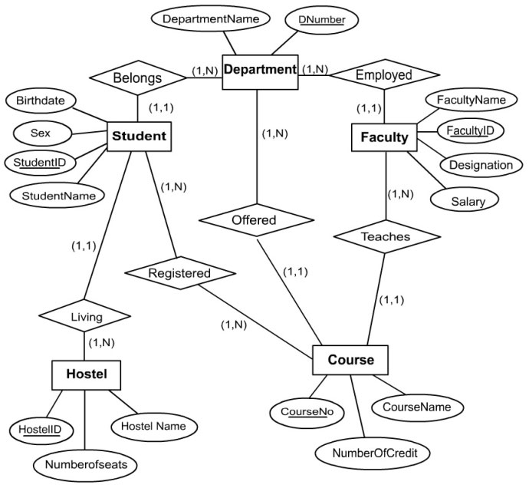
University ER diagram

Slide 51
Type of Attributes
Simple(atomic)- age of employee entity
Composite- first_name and last_name
Single-ID number
multivalued-phone number
Stored-age
Derived- do not exist in the physical database(DOB)

