Slide 1
Smaato AdExchange Infrastructure
Presuming that Smaato’s AdExchange (SOMA) can deliver detailed data on each auciton in any desired way, please describe how would you construct a component which calculates optimal floor prices. Expected is a list of which frameworks / software packages would you use and how these will interact.
Please describe, if you would use any AI / ML method for calculating the floor prizes or not. If yes, please describe, which. If no, please describe, why not.

Slide 2
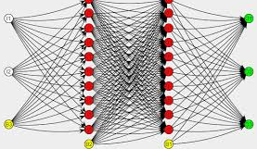
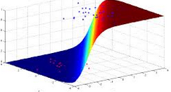
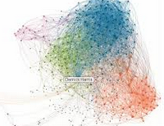
MACHINE LEARNING TYPES
Regression
Decision Tree
Neural Network
Ensemble Models
SVM
Random Forest

Slide 3
Which Machine Learning Algorithm??
What is the size of Training data ? - well Smaato has million of daily transactions so I believe an ETL and pre processing will give quite a good set of Dataset for training the Main model
Data Dimension/Features – I predicted few like Add Type , users , time , max and min bid but there might be some feature which seems like independent but statistics shows its not, so depend on the Table Smaato builds
Feature Independent ? - As above
Linear Dependency on Target– Depends on the data
Is over-fitting expected? - This is crucial, because result can be highly biased based on distribution of dataset and how each category of Adds collects or behave. Some adds might have less training data than other , or some add types are having huge number of bidders compared to others
Scalable Infrastructure – Whats Smaato infrastructure, depends on Nodes or scalability

Slide 4
Various Machine Learning Approach
Main Scalable Prediction Model
This is Add type and other features based prediction
This will be handling all the basic
Required dimensions to build a prediction Model
Since it won't run real-time , we can update the prediction Model in batch
We can try ensemble or Neural Network approach
Neural is like pipeline approach and we are very much particular
About optimized result we may try
This model can be retrained or more values can be added but not in real-time , so we can consider more features so we can assume complex and more time consuming formulas
Real Time Prediction
This is behaviour based prediction
While bidding happens, based on DSP involved , will fetch there previous trend and based on current entry , build a training prediction model in real time
It won't run on massive data , so it will be quick
Avg. the Main Prediction & Real time prediction to understand the squared error or log-loss
Can use regression or Decision tree to build the prediction model
Less features so quick analysis and prediction so regression even Random Forest can come handy

Slide 5
Basic Statistics
Find Standard variation to determine the spread of data
Find any outlier , any value which crosses the normal trend, that might be some spam or ...
P(A & B) = P(A)P(B|A)
probability of 1st event happening, then probability of 2nd event happening given 1st.
P(A|B) = (P(A)P(B))/P(B)
Build a Histogram or build exploratory Analysis
Check the Distribution may be continuous, binary or normal
Find Dimension and if required use PCA

Slide 6




Main Prediction Model(MPM)
Any Distributed
Resource depend on data tpe
For Data manipulation,
Machine Learning Model.
We will have 2 different ML running
One meant for floor Price prediction other DSP behaviour prediction

Slide 7
DSP Details
DSPID | ADDTYPE(any value from 0…n , presents what category of add , like game , social, finance) | MIN BID(in Amount) | MAX BID | BIDDING FREQUENCY(number of biddings made) | TIME IN(can find the active state of DSP) | TIME OUT(How long DSP tried bidding) | RESULT
1 | 1 | 2 | 10 | 5 | 10552 | 20555 | 1
1 | 0 | 1 | 20 | 30 | 9560 | 19560 | 0
1 | 1 | 1 | 5 | 25 | 15250 | 25658 | 0
1 | 1 | 2 | 6 | 20 | 16258 | 18965 | 0
1 | 0 | 2 | 10 | 10 | 15246 | 60598 | 1
1 | 2 | 5 | 15 | 5 | 1158 | 5896 | 0
1 | 1 | 1 | 15 | 10 | 11585 | 36989 | 0
1 | 2 | 1 | 18 | 5 | 989655 | 11100258 | 0
1 | 2 | 3 | 18 | 6 | 158934 | 256898 | 1
1 | 6 | 10 | 12 | 9 | 15872 | 99564 | 0

Slide 8
ADD Details
ADD ID | ADD TYPE | Avg. MIN BID (based on frequency) | Avg. MAX BID(winning) | Avg. Bids(in count) | TIME(in range)
1 | 1 | 1 | 15 | 10000 | 25565125
2 | 1 | 1 | 10 | 15245 | 2463656
3 | 2 | 1 | 12 | 65895 | 5745651
4 | 3 | 1 | 2 | 14000 | 57478585
5 | 2 | 1 | 4 | 25795 | 5475565
6 | 3 | 1 | 5 | 36549 | 9699856
7 | 4 | 1 | 6 | 24879 | 789222
8 | 4 | 1 | 12 | 35592 | 63697425
9 | 4 | 2 | 12 | 14736 | 6889523
10 | 5 | 3 | 10 | 36985 | 6584856

Slide 9
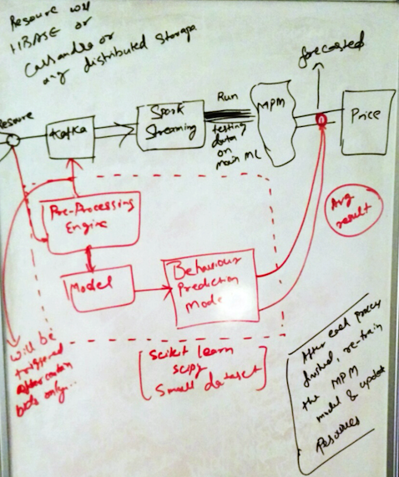

Slide 10

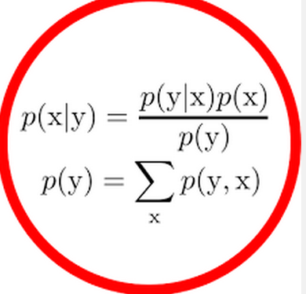
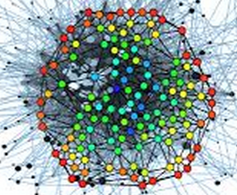






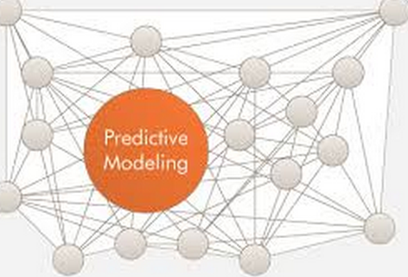
Basic Infrastructure
Any
Distributed
Scalable
Resource
Main
Model
Now
Update
The main
Predictive
model
These 2 separate
Predictive models
Will give an average result
Start
After
wards
Real Time Mach
Ine learning
Prediction
Behaviour based Predictive
Modelling

Slide 11
Why Apache Kafka
It is fault-tolerant, scales to enormous data sizes, and has a built in partitioning model
Kafka is a high throughput, distributed log that can be used like a queue, takes less memory than Redis
Real time analytic by consumer keeps track of data or ask for next time
Very popular for high volume data processing

Slide 12



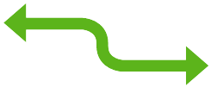


Real-Time Processing Pipeline

