Slide 1
Effect of Economic Indicators on Financial Market
A Data-driven Analysis
Abhishek Chattopadhyay
07.03.2025

Slide 2
Overview
Motivation
Introduction and economic indicators
Data collection and cleaning
Univariate analysis
Bivariate analysis
Summary

Slide 3
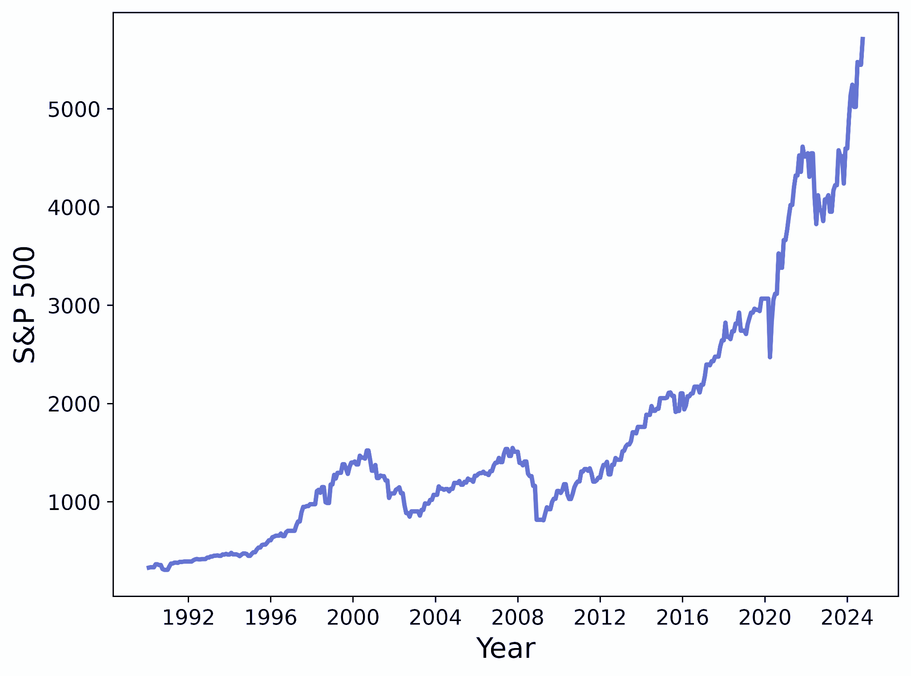
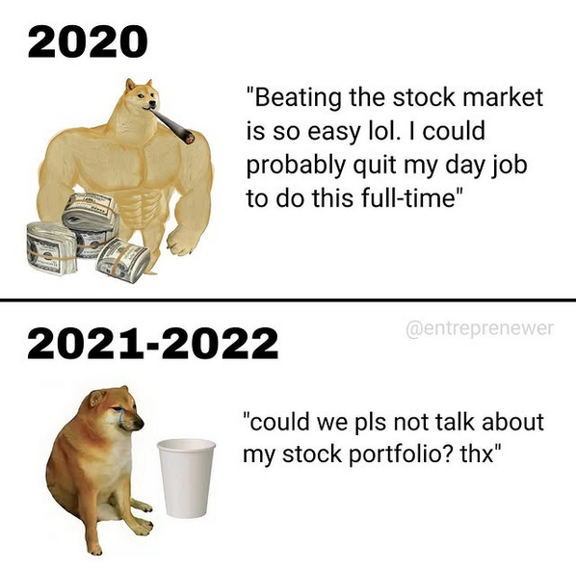
Why this topic?
Because it’s random and hard and it has math and machine learning!!!
Transferable: physics, economics, climate change, biology
Courtesy: @entreprenewer

Slide 4

Economic indicators
Economic indicators portray the health of an economy
Indicators: GDP, unemployment rate, inflation etc.
Financial market: one of the most dynamic things
Very difficult to predict the randomness
How do economic indicators affect the financial market?

Slide 5
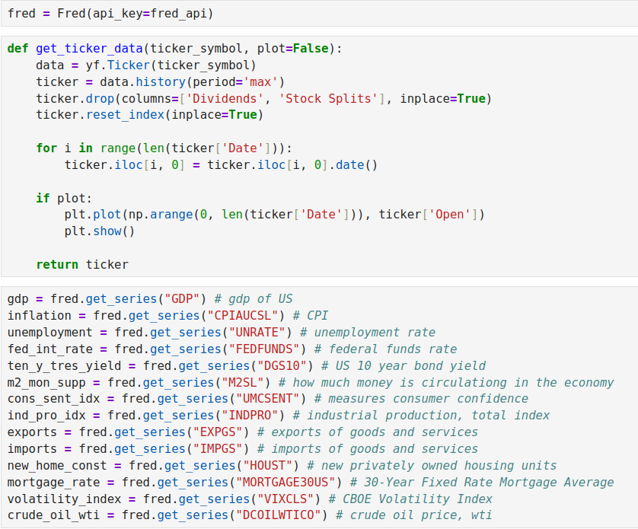
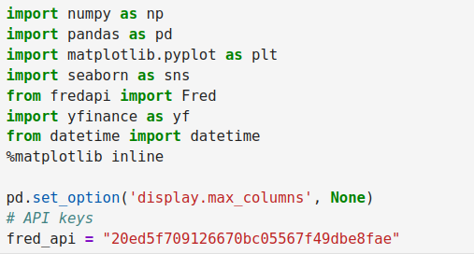
Data collection and cleaning
Economics data: FRED (Federal Reserve Economic Data)
Stock market data: Yahoo finance
Python implementation:

Slide 6
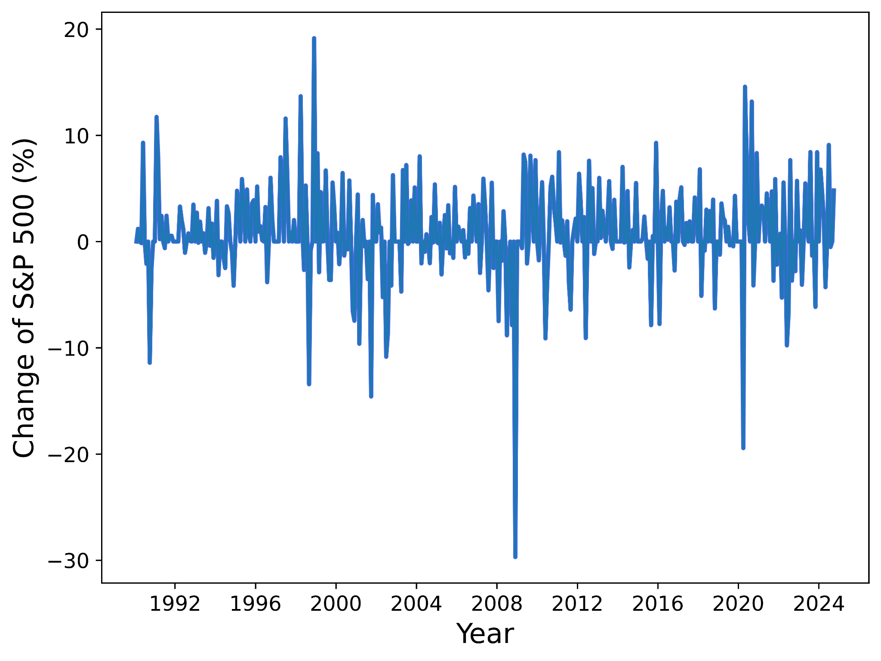
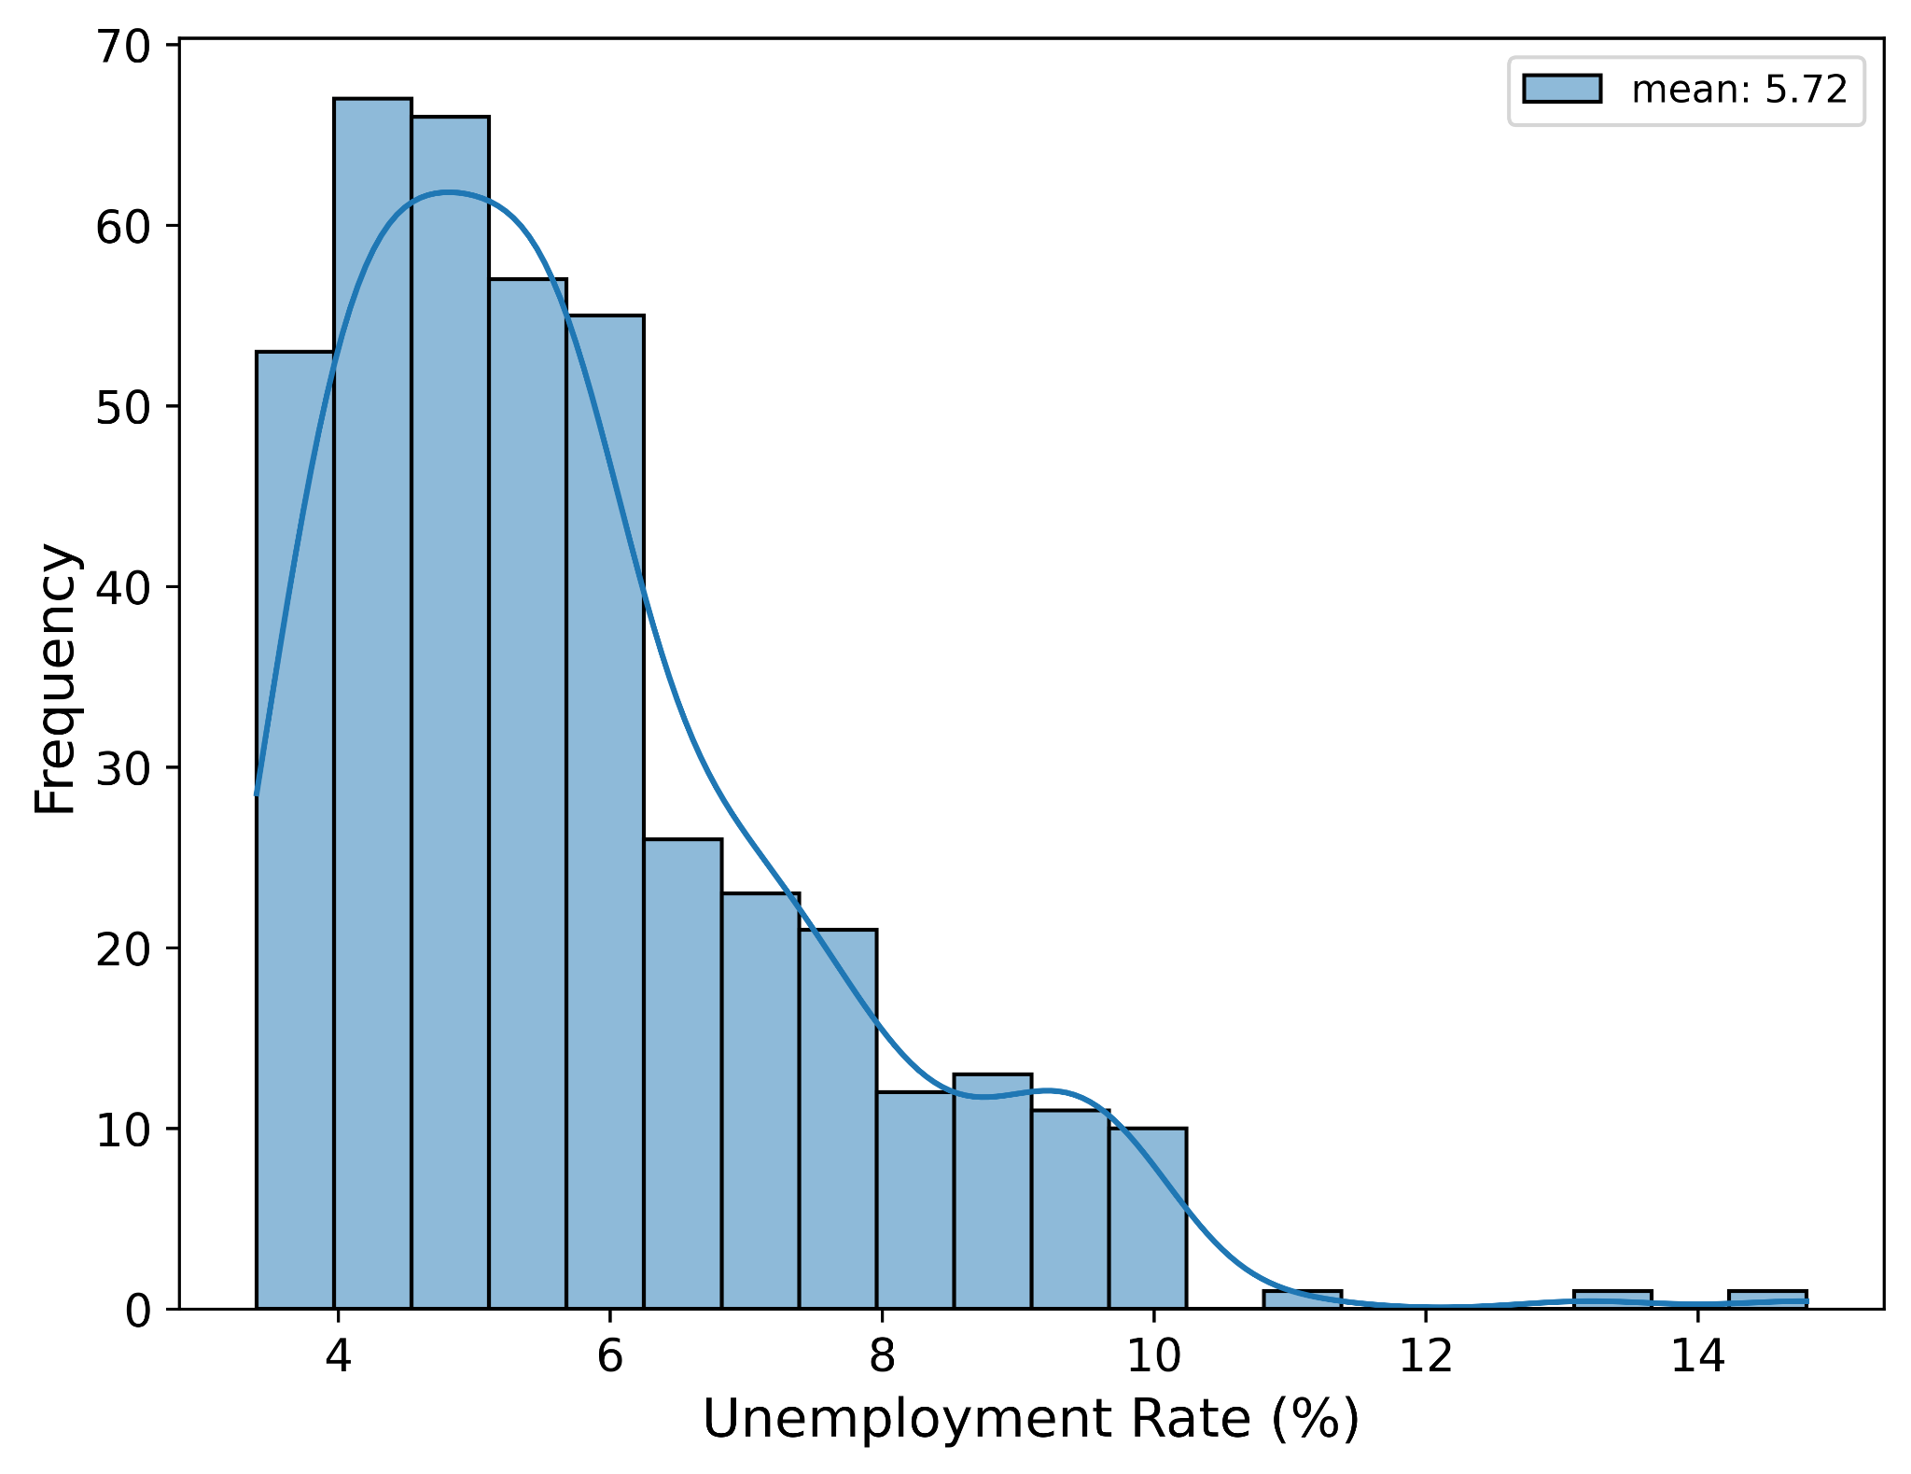
Univariate analysis
2008: Financial Crisis
2020: Covid-19

Slide 7
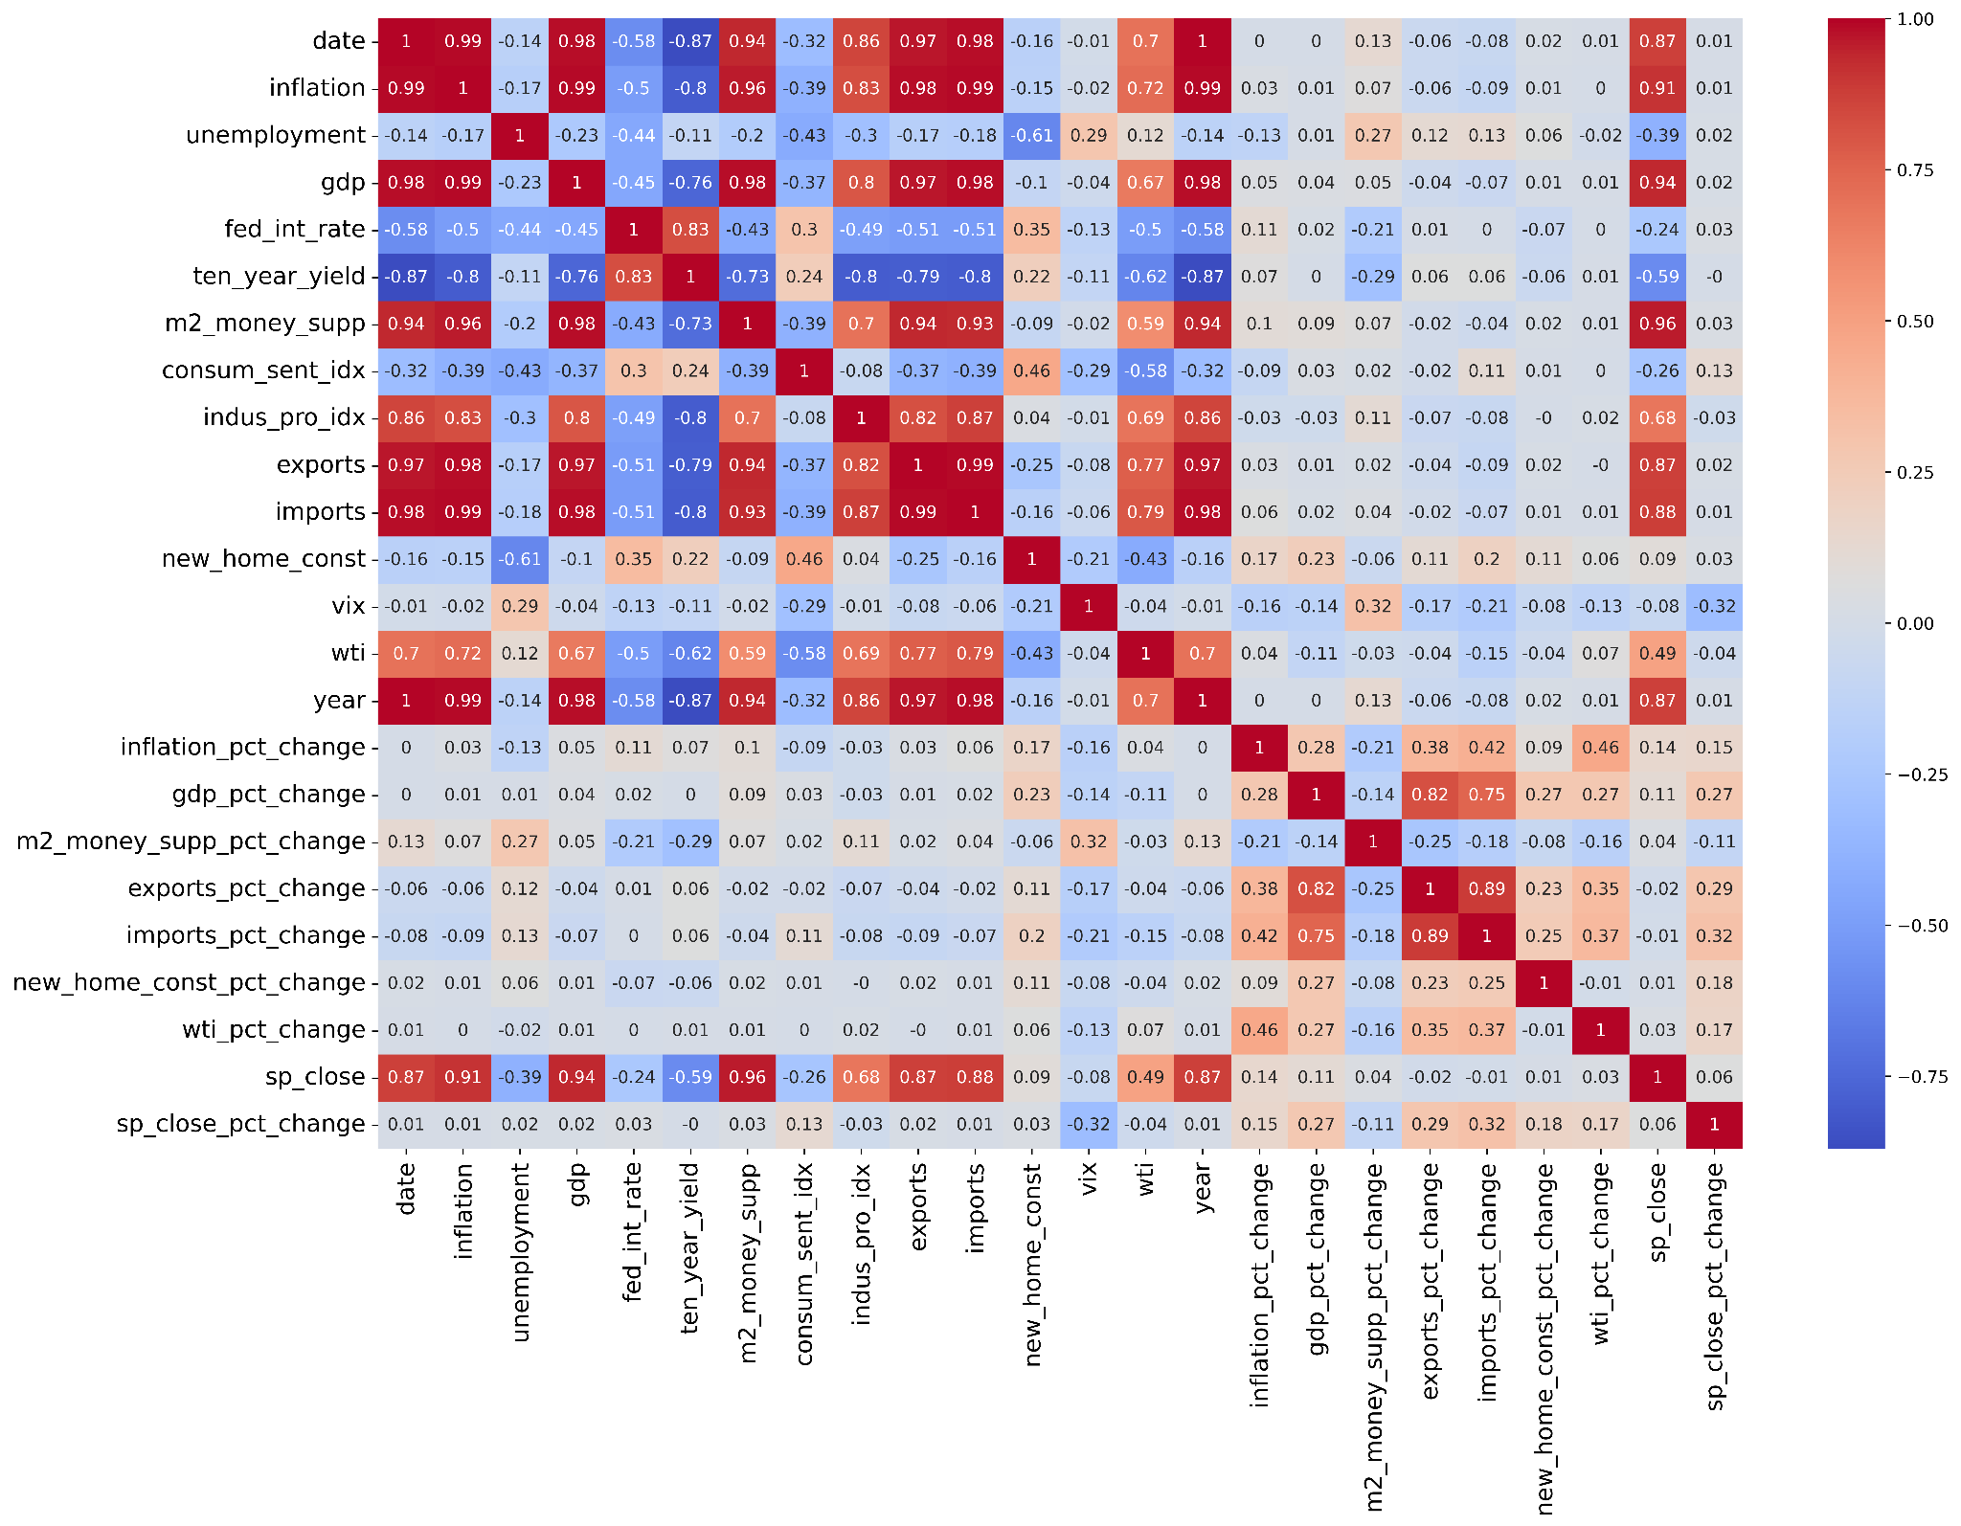
Bivariate analysis
S&P500 correlates (> 0.5) with
Date
Inflation
GDP
M2 money supply
Industry Production
Exports
Imports
How do they correlate?

Slide 8
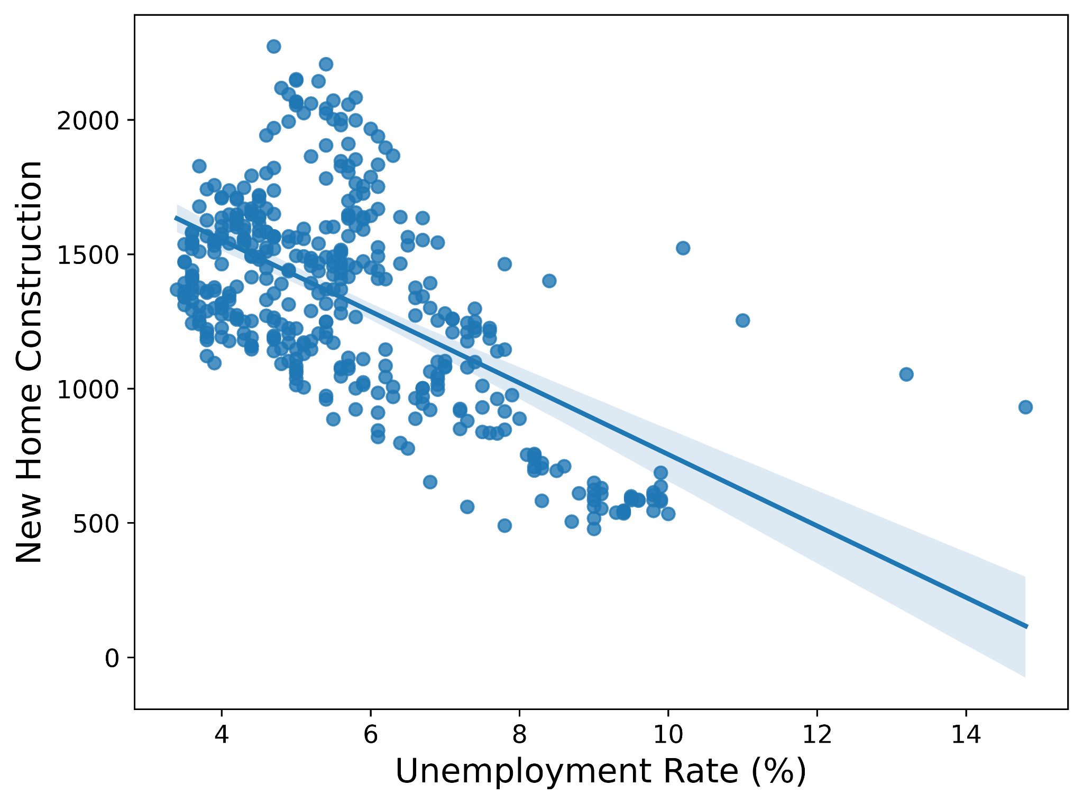
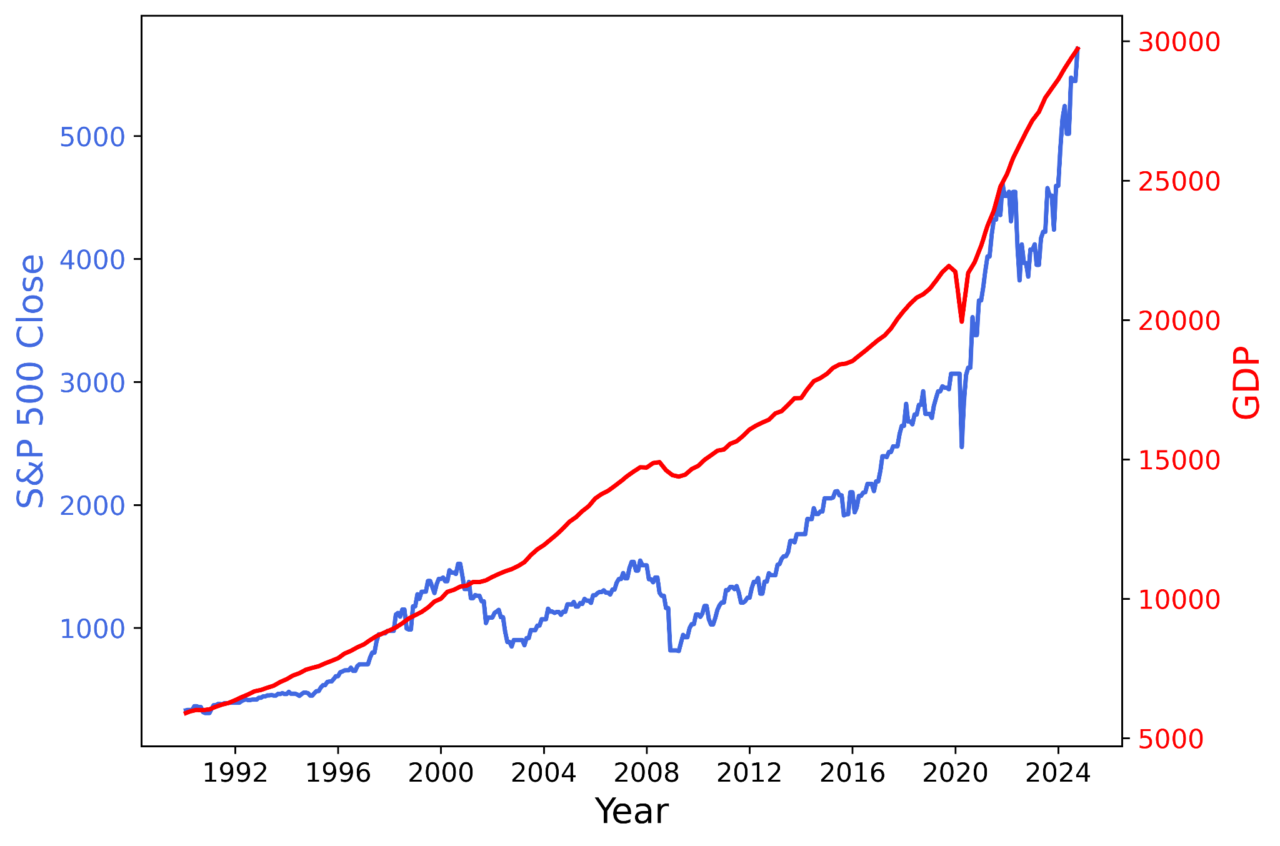
Static and dynamic correlation
Construction of new homes goes down when unemployment rate increases
S&P500 and GDP are dynamically correlated

Slide 9

Summary
Economic indicators are good parameters to track financial trend
Correlation is non-linear
Time series analysis is needed
Thank you!

