Slide 1
Fractured, Or Not-fractured, That Is The Question
A Computer Vision Mini Project
Abhi
11.04.2025

Slide 2
Overview
Introduction
Dataset and cleaning
Model training
Results
Summary

Slide 3
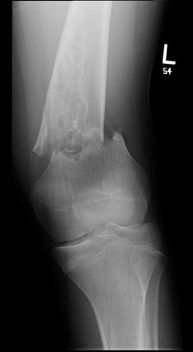
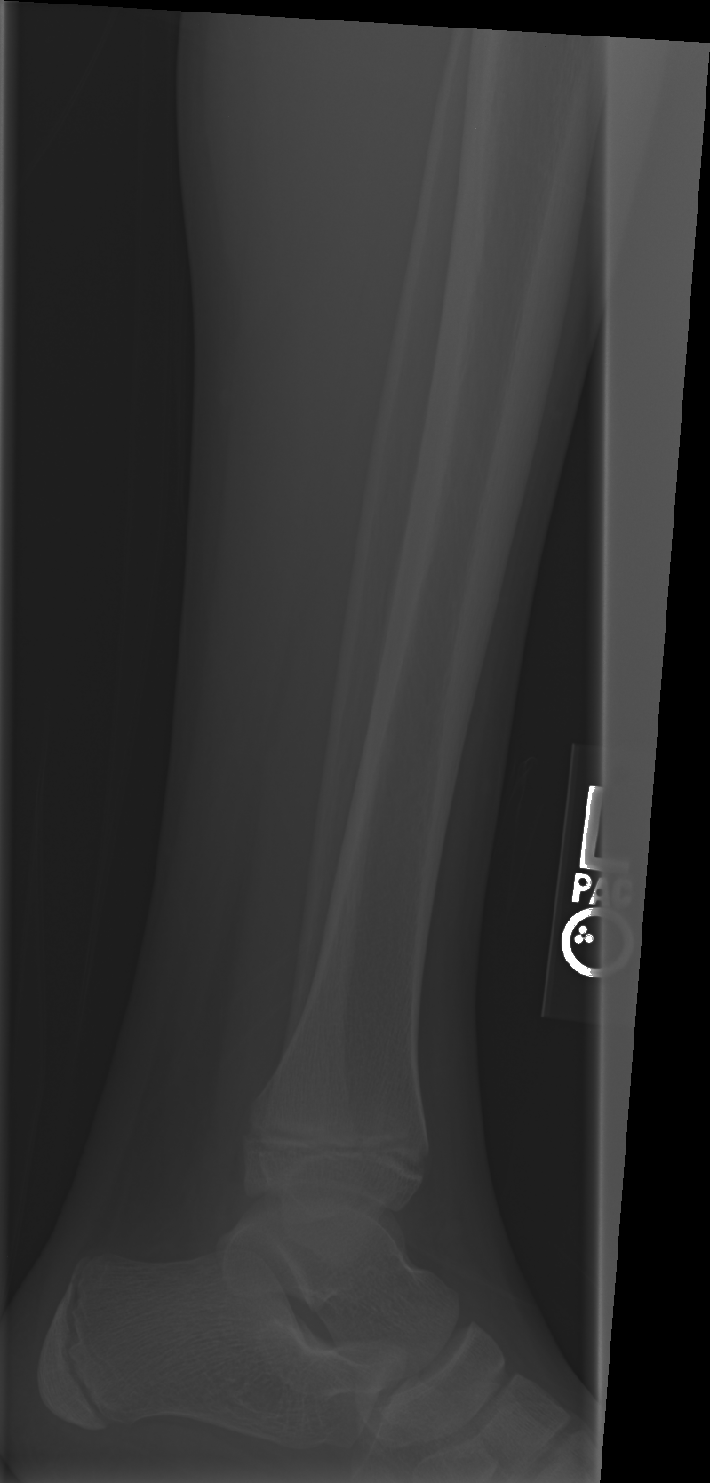
Intro
Hospitals in Germany are overcrowded with patients
But we have a shortage of stuffs
The Ortho department approached me to help them with an assistant
Work: Help to distinguish between fractured and non-fractured bones

Slide 4
Dataset and challenge
The dataset contains random images of fractured and not-fractured bones
Some of the images are corrupted
Computer vision algo is implemented using Tensorflow and is costly
How do I make it computationally efficient and run locally?

Slide 5
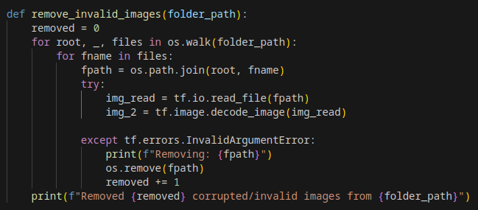

Wayout?
Remove corrupted images using Tf
Compile Tensorflow using GPU

Slide 6
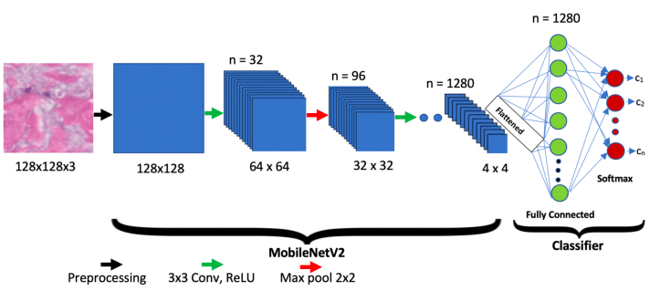
Model training
Computer vision model: MobileNetV2
Learning rate: 0.1
Adam optimizer
Batch size: 32
Data augmentation
Pretrained weights from Imagenet
Initial epoch: 10

Slide 7
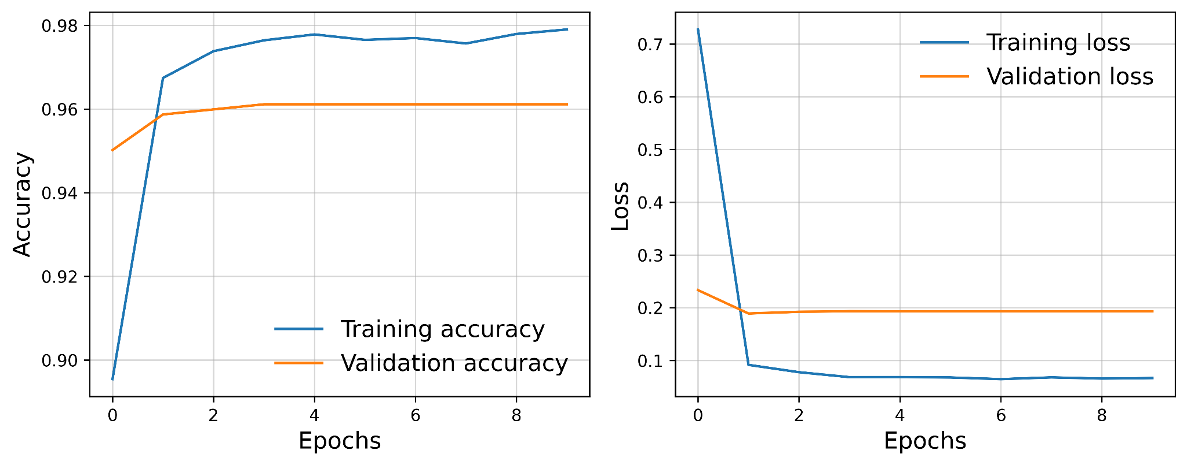
Results

Slide 8
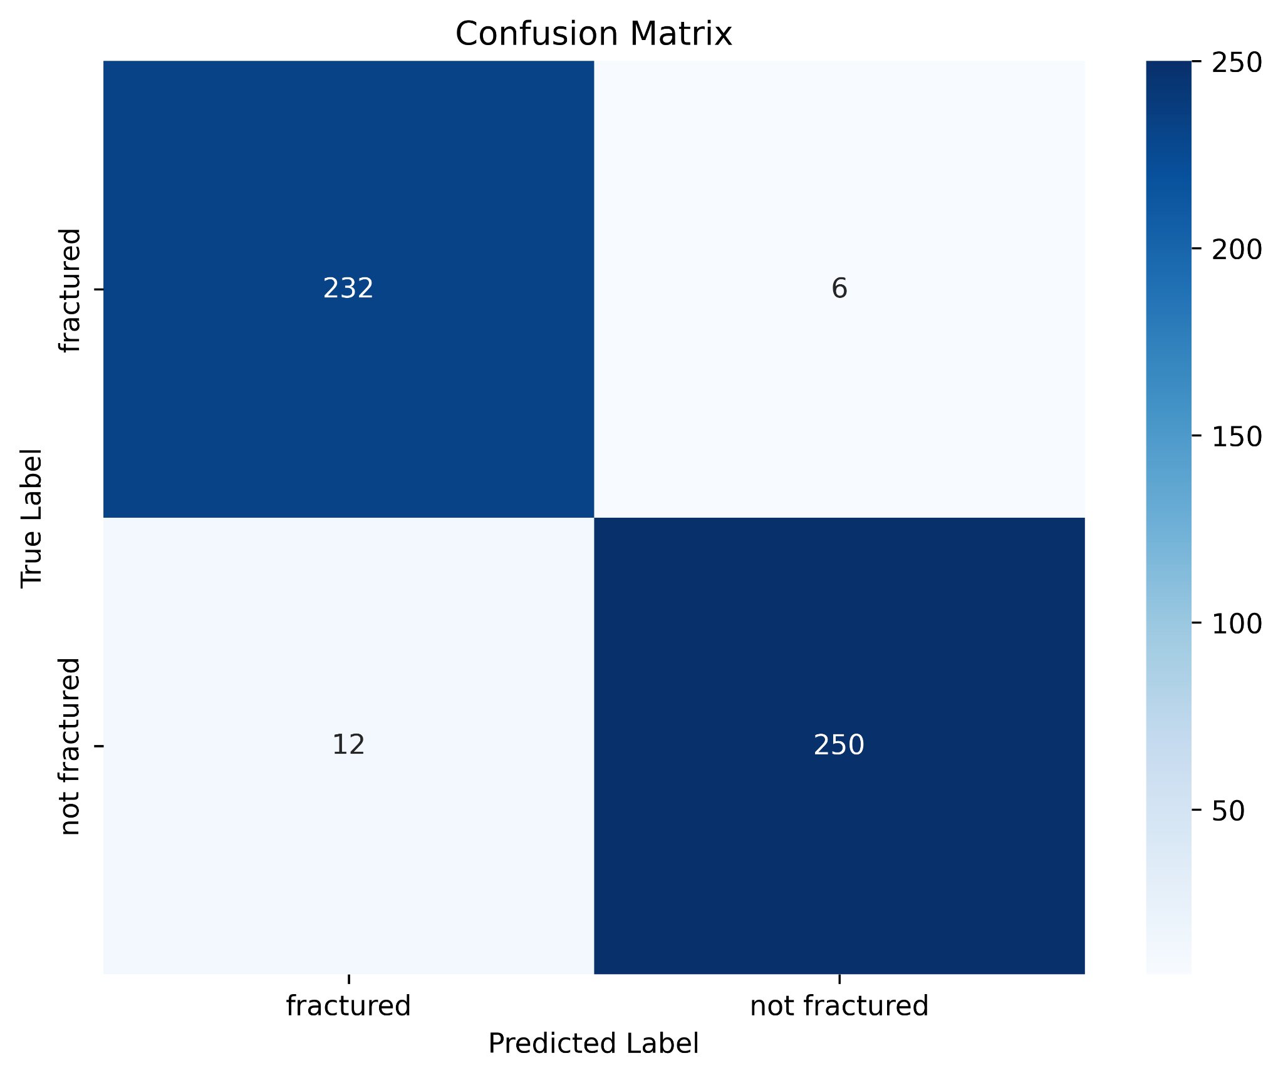
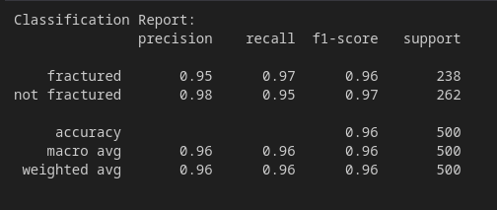
Confusion matrix
Overall very good predictions
Type 1 and type 2 errors are small

Slide 9
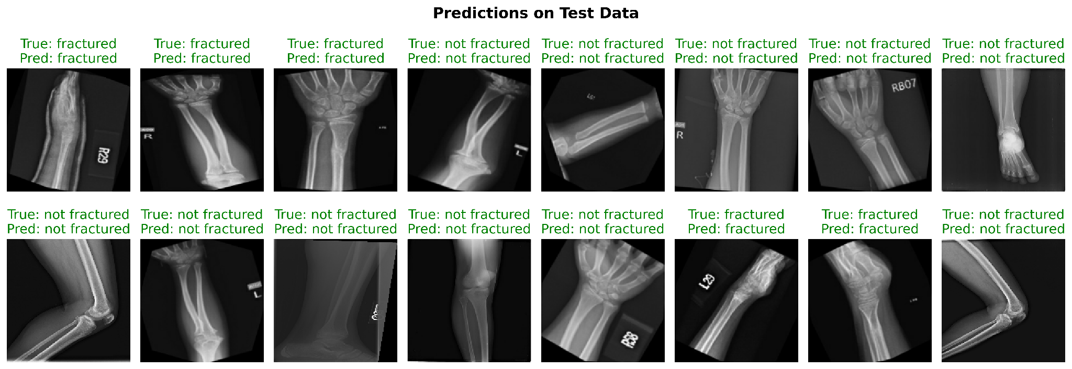
Moment of truth

Slide 10

Summary
MobileNetV2 works very well with this dataset
No need to fine tune the model
Time taken for 10 epochs: 176 sec. (roughly 3 min.)
Want to add some noise to the test data
Make a Streamlit app

