Slide 1
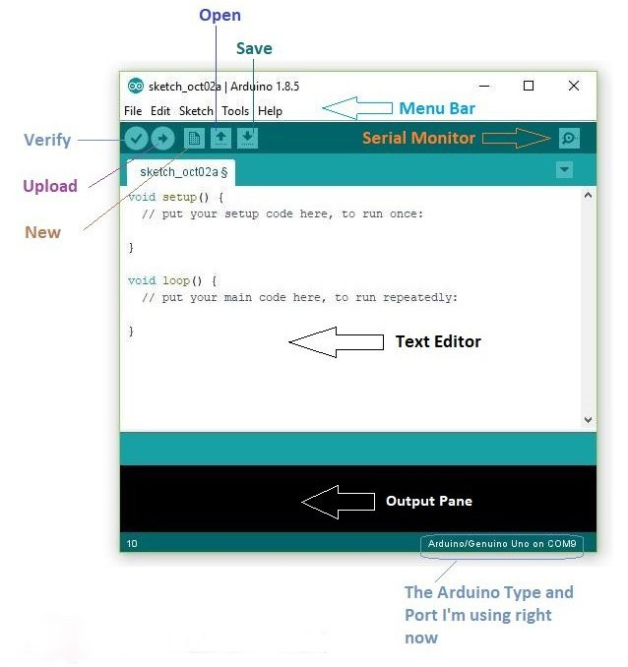
ARDUINO IDE BASICS
Arduino IDE is an open source software that is mainly used for writing and compiling the code into the Arduino module.
Parts of the environment
Save - ctrl/cmd+S
Verify - ctrl/cmd+R
Upload - ctrl/cmd+U
Text editor
Output pane
Board and port used

Slide 2
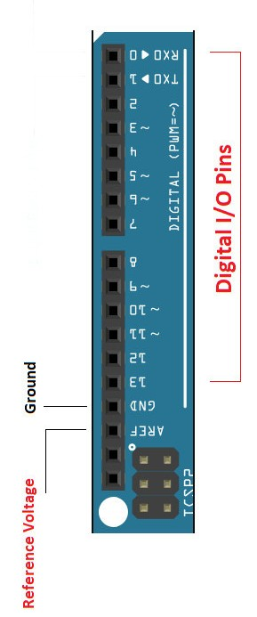
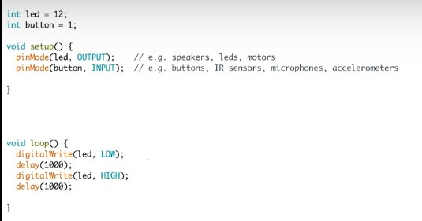
WORKING WITH PINS
pins in arduino
example code

Slide 3
EXPLAINING THE CODE
int led = 12;
void setup() and void loop() together are like the main() in C++.
void setup( )
This part of the code runs when the arduino board is powered and started.
void loop( )
When the setup() code is run completely, then the loop() code runs in an infinite loop, that is, the loop() code repeats itself infinitely till the board is powered off.
The digital pin numbered 12 is name by the variable led.
pinMode( led, OUTPUT ) ;
Sets the pin named led to a mode 'OUTPUT', by doing so, we can send desired output to the led pin.
digitalWrite( led, LOW );
This function sets the value of the led pin, which has already been set to output
mode, to ‘LOW' or 'HIGH' based on the input given

