Slide 1
UNDERSTANDING BIG DATA
The Unusual way
www.abhishek-jaiswal.github.io
By :-
Abhishek Jaiswal
Software Engineer
Web App Developer
Openerp Expert
Pythoniesta Programmer
www.twitter.com/abhishek_jaisw

Slide 2







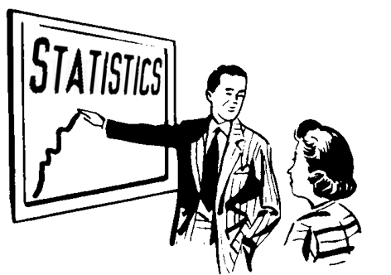

What is Big Data ?
The Unusual way
Decision Support
System
Product
3rd Party Survey
Expert Debates
Insurance company
Optimal Price ?
Maximize Profit
Data Warehouse
Run Statistical Algorithms

Slide 3
Data Warehouse - Limitations
Worked on Samples of data
  Looking through key hole and finding the size of the room
High turnaround time for meaningful results
  Deciding the cross the roads based on picture taken five minutes age

Slide 4
Big Data - The text book definition
"Big data are collection of data sets so large and complex that it
becomes so difficult to process using on-hand database management
tools or traditional data processing application"
- White tom definitive guide
Volume
Variety
Velocity

