Slide 3


Slide 4




•
•
•
•

Slide 6




•
•
•
•

Slide 7


Slide 8


1.
2.
•
•
•
•
3.

Slide 9
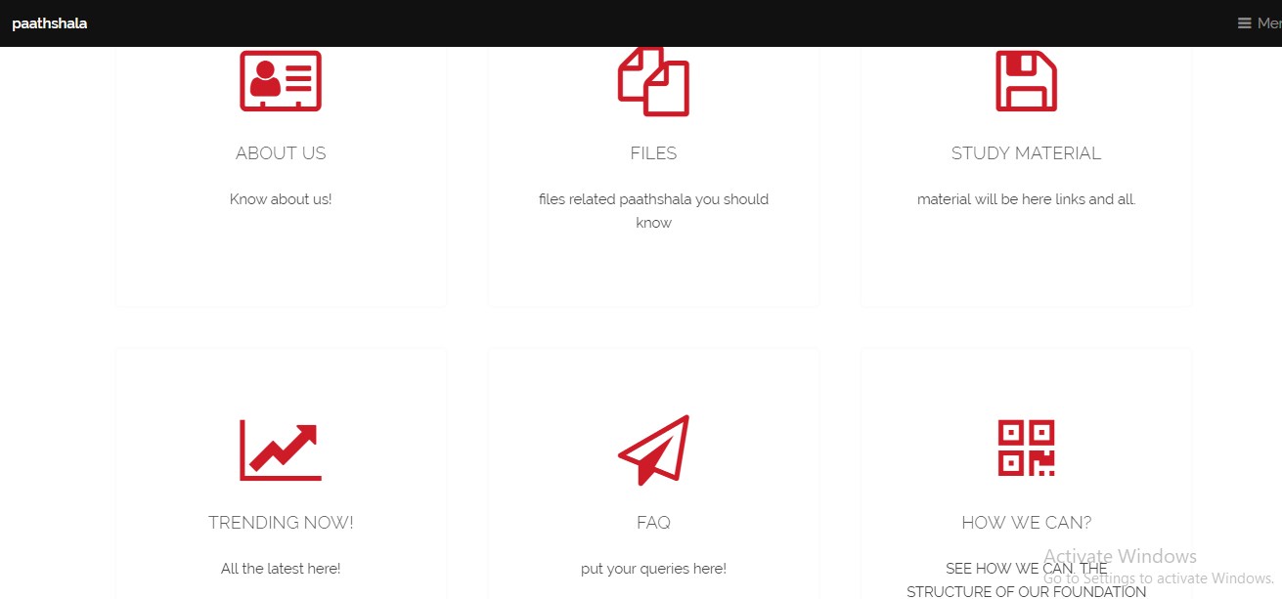
future aspect

Slide 10
OUR 15 HOURS WORK
CREATED THE STRUCTURE MODAL READY TO IMPLEMENT
LET SEE HOW OUR WORKS GOES ON.

Slide 11
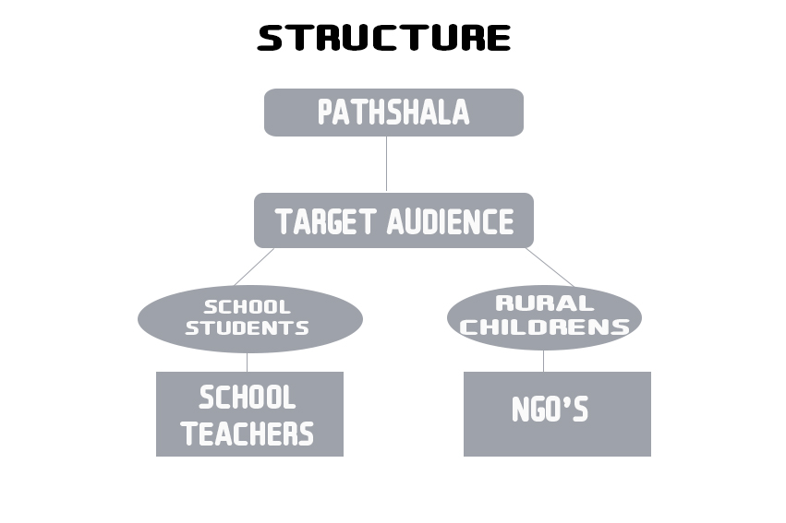

Slide 12
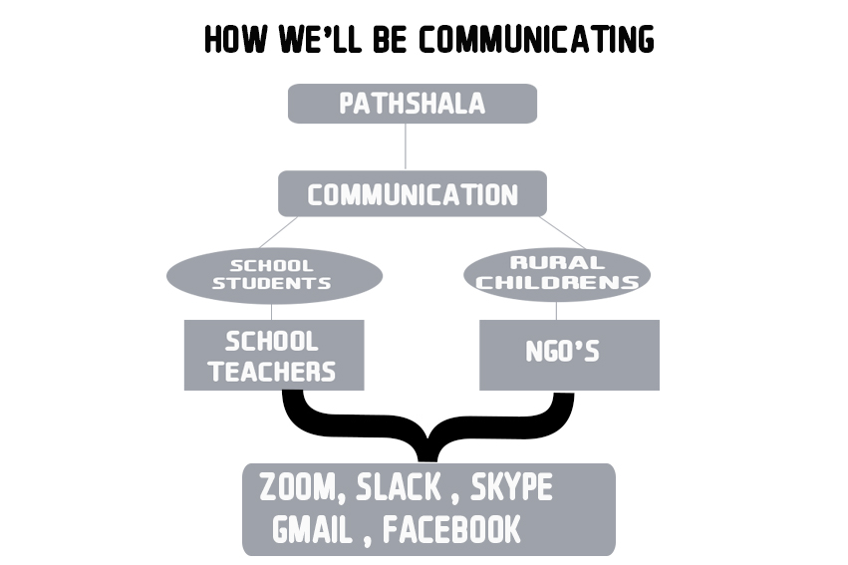

Slide 13
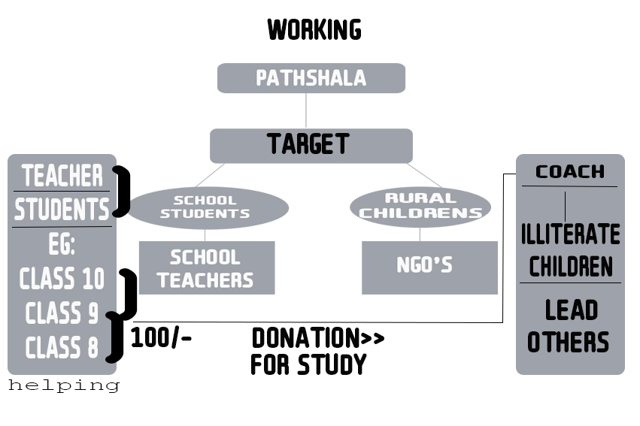

Slide 14
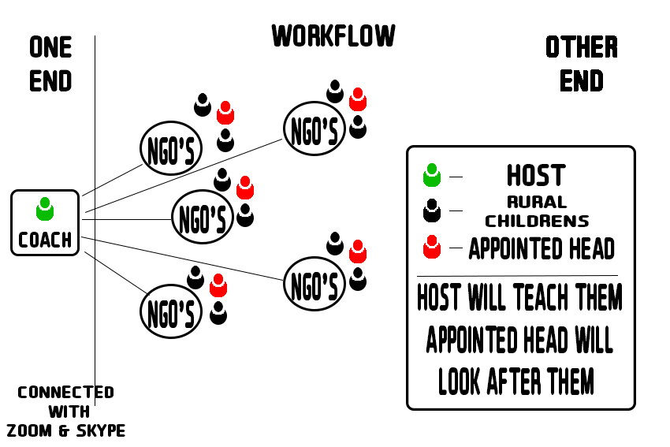

Slide 15
NOW WE ARE HIRING

