Slide 1
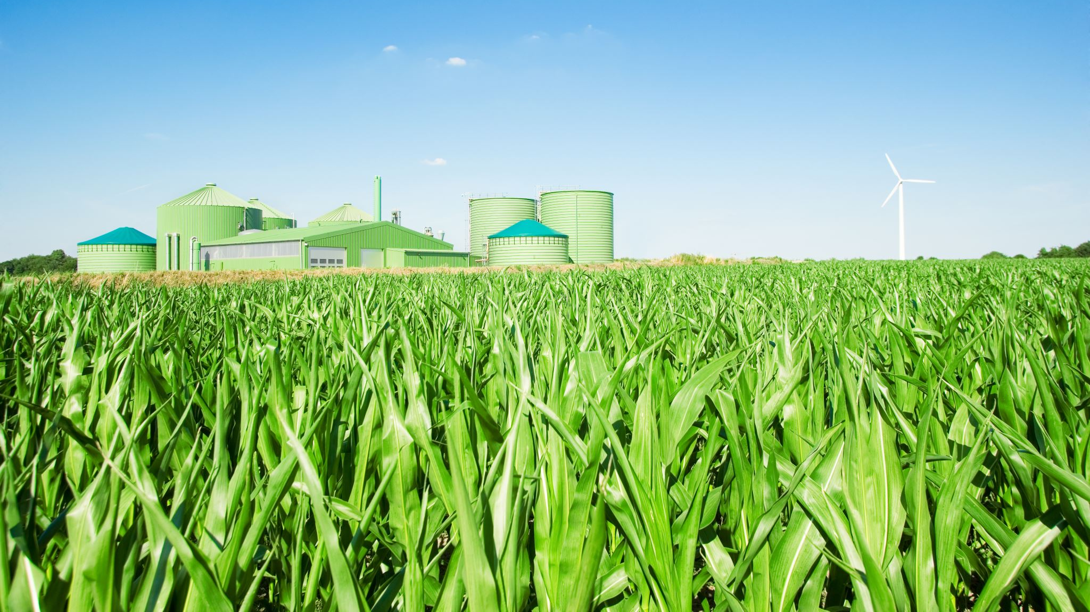
Malawi Yield Prediction
~ Abhishek Kotcharlakota

Slide 2
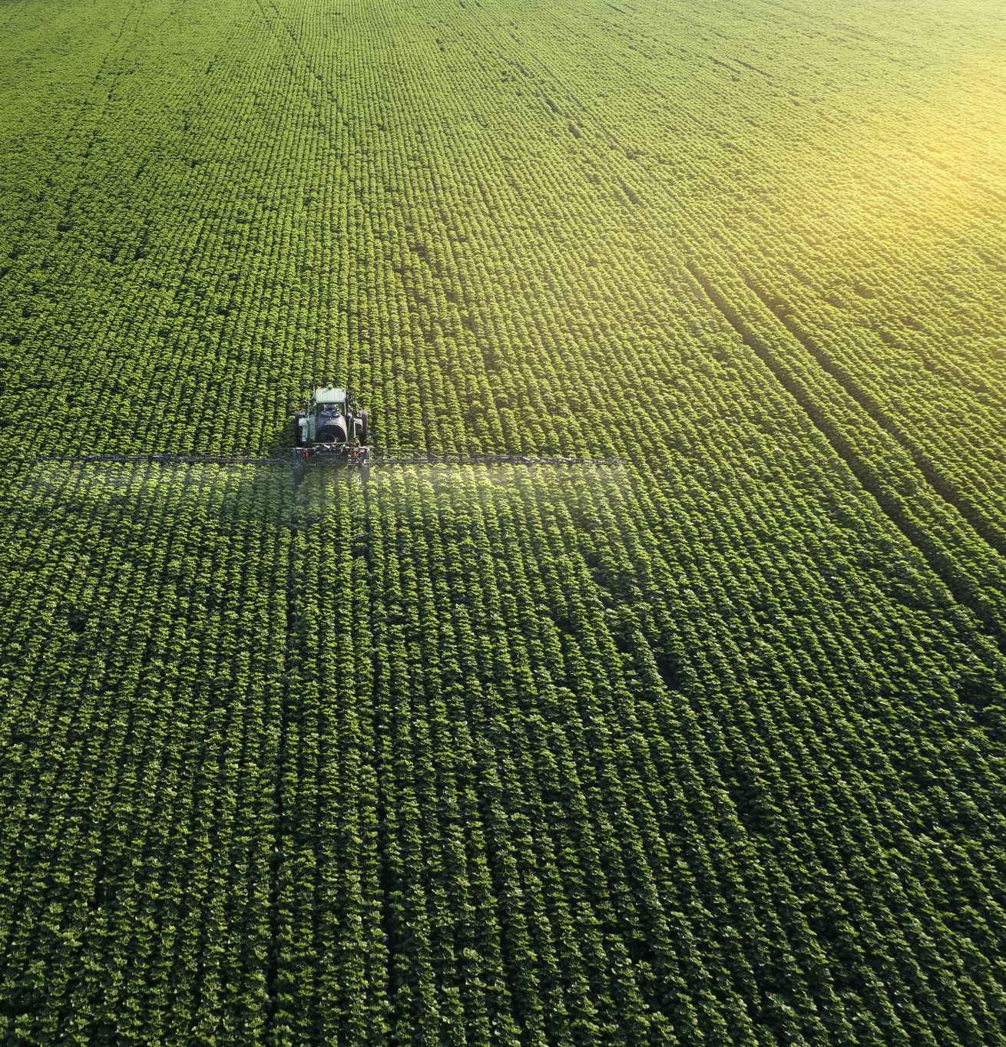
Objective
Our objective for the Malawi Yield prediction work is 2-fold =>
1. Build a machine learning based yield model, optimize features. Comment of the feasibility of such as model.
2. Analyze the intercropping scenario. Does intercropping have a positive or negative effect on yield in Malawi? Are the mono-cropped and intercropped fields differentiable?

Slide 3
Data
The data available to us is from multiple sources for 2 years – 2023, 2024. Because of limited temporal data, I am unable to leverage a lot of Geocif-related ideas such as LOYO, or using lag yields (the 2 years don’t have the same fields)
Relevant features are – 1. Ground truth: Dominant crop(Mostly maize) , minor crops(Pigeonpea, Cowpea etc.) , Yield, Year. 2. AGROECO – Daily temperature, Precipitation 3. Satellite – Planet Biweekly, 8 band.

Slide 4
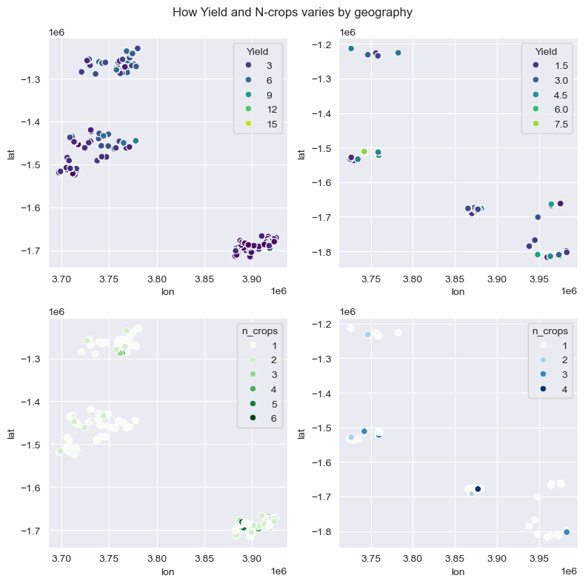
Data is available in 3 distinct regions

Slide 5
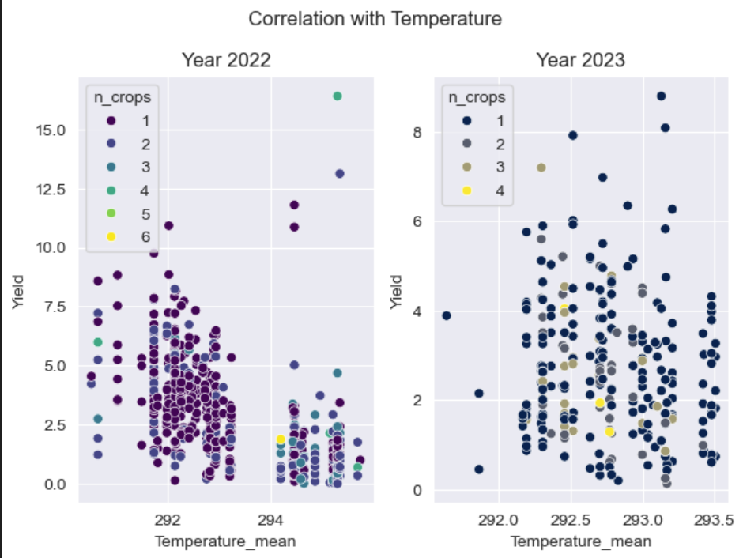
Maybe because of different regions, yield is negatively correlated with temperature in 2022.

Slide 6
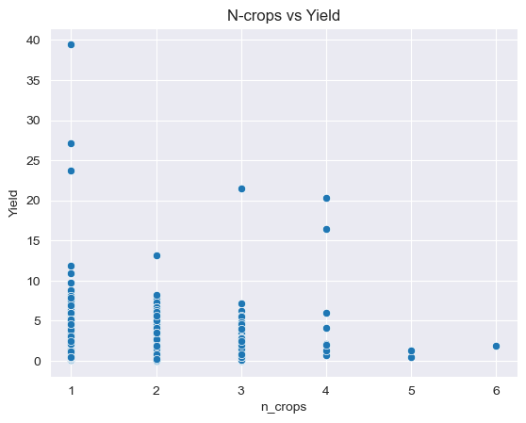
Yield Outlier issue
Number of crops is negatively correlated with Yield.
Yield has some extreme values. Is it suggested to perform outlier elimination; or does that delete important data.
All the fields above 15 are less than a hectare (as is the norm in Malawi)

Slide 7
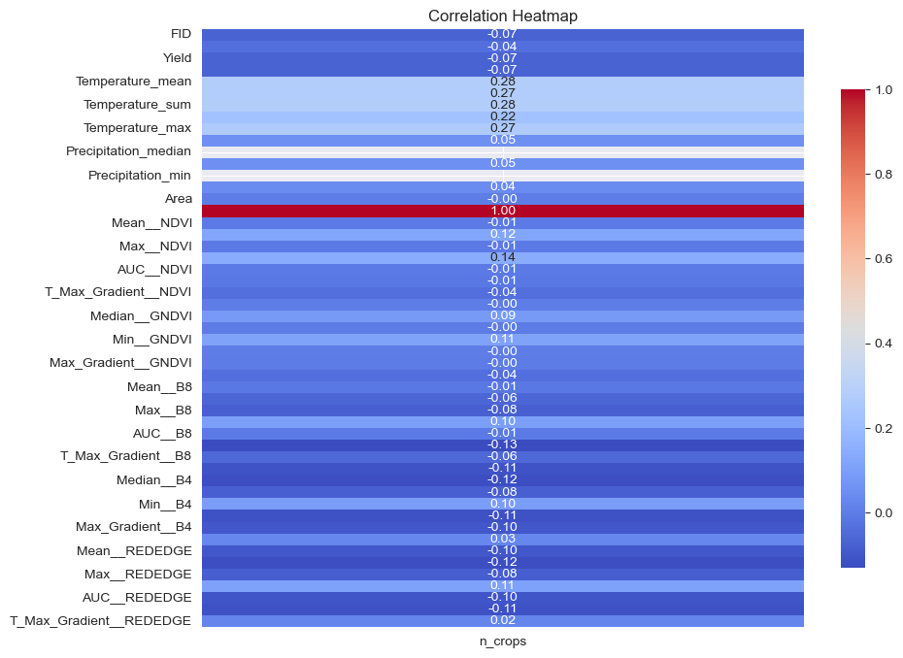
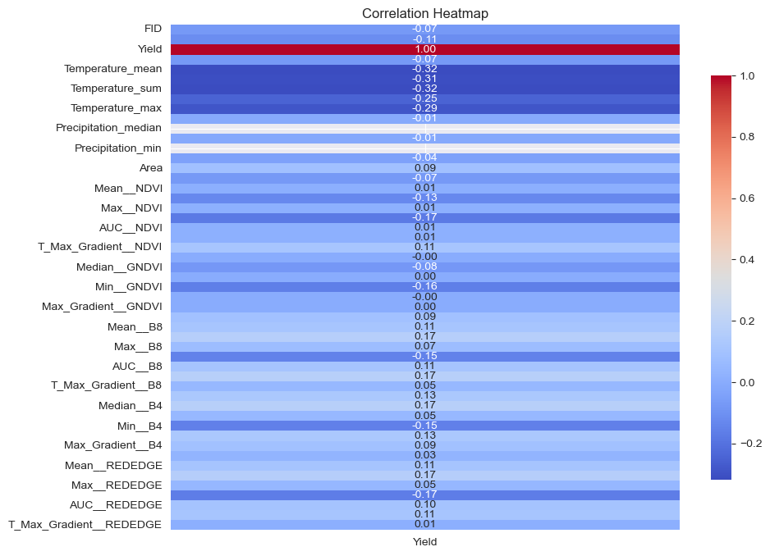
Correlations with Yield and n-crops.
Only Temperature is significantly correlated with Yield.
I do not observe any features with significant correlation wrt n-crops.

Slide 8
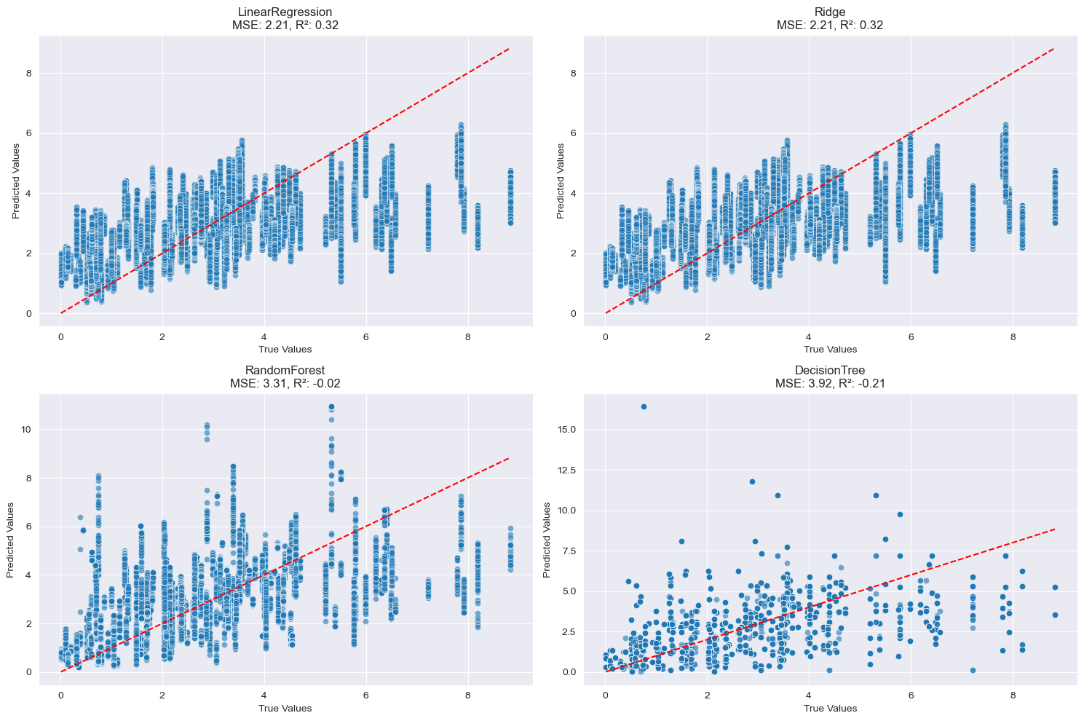
In the end – ML doesn’t give great results.

