Slide 1
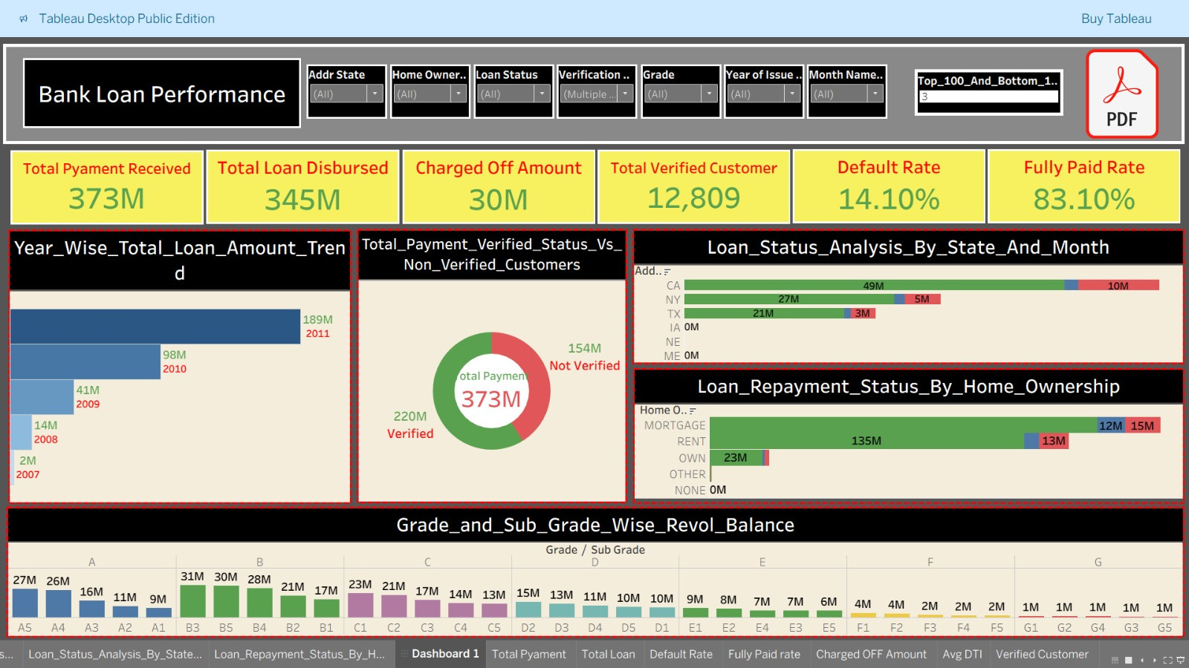
TABLEAU DASHBOARD

Slide 2
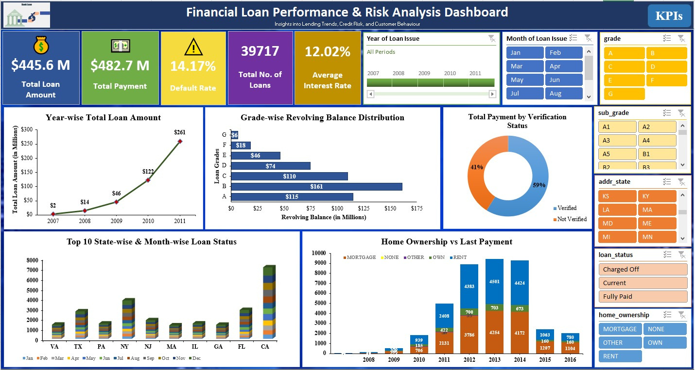
EXCEL DASHBOARD

Slide 3
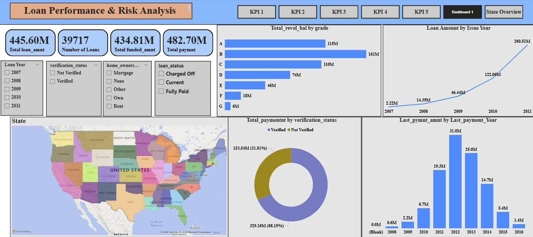
POWER BI DASHBOARD

Slide 4
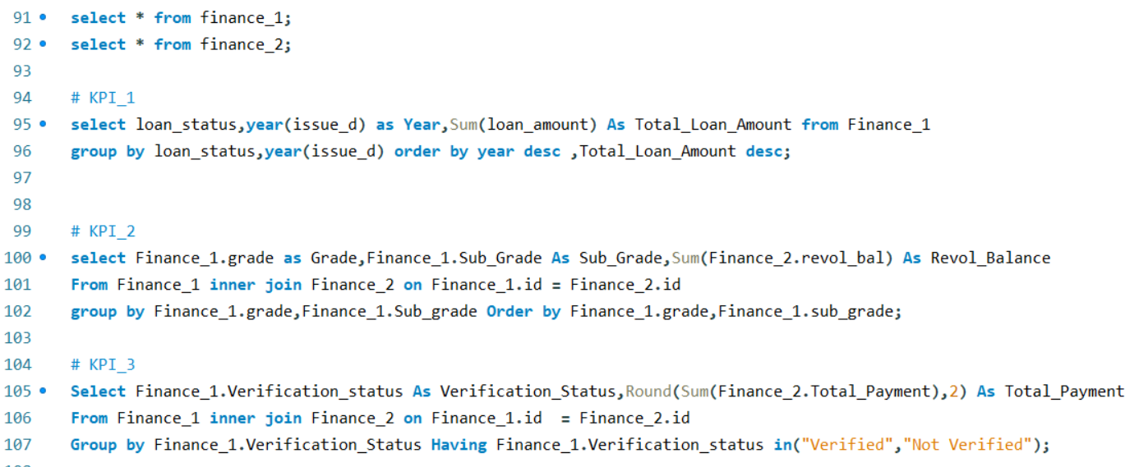
MYSQL QUERIES

Slide 5



Slide 6




Slide 7




Slide 8




Slide 9


