Slide 1

Data Lake Value Proposition
Medical Data Processing Company, San Francisco
Abhishek Kumar
Udacity IPS Version 1.0

Slide 2
Agenda
What is a Data Lake
Components of a Data Lake
Data Lake vs Data Warehouse
Business Value of Data Lake Solution
Proposed Data Lake Architecture for Medical Data Processing system
Udacity IPS Ver. 1 2/2020

Slide 3
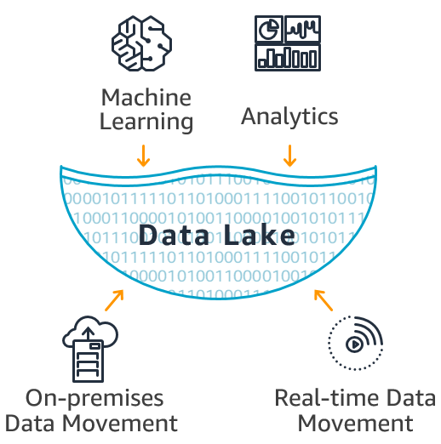
What is a Data Lake
Data Lake: A storage repository that holds a vast amount of raw data in its native format until it is needed for analytics application in an organization.
Properties of a Data Lake
Contains structured data, semi-structured data, and unstructured data
No fixed storage, no file type limitations, flexible format storage
Schema for a data lake is not predetermined
Flexible and easily expanded through the scaling of its servers
Transformation of data in case of regular and advanced analytics (AI/ML)
Need regular maintenance and governance

Slide 4
Components of Data Lake
Ingestion Layer
To ingest raw data into the Data Lake
Processing Layer
Implements business logic and analytical applications
Storage Layer
Store the data at scale in a data lake.
Serving Layer
Consumers get meaningful information.
Ingestion Layer
Type of data ingested – Real time data, batch data, one-time load data, historical data
Ingestion sources – Database servers, web servers, email, File Transfer Protocol (FTP), Internet of Things (IoT)
Example of data ingestion tools – Sqoop, Flume, Kafka, Nifi
Processing Layer
Business logic applied in this layer
Runs user queries and advanced analytical tools
Examples – MapReduce, Hive, Pig, Spark
Storage Layer
Scalable, cost-effective and allow fast access to data
Support various data formats
Example – HDFS, Cloud-storage options
Serving Layer
Extract value from the data and help business
Examples – Data visualization (PowerBI, Tableau), AI/ML, Ad-hoc reports

Slide 5
Data Warehouse
Data Lake
Philosophy - Think First, Load Later
Processing - Structured Data
Storage - Expensive for large data storage
Agility - Less Agile (Rigid)
Usage - Operational Reporting (Suits Business Users)
Security - Matured
Philosophy - Load First, Think Later
Processing – Structured, Semi-structured, Unstructured Data
Storage - Built for low-cost storage
Agility - Highly Agile (Flexible)
Usage – Advanced Analytics (Suits Data Scientists)
Security – Still maturing
Udacity IPS Ver. 1 2/2020

Slide 6
Business Value of Data Lake
Medical Data Processing Company, San Francisco
Problem Statement: Evaluation of current data system requirements and proposal of an end-to-end enterprise data lake solution to solve the current and future data challenges of Medical Data Processing Company, San Francisco
Analysis of the problem: The rapid growth of data as well as the hardware limitations design has led to problems related to storage, scalability, data quality, schema flexibility and advanced analytics.
Business Outcomes of a Data Lake
Democratize Data: Break data silos and make data available to the whole organization thereby saving time
Scalability: Allows to scale horizontally and store data from diverse sources in its raw format
Advanced Analytics: Apply complex queries and makes machine learning and deep learning seamless. It helps in real-time decision analytics.

Slide 7
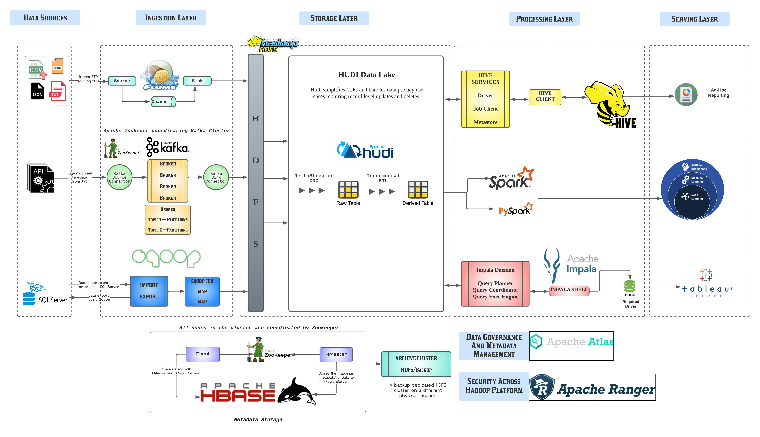
Data Lake Architecture

Slide 8
THANK YOU
Udacity IPS Version 1.0

