Slide 1


Data Governance @ SneakerPark
Prepared by: Abhishek Kumar
Submitted on: 05/02/2022

Slide 2
Background
SneakerPark is an online shoe reseller that allows people to buy and sell used and new shoes. Buyers can bid for shoes or buy them outright, and sellers can set a price or sell to the highest bidder.
Each buyer and seller must have an active account in order to sell, bid, or purchase sneakers using SneakerPark’s website.
SneakerPark authenticates the shoes before shipping them to the buyer, so before listing an item, the seller must ship it to SneakerPark’s warehouse. Upon receipt, SneakerPark assigns an item number to each pair of sneakers and notifies the seller that they are now free to list their item. If the item is not listed within 45 days, SneakerPark returns it to the seller and sends an invoice to the seller for the shipping cost.
If the item is found to be inauthentic or in an unacceptable condition, it is also returned back to the seller in a similar fashion.
When the item sells, the buyer’s account is credited with the purchase price minus the SneakerPark service fee and shipping fees to deliver the item to the buyer.
Currently, SneakerPark only supports sales within the United States.

Slide 3
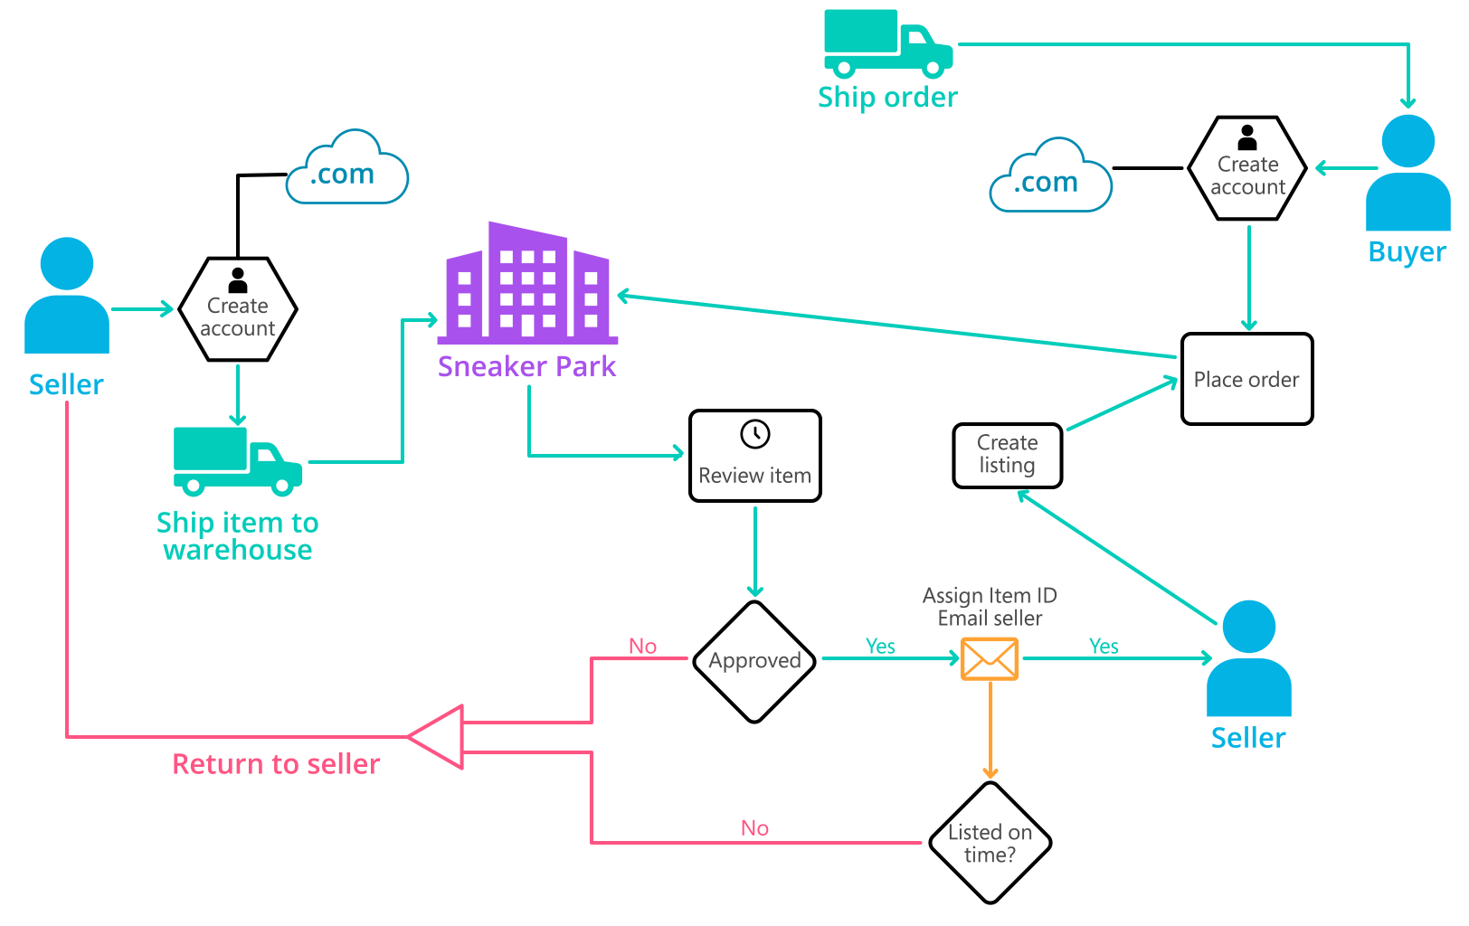
Background (cont’d)
Below you can see a diagram that will hopefully help you visualize some of SneakerPark's business processes. Keep in mind that it does not capture ALL processes and every nuance, but simply serves as another artifact to use in your project.

Slide 4
Step 1
Enterprise Data Catalog Part 1: Enterprise Data Model

Slide 5
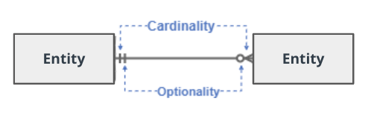
Create a conceptual data model that will provide SneakerPark with a holistic view of its data systems and help you grasp the organization's important entities and relationships, which will be instrumental as you move further in the project. You can use Lucidchart or any other diagramming tool of your choice, but please use the Crow’s Foot/IE Notation and please be sure to indicate both cardinality (the type of a relationship such as 1:N or N:N) and optionality (whether the relationship is optional or mandatory).

Slide 6
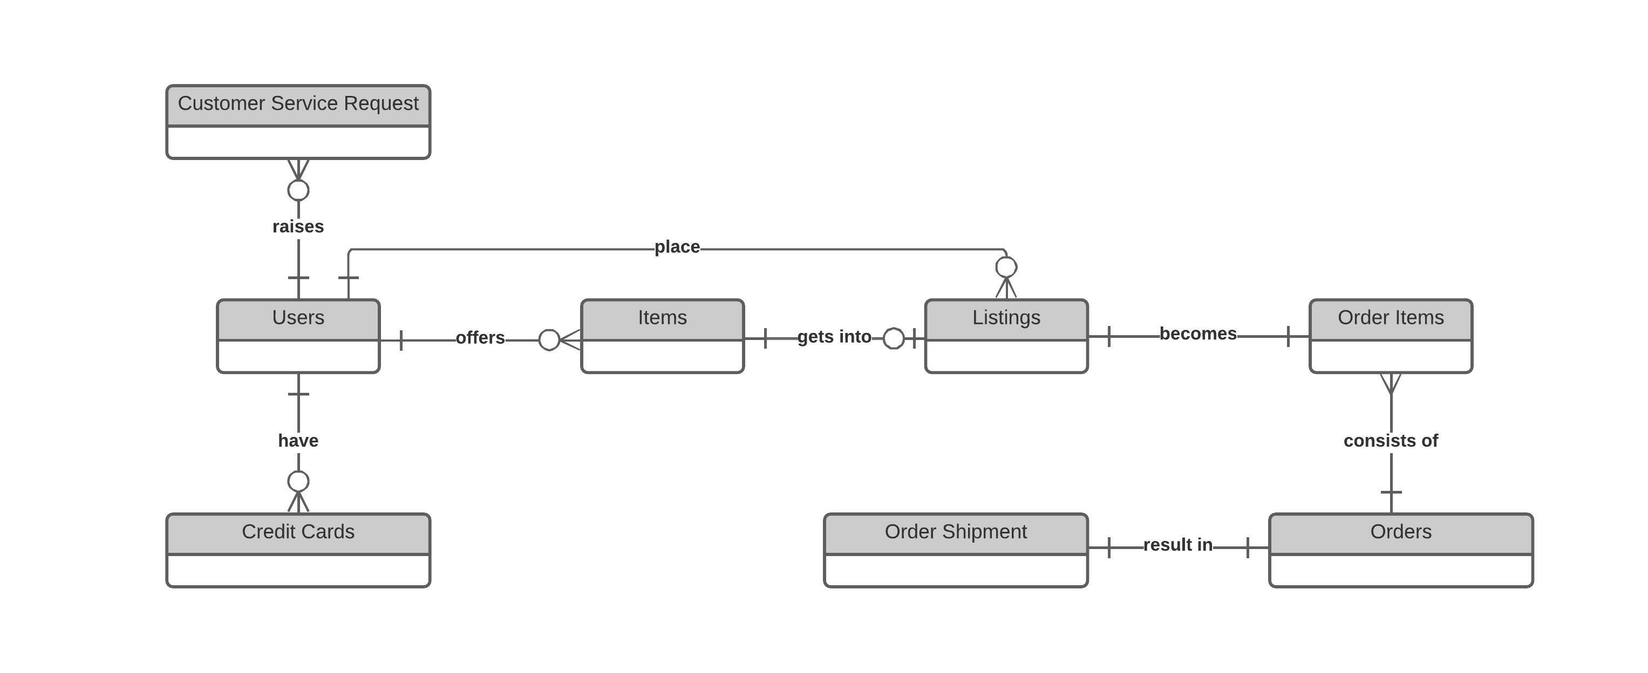
Enterprise Conceptual Data Model for SneakerPark
Created using Lucidchart

Slide 7
Step 2
Enterprise Data Catalog Part 2: Metadata

Slide 8
Create the first version of the Metadata Catalog by documenting the metadata from all systems in the "Data Dictionary" and the “Enterprise Data Catalog” tabs of the provided Sheets template.
Please note that you are required to fill out all fields in both tabs.
Refer to the Spreadsheet - Data Dictionary and Business Metadata for this part.

Slide 9
Step 3
Data Quality
Part 1: Profiling and Cleansing

Slide 10
Profile the data to identify at least 3 data quality issues you see in the data. Also provide at least 1 data quality issue that you haven’t yet seen in the data but can foresee occurring in the future. Based on the issues you’ve identified, come up with the data quality rule for each data quality issue, including for the one that you foresee.
Make sure you fill out all columns in the "Data Quality Issues" tab with your answers in the provided Sheets template.
Refer to the Spreadsheet - Data Quality Issues and Data Quality Dashboard.

Slide 11
Step 4
Data Quality
Part 2: Monitoring

Slide 12
Using the metrics you've created in the last step, please create a mock-up of a data quality monitoring dashboard that will be used to monitor the data to ensure compliance with your data quality rules.
Please make sure to label your metrics clearly on your mock-up.
Refer to the Spreadsheet - Data Quality Dashboard.

Slide 13
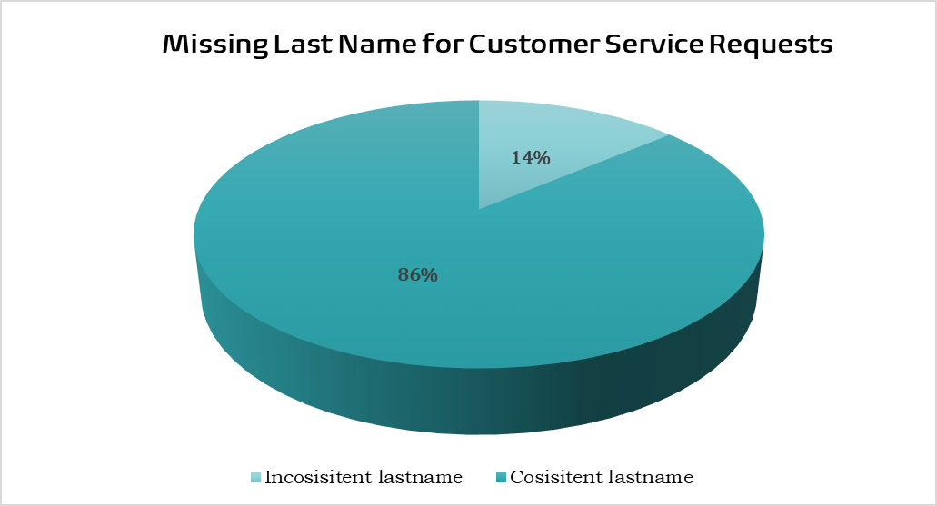
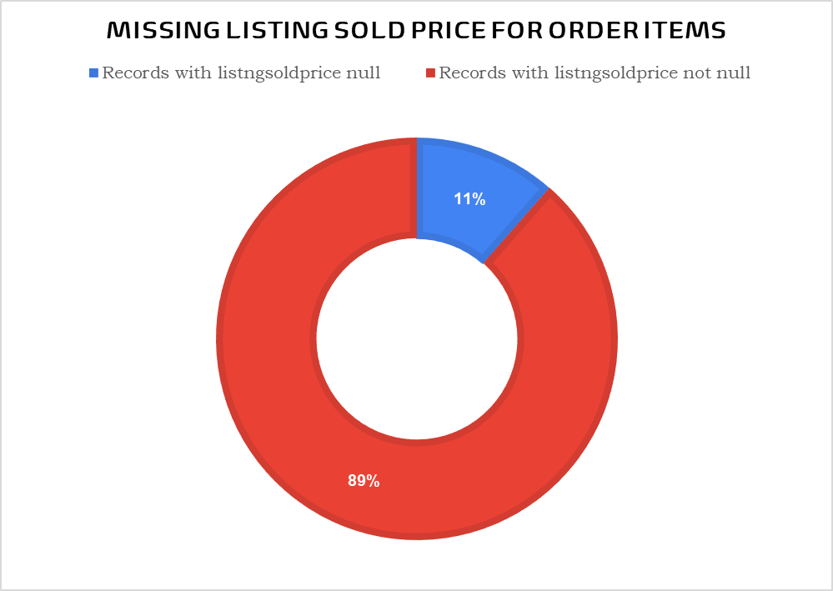

Slide 14
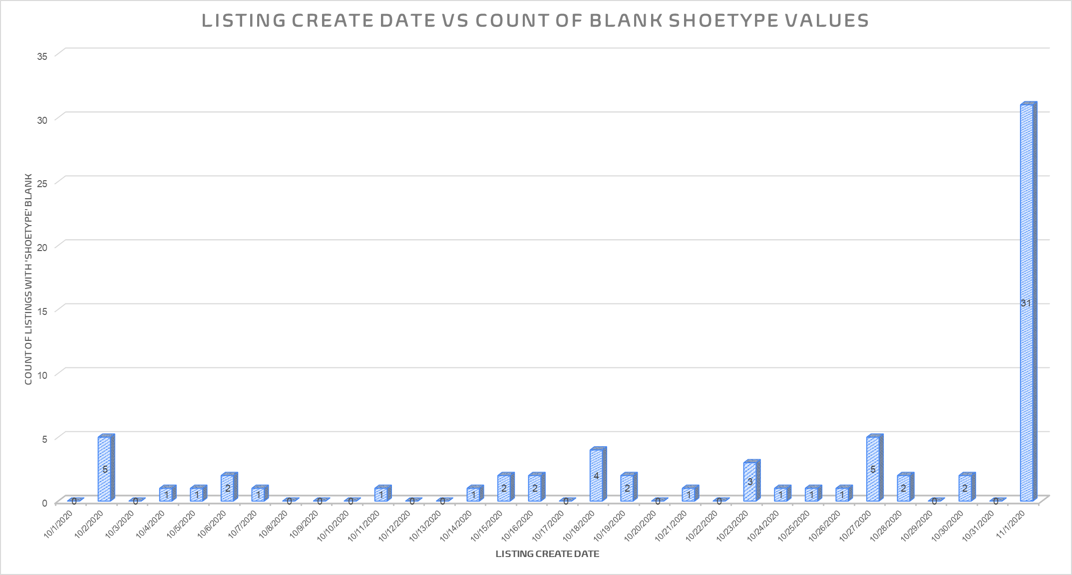

Slide 15
Step 5
Master Data Management
Part 1: MDM Architecture

Slide 16
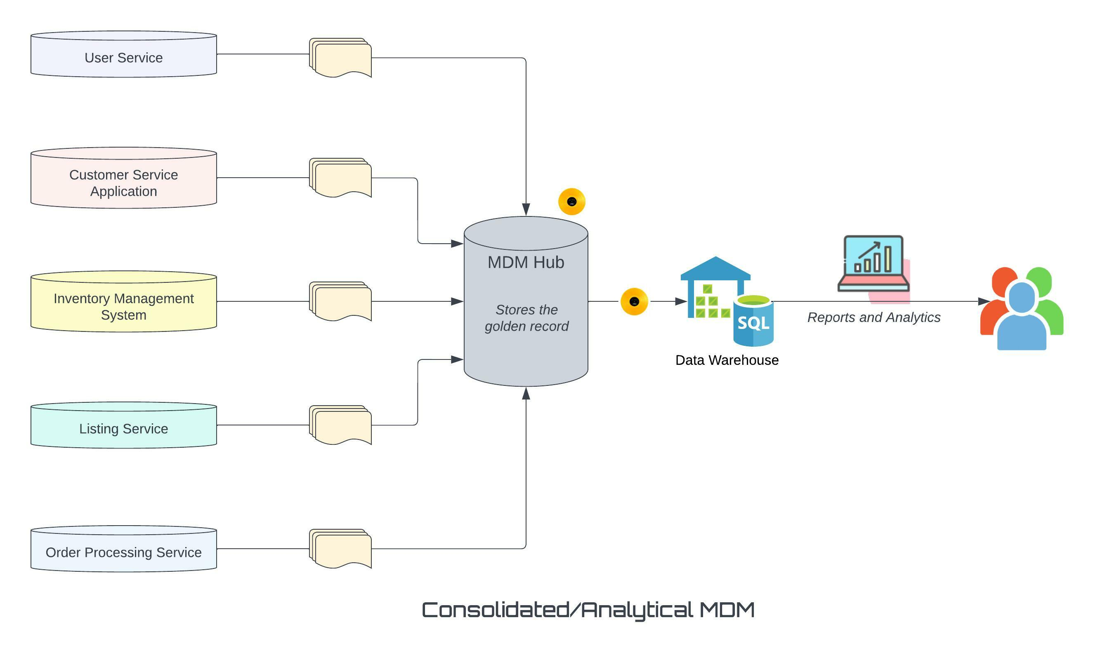
Based on what you’ve read about SneakerPark’s systems and business model, sketch out a proposed MDM implementation architecture, and write a detailed explanation of why you chose this specific approach.
Tip: Think about how your plan and its implementation might affect existing systems.
Replace example screenshot below with your own solutions (obviously feel free to take more space).
Next, please write at least a paragraph explaining your choice.

Slide 17
Explanation:
Considering SneakerPark’s data source distribution and data operations, we choose Consolidated/Analytical MDM implementation architecture. The idea is to physically consolidate, match, clean and store the data from data sources (User Service, Inventory Management, System Listing Service, Order Processing Service, Customer Service Application) in a central repository called the MDM Hub.
The idea is to store the golden records in a central location so that systems with interact with each other directly and indirectly have a single version of truth. SneakerPark is a customer-centric business where the customer interacts with different data source systems in order to buy or sell the products. Such systems are prone to duplicate and missing data. Having a consolidated MDM hub will help create an Enterprise Data Warehouse for the analytics team to draw trends and reports for SneakerPark’s businesses.
Though this approach will be slightly complex and expensive, it will cause minimum intrusion to the existing systems.

Slide 18
Step 6
Master Data Management
Part 2: Master Record

Slide 19
In this step, you will define a set of matching rules that will be used by the SneakerPark's MDM Hub to match item and customer entities between the company's different systems.
Please come up with 4 rules - 2 for Items and 2 for Customers and list them below.
Part (A): Customer
1. Source Systems and Tables
2. Match Rules to be used for merging records
Primary match: Match customer data on userid. All three tables have userid column.
Secondary match: Match customer data on firstname, lastname and email. users table and creditcards table have firstname, lastname and email.
3. Rationale for specific source for each column
Source System | Table Name
User Service | users
Customer Service Application | customerservicerequests
User Service | creditcards
Golden Record Column | Source Table | Reason
userid | users or customerservicerequests | Taken from users. Data provided by user while creating the account.
firstname | users or customerservicerequests | Taken from users. Data provided by user while creating the account.
lastname | users or customerservicerequests | Taken from users. Data provided by user while creating the account.

Slide 20
Golden Record Column | Source Table | Reason
email | users or customerservicerequests | Taken from users. Data provided by user while creating the account.
address | users | Only exists in users
zipcode | users | Only exists in users
creditcardnumber | creditcards | Only exists in creditcards
phone | customerservicerequests | Only exists in customerservicerequests
4. SQL Script for the matching rules
/** Creating Golden Record for Customer **/
/** Creating a Common Table Expression **/
WITH users_table AS (
SELECT *
FROM usr.users
),
/** Rolling up multiple rows of credit cards into a single row and column **/
creditcards_table AS (
SELECT DISTINCT userid,
STUFF ((SELECT ', ' + cc2.creditcardnumber FROM usr.creditcards AS cc2
WHERE cc2.userid = cc.userid
FOR XML PATH ('')), 1,1,'') [Credit Cards]
FROM usr.creditcards cc
),
/** Rolling up multiple rows of phone numbers into a single row and column **/
customerservicerequests_table AS (
SELECT DISTINCT userid,
STUFF ((SELECT ', ' + csr2.phone FROM cs.customerservicerequests AS csr2
WHERE csr2.userid = csr.userid
FOR XML PATH ('')), 1,1,'') [Phone Numbers]
FROM cs.customerservicerequests csr
)
SELECT
users_table.*,
creditcards_table.[Credit Cards],
customerservicerequests_table.[Phone Numbers]
FROM users_table
LEFT JOIN creditcards_table
ON users_table.userid = creditcards_table.userid
LEFT JOIN customerservicerequests_table
ON users_table.userid = customerservicerequests_table.userid;

Slide 21
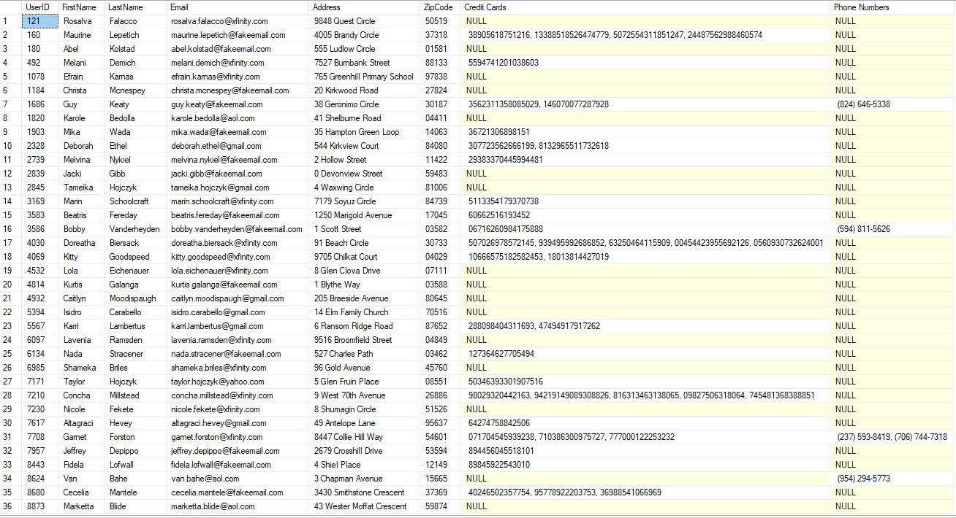
5. Customer master with best pieces of information
Total distinct user count is 400. For detailed information refer to the spreadsheet ‘Golden Record - Customers’.

Slide 22
Part (B): Items
1. Source Systems and Tables
2. Match Rules to be used for merging records
Primary match: Match items data with listings data on itemid and productid.
Secondary match: Match items data with listings data on sellerid.
3. Rationale for specific source for each column
Source System | Table Name
Inventory Management System | items
Listing Service | listings
Golden Record Column | Source Table | Reason
itemid | items | Exists in items only.
itemname | items | Exists in items only.
sellerid | items or listings | Exists in items, not all sellers are listed.
type | items or listings | Exists in items, but for some records in listings it is missing.
brandname | items or listings | Exists in items, but for some records in listings it is missing.
color | items or listings | Exists in items, but for some records in listings it is missing.
size | items or listings | Exists in items, but for some records in listings it is missing.
sex | items or listings | Exists in items, but for some records in listings it is missing.
condition | items or listings | Exists in items, but for some records in listings it is missing.

Slide 23
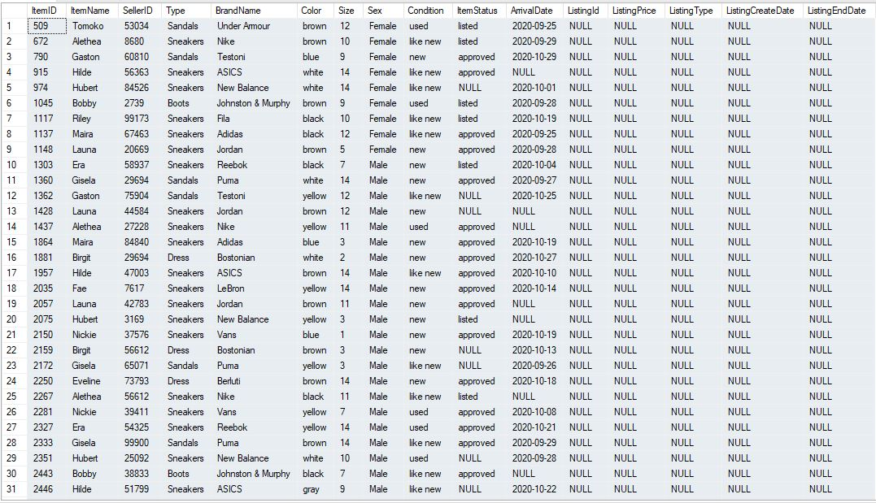
Golden Record Column | Source Table | Reason
itemstatus | items or listings | Exists in items, but for some records in listings it is missing.
arrivaldate | Items | Exists in items only.
listingid | listings | Exists in listings only.
listingprice | listings | Exists in listings only.
lisitngprice | listings | Exists in listings only.
listingtype | listings | Exists in listings only.
listingcreatedate | listings | Exists in listings only.
listingenddate | listings | Exists in listings only.
4. SQL Script for the matching rules
/** Creating Golden Record for Items **/
SELECT i.*, l.ListingId, l.ListingPrice, l.ListingType, ListingCreateDate, l.ListingEndDate
FROM im.items i
left join li.listings l
ON i.itemid = l.productid and i.sellerid = l.sellerid;
5. Customer master with best pieces of information
Total distinct items count is 797. For detailed information refer to the spreadsheet ‘Golden Record - Items’.

Slide 24
Step 7
Data Governance:
Roles and Responsibilities

Slide 25
Write 1-2 paragraphs discussing what data governance roles and responsibilities will be necessary to oversee this new Data Management initiative. Please be sure to discuss the responsibilities in the context of at least 3 different aspects of Data Governance (such as Data Quality Management, Metadata Management, MDM, etc). Based on what you know, do SneakerPark's current employees have the necessary skills for these roles or should the company make new hires?

Slide 26
SneakerPark’s business is data-driven and must involve the establishment of policies and procedures related to how data is ingested and processed. Currently the data is not of high quality and is not adequately managed throughout its life cycle.
Metadata Management is about capturing metadata distributed across the enterprise in a central location that can be easily accessed. Business teams in different departments use the metadata management system in their day-to-day activities to find data, conduct processes, and create reports. It is important from data governance point of view to have a system that centralizes the information about the content of the data. This can be done by creating an extensive data dictionary as well as Business metadata for SneakerPark.
Effective Data Quality Management is a key discipline of Data Governance. Implementing data quality is critical to the success of data integration, data migration, or business intelligence projects of SneakerPark. If the data quality is poor, the reports and dashboards SneakerPark team builds may not be meaningful or useful to business users. SneakerPark needs to automate processes to identify, fix and monitor data quality issues.
A common data problem is that the same data exists in more than one application in a company and is unreliable. On analyzing SneakerPark’s different schemas and tables it was found the data has a lot of discrepancies. A lot of attributes co-exist under different schemas/tables and on joining resulted in either blank values or a mismatch. Master data and Master Data Management help solve this problem. Thus, SneakerPark requires a consolidated and unified version of data.
SneakerPark should hire data stewards who are specialized in certain domains (products, customers) and data assets. As the company grows, they can plan to hire a data governance manager and setup a data governance committee that will be involved in making policies and standards.

Slide 27
Standout Suggestions

Slide 28
Create a Business Glossary for SneakerPark and define common terms such as Item, Buyer, etc. Think and discuss how SneakerPark can improve on the consistency of the terms that its systems currently use. (You can use the “Business Glossary” tab of the same Sheets template you’ve been using for the other parts of this project to get you started.)
Document SneakerPark’s current naming conventions. Can you think of any improvements? (You can use the “Standard Naming Conventions” tab of the same Sheets template you’ve been using for the other parts of this project to get you started.) Some examples of Naming Conventions include;
Do not use spaces or special characters.
Use only LOWERCASE.
All identifier fields should end in “_id”.
Avoid acronyms and abbreviations.
Write SQL scripts for the matching rules that you’ve created in Step 6.

