Slide 1




Alchemi: A .NET-based Enterprise Grid Framework
Grid Computing and Distributed Systems (GRIDS) Lab.
Dept. of Computer Science and Software Engineering
The University of Melbourne, Australia
www.gridbus.org / www.alchemi.net

Slide 2
Agenda
Introduction to Enterprise grids
Alchemi: Overview
Programming with Alchemi
Performance evaluation: how does Alchemi stack up against other similar efforts
Projects based on Alchemi
Summary

Slide 3
Introduction to Enterprise grids

Slide 4
Enterprise/Desktop Grids
Desirable qualities
  Harness the unused computing power of their existing desktop computers to build virtual supercomputers to satisfy growing compute-needs (maximize resource utilization)
  Minimize additional investment in h/w and s/w infrastructure
  Reduce impact on users in daily operations
  Tightly controlled (semi-)centralized environment

Slide 5







Basic Enterprise grid architecture
Internet
Controller allocates units of computation to workers and stores results.
User uses API’s and tools to create and run grid applications.
Internet
Workers execute units of computation and return results to central controller.

Slide 6
Enterprise Grid Middleware:
Design Considerations
Usability
  Easy to use installers
  Minimal configuration
Connectivity
  Work behind firewalls, proxy/NAT servers
Unobtrusiveness – No/minimal impact on use activities
  Workers need to run with background priority so that user applications are not affected
Programmability
  Fine-grained abstraction: familiar programming paradigm + reusable components
  Course-grained abstraction: file-based jobs
  Scheduling APIs to enable plugging-in new scheduling algorithms
Interoperability
  Web service interfaces for job submission, monitoring, management

Slide 7
Enterprise Grid Middleware:
Design Considerations contd…
Reliability
  Threads on disconnected workers should be restarted
  Require smooth restart from last known state in the event of a crash
Scalability
  Database for state – minimal state in memory
  Multithreaded
Security
  Authentication, Authorization, Auditing (AAA)
  Code security: Run remote jobs in a sandbox with fine-grained permissions
Manageability
  GUI for monitoring/administration

Slide 8
Alchemi: Overview

Slide 9
Alchemi Introduction
What is Alchemi?
  Enterprise grid framework and runtime machinery to create a high-throughput computing environment by harnessing distributed resources
    .NET-based (Windows)
    Voluntary execution (cycle stealing) or
    Dedicated execution
    LAN or Internet
  Programming environment
    Independent grid threads (.NET API)
    File-based jobs (input, executable, output)
  Web service for interoperability with other grid middleware
    File-based jobs
  Monitoring, administration tools

Slide 10
Why .NET based?
Why .NET/Windows?
  More than 90% of machines worldwide run variants of Microsoft Windows operating system. Hence designing for Windows is seen as key factor in industry adoption of grid computing technology
  Most existing systems are *nix-based / optimized for *nix.
  Many features of the new .NET platform can be leveraged
  Support multiple languages - write API/libraries once in any .NET language and make use from any other .NET supported language.

Slide 11
Alchemi Architecture
e-Science Application
e-Business Application
e-Engineering Application
e-Commerce Application
Alchemi .NET API
(Object-Oriented Grid Programming Environment)
Precompiled executables
Alchemi Jobs
(XML representation)
Alchemi Console Interface
Alchemi Cross-Platform Manager
Grid Threads (.NET objects)
Alchemi Manager
Alchemi Executor
Alchemi Executor
Alchemi Executor
Windows-based machines with .NET Framework

Slide 12
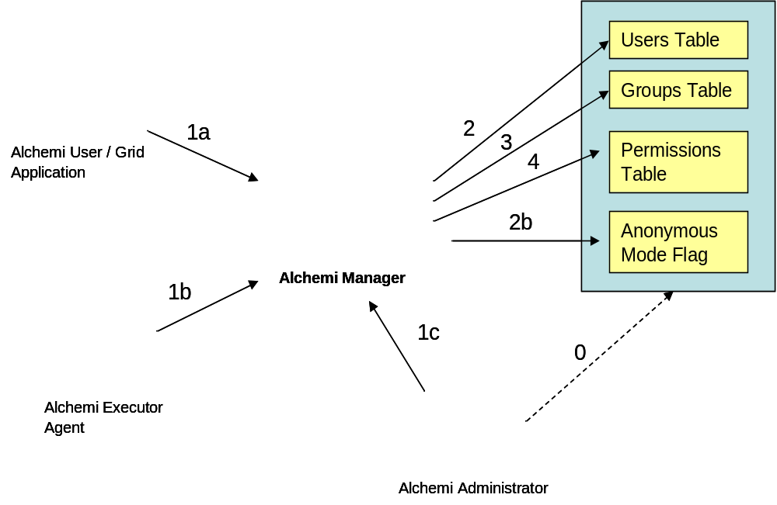
Role-based Security
Authentication:
Simple username / password
Authorization:
Role-based permissions
Auditing:
All jobs/threads executed are recorded in a database and linked to user account used for Authentication

Slide 13
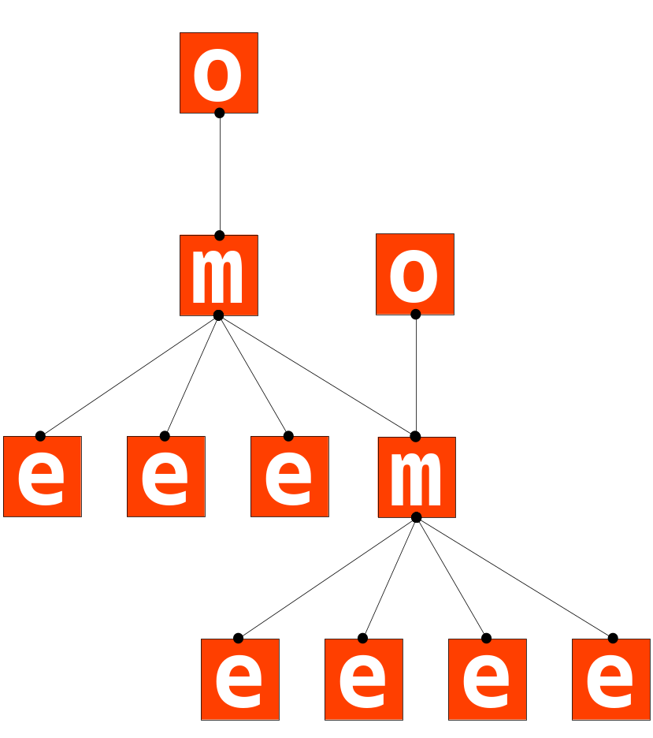
Multi-Level Grid
Managers connected hierarchically
  1+ Executor
  1+ Owner
Intermediate Managers are viewed as Executors
U
U

Slide 14
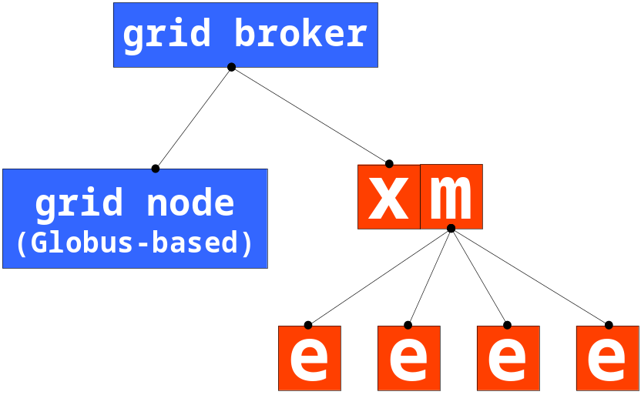
As a Node for Global Grids
Cross-Platform Manager – Web Services Interface
Alchemi grids as nodes (classical grid model)

Slide 15
Execution Model
Dedicated Executor
  2-way communication between Executor and Manager
Voluntary Executor
  1-way communication between Executor and manager (Executor works from behind firewalls)
Dual benefit
  Flexible resource management
  Flexible deployment

Slide 16
Programming applications with the Alchemi framework

Slide 17
Components
Grid application
  Consists of independent grid threads
Manager – central controller
  Discovery, scheduling, dispatching, monitoring
Cross Platform Manager
  Web service interface
Executor – worker agent
User
  Runs grid applications
  Monitoring
  Administration
Custom Grid
Middleware
U
X
U
User Node
M
Manager Node
E
Executor Node
M
X
Cross Platform
Manager Node
Legend
E
E
E
E
E

Slide 18
OO Grid Thread Model
Grid Application (object) consisting of a collection of Grid Thread (objects)
  Transparent execution of threads
  Event-driven
  Reusable drag-and-drop components
Easy to use
  Development of new grid applications

Slide 19
Grid Thread in C#
[Serializable]
public class MultiplierThread : GThread
{
private int _A, _B, _Result;
public int Result
{
get { return _Result; }
}
public MultiplierThread(int a, int b)
{
_A = a;
_B = b;
}
public override void Start()
{
_Result = _A * _B;
}
}

Slide 20
Grid Application
static void Main()
{
...
GApplication ga = new GApplication(
new GConnection("localhost", 9000, “user", “password")
);
ga.Manifest.Add(new ModuleDependency(typeof(MultiplierThread).Module));
for (int i=0; i<10; i++)
{
MultiplierThread thread = new MultiplierThread(i, i+1);
ga.Threads.Add(thread);
}
ga.ThreadFinish += new GThreadFinish(ThreadFinished);
ga.Start();
...
}
static void ThreadFinished(GThread th)
{
...
}

Slide 21
Grid Job Model
Tasks consisting of jobs
XML-based representation of tasks and jobs
Command line interface
  Submission
  Monitoring
  Result retrieval
Programmatic interface
Grid-enabling existing legacy applications

Slide 22
XML-Based Task Definition
<task>
<manifest>
<embedded_file name="Reverse.exe">[base64-encoded contents]</embedded_file>
</manifest>
<job id="0">
<input>
<embedded_file name="input1.txt">[base64-encoded contents]</embedded_file>
</input>
<work run_command="Reverse.exe input1.txt > result1.txt" />
<output>
<embedded_file name="result1.txt"/>
</output>
</job>
<job id="1">
<input>
<embedded_file name="input2.txt">[base64-encoded contents]</embedded_file>
</input>
<work run_command="Reverse.exe input2.txt > result2.txt" />
<output>
<embedded_file name="result2.txt"/>
</output>
</job>
</task>

Slide 23
Alchemi performance evaluation

Slide 24
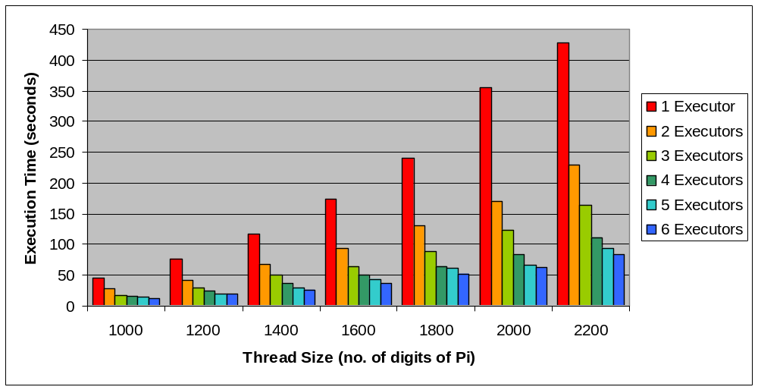
Performance Evaluation 1: Standalone Node (High Precision Pi Calculation)

Slide 25






Performance Evaluation 2:
(Alchemi as a Global Grid Node)
User Application
Gridbus Broker
[Linux Server@manjra.cs.mu.oz.au]
IBM eServer @ ANU, Canberra (Linux + Globus)
IBM eServer @
Adelaide (Linux +
Globus)
Windows Desktop Cluster @ Melbourne (.NET + Alchemi Manager)
[maggie.cs.mu.oz.au]
IBM Cluster @ VPAC, Melbourne (Linux+Globus)
Cluster @ AIST, Tsukuba, Japan
(Linux+Globus)
A Cluster Node @ UCSD, San Diego (Linux+Globus)
Alchemi Executors
Alchemi Executors
Desktop PC (i686 Pentium & Windows 2000) of GRIDS Lab running Alchemi Executors.

Slide 26
Performance Evaluation 2: Resources
Resource | Location | Configuration | Grid Middleware
maggie.cs.mu.oz.au [Windows cluster] | University of Melbourne | 6 * Intel Pentium IV 1.7 GHz | Alchemi
quidam.ucsd.edu [Linux cluster] | University of California, San Diego | 1 * AMD Athlon XP 2100+ | Globus
belle.anu.edu.au [Linux cluster] | Australian National University | 4 * Intel Xeon 2 | Globus
koume.hpcc.jp [Linux cluster] | AIST, Japan | 4 * Intel Xeon 2 | Globus
brecca-2.vpac.org [Linux cluster] | VPAC Melbourne | 4 * Intel Xeon 2 | Globus

Slide 27
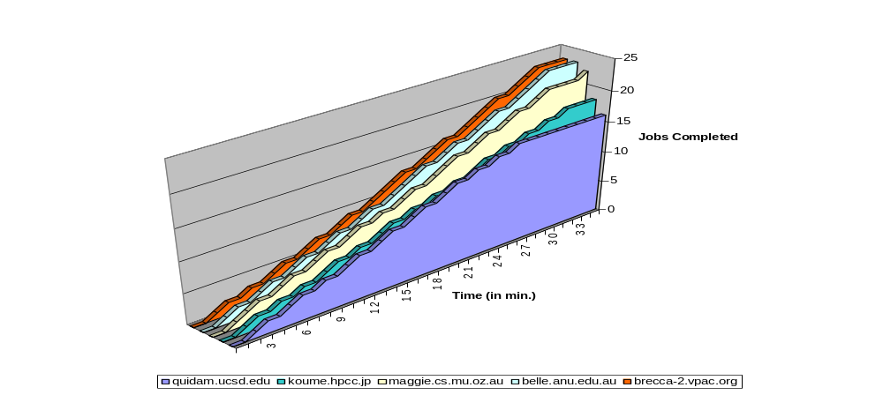
Performance Evaluation 2: (100 jobs completed by different nodes)

Slide 28
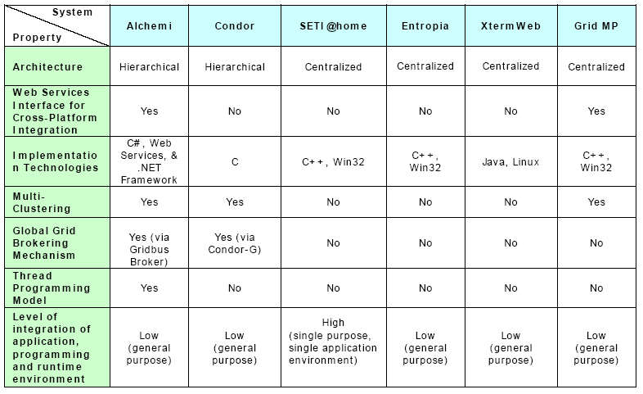
Related Works and Comparison

Slide 29
Projects based on Alchemi

Slide 30



Projects Using Alchemi
CSIRO Land & Water [Canberra]
  Framework for parallel execution of environmental simulation models
Tier Technologies, [USA]
  Large scale document processing
FMI Biomedical Research Inst., [Switzerland]
  Detection of patterns of transcription factors in mammalian genes

Slide 31



Projects Using Alchemi(2)
stochastix GmbH, [Germany]
  Commercial Product: Asynchronous Excel Tasks using ManagedXLL and Alchemi .Net Grid Computing framework
  (ManagedXLL, is in use on several hundred trading desks at the world’s largest banks and hedge-funds)
Correlation Systems Ltd., [Israel]
  FoxFix2, an Alchemi-based tool for estimating the location of an HF radio transmitter using SSL technology
Satyam Computers, [India]
  micro-array data processing application for early detection of breast cancer

Slide 32
Projects Using Alchemi (3)
GridCrypt – Grid course student project
  Distributed symmetric key cryptography
ExcelGrid – Grid course student project
  Excel front-end to Alchemi & Gridbus Broker (via Excel plug-in)
NMAMIT, Nitte, Karnataka, India
  Fault detection using the n-modular redundancy and voting
Private Grid Initiative (The Netherlands)
  10 node testbed for innovative applications
  Online for > 3 months
Silica (South Africa)
  Financial services company: Distributed fund administration system
And many more…

Slide 33
Alchemi community
Open-source software
Hosted on sourceforge.net
Active user / developer community

Slide 34
Summary

Slide 35
Summary
  Alchemi is an easy-to-use Enterprise Grid framework
  Offers a simple way to get up and running with a Windows-based compute Grid
  Has a flexible programming model and simple tools for monitoring and administration

Slide 36
Current Status
  Alchemi is currently in v.1.0.4
  v.1.0.* includes an improved extensible Console interface for monitoring and administration
  Executor & Manager now run in service-mode (as a SYSTEM user) such that they are always running without the need for a user to logon
  Manager storage is abstracted out, so that any RDBMS which has a OleDb driver can be used as the back-end storage system. In-memory storage is also possible.
  New Java API for java clients to submit jobs to Alchemi Manager web-service
  Improved fault-tolerance and logging

Slide 37
Future Work
  Inter-thread communication (MPI-like or .NET remoting-based)
  Multi-clustering / federation (for decentralization and improving scalability)
  Economy scheduling
  Web-based tools for monitoring/admin
  Workflow and other application models
  Data-centric features
  Integration/interoperability with WSRF standards and grid-services, JSDL (job-submission language)
  More fine-grained task execution to enable distributed transactions
  Interfaces for exploiting human presence at node to enable interesting applications

Slide 38
More Info:
http://www.alchemi.net
  Software download
  Source code (GPL)
  Examples
  Documentation
  Resources for users & developers
  News
  Papers
Contact: raj, kna {@csse.unimelb.edu.au}

Slide 39
Acknowledgements
Team
  Krishna Nadiminti (Active developer), A. Luther (Project founder/Developer) and R. Buyya (CI/Mentor)
Interface to Gridbus Broker
  S. Venugopal
  R. Ranjan
Executor Service
  Rodrigo Assirati Dias and his team
Applications and Tools
  GridCrypt – A Setiawan, D. Adiutama, J. Liman
  ExcelGrid – K. Nadiminti
Sponsored By
  University of Melbourne
  ARC Discovery Projects
The User and developer community on SF.net

Slide 40
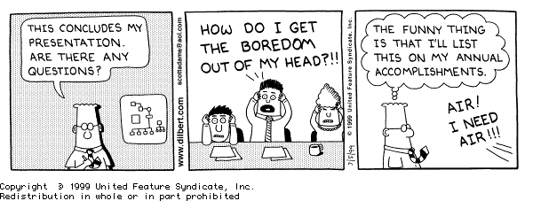
Thank you

