Slide 1


DETECTION OF SPINE INJURIES
Presentation by:
BHUVAN U KADLAS [4VV20CS020]
DHEEMANTH GOWDA [4VV20CS044]
ABHISHEK L [4VV20CS004]
D S YASHWANTH [4VV20CS026]
Under the guidance of
Dr .Chethana H T
Associate Professor, Department of Computer Science & Engineering

Slide 2
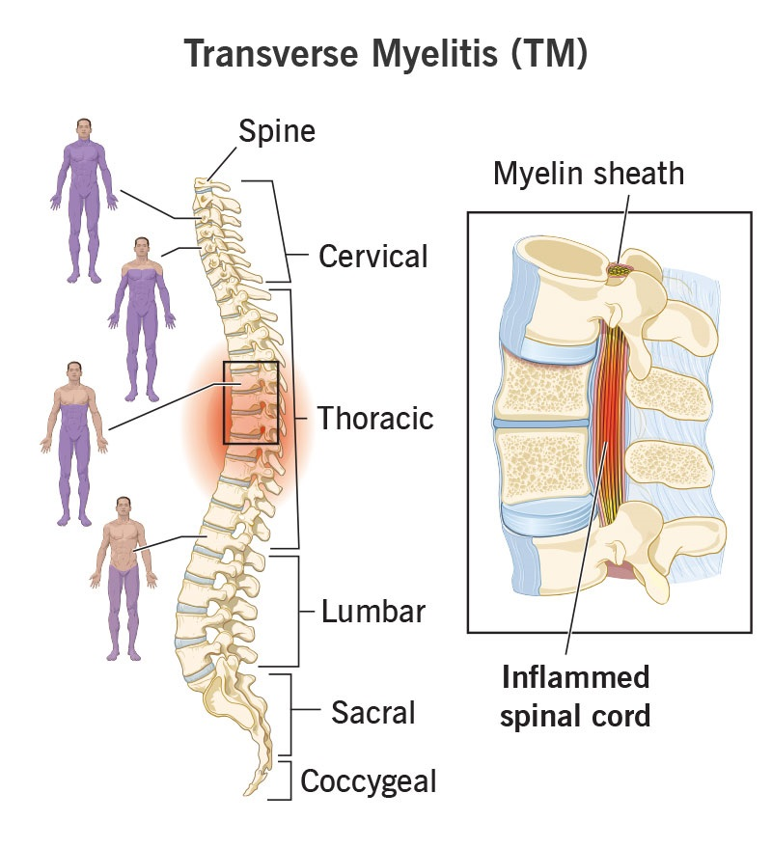
Background
Myelitis is spinal cord inflammation causing weakness, numbness, pain, paralysis. It affects all ages due to infections or autoimmune disorders.
The disease manifests differently in different individuals, with symptoms ranging from mild to severe. In some cases, myelitis can cause permanent damage to the spinal cord and result in long-term disability.
Diagnosing myelitis involves clinical evaluation, history review, MRI, or cerebrospinal fluid analysis. Early detection is vital for effective treatment.
Using DL models on large medical imaging datasets, researchers develop accurate tools for myelitis diagnosis. This improves patient outcomes with non-invasive, cost-effective solutions.
Fig 1 : Myelitis

Slide 3
OBJECTIVES
Motive: Enhance Myelitis detection in Spinal Cord with data augmentation & efficient model training.
Methodology: Utilize diverse datasets, train the same with CNN models ,and deploy the models on a web page using the Flask framework
Dataset: 1500+ images for detection and clinical markers of 400 patients for prediction.
Image Augmentation: Use image data generator for varied characteristics, enriching dataset.
Model: Utilize CNN architecture for feature extraction and classification.
Algorithm: SGD machine learning algorithm used for linear or nonlinear classification.
Deployment: Develop a web application using Flask framework to host the model, providing accessibility and user-friendly interface for Myelitis detection

Slide 4
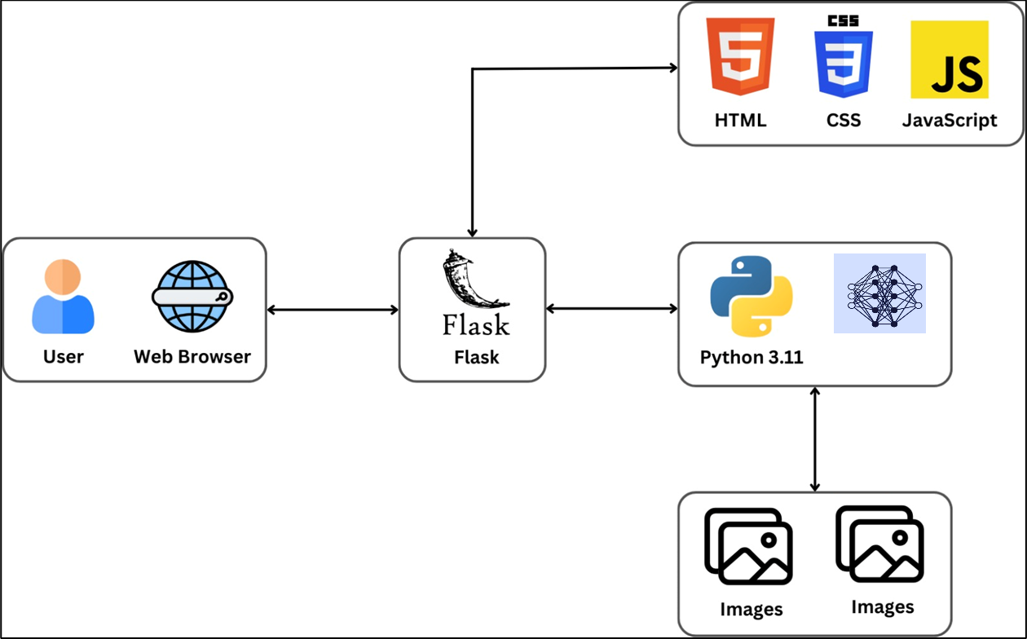
SYSTEM ARCHITECTURE
Fig 2 : System Architecture

Slide 5
DETECTION

Slide 6
Proposed Methodology for Detection
Data collection: Kaggle.
Split Ratio: 70:30 (Train:Test).
Pre-processing: adjusting contrast, enhancing quality, Width and Height Shift, Shear, Zoom and Horizontal flip
CNN architectures: Feature extraction and classification using.
Deployment: Flask framework.

Slide 7
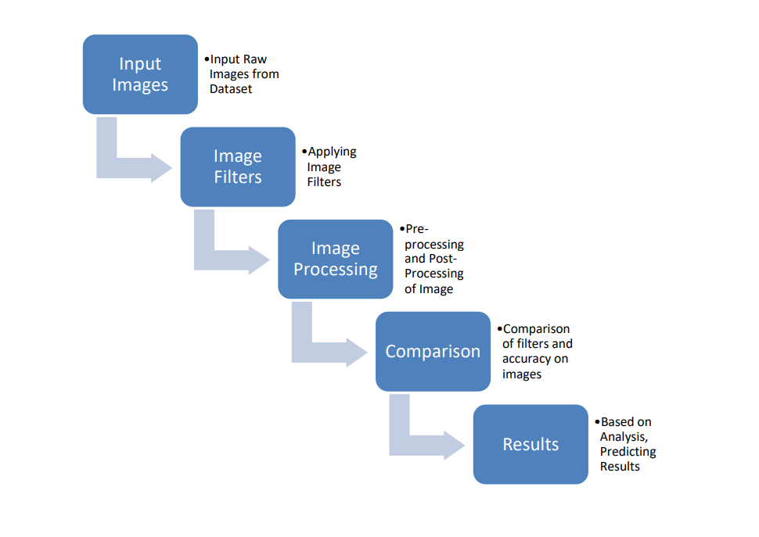
Proposed Methodology for Detection
Fig 3 : Proposed methodology for Detection

Slide 8
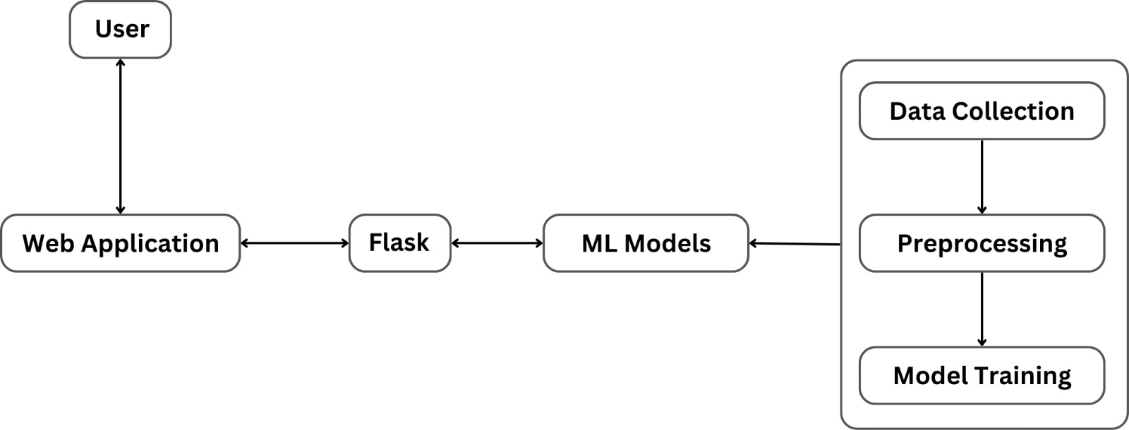
Workflow
Fig 4 : Workflow of the project

Slide 9
CNN Architecture
Convolutional layer with 32 filters of size (3, 3),
ReLU activation function.Max pooling layer with pool size (2, 2).
Convolutional layer with 64 filters of size (3, 3), ReLU activation function.
Max pooling layer with pool size (2, 2).
Convolutional layer with 128 filters of size (3, 3), ReLU activation function.
Max pooling layer with pool size (2, 2).
Convolutional layer with 128 filters of size (3, 3), ReLU activation function.
Max pooling layer with pool size (2, 2).
Flatten layer to convert the 2D matrix data to a vector.
Dense (fully connected) layer with 128 neurons and ReLU activation function.
Dropout layer with a rate of 0.5 to prevent overfitting by randomly dropping out connections during training.
Output layer with 1 neurons and softmax activation function, assuming binary classification.
There are 8 convolutional layers (including pooling layers), 1 flatten layer, 1 dense layers, and 1 dropout layer, making a total of 11 layers in this architecture.

Slide 10
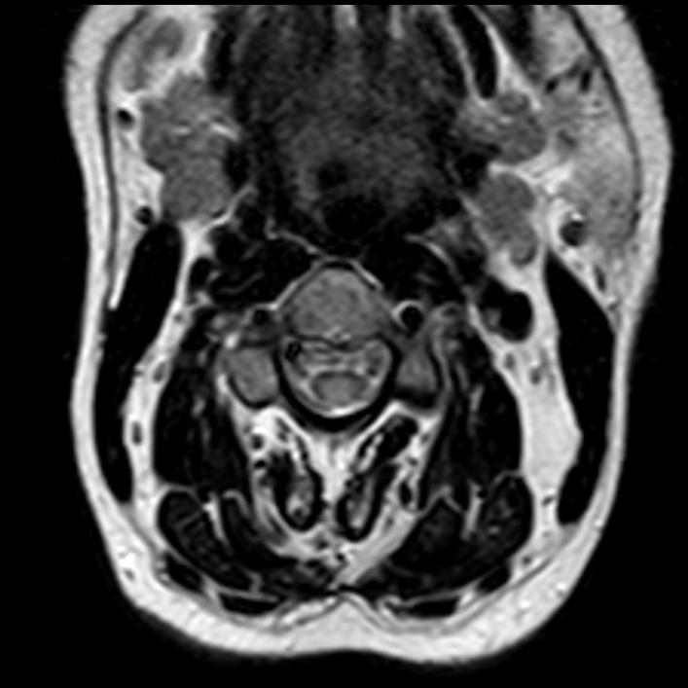
Yes
MRI Scan
64 x 64 x 64
No
128 x 128 x 32
128 x 128 x 64
Max Pooling
(Subsample)
Classes probability
distribution
256 x 256
256 x 256 x 32
Convolution
Max Pooling
(Subsample)
Convolution
Fully connected
Layers
Flatten
Fig 5: CNN Architecture

Slide 11
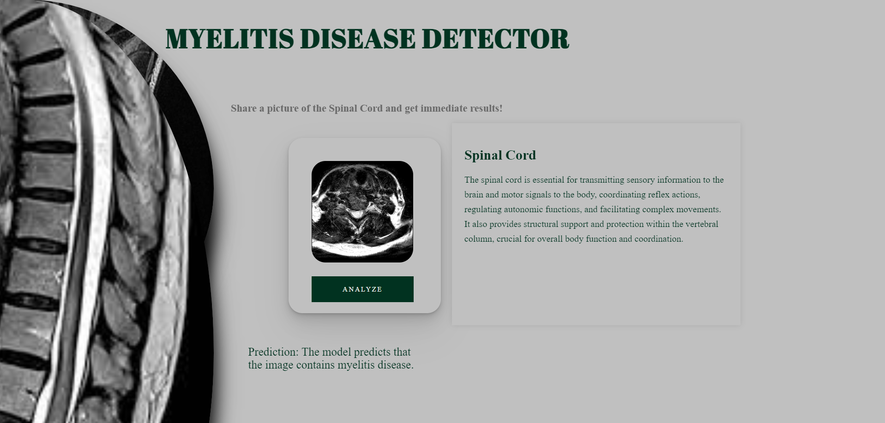
Input And Output for Detection
Input: MRI Images of the Spinal Cord.
Output:
Fig 6 : Output for the Detection Model

Slide 12
Evaluation Metrics
Accuracy: Accuracy measures the proportion of correctly classified samples out of the total number of samples. In the context of Myelitis, accuracy represents the overall effectiveness of the CNN model in correctly identifying both CKD and non-CKD.
Recall (Sensitivity): Recall, also known as sensitivity or true positive rate, measures the ability of the model to correctly identify positive instances out of all actual positive instances.
Precision: Precision measures the proportion of true positive predictions out of all positive predictions made by the model. It indicates the accuracy of positive predictions made by the model.
F1-score: F1-score is the harmonic mean of precision and recall. It provides a single metric that balances both precision and recall, making it useful when the class distribution is uneven.

Slide 13
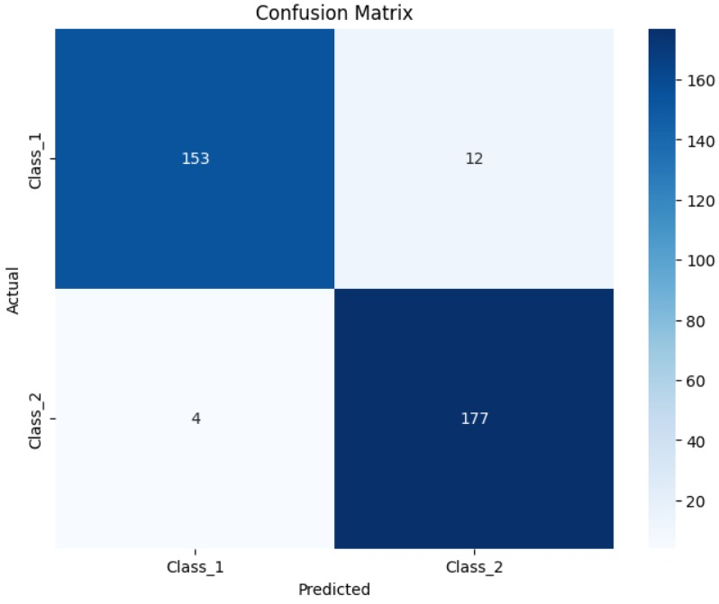
Evaluation
Fig 7: Confusion Matrix of the Detection Model

Slide 14
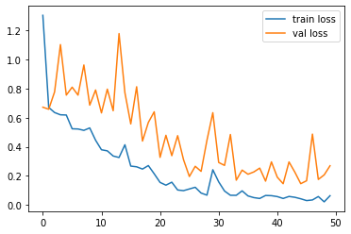
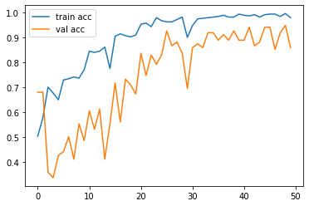
Evaluation
Fig 8: The trained model’s accuracy
Fig 9: The Model’s loss accuracy

Slide 15
Evaluation
Model | Accuracy
SGM | 98.8
Crow Search-Rider optimization | 88
Random Forest | 87.2
Naïve Bayes | 90.6
Decision Tree | 82.5
SVM | 88.82
Table 1: Comparison of Proposed method with existing methods

Slide 16
Evaluation
EVALUATION
We can observe in Figure 11 observe a consistent rise in the accuracy of the model for every epoch.
This will help us understand the performance of the model better.
The Figure 12 shows the various loss values at each epoch.
When the loss function value is changed, accuracy suddenly decreases.
This loss function graph aids in the prediction of learning problems.
Such problems may result in underfitting or an overfitted model.

Slide 17
SYSTEM ARCHITECTURE
1. Presentation Layer:
HTML: For structuring the webpage.
CSS: For styling the webpage and making it visually appealing.
JavaScript: For adding interactivity and handling user inputs on the webpage. We'll JavaScript to send requests to Flask backend and display the results.
Fig 10 : Home Page

Slide 18
SYSTEM ARCHITECTURE
2. Application Layer:
Flask Framework: Flask is used to host your machine learning models and handle HTTP requests from the frontend.
Python: The language used to develop the Flask application.
Deep Learning Model: SGD Classifier, Back Propagation and Loss Function
Deep Learning Model: CNN.

Slide 19
SYSTEM ARCHITECTURE
3. Communication Layer:
HTTP Protocol: Facilitates communication between the frontend and backend. The frontend sends HTTP requests (e.g., using JavaScript's fetch API) to the Flask backend, and the backend responds with HTTP responses containing the results.

Slide 20
Achievement
Successfully achieved accurate identification of myelitis disease in patients.
Developed a model with high precision and recall for detecting myelitis in medical images
Implemented data augmentation techniques to improve model resilience and generalization.
Successfully deployed the model using Flask, enabling integration in various applications such as laptops and smartphones.
Upon evaluation, the model consistently delivers precise results with high accuracy.

Slide 21
Limitations
Integration into Clinical Workflow: Clinicians may require additional training to interpret and trust the model's predictions, potentially leading to delays in adoption.
Ethical and Legal Considerations: Deploying DL-based systems for myelitis detection raises ethical and legal concerns such as patient privacy, consent, data security, and liability, necessitating careful consideration and compliance with regulations.
Data Availability and Quality: Obtaining a comprehensive dataset covering diverse demographics, myelitis types, and imaging modalities poses challenges, potentially limiting the model's effectiveness.
Clinical Validation: Validating the model's performance in real-world clinical settings is crucial. Future research should involve prospective studies to assess its impact on clinical decision-making and patient outcomes.
Dynamic Nature of Health Data: Health data relevant to myelitis, including factors influencing its occurrence, may evolve over time, necessitating continuous monitoring and adaptation of the model to maintain accuracy.

Slide 22
Conclusion
This technique of using medical image processing technologies will increase the use of myelitis detection.
This work's computer-generated results will contribute to raising the standard for clinical judgement in the identification of myelitis.
This algorithm is able to identify the myelitis from images.
Because of augmentation, there are now more original photos, and a sizable dataset is ready.
Later, CNN and ImageGenertor was used to choose features from the enhanced photos.
The suggested framework attained a noteworthy 96. 21% accuracy rate in this field.

Slide 23

THANK YOU

