Slide 1
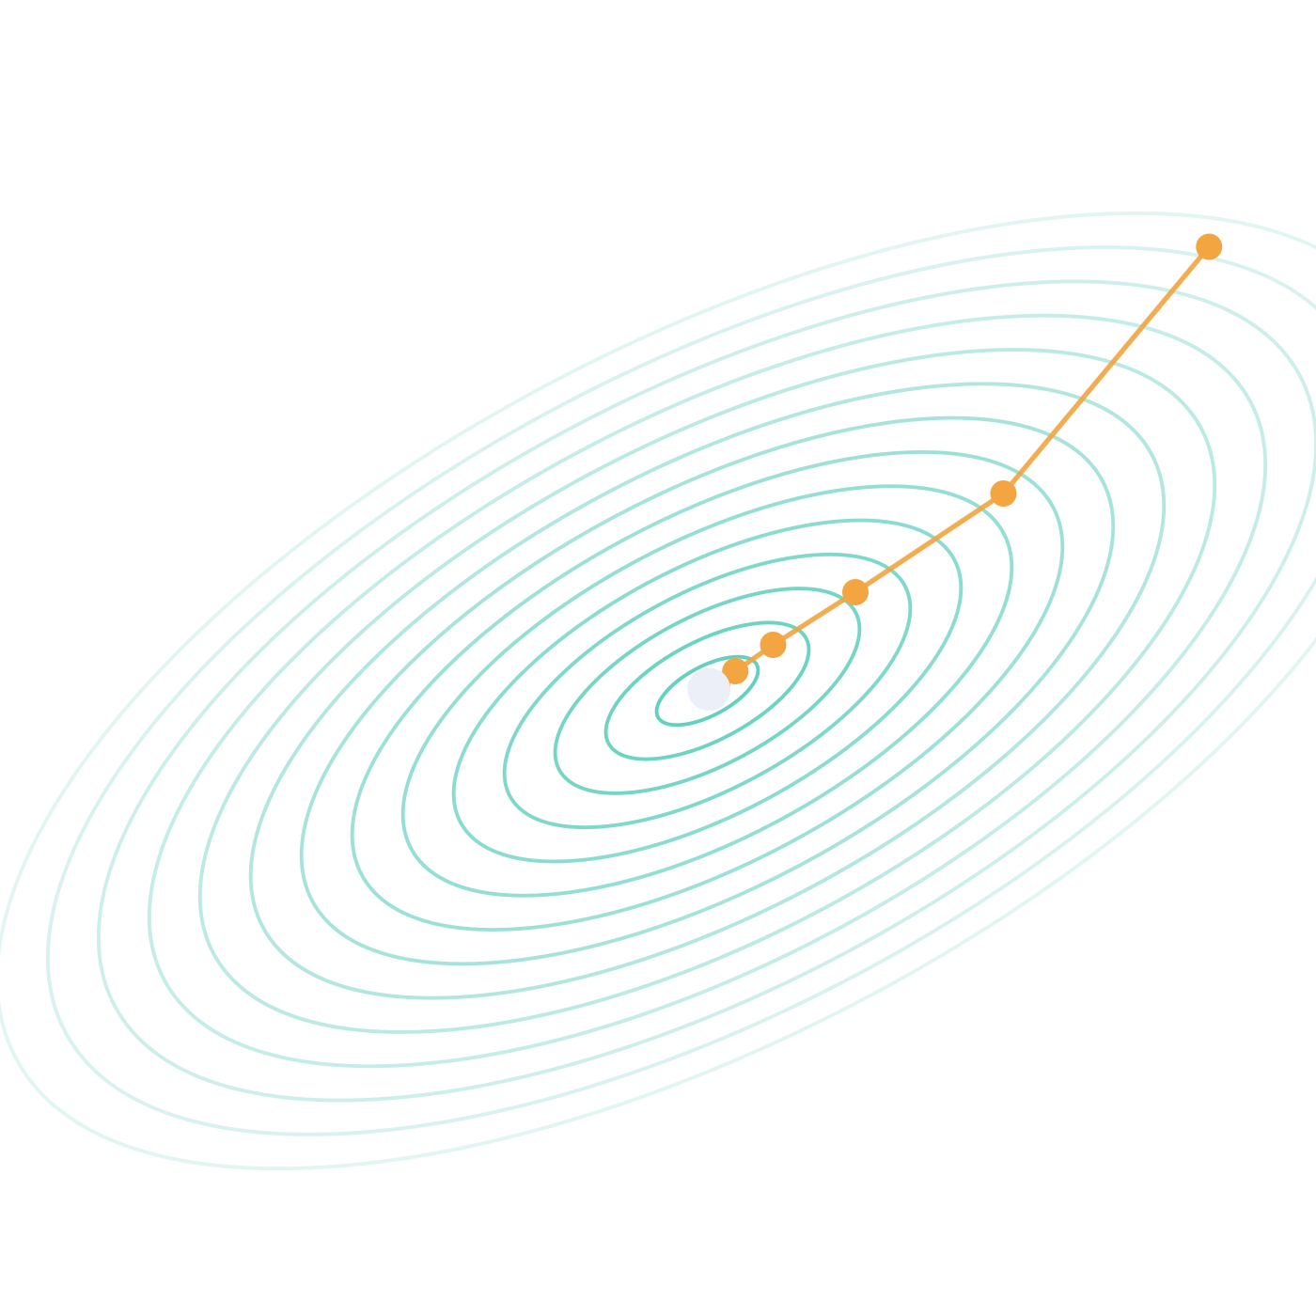
What does it mean for a machine to learn?
How a neural network actually learns, from one knob to an LLM
Devocracy | Abhishek
Notes:
Hook. Show of hands: who used an AI assistant today? Keep it up if you could explain what "the model was trained" actually means, mechanically. That gap is this talk.

Slide 2
Nobody wrote the rules
Rules
+
Data
Program
Answers
Software you write
Data
+
Answers
Training
Rules, stored as numbers
Software that learns
Your coding assistant has no if-statement for Python syntax, politeness, or what a race condition is. Every one of those behaviours was found by training, not written by a person. Today: how that finding works.
Notes:
Classic programming: we write rules. Machine learning flips it: we give examples of inputs and correct answers, and training produces the rules, except the rules are numbers, not code. Nobody at any lab wrote a rule for how to indent Python.

Slide 3
Where we're going
1
2
3
4
5
6
Knobs
Score
Nudge
Backprop
Bends
Next token
A model is a function with dials
One number for how wrong
Turn every dial downhill
All the slopes, fast
From straight lines to any shape
The same loop, at LLM scale
Demo 1
Demo 2
Demo 3
One tiny example all the way through, then scale it up. Every number on these slides can be checked with a calculator.
Notes:
Roadmap. Karpathy-style: one tiny example we build up by hand, then scale. Three live demos. Nothing I show needs more than multiplication.

Slide 4
A model is a function with knobs
Fixed recipe of
multiply and add
2
Input
Output
knobs in our first model
Knobs = weights = parameters. Same thing, three names.
405 billion
Training never edits the recipe. It only changes the knob values. After training, the knobs are frozen and shipped: that is the multi-gigabyte weights file.
knobs in Llama 3.1 405B
Same idea. Different number of knobs.
Notes:
A model is two things: a fixed recipe (the architecture, a few hundred lines of code) and a pile of knob values. Learning only touches the knobs. Our first model has 2. A big open LLM has 405 billion. The ideas are identical.

Slide 5
Meet the smallest neural network
The task: convert Celsius to Fahrenheit. We are not allowed to tell it the formula. We only give it examples.
°C | °F
0 | 32
10 | 50
20 | 68
30 | 86
°C in
× w
+ b
guess °F
Two knobs: w (a multiplier) and b (an offset). That is one neuron.
Start with arbitrary knobs: w = 1, b = 0.
The right answer is w = 1.8, b = 32. The model does not know that. Let's see if it can find out.
Notes:
Our running example. Everyone here knows F = 1.8C + 32. The model does not. It only gets thermometer readings. One neuron: multiply by w, add b. Start with a bad guess: w=1, b=0.

Slide 6
Step 1 of learning: keep score
Input
Guess
Truth
Miss
10 °C
1 × 10 + 0
= 10 °F
50 °F
10 − 50
= −40
Loss = miss × miss
Why square it?
= 1,600
Too high and too low both count as wrong
Big misses hurt far more than small ones
Many examples? Average them. Still one number.
One number that says how wrong the model is.
Notes:
Before a model can improve, it needs a scoreboard. Feed in 10 degrees C. Guess: 10. Truth: 50. Miss by 40. Square it: loss 1,600. With many examples you average: still one number. Hold on to 1,600.

Slide 7
Learning =
turning the knobs so
the loss goes down.
That's it. Everything else in this talk is about doing that efficiently, for billions of knobs.
Notes:
This is the definition. Pause on it. No understanding, no rules, no memorising. Knobs, one score, and a way to nudge the knobs so the score drops.

Slide 8
The wiggle test: which way should each knob turn?
Nudge one knob a tiny bit, re-run the model, and see what the loss does.
Nudge | New guess | New loss | Change | Slope = change ÷ nudge
w: 1.00 → 1.01 | 10.10 | 1,592.01 | −7.99 | ≈ −800
b: 0.00 → 0.01 | 10.01 | 1,599.20 | −0.80 | ≈ −80
Negative slope
Size of the slope
Why is w 10× bigger?
Turning this knob up makes the loss go down. So turn it up.
How much this knob matters right now. Big slope, big effect.
w multiplies the input, 10. A nudge to w gets amplified 10×.
Notes:
How do we know which way to turn? Wiggle. Bump w from 1 to 1.01: guess 10.1, loss 1592, it dropped about 8. Slope about minus 800. Bump b by 0.01: loss drops 0.8, slope minus 80. Negative means turn it up. And w matters ten times more, because it multiplies the input 10. This slope has a name: the gradient.

Slide 9
The gradient is a to-do list for every knob
new knob = old knob − step size × slope
Knob | Old | Slope | Step size × slope | New
w | 1.00 | −800 | 0.0005 × −800 = −0.40 | 1.40
b | 0.00 | −80 | 0.0005 × −80 = −0.04 | 0.04
New guess: 1.4 × 10 + 0.04 = 14.04. Still wrong, but less wrong.
Minus sign: we move against the slope, i.e. downhill.
19% less wrong. Now repeat a few thousand times.
Notes:
The update rule. For every knob: subtract step size times slope. Step size 0.0005. w goes 1 to 1.4, b goes 0 to 0.04. New guess 14.04. Loss drops from 1600 to 1293. One nudge, 19 percent less wrong. Training is this, repeated.

Slide 10
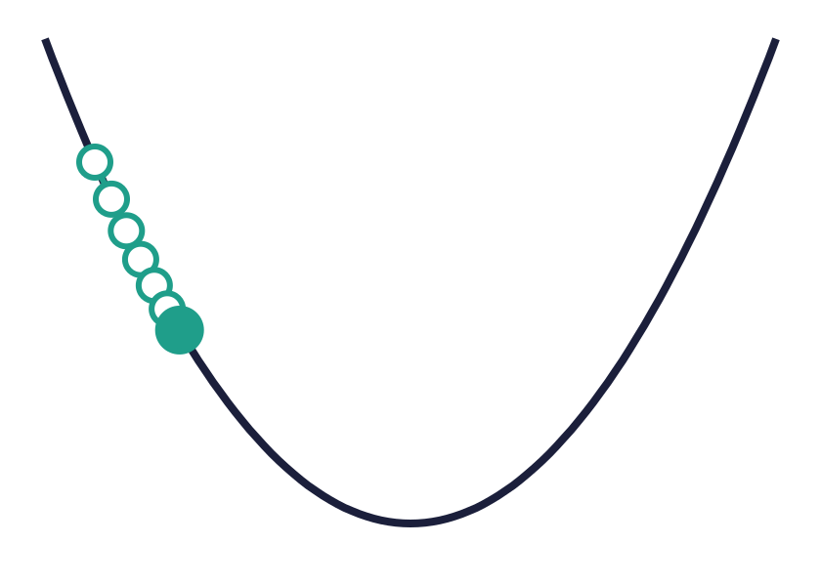
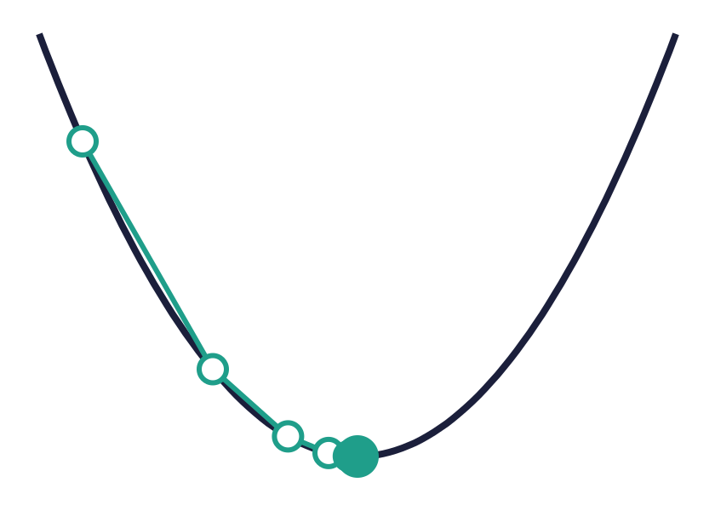
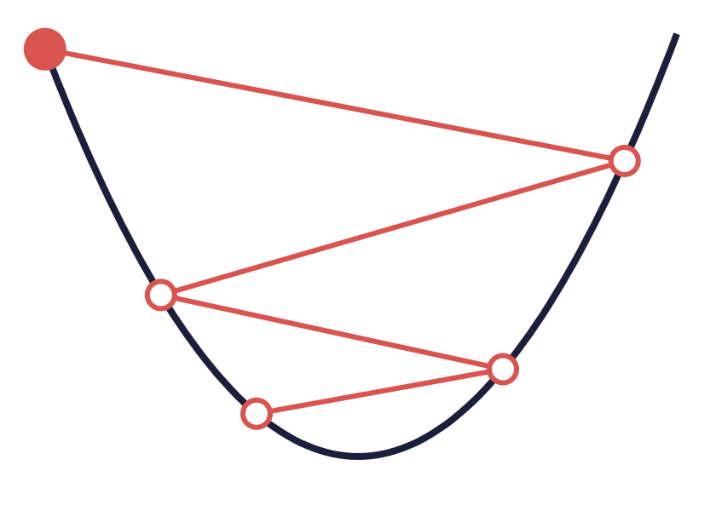
Picture it: a ball rolling downhill
Every combination of knob values has a loss, so the knobs define a landscape. Training rolls a ball downhill, one nudge at a time. The step size (the learning rate) decides how big each step is.
Too small
Just right
Too big
Heading the right way, but takes forever.
Big steps while steep, small steps near the bottom.
Overshoots the valley, lands higher up, and can explode.
Notes:
Zoom out. Every knob setting has a loss, so you get a landscape. Learning is a ball rolling downhill. The step size, called the learning rate, matters a lot: too small, forever; too big, you bounce out of the valley. Let me show you, live.

Slide 11

Live demo 1
Two knobs find the rule
What to watch
The dashed misses shrink as the line swings into place
The ball rolls down to the valley floor
It lands near w = 1.8, b = 32, without being told
Then: crank the step size and watch it explode
Switch to the browser, press 1
Notes:
Demo 1. See script for keys.

Slide 12
Wiggling works. It just doesn't scale.
Wiggle test
Backpropagation
One extra run of the model per knob, per nudge.
One run forward, one pass backward, and you have the slope for every knob at once.
2 knobs
3 runs per nudge. Fine.
≈ 3×
405B knobs
405 billion runs per nudge.
Training needs millions of nudges. This never finishes.
the cost of one forward run, whether you have 2 knobs or 405 billion.
Same answers as the wiggle test. Exact, not approximate, and billions of times cheaper.
Notes:
The wiggle test is honest but hopeless at scale: one extra model run per knob. 405 billion knobs means 405 billion runs for a single nudge. Backprop gets every slope in one forward and one backward pass, roughly 3x the cost of a forward pass, no matter how many knobs. That single trick is why deep learning is possible.

Slide 13
Backprop is the chain rule, and the chain rule is gears
If gear A turns gear B 3× as fast, and B turns C 2× as fast, then A turns C 6× as fast. Rates multiply along a chain.
w
× 10
guess
× 1
miss
× −80
loss
guess = w × 10
miss = guess − 50
loss = miss², and at
miss = −40 that's 2 × −40
Backward pass: carry the rate back from the loss, multiplying at each link
−80 × 1 × 10 = −800 for w and −80 × 1 × 1 = −80 for b
Exactly what the wiggle test measured. Each link only knows its own local rate.
Notes:
How does backprop get every slope in one pass? Chain rule. Think gears: rates multiply. w drives guess at 10x, guess drives miss 1-for-1, miss drives loss at 2 times the miss, minus 80. Multiply back from the loss: minus 800. Same number the wiggle test found. Each node only needs to know its own tiny local rate. Karpathy's micrograd is 100 lines doing exactly this.

Slide 14
You never write this by hand: the training loop
guess
for step in range(10_000):
guess = model(x)
loss = ((guess - y) ** 2).mean()
loss.backward()
optimizer.step()
optimizer.zero_grad()
Forward: run the recipe with current knobs
score
Loss: one number for how wrong
backprop
Chain rule: slope for every knob
nudge
Every knob steps downhill
PyTorch records every multiply and add during the forward run as a graph, then walks that graph backwards. In essence, this loop trained every model you use.
Notes:
In real life you write five lines. model(x) is the forward pass. The loss line is the scoreboard. loss.backward() is the gears: PyTorch recorded every operation and walks it backwards. optimizer.step() is the nudge. That is, in essence, the loop behind every model you use.

Slide 15
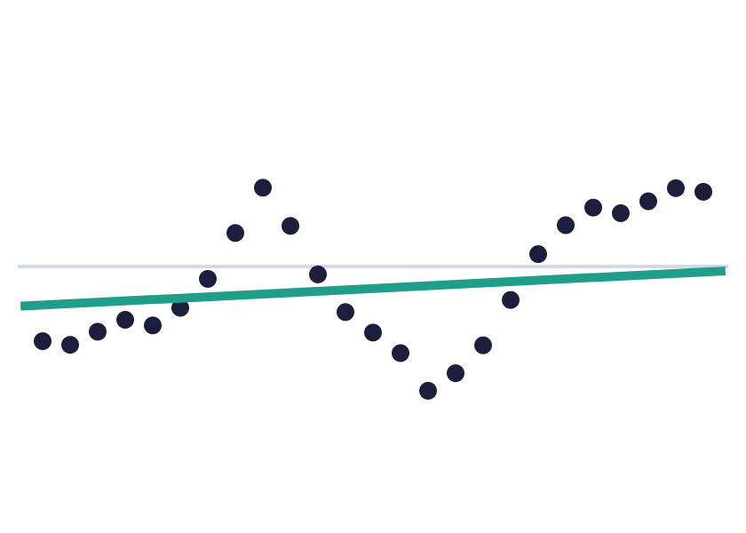
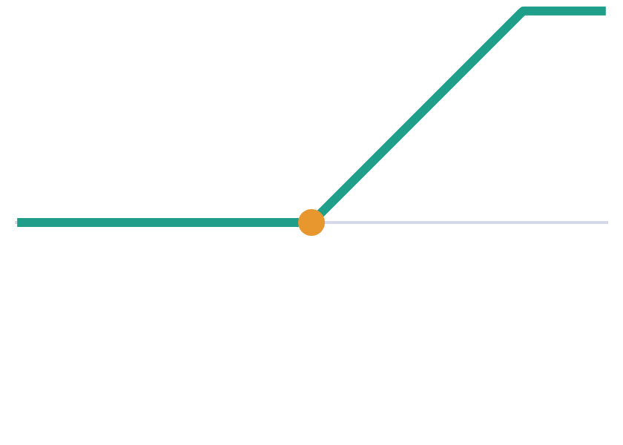
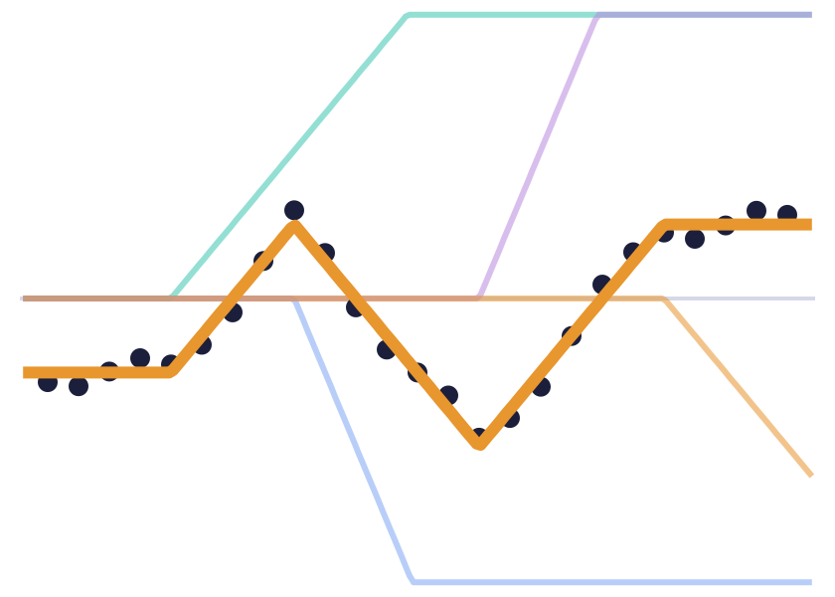
Straight lines aren't enough, so add a bend
One neuron
Add a bend
Stack many hinges
Multiply and add can only ever draw a straight line.
“If the result is negative, output 0.” That's ReLU: a hinge.
Each hidden neuron contributes one bend. Summed, they can trace any shape.
Hidden neurons and layers are just this: lots of hinges, stacked. The training loop doesn't change at all.
Notes:
Problem: one neuron is a straight line forever. Real data is curvy. Fix: add a bend. ReLU: if negative, output zero. One neuron now makes a hinge. Put many side by side and add them up and you can trace any shape. Layers stack this further. Same loop trains it.

Slide 16
Live demo 2
Hinges building a curve
What to watch
1 neuron: one bend, and it can't make a wave
8 neurons: the curve snaps into shape
Each coloured dot is one neuron's bend
Nobody assigned the jobs. The gradient did.
Switch to the browser, press 2
Notes:
Demo 2. See script for keys.

Slide 17
An LLM learns the same way. The loss is surprise.
for i in range(
next token?
Surprise scale
Chance it gave the right token | Surprise
100% | 0
50% | 0.7
10% | 2.3
1% | 4.6
1 in 100,000 (random guess) | 11.5
Guess → score → backprop → nudge. Same loop, run on trillions of next-token guesses.
The model guesses a probability for every token in its vocabulary. The real next token is revealed. Loss = how surprised it was.
Notes:
Now the leap. An LLM is trained on one task: predict the next token. It outputs a probability for every token in the vocabulary. We reveal the real one and score its surprise. Put 100% on the right token: zero surprise. Guess randomly over 100k tokens: 11.5. Training pushes surprise down. Then backprop, nudge, repeat on trillions of tokens.

Slide 18
Live demo 3
A 729-knob language model learns names
What to watch
It only sees the previous letter (an LLM sees thousands of tokens)
Gibberish turns into name-shaped words
Loss falls from 3.30, the "knows nothing" line
Type a name: how surprised is it?
Switch to the browser, press 3
Notes:
Demo 3. See script for keys.

Slide 19
Same loop. Wildly different scale.
Model | Knobs | Training examples | Training time
Our neuron (Demo 1) | 2 | 24 readings | milliseconds
Names model (Demo 3) | 729 | ~1,160 letter pairs | seconds
Llama 3.1 405B | ~405 billion | ~15 trillion tokens | months, on ~16,000 GPUs
The ideas don't change with scale. The engineering does.
Those 405 billion numbers are the frozen weights file from the inference talk. Now you know where every one of them came from: millions of nudges.
Notes:
Same four steps at every row. What changes is knobs, data, and compute. Figures for Llama 3.1 are Meta's published ballpark: about 15 trillion tokens, trained on around 16 thousand H100s. Tie back: the 140 GB weights blob from the inference talk is exactly these knobs, after training.

Slide 20
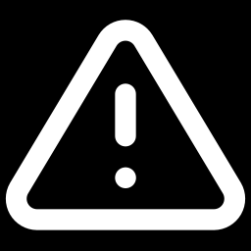
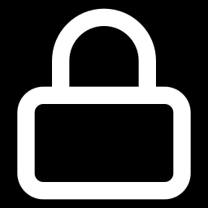
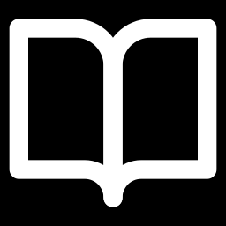
What this means for your day job
Trained to be unsurprising, not correct
It doesn't learn from your chat
Best at what it saw most
A confident wrong answer is just a low-surprise guess. Verify facts, APIs and versions.
Weights are frozen after training. Your conversation is input, not training. Next session, same knobs.
Popular languages got billions of nudges. Your internal codebase got none. Give it context and examples.
Notes:
Three practical consequences. One: the base objective is low surprise, not truth; hallucination is the loss working as designed (post-training helps, but does not change the foundation). Two: it does not learn from your chat; the weights are frozen, memory features just paste text back in. Three: it is best at what it saw most; your internal code got zero nudges, so give it context.

Slide 21
The mental model to walk out with
1
A model is a function with knobs.
Training only changes the knob values.
2
Loss is one number for how wrong.
Learning = turning knobs so it goes down.
3
The gradient says which way to turn each knob.
And how much it matters right now.
4
Backprop is the chain rule.
Every slope in one backward pass, at any scale.
5
An LLM is this loop, enormous.
Next-token surprise is the loss.
Notes:
Five things. Knobs. One score. Gradient says which way. Backprop makes it cheap. An LLM is this loop at enormous scale with surprise as the loss. None of it was magic: multiplication, a scoreboard, and patience.

Slide 22
Thank you.
Questions?
Go deeper
Andrej Karpathy, "Neural Networks: Zero to Hero". Build micrograd (backprop in ~100 lines) and makemore (Demo 3, grown into a GPT) from scratch.
The demo is a single HTML file. It runs offline in any browser.
Notes:
Close. Point to Karpathy's series: this talk is basically lecture 1 and 2 compressed. Leave the demo up for Q&A.

