Slide 1



Accessible Education for Underserved Communities
A Technology-Driven Solution for Quality Education
Team Name: Knights
Team Leader: Abhishek Maurya
Problem statement: Lack of Access to Quality Education in Underserved Communities

Slide 2
Problem Statement
Lack of Access to Quality Education
Millions of children and adults in underserved communities lack access to quality education due to:
- Inadequate infrastructure
- Insufficient resources
- Shortage of trained teachers
Impact: Educational gap leading to poverty and inequality

Slide 3
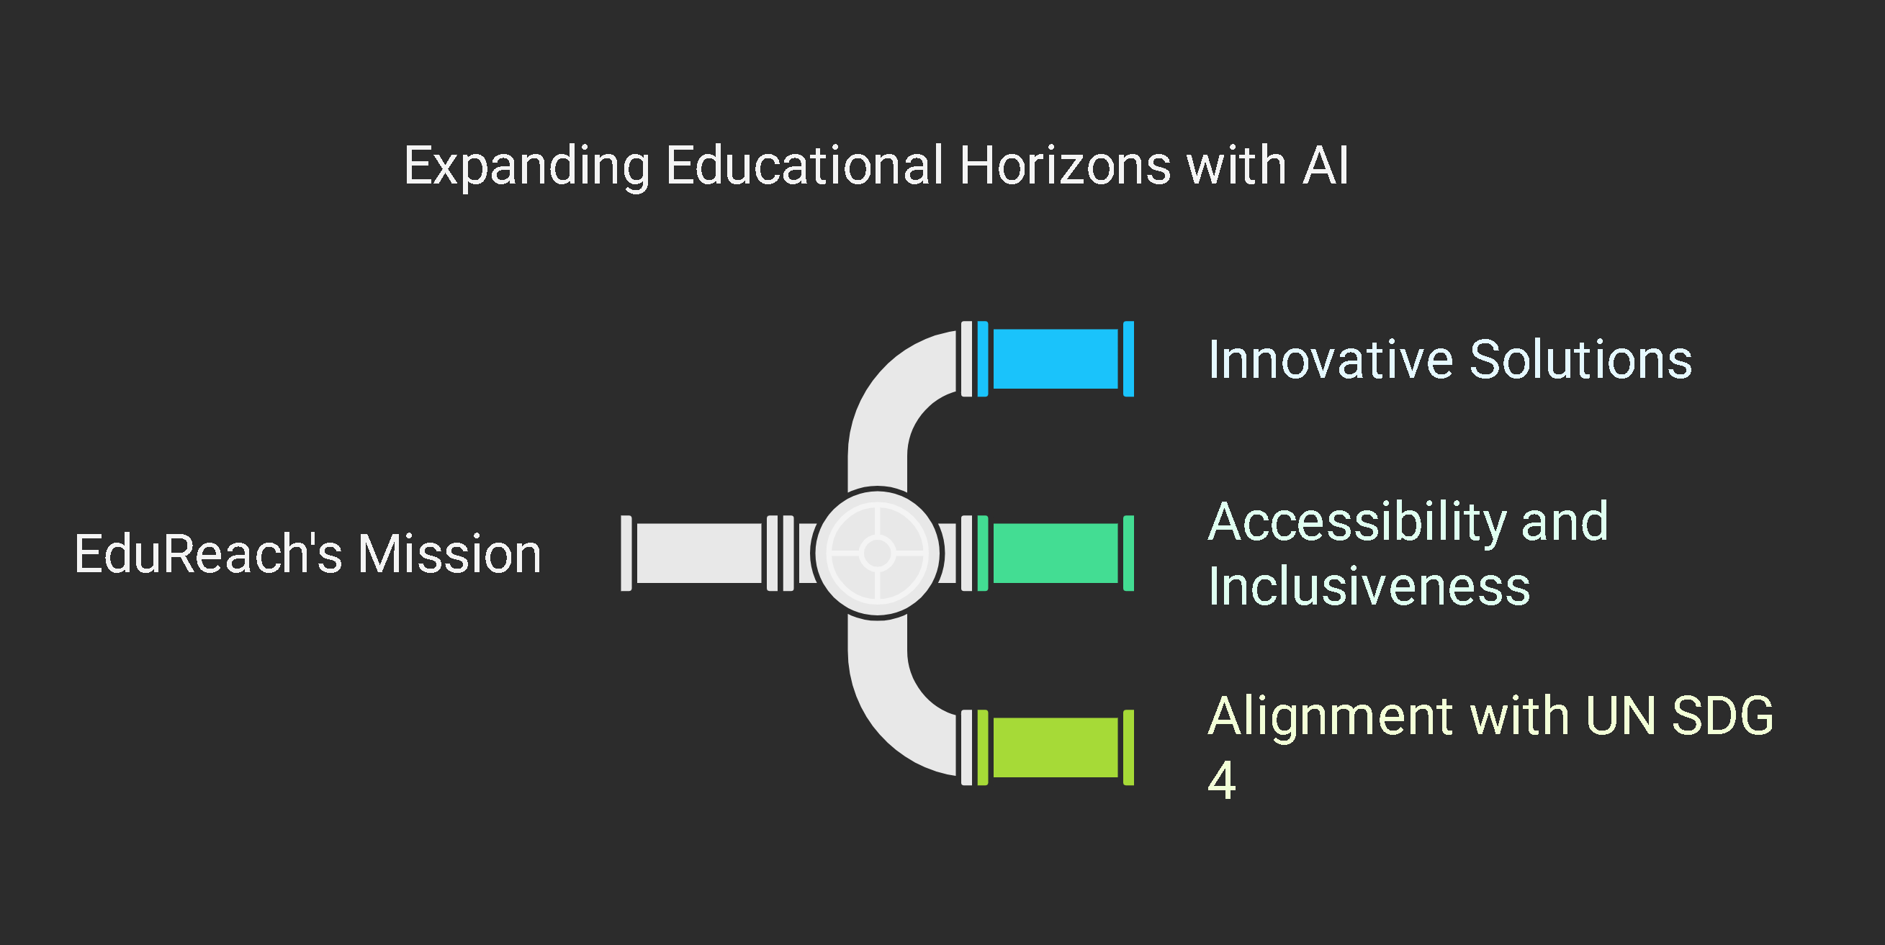
Objective
Develop an innovative, scalable, and technology-driven solution
Ensure education is accessible, inclusive, and personalized for diverse learners
Align with UN SDG 4: Quality Education to promote lifelong learning opportunities for all

Slide 4
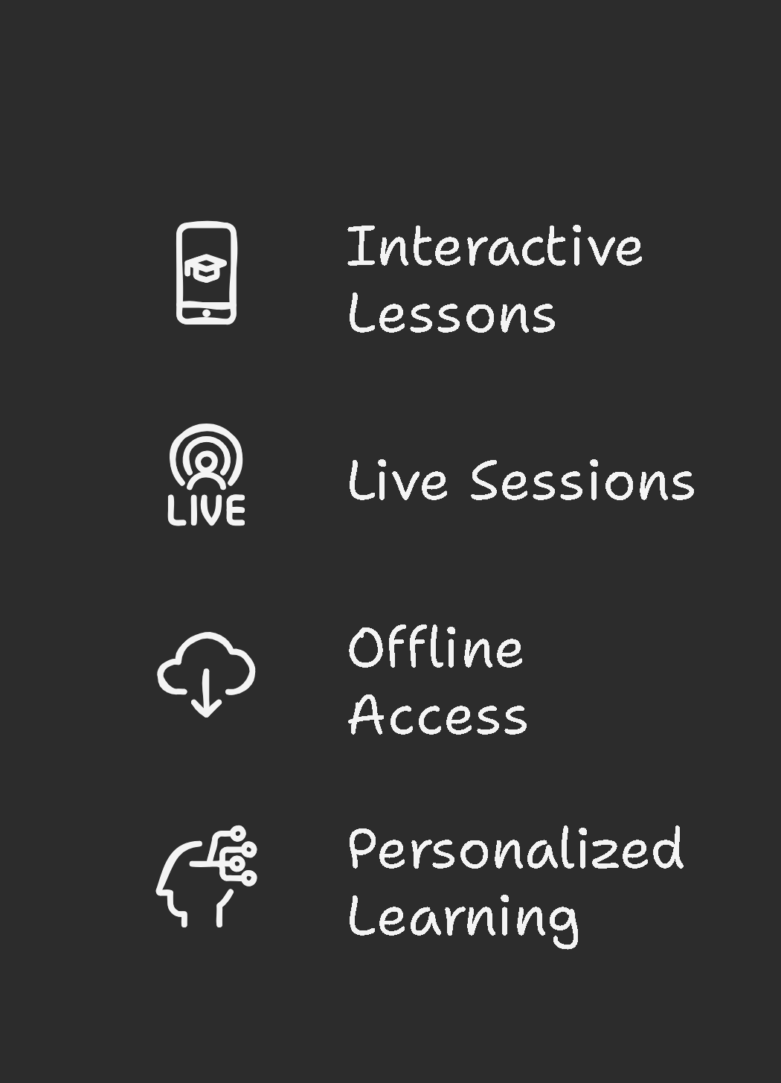
Our Solution
A mobile-based learning platform (EduReach) designed for underserved communities
Key Features:
- Interactive lessons via Jetpack Compose
- Live & recorded sessions powered by Firebase
- Offline access using SQLite
- AI-driven personalized learning paths

Slide 5





Opportunities
Unique Approach: Unlike other platforms, our app focuses on offline learning, AI-driven personalization, and low-resource accessibility for underserved communities.
Problem Solving: Enables learning without the internet, offers affordable education, and provides interactive lessons with a community forum for support.
USP: Offline mode, AI-powered learning, community support, and built using Gemini Code Assist, Jetpack Compose & Firebase for scalability and efficiency.

Slide 6
Technology Stack
Frontend: Kotlin, Jetpack Compose
Backend: Firebase, SQLite
Database: Firebase Firestore & SQLite
Deployment: Android-based mobile application
AI Integration: Google Dialogflow (for AI tutor)
Google API Integration: For fetching courses
Development Assistance: Gemini Code Assist (Used for faster and optimized coding)

Slide 7
Features
Smart Learning Modules: AI-powered personalized lessons
Offline Learning: Download lessons for later use
Community Forum: Peer-to-peer discussion and teacher support
Progress Tracking: Personalized performance reports

Slide 8
MVP and Prototype
MVP development is in progress
Tools Used: Kotlin, Jetpack Compose, Firebase, SQLite
Prototype Available on Figma https://www.figma.com/proto/Cin2qEByuqXQizsK8JfNzv/EduReach
GitHub: https://github.com/abhishek-maurya576/EduReach

Slide 9
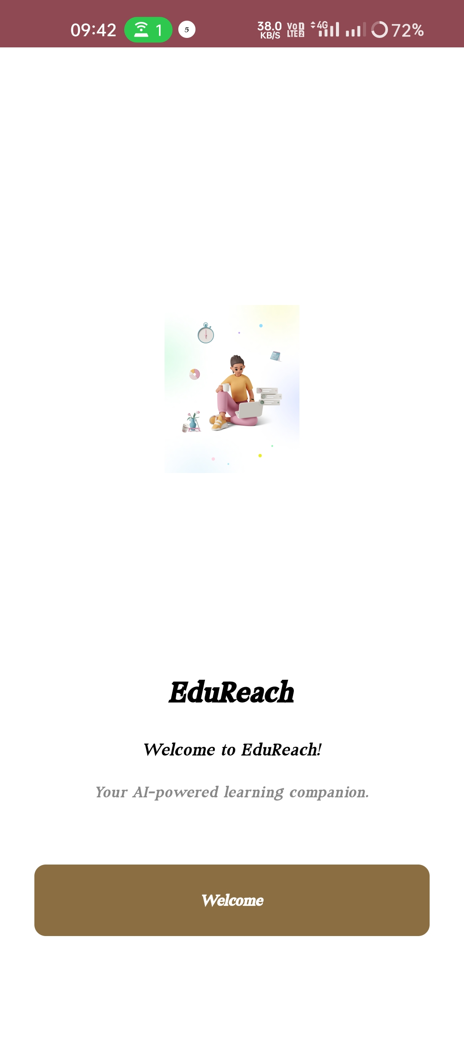
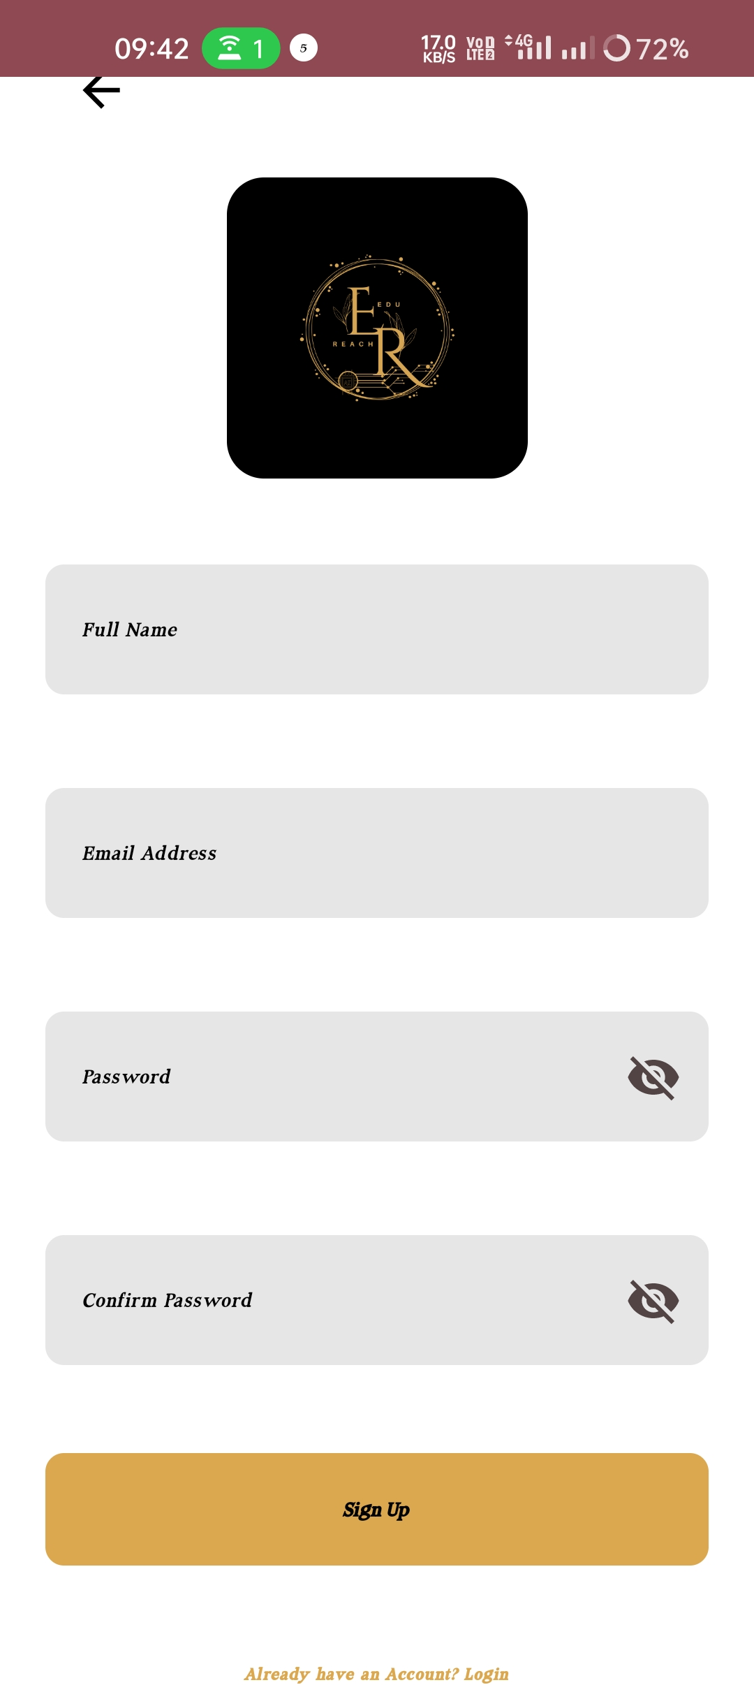
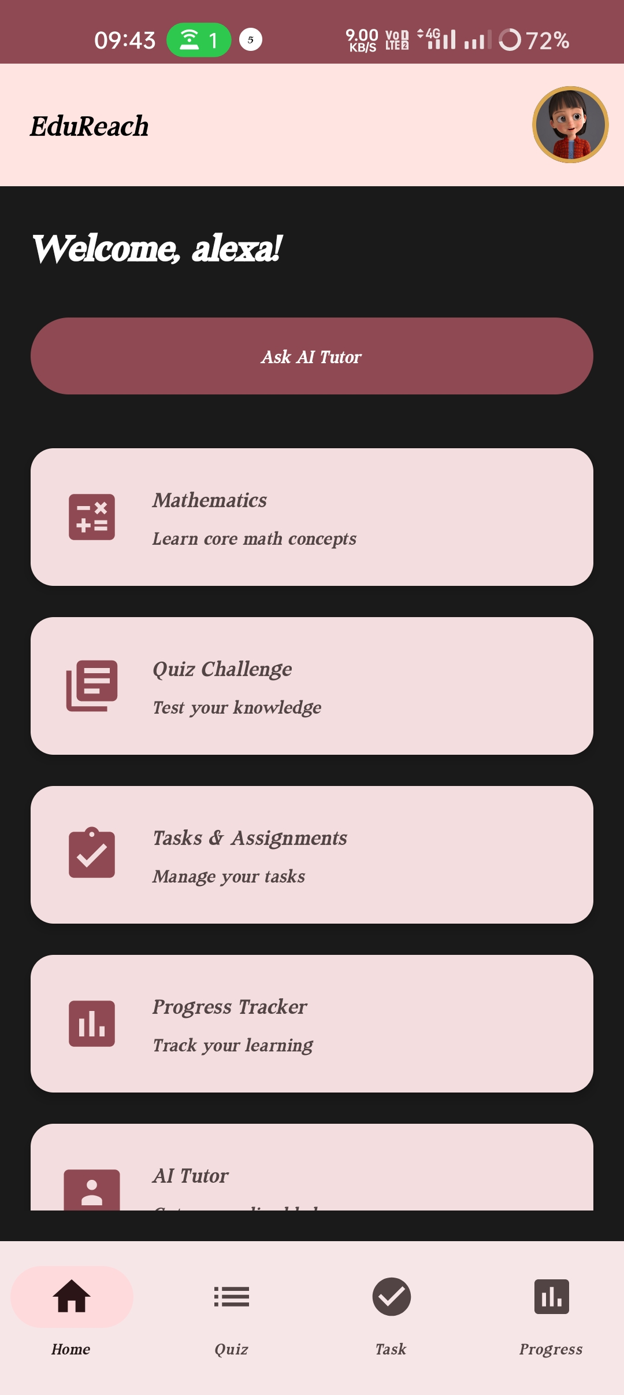
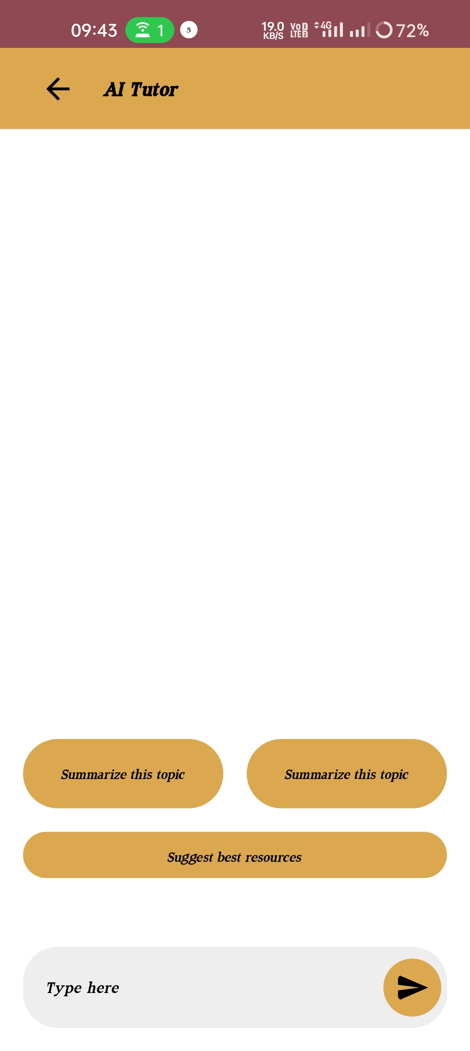
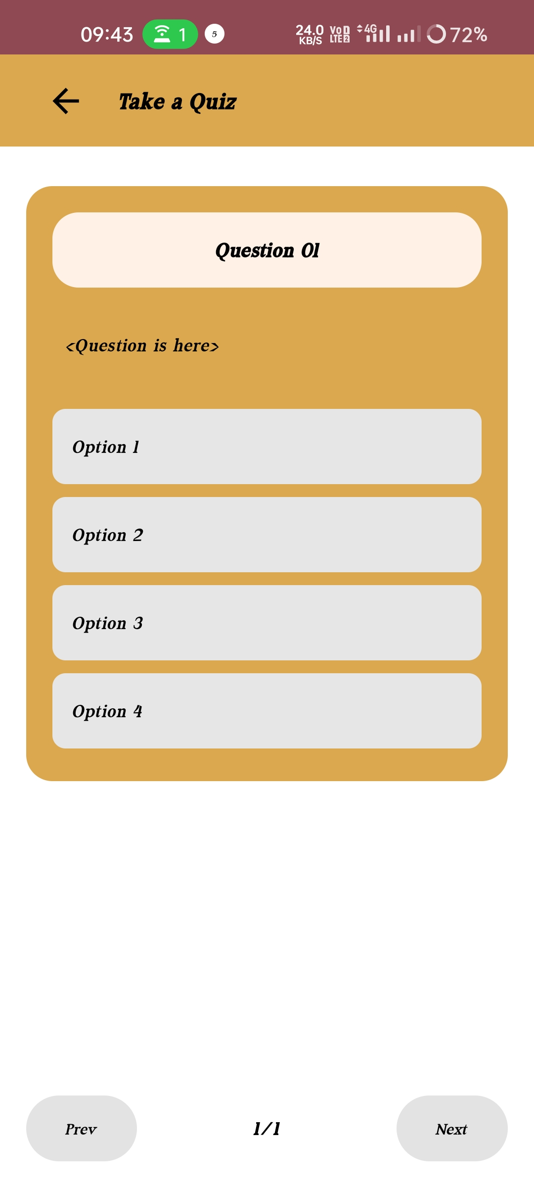
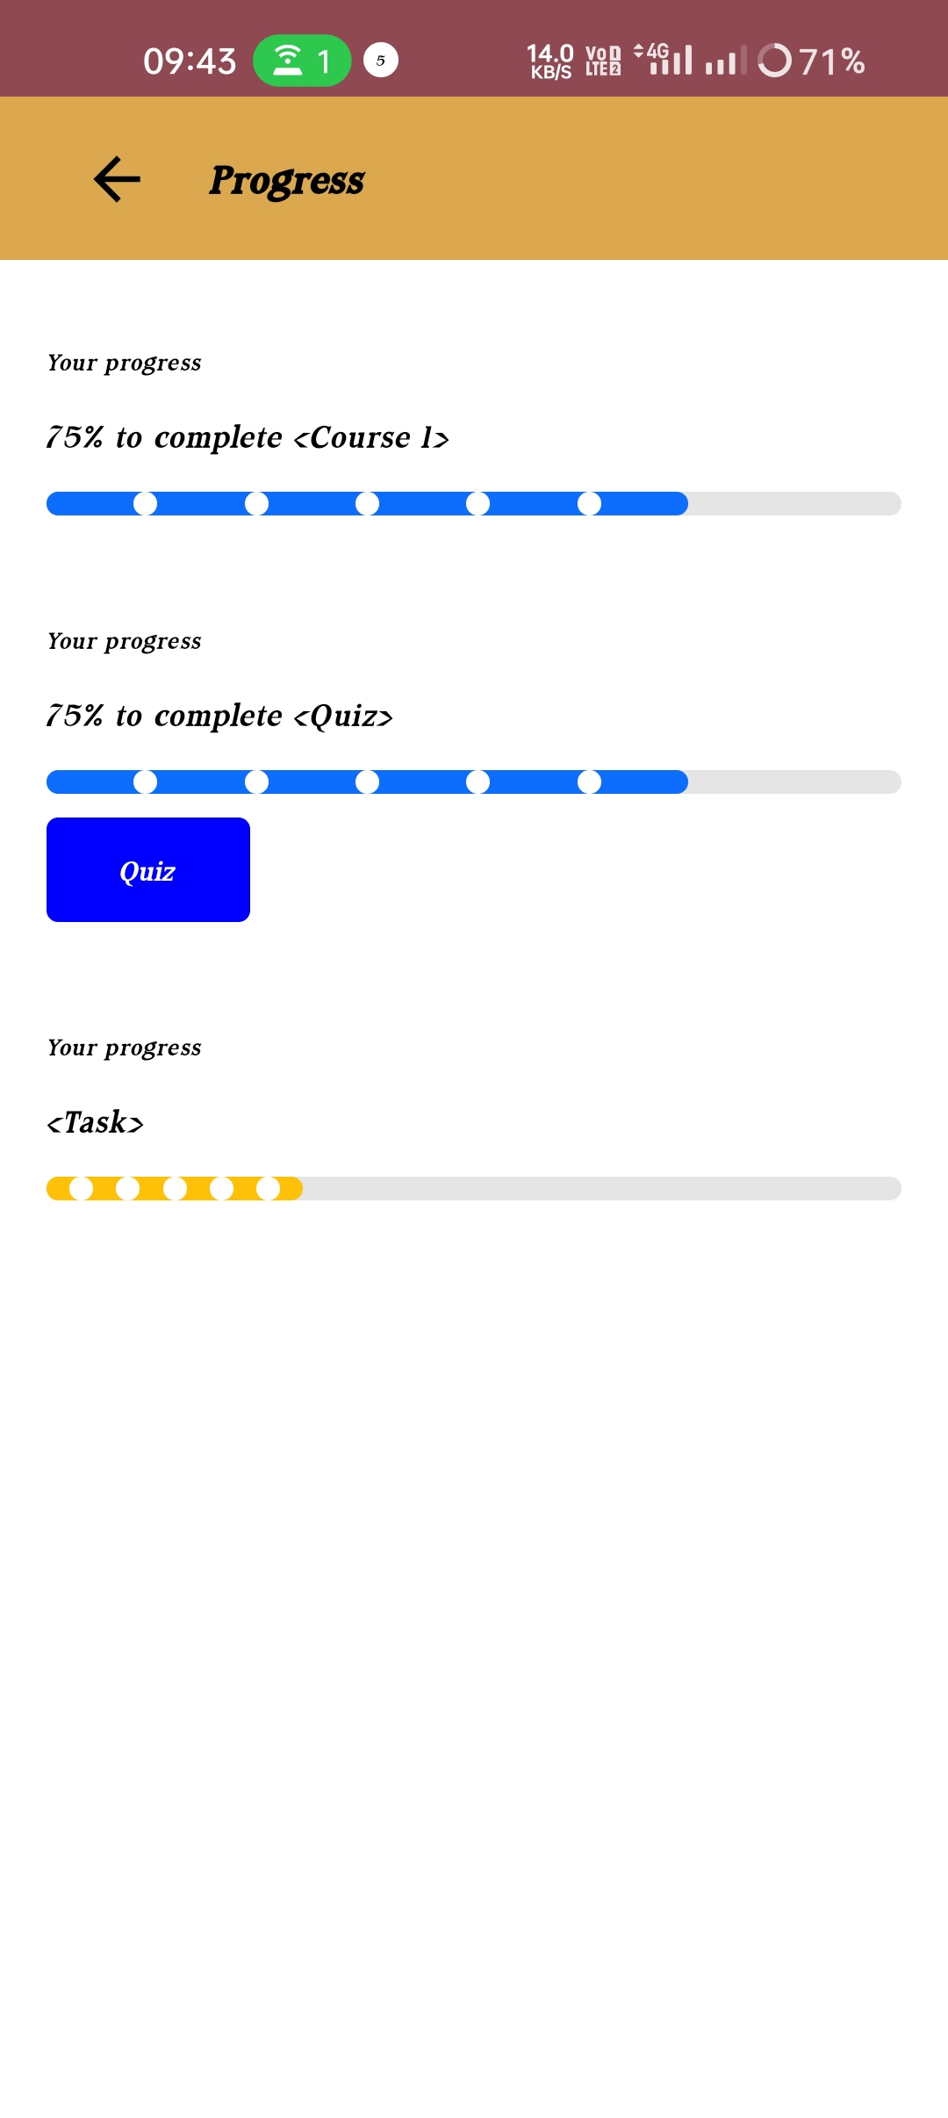
Snapshot of MVP
Welcome screen
Signup Screen
Home screen
AI Tutor chat bot
progress screen
Quiz screen

Slide 10
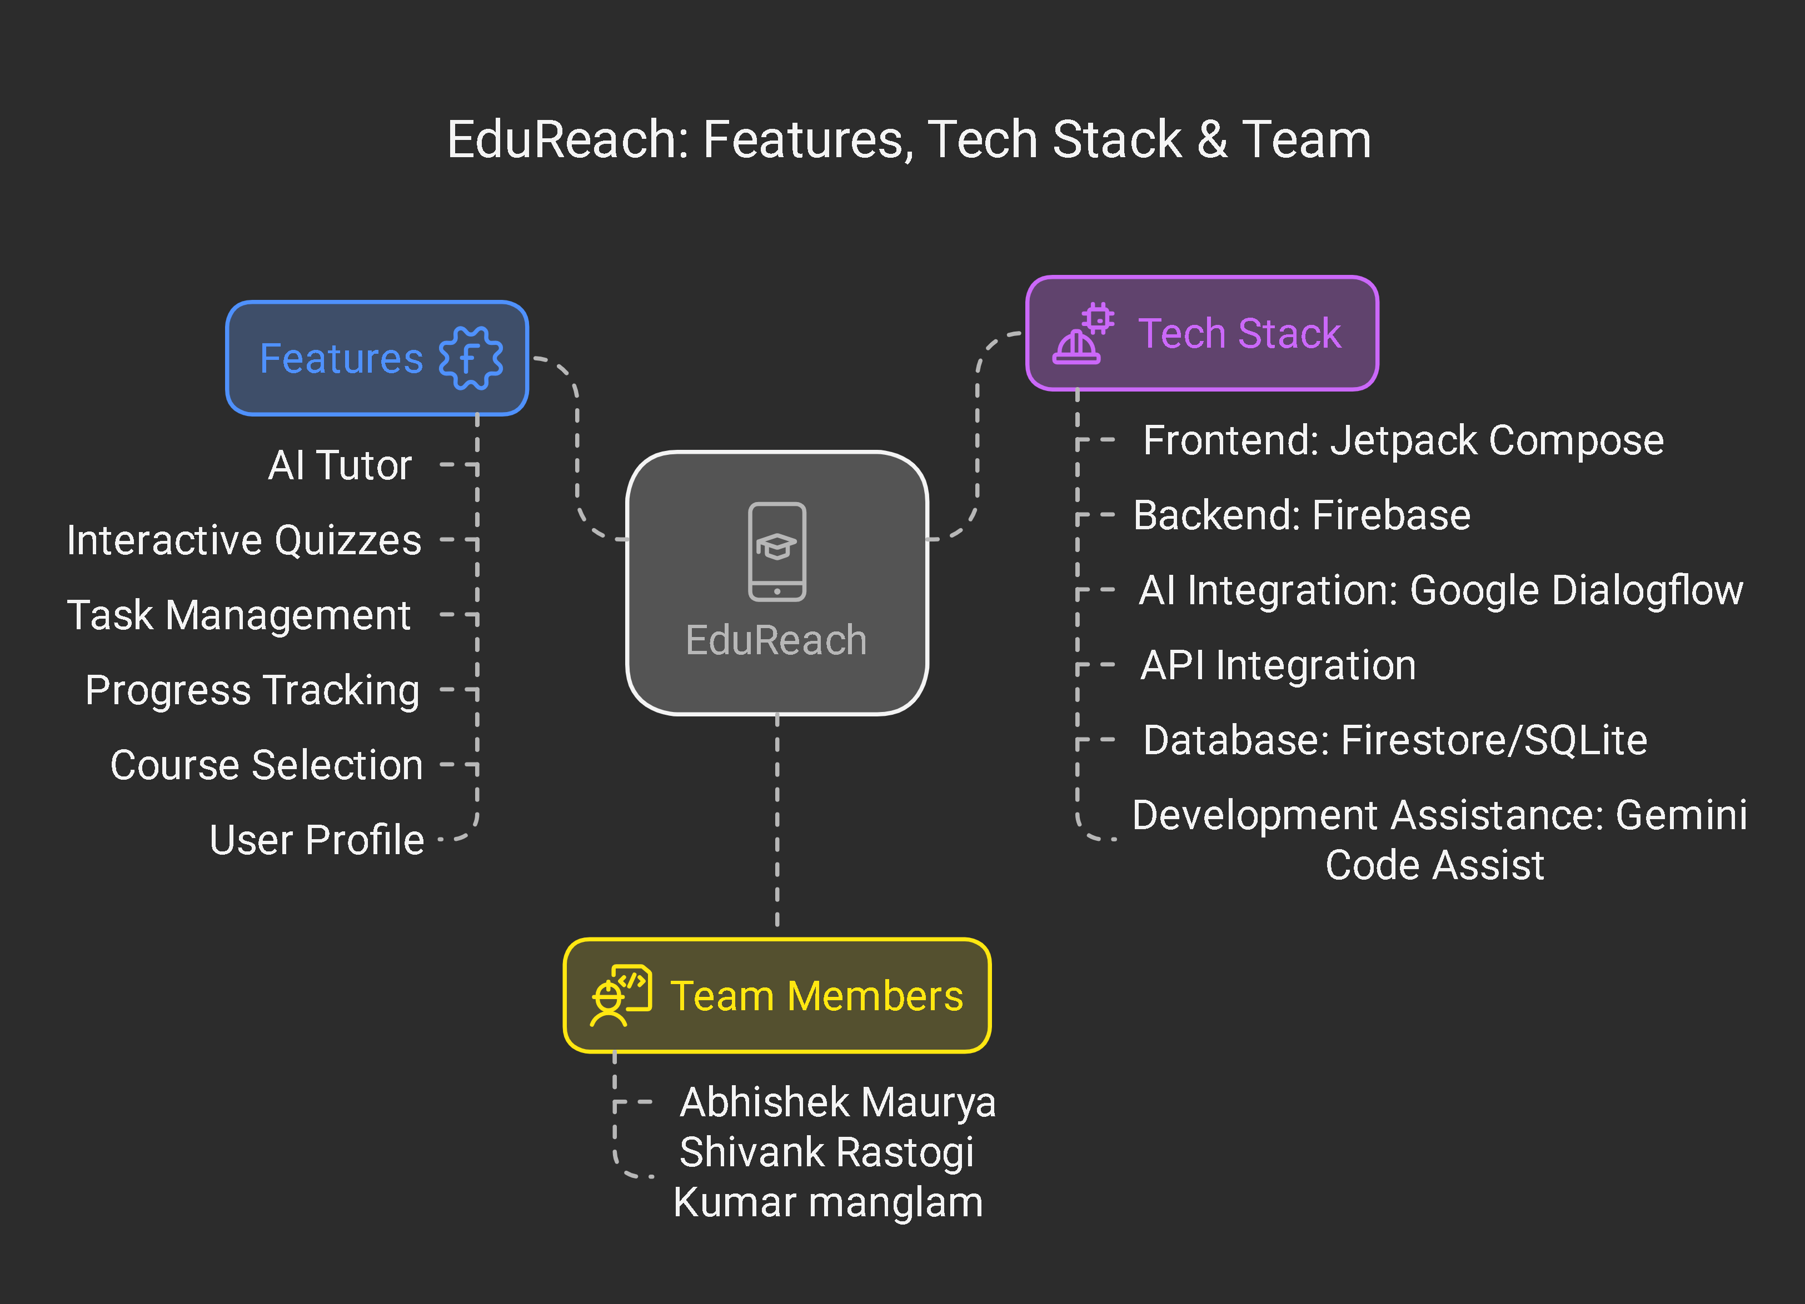
Team & Responsibilities
Abhishek Maurya - App Development (Android developer, Firebase)
Kumar Manglam - Backend & Database (SQLite, Firestore)
Shivank Rastogi - UI/UX Design (Figma, User Research)

Slide 11
Conclusion & Next Steps
Further Development: Refining features based on user feedback
Testing & Deployment: Pilot launch in select regions
Seeking Support: Collaboration with NGOs & Education Institutions

Slide 12
Thank You!
Contact: maurya972137@gmail.com
GitHub Repository: https://github.com/abhishek-maurya576/EduReach
Demo: https://www.figma.com/proto/Cin2qEByuqXQizsK8JfNzv/EduReach MVP: https://github.com/abhishek-maurya576/EduReach/releases/tag/v1.0.0

