Slide 1
Seminar on Quantum Computing
Abhishek Pokhriyal
(140970101003)
abhip099@gmail.com
Computer Science and Engineering
THDC - IHET, Tehri
March 31,2016

Slide 2
Overview
Introduction
Why Quantum Computing?
History & Development
Quantum Mechanics
Quantum Computer
Qubits and Quantum Gates
Quantum Algorithms
Deutsch and Shor’s algorithm
Setbacks
Future

Slide 3
Introduction
Quantum Computation:
Computation using the quantum-mechanical power of Nature
Develop fast quantum algorithms for problems that are hard to solve on a classical computer
Develop techniques to implement quantum computer

Slide 4
Why Quantum Computing?
To reduce the complexity of certain computational tasks
To efficiently simulate other quantum systems
Moore’s law has physical limits
To clarify mysterious nature of quantum physics

Slide 5
Beginning and development...
Manin (1980): quantum computers might simulate quantum systems more efficiently
Feynman (1982): Independently developed the same idea in more detail
Deutsch (1985): described the first universal quantum computer
Shor (1994): discovered an important algorithm for factoring
Cirac & Zoller (1995): proposed trapped ion quantum computing

Slide 6
Quantum Mechanics
A generalization of probability theory
Nature is described not by probabilities, but by numbers called amplitudes that can be +ve, -ve, or even complex.
Two principles:
unitary evolution (multiplying the quantum state by a unitary matrix) and
measurement in a standard basis, results in a collapse of the state

Slide 7
Quantum Mechanics
The following are main parts of quantum mechanics that are important for quantum computing:
Superposition and interference
Uncertainty
Entanglement
Linear algebra
Dirac notation
Representing information

Slide 8
Quantum Computer
Quantum-mechanical phenomena are used to perform operations on data
The systems that encode the individual bits must have no physical interactions
Qubits – unit of information
Quantum Gates – Operations on qubits

Slide 9
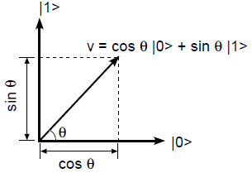

Qubits
A single qubit is a vector:
|ψ〉 = a|0〉 + b|1〉
a,b ∈ C and |a|² + |b|² = 1
where
When v is measured it will
yield 0 with probability cos² θ
yield 1 with probability sin²θ

Slide 10
Quantum Gates
Analogous to logic gates (AND, OR, NOT)
Operates on qubits
Examples of 1-qubit gate
Bitflip gate X : Swaps |0〉 and |1〉 (like NOT)
Phaseflip gate Z : Puts a “-” in front of |1〉
Phase gate R_{Φ} : Rotates the phase of |1〉 by Φ
Note: Z is a special case of R: Z = R_{π}
Hadamard gate H : Equal probability of observing |0〉 or |1〉 after measurement.

Slide 11




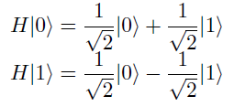
Representation of Quantum Gates
Applying Hadamard gate to qubits
If we apply H to |0〉 and then apply another H to the output of first H we obtain a |0〉: the positive and negative amplitudes for |1〉 cancel out! This effect is called interference.

Slide 12
Quantum Algorithms
Deutsch algorithm (1985)
Simon’s algorithm (1994)
Shor’s algorithm (1994)
Grover’s algorithm (1996)

Slide 13
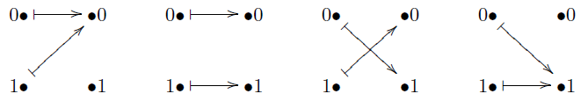
Deutsch Algorithm
Given a function f : {0,1} →{0,1}
Compute f(0)⊕ f(1)
Classical computer would require two queries to f to determine this value
Informally, test whether a coin is fake or genuine

Slide 14
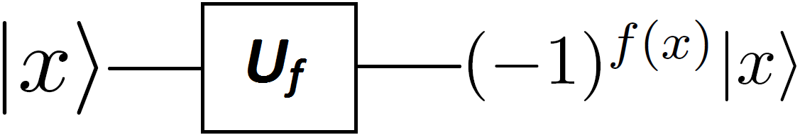
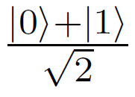
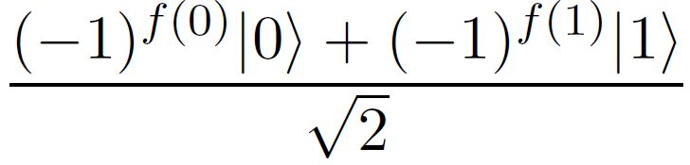
Deutsch contd..
Start with |0〉
Apply Hadamard transform
Apply Phase query
Apply Hadamard transform
Measure the result
If result = 0 → constant function
Else (result = 1) → balanced function

Slide 15
Shor’s Factoring Algorithm
Most important quantum algorithm
Factor an integer N in Õ(log² N) on a quantum computer
Idea behind Algorithm:-
Input: a number N
Choose a random no. x
Calculate its order r modulo N i.e. find r s.t.
x^{r} ≡ 1 mod N
Factor N using Chinese remainder theorem

Slide 16
Importance of Shor’s Algorithm
No classical algorithm can factor N in polynomial time
Factoring is considered hard on a classical computer.
Existence of SFA is surprising
RSA cryptosystem in danger

Slide 17
Setbacks
The most difficult obstacles appear to involve the decoherence of quantum superpositions through the interaction of the computer with the environment, and
the implementation of quantum state transformations with enough precision to give accurate results after many computation steps.

Slide 18
Future
Linear ion trap, one of the more promising proposals for a physically realizable quantum computer.
Information is stored into electronic states of ions,
Ions are confined to a linear trap and cooled to their ground state
Laser light is used to manipulate information in the form of different electronic transitions.
However, the uncontrollable interactions of ions with their environment induce various errors known as decoherence (such as e.g. spontaneous emission in ions) and thus severely limit the power of computation.
Quantum error correction - A method of performing reliable quantum computation using unreliable basic components (e.g. gates) providing that the error rate in this components is below a certain allowed limit.

Slide 19
Conclusion
Quantum computing is faster
Can solve problems that are hard to solve classically
Has serious effects on cryptography
Quantum computers violates the extended Church-Turing thesis
But is it physically realizable?

