Slide 1
Apache Spark & Kafka
Abhishek Rawat

Slide 2
The “Big Data” Problem
Problem
A single machine cannot process or even store all the data!
Solution
Distribute data over large clusters
Difficulty
How to split work across machines?
How to deal with failures?
How to deal with slow nodes?

Slide 3


Slide 4
What is Apache Spark?
Apache open source project originally developed at AMP Lab (University of California Berkeley) in 2009
Apache Spark is a fast and general-purpose cluster computing system
It provides high-level APIs in Java, Scala, Python and R
Notes:
A cluster is a type of parallel or distributed computer system which consists of a collection of inter-connected stand-alone computers working together as a single integrated computing resources
Cluster are typically used for high availability for greater reliability or high performance computing to provide greater computational power than a single computer can provide.

Slide 5
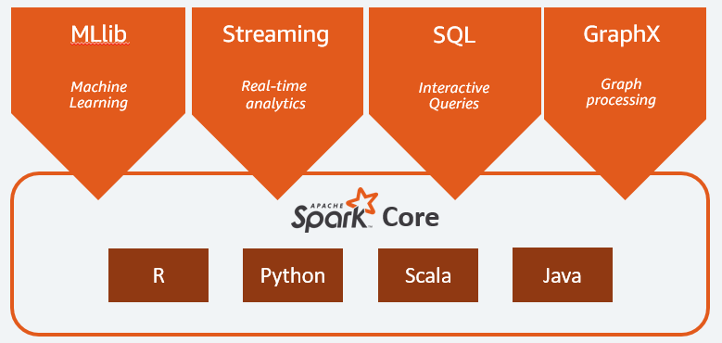
Why Apache Spark?
Elegant Developer APIs
In-memory computation model – Fast!
Fault tolerance
Notes:
Single environment for data manipulation, querying, and Machine Learning.
LAZY EVALUATION
Spark components are what make Apache Spark fast and reliable.

Slide 6
Spark Streaming
Spark can perform -
Batch Processing - processing of the previously collected data in a long batch
Stream processing - Ability to ingest, process and analyse data in-motion in real- or near-real-time
Why Spark Streaming?
Many important applications must process live streams of data and provide results in near-real-time
Social Network Trends
Fraud Detection
This requires
Large clusters to handle workload
Fast computations
Notes:
Stream processing of live data streams – Scalable – High-throughput – Fault-tolerant

Slide 7


Slide 8
What is Apache Kafka?
It is a scalable, fault-tolerant, publish-subscribe messaging system
Provides a framework for storing, reading and analysing streaming data
Kafka is designed to be run in a distributed environment
Additional processing power
Additional storage capacity
Kafka has record retention – retains all the published records
Notes:
Kafka Has Record Retention
Kafka clusters retain all published record. If you don’t set a limit, it will keep records until it runs out of disk space. You can set time-based limits (configurable retention period), size-based limits (configurable based on size), or compaction (keeps the latest version of record using key). You can, for example, set a retention policy of three days or two weeks or a month. The records in the topic log are available for consumption until discarded by time, size, or compaction.
It is scalable, reliable bcs of distributed and partitioned nature,scalable, and maintains stable performance even many TB of messages are stored.
Kafka is very fast and guarantees zero downtime and zero data loss.

Slide 9
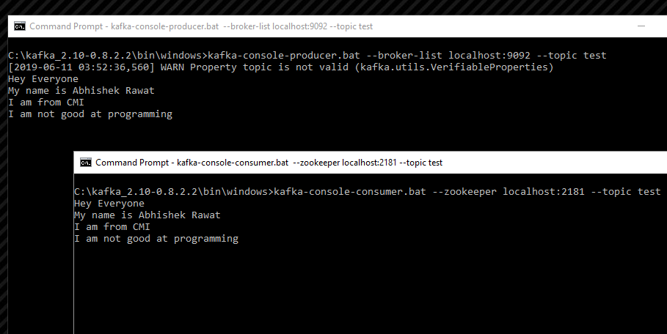
Kafka Working

Slide 10
Kafka
Spark
Storage Systems
Streaming Data
MLLib
SparkSQL

Slide 11
Why combine Kafka and Spark Streaming?
This emphasizes retaining the input data
As your application evolves, its code changes
If you shut down your Spark jobs for an hour, then you will miss data from that hour
Kafka persists everything to disc - will help retrieve all data from the time Spark jobs were offline.

Slide 12
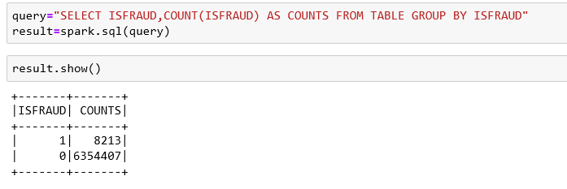

Fraud Detection
Step 1: Machine Learning on Spark and Saved the Model
A sample of using Spark SQL
ML results

Slide 13
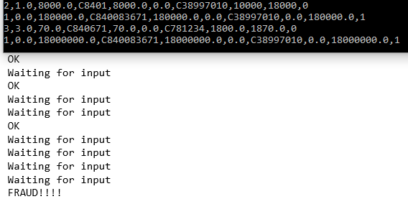
Fraud Detection
Step 2: Starting Kafka producer (which sends in the data) and Consumer which uses Spark Streaming and the saved model to give us the output.
We input the following parameters in the correct order: step,type,amount,nameOrig,oldbalanceOrg,newbalanceOrig,nameDest,oldbalanceDest,newbalanceDest,isFlaggedFraud

Slide 14
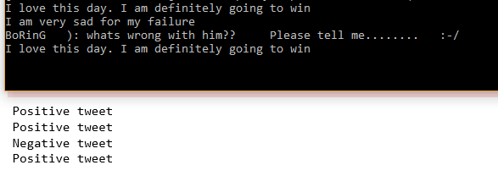
Twitter Sentiment Analysis

Slide 15
Thank You

Slide 16
Appendix

Slide 17
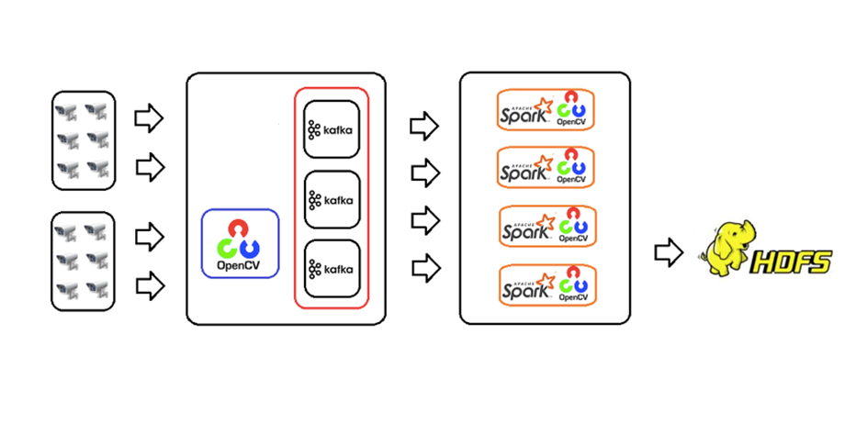
Video Stream Analytics Using OpenCV, Kafka and Spark

Slide 18
Video Stream Analytics Using OpenCV, Kafka and Spark
Video Stream Collector
OpenCV video processing library to convert a video stream into frames
Send data to Kafka producer in JSON format
Stream Data Buffer
To process a huge amount of video stream data without loss
Kafka works as a buffer queue for the data that the video stream collector produces
Video Stream Processor
Built on Apache Spark provides a Spark Streaming API to consume and process messages from Kafka

Slide 19
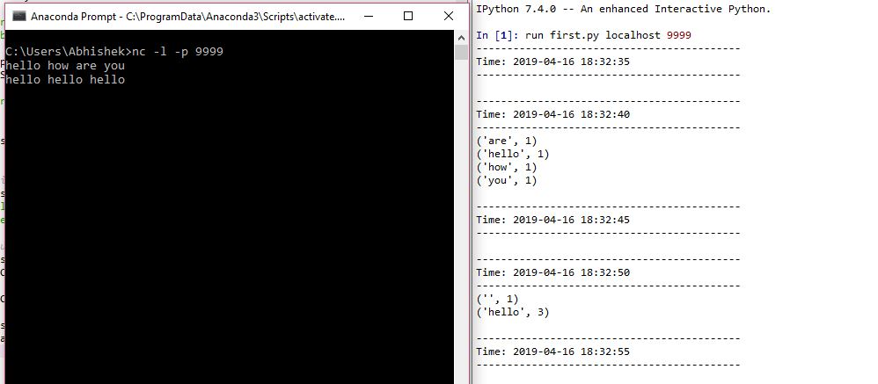
Spark Streaming – Word Count

Slide 20
What is Spark’s In Memory Computation?
Data is kept in random access memory (RAM)
Is processed in parallel
Why good?
When we need a data to analyse it is already available on the go or we can retrieve it easily.
It is good for real-time risk management and fraud detection.
The data becomes highly accessible.
The computation speed of the system increases.
Improves complex event processing.
It is economic, as the cost of RAM has fallen over a period of time.
Go Back

Slide 21
Resilient Distributed Dataset (RDD)
RDD is a fundamental data structure of Spark
Resilient: Fault tolerant because of RDD lineage DAG(Directed Acyclic Graph) and so able to re-compute missing or damaged partitions due to node failures.
Distributed: Since data is stored on many nodes
Dataset: Represents records of data we work on
Is a collection of objects spread over one or more nodes
RDDs are automatically distributed across the network by means of Partitions
When you execute some action, a task is launched per partition i.e. more parallelism
Go Back

Slide 22
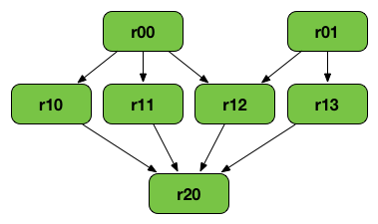
RDD Lineage
RDD Lineage is a graph of all the parent RDDs of a RDD
Built as a result of applying transformations to the RDD
Creates a logical execution plan
Achieves fault tolerance
Go Back

Slide 23
Lazy Evaluation
Transformations are lazy in nature
If we call some operation in RDD, it does not execute immediately
Spark maintains the record of which operation is being called
We can execute operation any time by calling an action on data
Advantages
Saves Computation and increases Speed
Reduces Complexities – Since we do not execute every operation
Optimization - By reducing the number of queries

Slide 24
Caching
You can cache an RDD in memory by calling rdd.cache()
When you cache an RDD, it’s Partitions are loaded into memory of the nodes that hold it
Improves performance
When an action is performed on a RDD, it executes it’s entire lineage
Imagine performing an action multiple times on the same RDD with long lineage
Caching stores the computed result of the RDD in the memory
Thereby eliminating the need to re-compute it every time.

Slide 25
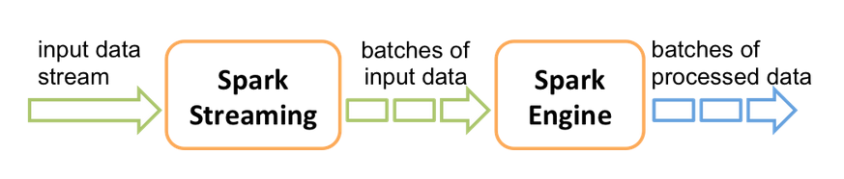
D-Streams
High-level abstraction representing continuous stream of data
Internally represented as a sequence of RDDs
Operation applied on a D Stream translates to operations on the underlying RDDs

Slide 26
Hadoop – HDFS
Hadoop is an open-source framework that allows to
Store and process big data
In a distributed environment across clusters
It is designed to scale up from single servers to thousands of machines, each offering local computation and storage.
The Hadoop Distributed File System (HDFS) is the primary data storage system used by Hadoop applications.
Highly efficient parallel processing
Highly fault tolerant – replication

Slide 27
Role of Zookeeper
It is essentially a centralized service for distributed systems
Keeps track of
Nodes and topic registry
Node failure
Consumer offsets – information about how many messages the consumer consumes

Slide 28
Bibliography
https://spark.apache.org/
https://www.tutorialspoint.com/apache_spark/apache_spark_introduction.htm
https://cloudnesil.com/2018/12/14/apache-spark/
https://www.slideshare.net/Hadoop_Summit/apache-spark-crash-course-98521732
https://data-flair.training/blogs/spark-in-memory-computing/
https://jaceklaskowski.gitbooks.io/mastering-apache-spark/spark-rdd-lineage.html
https://data-flair.training/blogs/apache-spark-lazy-evaluation/
https://www.quora.com/What-is-lineage-graph-in-Apache-Spark
http://vishnuviswanath.com/spark_rdd.html
https://www.quora.com/What-are-the-pros-and-cons-of-Apache-Spark
https://databricks.com/glossary/what-is-spark-streaming
https://www.bernardmarr.com/default.asp?contentID=1525
https://en.wikipedia.org/wiki/Apache_Kafka
https://dzone.com/articles/what-is-kafka
https://www.oreilly.com/ideas/questioning-the-lambda-architecture
https://www.infoq.com/articles/video-stream-analytics-opencv/
https://www.tutorialspoint.com/hadoop/

