Slide 1
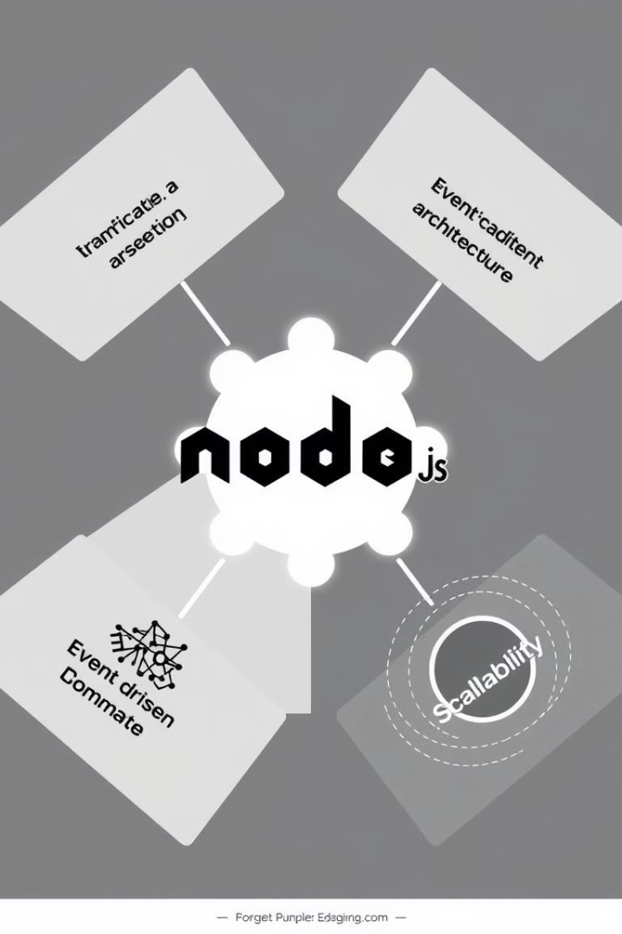

Unleashing the Power of Node.js: A Beginner's Guide
Welcome to the world of Node.js, a powerful JavaScript runtime environment that has revolutionized web development. This guide will equip you with the fundamentals of Node.js, enabling you to build dynamic web applications and unlock its incredible capabilities.
by Abhishek S

Slide 2
What is Node.js?
JavaScript Everywhere
Event-Driven Architecture
Node.js allows you to use JavaScript for both frontend and backend development, creating a seamless experience and simplifying your development workflow. This unified language eliminates the need to learn separate languages for different parts of your application.
Node.js utilizes an event-driven architecture, making it highly efficient for handling concurrent requests. It manages multiple requests simultaneously without blocking, ensuring a smooth and responsive user experience.

Slide 3
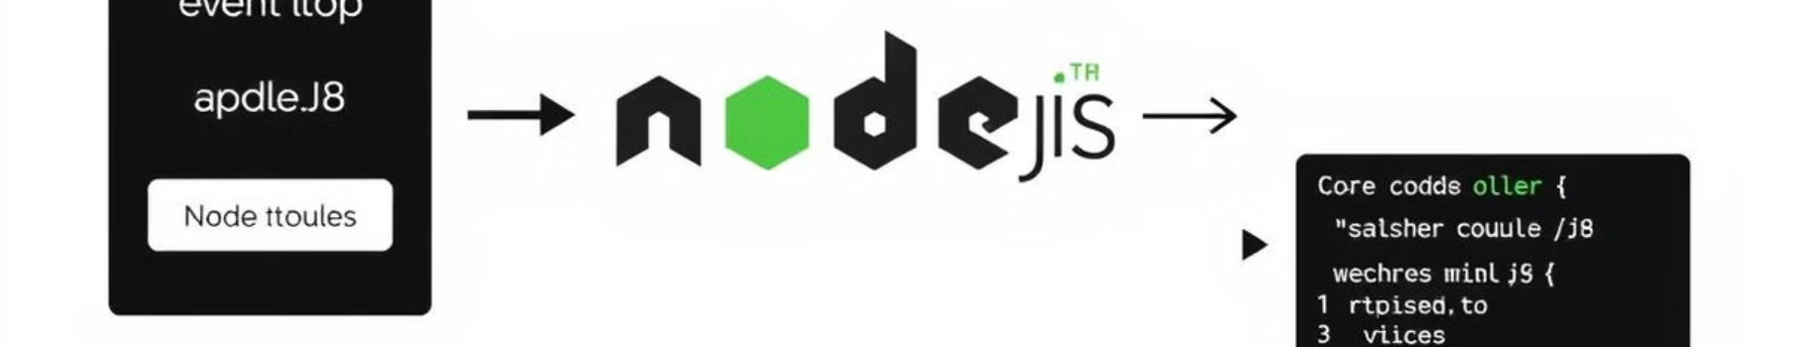
Diving into Node.js Basics
1
The Event Loop
2
The V8 JavaScript Engine
3
Core Modules
At the heart of Node.js is the event loop, a continuous process that listens for events, executes callbacks, and manages the flow of your application.
Node.js offers a wide range of built-in modules for various tasks, such as file system interaction, networking, and HTTP communication.
Node.js is powered by Google's V8 JavaScript engine, renowned for its high performance and efficient execution of JavaScript code.

Slide 4
Working with Modules and Packages
Creating Modules
Using npm
Modules allow you to break down your code into reusable components, promoting organization and maintainability. You can create your own modules and use them across your application.
The Node Package Manager (npm) is a powerful tool for managing external packages and dependencies. It simplifies the process of installing, updating, and managing packages used in your Node.js projects.

Slide 5
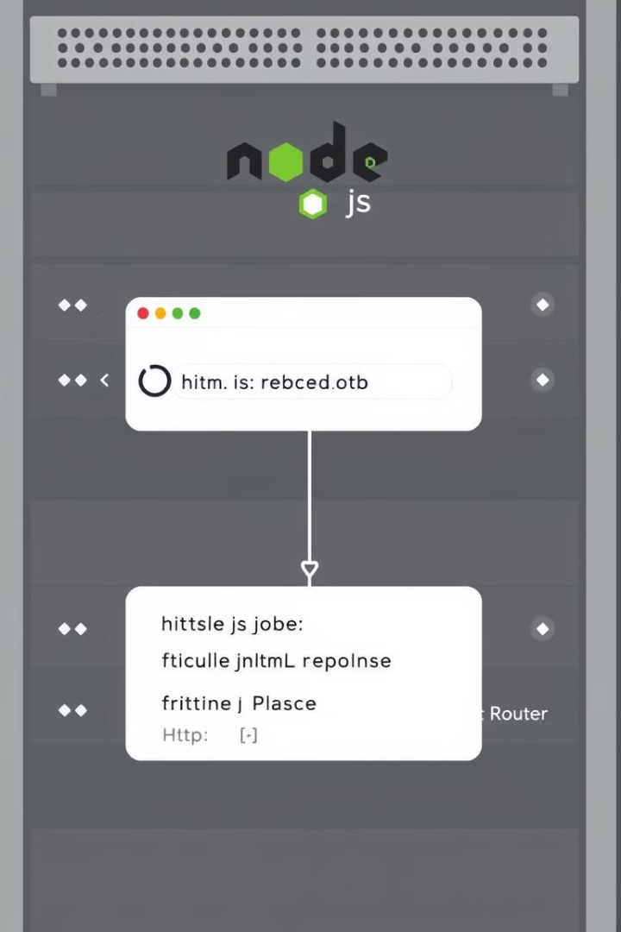


Building Web Servers with Node.js
Basic HTTP Server
Node.js allows you to create your own basic HTTP servers, handling incoming requests and sending responses back to clients. This gives you complete control over your web application's logic.
Express.js
Express.js is a popular and robust framework for building web applications in Node.js. It provides powerful tools for routing, middleware, and handling HTTP requests and responses, streamlining your development process.

Slide 6




Embracing Asynchronous Programming
Callbacks
Promises
async/await
Callbacks are functions that are executed after a specific task completes. They allow you to handle asynchronous operations and maintain the non-blocking nature of Node.js.
Promises provide a more structured and cleaner way to handle asynchronous operations. They represent the eventual completion or failure of an asynchronous task.
async/await offers a more intuitive syntax for working with Promises, making asynchronous code easier to read and write.

Slide 7

Connecting to Databases with Node.js
MongoDB
MySQL
MongoDB is a popular NoSQL database, ideal for storing JSON-like documents, providing flexibility and scalability. Node.js offers drivers for connecting and interacting with MongoDB databases.
MySQL is a relational database management system (RDBMS) widely used for structured data. Node.js provides drivers for interacting with MySQL databases, allowing you to manage and access your data efficiently.

Slide 8



Middleware and Routing in Express.js
1
Middleware
2
Routing
3
Request/Response Handling
Middleware in Express.js allows you to intercept requests and responses before they reach your application's core logic. It enables you to perform tasks like authentication, authorization, logging, and modifying data, enhancing your application's functionality.

Slide 9
Authentication and Authorization
1
User Authentication
2
JWT (JSON Web Tokens)
3
Token Verification
Authentication verifies the identity of users, ensuring that only authorized users can access your application's resources. Authorization controls access to specific features and data based on user roles and permissions.

Slide 10
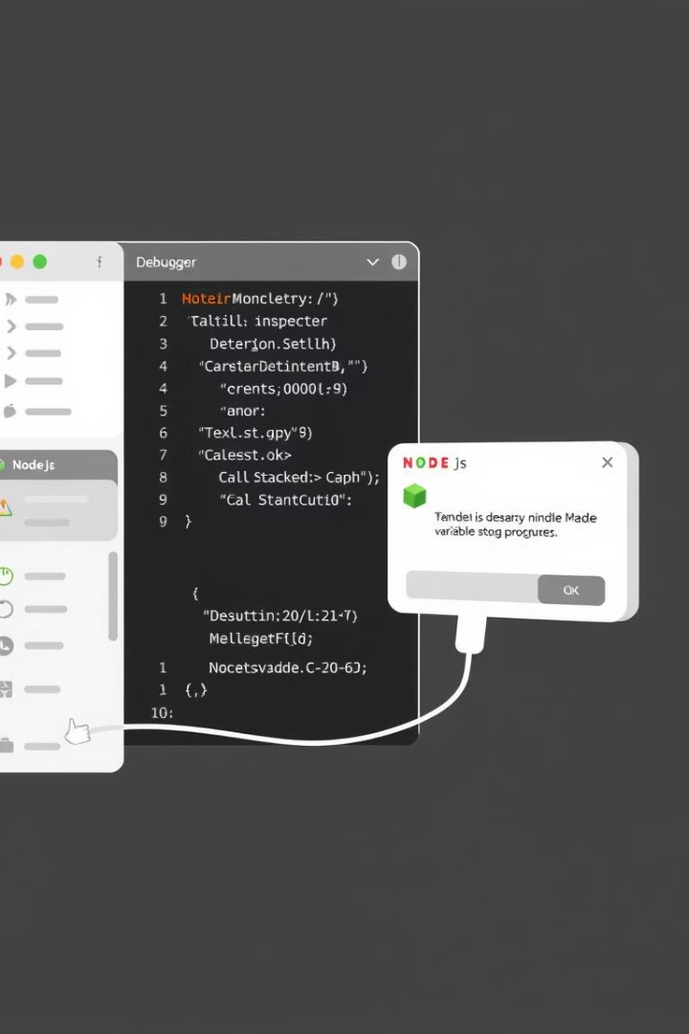
Error Handling and Debugging
1
2
Error Handling
Debugging Tools
Node.js provides mechanisms to gracefully handle errors, preventing your application from crashing and ensuring a smoother user experience.
Debugging tools help you identify and resolve errors in your code. Node.js offers built-in debugging tools and external libraries to assist you in finding and fixing issues.
3
Logging
Logging is crucial for monitoring your application's behavior, identifying potential problems, and understanding how your application performs over time.

