Slide 1


CROP PRICE PREDICTOR
AI-Powered Forecasting for Agricultural Markets. Predicting Avg Min & Max Prices with Prophet & Streamlit.

Slide 2

HACKANOVATION 2.0 GANDHI INSTITUTE OF ENGINEERING AND TECHNOLOGY UNIVERSITY Team Name:TENSOR Pid: PS-HK16 AI-Based Post-Harvest Loss Reduction &Crop Planning Intelligence System Team Members: Ishan Mishra(25CSE005) Deepak Kumar Mishra(25CSE164) Abhishek Sadangi(25CSE00S6) Sriya Dash(25CSEAIML334)

Slide 3

HACKANOVATION 2.0 PROBLEM STATEMENT:
AI BASED POST HARVEST LOSS REDUCTION AND CROP PLANNING INTELLIGENCE SYSTEM

Slide 4
HACKANOVATION 2.0 OBJECTIVES:
ØPredict future market prices of crops to help farmers make better selling decisions. ✅
Identify the most suitable soil type for cultivating a particular crop.✅
Analyze environmental factors such as temprature and rainfall to recommend optimal crop growth conditions.✅
Provide data-driven insights to improve crop planning and profitability for farmers.✅
FUTURE SCOPE:
Multi-language support to make the platform accessible to farmers from different regions.
Incorporation of government policies, market demand, and supply chain data to improve price prediction accuracy.

Slide 5

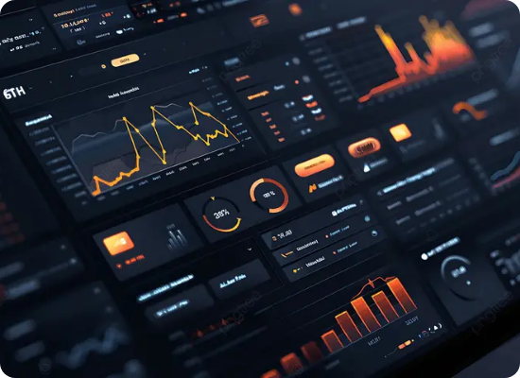
HACKANOVATION 2.0
The Solution
A Streamlined Forecasting App
CropCast is a web application designed to put predictive analytics directly into the hands of those who need it.
Built on Streamlit: Ensuring a fast, responsive, and intuitive user interface.
Instant Predictions: Real-time processing of future dates.
Actionable Outputs: Provides a clear range (Min/Max) to help gauge market risk.
Accessible: No coding or data science expertise required for the end user.

Slide 6









HACKANOVATION 2.0
The Data Foundation
Kaggle Dataset
Decade of History
Core Features
Our model is trained on a robust, publicly verified agricultural dataset sourced from Kaggle, ensuring high data integrity and consistency.
The dataset captures daily market movements from the year 2010 onwards, providing a massive volume of historical context.
We isolate key variables: Crop Name, Date, Avg Min Price, and Avg Max Price to build highly targeted forecasting models.

Slide 7


HACKANOVATION 2.0
How It Works
1. User Inputs
2. App Outputs
The interface requires only two simple inputs from the user, making it incredibly frictionless.
The backend processes the request through our trained Prophet model and returns a realistic price range.
Crop Name: Select from a comprehensive dropdown of available agricultural commodities.
Avg Min Price: The predicted lower bound of the market rate for the selected date.
Target Date: Choose the specific future date for which you need a price estimation.
Avg Max Price: The predicted upper bound, allowing users to estimate maximum potential yield.

Slide 8
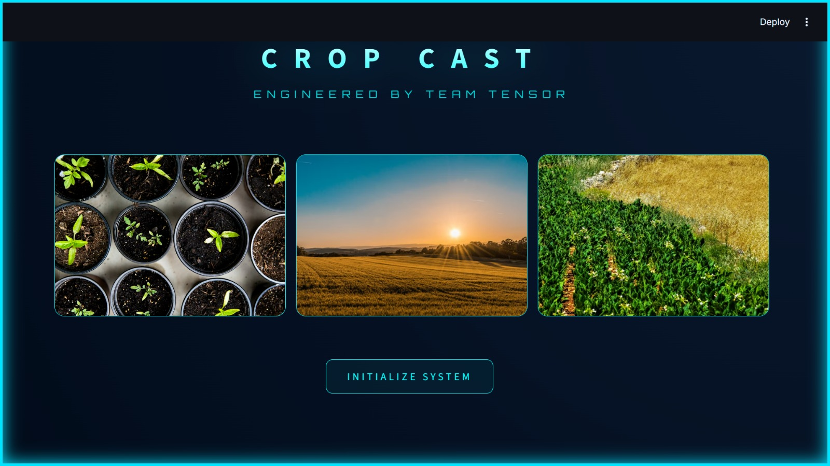
INPUT:

Slide 9
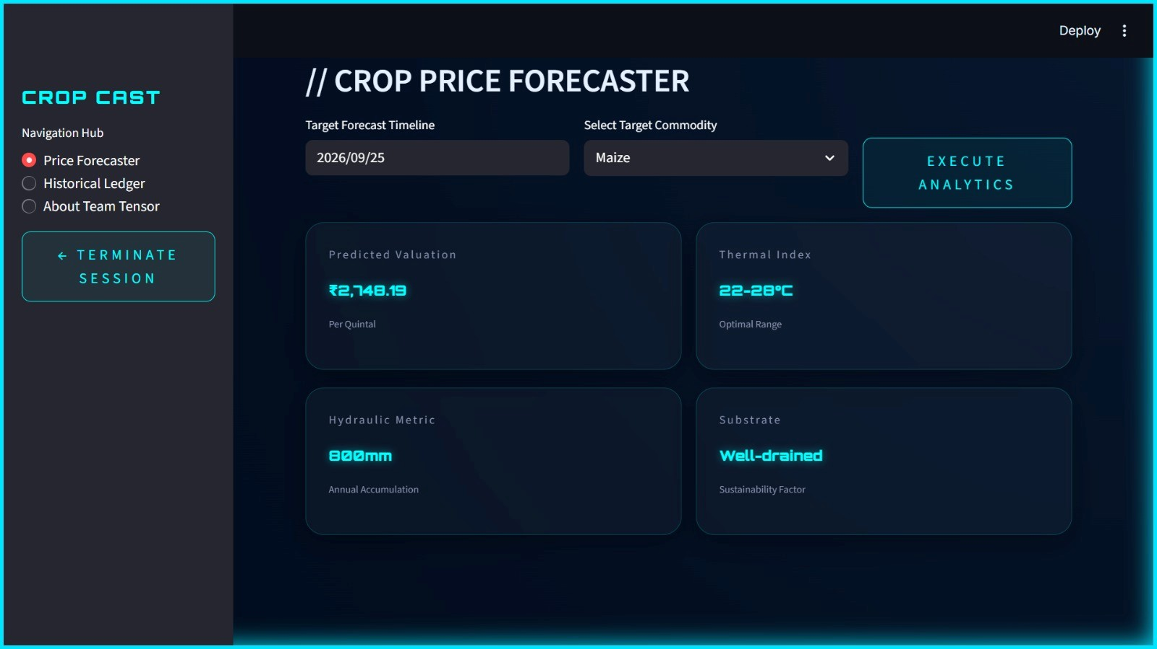
HACKNOVATION 2.0 OUTPUT:

Slide 10
HACKANOVATION 2.0 Powered by XG boost:
XGBoost (Extreme Gradient Boosting) is an advanced machine learning algorithm known for its high performance and accuracy in predictive modeling.
It works by combining multiple decision trees to improve prediction accuracy and reduce errors.
XGBoost captures:
• Non-linear relationships in the data
• Trends and seasonal patterns
• Feature interactions between variables
• Complex dependencies that traditional statistical models may miss
Model Concept (Simple Form):
\hat{y} = \sum_{k=1}^{n} f_k(x)
Where:
• f_k = individual decision trees
• x = input features
• \hat{y} = predicted output

Slide 11
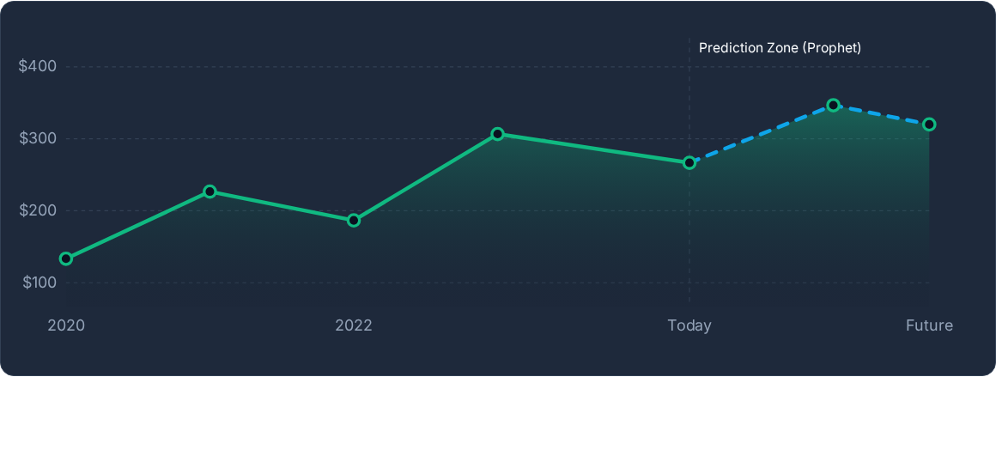
Forecasting Trends
Visual representation of Prophet capturing historical volatility and charting future price trajectories based on learned seasonality.

Slide 12
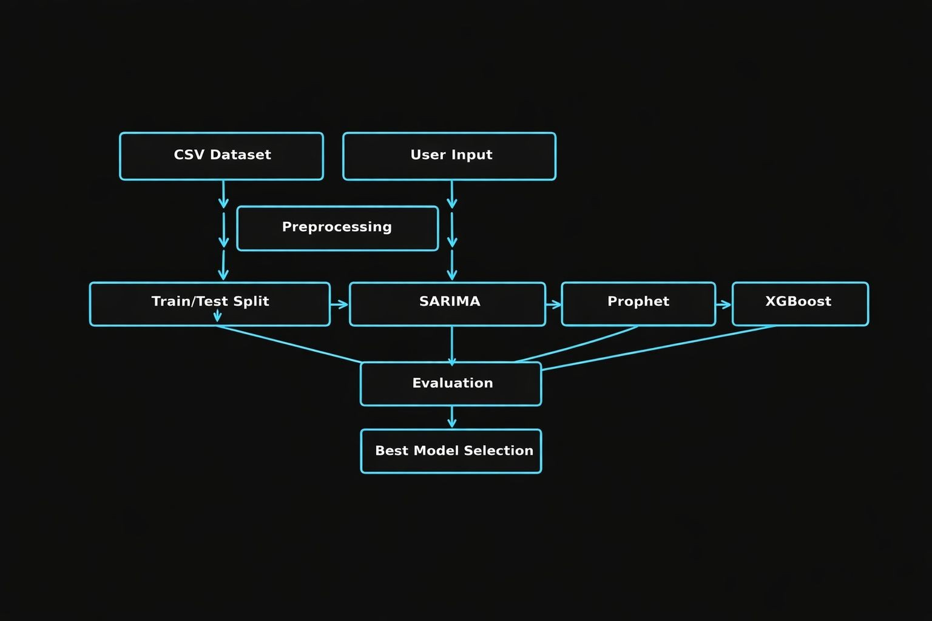
MODEL ARCHITECTURE:

Slide 13




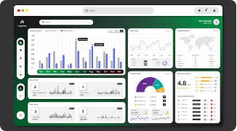

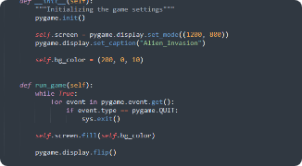

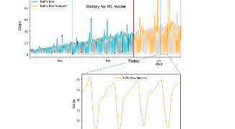
HACKANOVATION 2.0
The Tech Stack
Streamlit
Python Base
XG Boost
Provides the rapid deployment framework for our interactive, user-facing web interface.
The core backend language handling data manipulation (Pandas) and bridging the UI to the model.
The time-series forecasting engine powering the complex predictive mathematics under the hood.

Slide 14
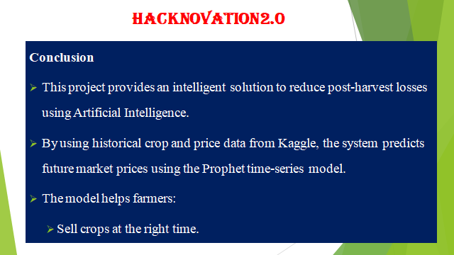
CONCLUSION:
HACKANOVATION 2.0

Slide 15
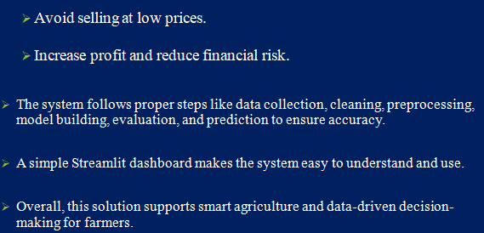

Slide 16





Image Sources
https://img.freepik.com/premium-photo/farmer-using-tablet-lush-green-field-showcasing-modern-agricultural-technology-sustainable-farming-practices_1317057-27747.jpg?w=360
Source: www.freepik.com
https://png.pngtree.com/thumb_back/fw800/background/20260110/pngtree-modern-dark-themed-data-analytics-dashboard-with-vibrant-accents-image_21052087.webp
Source: pngtree.com
https://img.freepik.com/premium-vector/modern-dashboard-ui-design-with-charts-data-visualization_25444-827.jpg
Source: www.freepik.com
https://i.sstatic.net/Tc96Y.png
Source: stackoverflow.com
https://codilime.com/img/ai-and-machine-learning-for-networks-time-series-forecasting-and-regression-1.png
Source: codilime.com

Slide 17


