Slide 1


Where should you book your next Airbnb ?
Abhishek Saha Sameen Haroon Sharon Xu Zeyu Zhu
Group 5 High Five A++

Slide 2


Given the competitive and data-rich nature of the travel industry, our project focuses on Airbnb
There is availability of data at scale in the online travel and hospitality space
Data is being passed digitally to consumers in real-time along with an immediate feedback loop
Increased competition provides consumers with more choices but also creates the need for informed decision-making
The industry is highly relevant to everyday consumers, including us
Airbnb is a disruptive and growing force in the online hospitality space
The number of Airbnb users in the United States is 38 million right now and is forecasted to reach 43.3 million by 2020
However, there is an opportunity to better enable Airbnb customers to make decisions about where they stay
There is rich data on Airbnb which is available for public use

Slide 3





More specifically, we chose to leverage city-level Airbnb listing data for Los Angeles
Primary data from Inside Airbnb, http://insideairbnb.com/index.html
Focused on a single city, Los Angeles, with 43,000+ listings and 100+ attributes available
Distilled data to key relevant features such as
Location
lat/long
neighborhood
Customer feedback
ratings
reviews
Rental details
room type
capacity
Amenities
wireless internet
air conditioning
Service details
Host flexibility
Host experience
Los Angeles was deemed a good choice given the high level of tourism it receives and its urban sprawl. It also has a large number of Airbnb listings but is not as widely studied as other cities such as New York and San Francisco

Slide 4
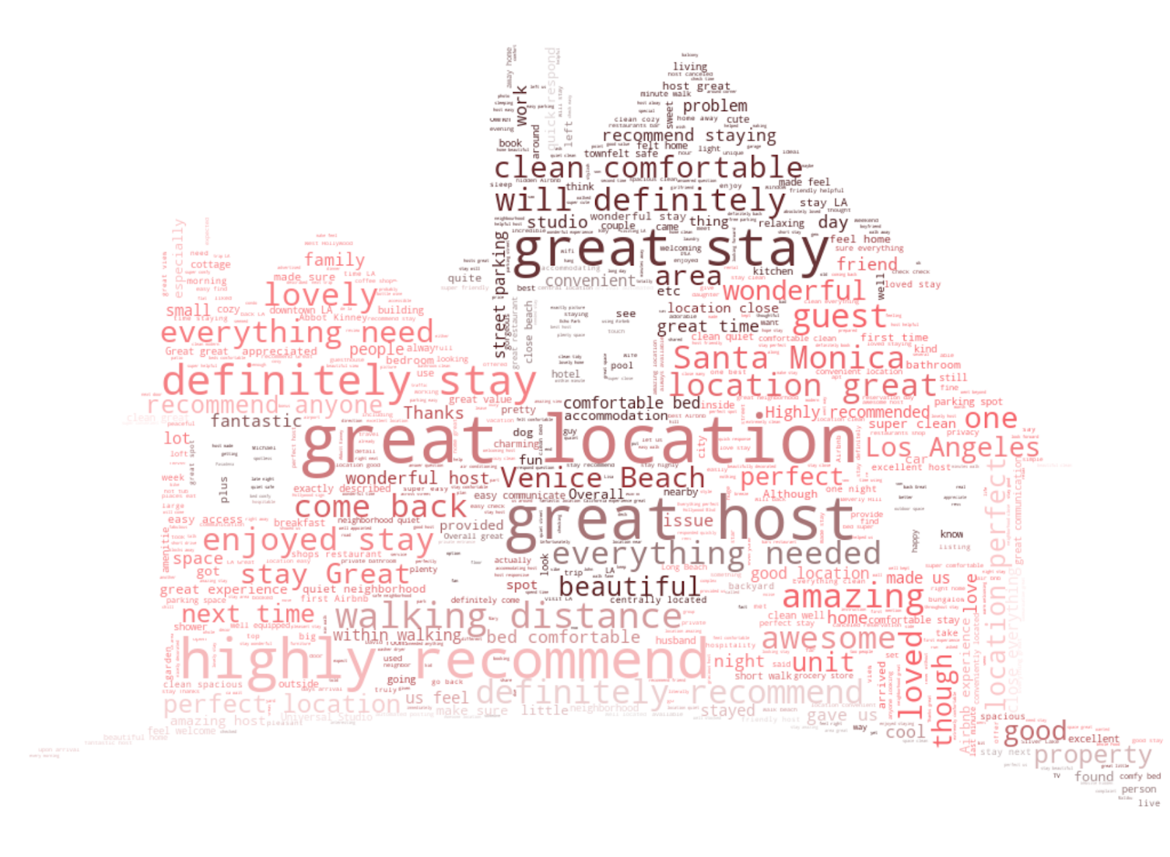
Our analysis focuses on granular location data due to the critical role of location in driving travel rentals
Location matters, but it can be hard to tell what good is
Opportunity to use rich Airbnb and geographic data to help users differentiate between locations
As travelers, we know that location is a major factor in finding a place to stay when visiting a new city
However, it can be challenging to tell apart better vs. worse neighborhoods, and desirable locations can span across predefined boundaries
Airbnb’s interface provides a map view, but doesn’t help a user identify which areas of a city travelers desire
Word map from randomly sampled 100,000 reviews for all listings in LA
Made in Python using WordCloud and matplotlib

Slide 5
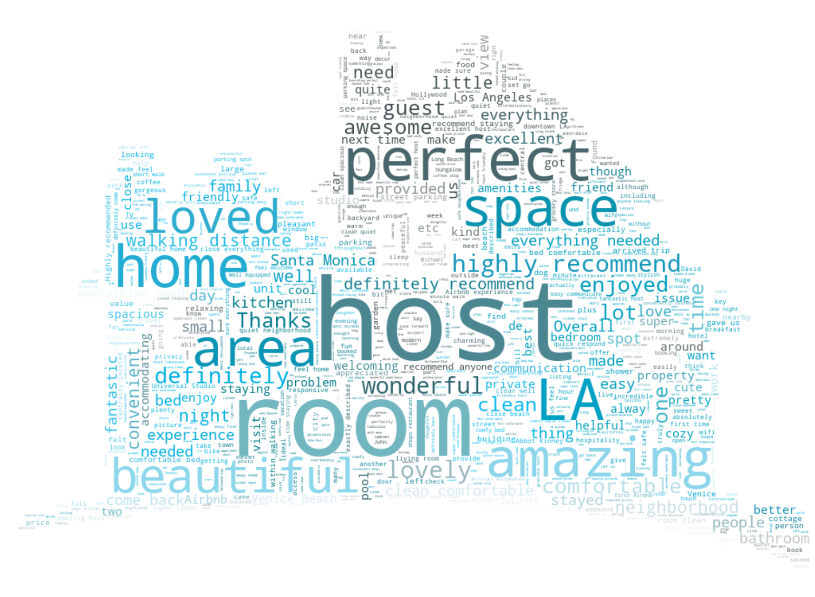
We’ve sought to combine relevant data and data vis. tools to help users find the right area and the right listing
Right Area
Right Listing
Looked at ways to leverage available Airbnb data such as location ratings to create geographic clusters
Paired these clusters with custom map layers in Tableau to ensure users could see these clusters in context
Calculated and categorized area proximity to major tourist attractions
Added in insights on how these areas stack on price and overall ratings
Used online research and friendly conversations to gauge what customers prioritize in listing search
Used natural language processing of reviews to explore additional traits that customers value
Sought to overcome some limitations in current Airbnb filtering capabilities to better improve listing results
Introduced tabular comparison of listings across key measures and characteristics

Slide 6

Putting it all together…

Slide 7
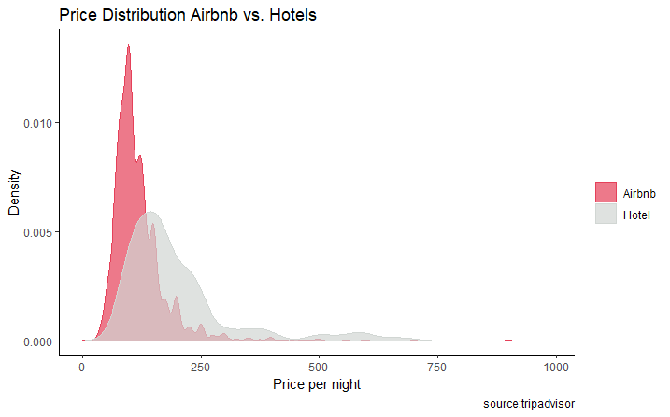
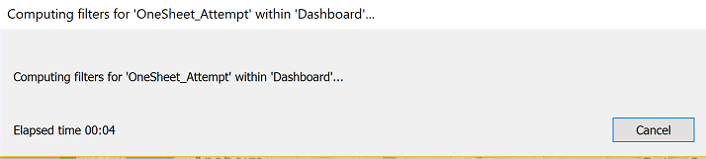
As with most projects, we learned some valuable insights along the way
1
Acquiring all the data you want can be challenging, possibly unfruitful, but always interesting
2
At the same time, its important to think through the right use-cases and audiences using the data available
Three packages, dozens of attempts and numerous how-to-articles later….we could get hotel prices, just not latitudes and longitudes
While we thought through the perspectives of Airbnb hosts, business managers and customers, we realized our data was richest for the latter
Airbnb Listing Prices vs. Hotel Prices in LA
Average Price for Hotel: $197.78
3
There are also meaningful tradeoffs between technology and functionality that are worth keeping in mind
Average Price for Airbnb: $118.38
(entire house, 2 people)
Each additional filter or data layer we added steadily increased our load times (we had 3 cities to start, DC and Chicago got bumped)
4
Don’t ever use Comic Sans MS. Except in pink. At the end of a semester in a class presentation on data visualization.

Slide 8

Thank you!
Questions?

