Slide 1

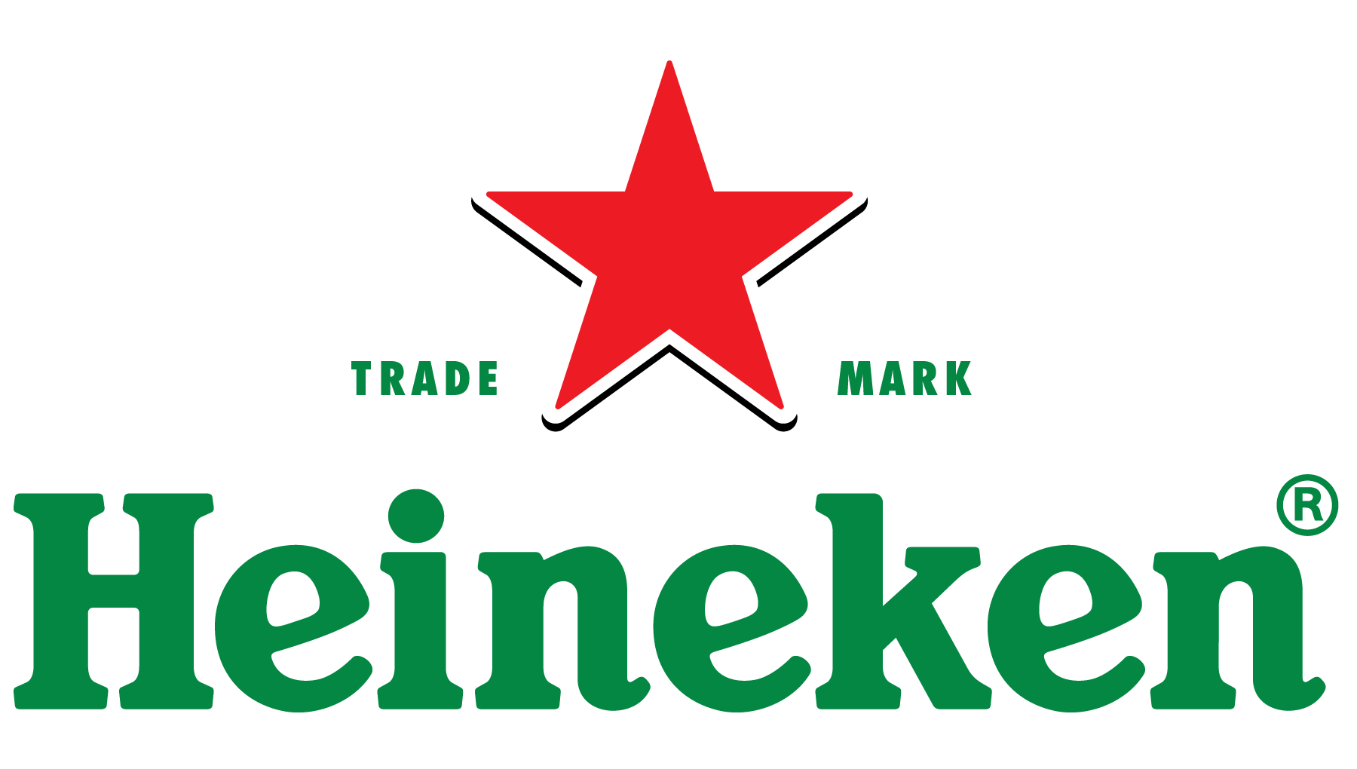
Using Recommender Systems to Increase Sales of Heineken Branded Products
Gary Gao, Miller Page, Abhishek Saha, Alana Zhao

Slide 2
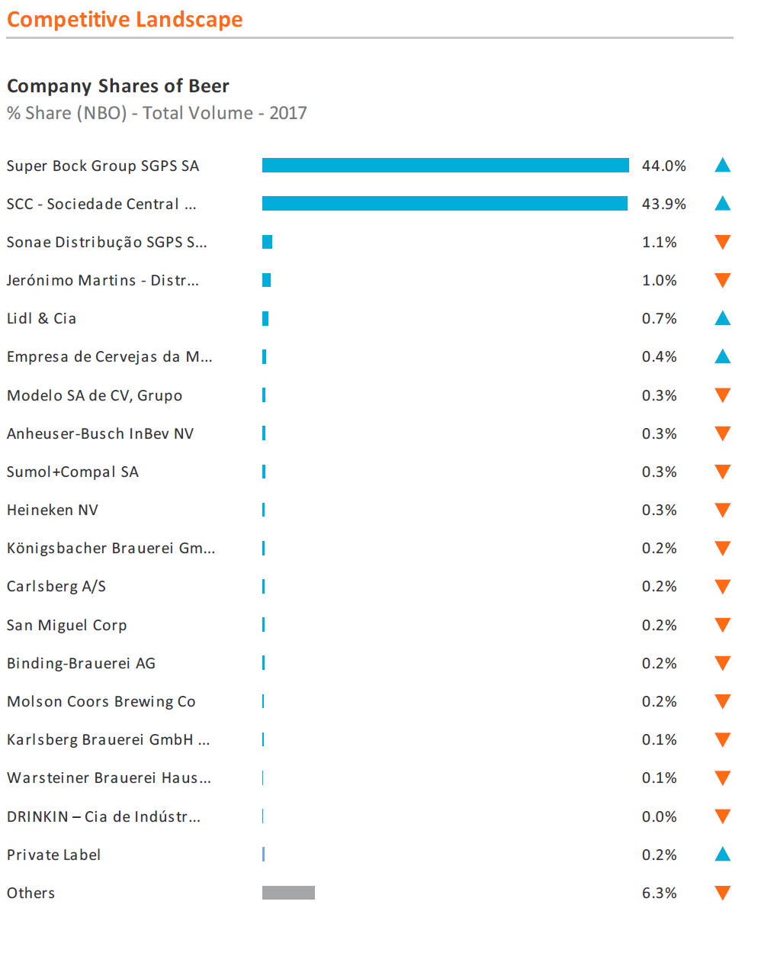
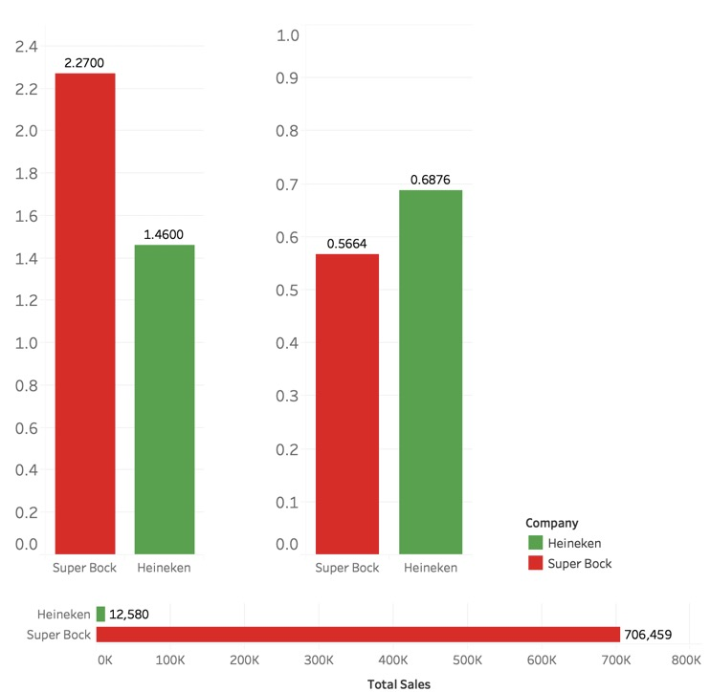
How can Heineken increase their sales from Super Bock customers?
Market Level
Supermarket Chain Level
Average Price ($)
Discount Frequency
Heineken is cheaper and on sale more than Super Bock yet sold much less.
How can they reach these customers to boost revenue?

Slide 3

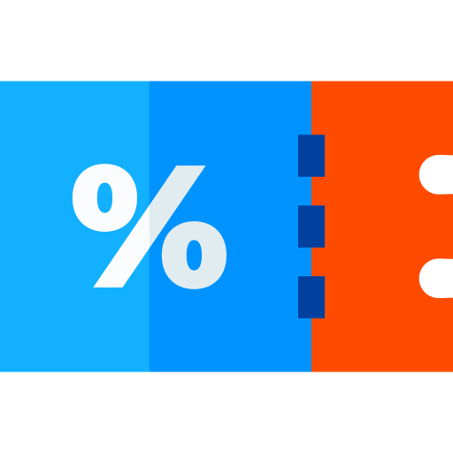
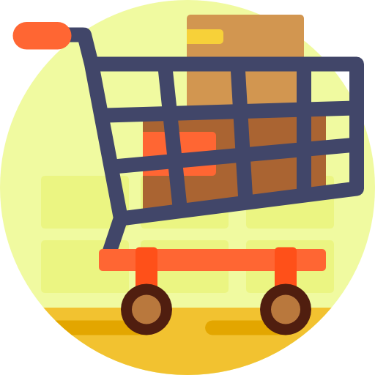

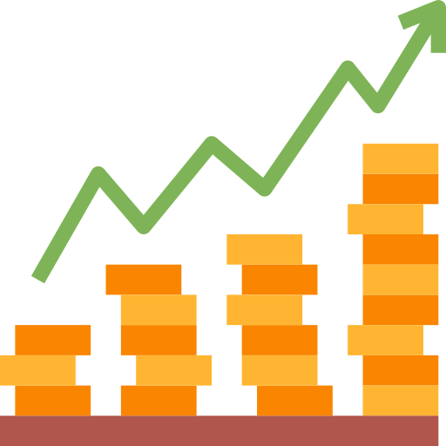
We implemented Naïve Bayes conditional probability to find personalized offer levels for each customer
Validated the rationality of recommendations
Estimated purchasing behaviors by finding their average purchase discount
Built customer profiles of most commonly co-purchased items
Implemented the Naïve Bayes collaborative filtering approach
Calculated incremental benefits to Heineken
Technique:
Jaccard Similarity
Method:
20 offer levels ranging 0% to 100%
Method:
Top 5
co-purchased items
Technique:
Naïve Bayes Conditional Probability
Method:
Incremental quantity & revenue, ROI

Slide 4
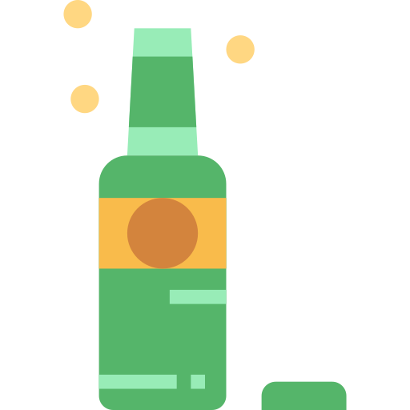
Utilizing our recommender system boosts Heineken’s sales by ~22%
Increase in sales volume
Increase in revenue
Return on investment
25%
22%
2.8
2.8
Heineken could significantly gain by implementing our Naïve Bayes collaborative filtering-based recommender system
Purchase profile of majority of Super Bock users was similar to Heineken users, hence promote latter’s products to former
Heineken could expand on this by appropriately pricing their products and designing a suitable marketing mix model

