Slide 1
Processing critical health events in real time using clinical ground rule based guidelines.
Presented by:
Abhishek Tiwari (MDE2024008)
Moksh Rajput (MDE2024001)

Slide 2
Objective:
Build a distributed platform for chronic disease health data processing using Big Data technologies.
Implement national/international treatment guidelines via Siddhi CEP for event detection.
Real-time event detection for critical health events.

Slide 3
Proposed Methodology:
Dataset Preparation.
Data conversion to JSON.
Real-Time data ingestion.
Event Processing using Siddhi CEP.
Rule-Based Detection.

Slide 4
Datasets Used:
Cardio Disease Prediction Dataset.
Heart Failure Prediction Dataset.

Slide 5
Preprocessing:
Handling missing data (with median).
Mapping Categorical Data.
Min-max scaling on integer columns.
Selecting Relevant Columns.
Converting to JSON for Kafka streaming.

Slide 6
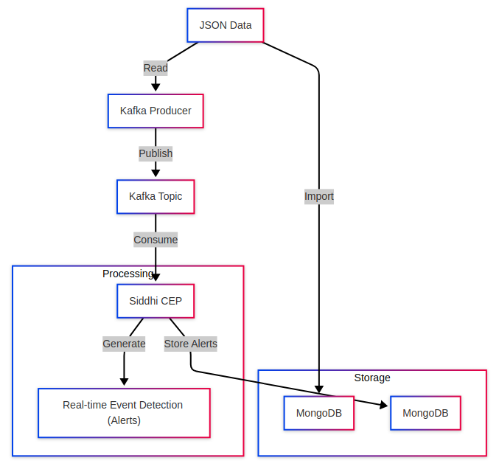
System Architecture:

Slide 7
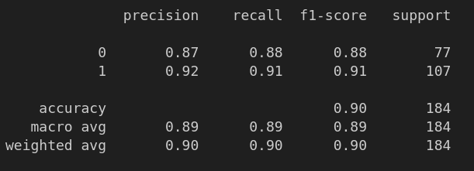
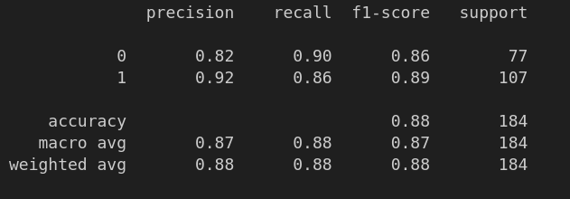
Metrics:
Fig. Metrics for Randomized search CV and XGBoost respectively for heart disease prediction dataset.

Slide 8
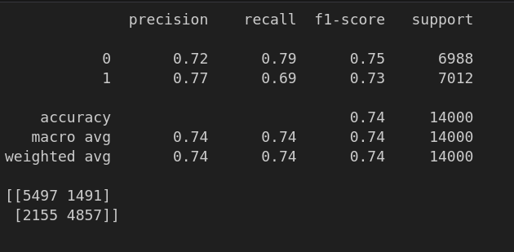
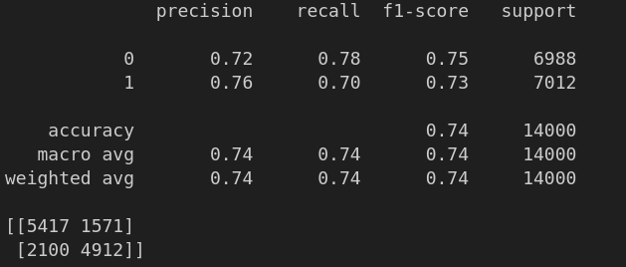
Metrics:
Fig. Metrics for Randomized Search CV and XGBoost for cardio disease prediction dataset.

Slide 9
Sample Rules (for Heart Disease Prediction):
If ST_Slope in ['Down', 'Flat'] and Sex = 'F' and ChestPainType in ['ASY', 'ATA'] and RestingBP ≤ 187.28 and Oldpeak ≤ 1.05 → Class 0
If ST_Slope in ['Down', 'Flat'] and Sex = 'F' and ChestPainType in ['ASY', 'ATA'] and RestingBP ≤ 187.28 and Oldpeak > 1.05 → Class 1

Slide 10
Sample Rules (for Cardio disease Dataset):
ap_hi <= 129.50 THEN cholesterol <= 2.50 THEN age > 22203.50 THEN ap_lo > 78.00 THEN active <= 0.50
ap_hi > 129.50 THEN ap_hi > 133.50 THEN ap_lo <= 5.00 THEN id > 56213.00

Slide 11
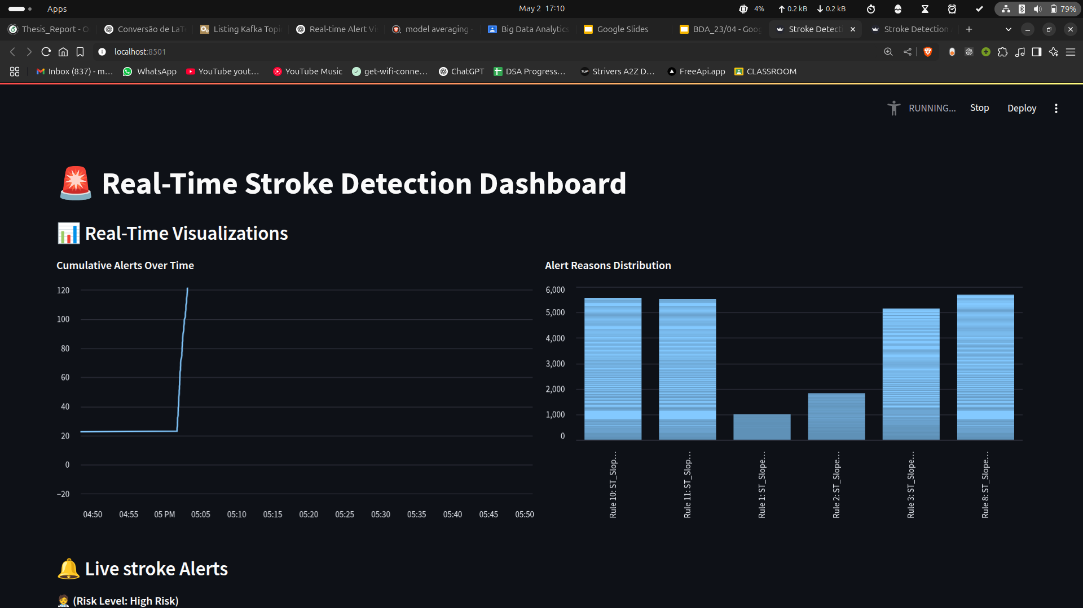
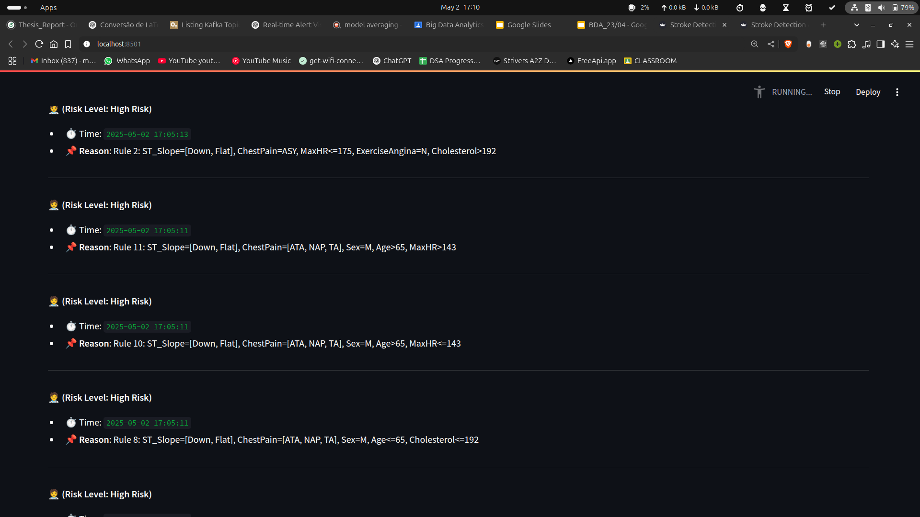
Dashboard:

Slide 12
Challenges:
Biasedness of data.
Unavailability of a domain expert.
Generating synthetic data in real time.
Rules not medically aligned properly.

Slide 13
Thank You!

