Slide 1

Human Reliability Estimation using Physiological Behavior
By Abhishek Topwal (21CS60R01)
Under the guidance of Prof. Debasis Samanta
THESIS PART 1 -CS67101

Slide 2
CONTENTS:
Introduction
P-SPHERE
EXPERIMENT
Classification of PSFs
Further Work

Slide 3
What is HUMAN RELIABILITY ?

Slide 4
Reliability of an item is the probability that the item will perform its required function under given conditions for a reference time interval [1].
[1]. http://www.facweb.iitkgp.ac.in/~baidurya/dissemination/Chapter%2016%20Reliability.pdf

Slide 5


ITEM HUMAN

Slide 6
HOW TO FIND HUMAN RELIABILITY
?

Slide 7
HUMAN RELIABILITY ANALYSIS (HRA)
Its aim is to examine the human factors in a workplace.
It involves identifying, modelling and quantifying the probability of human error.

Slide 8
HUMAN ERROR PROBABILITY (HEP)
It is the ratio between the number of performed errors and the number of given opportunities for error to occur.

Slide 9
PERFORMANCE SHAPING FACTORS (PSFs)
Factors which characterize significant facets of human error and provide a numerical basis for HEP values.
These can be environmental factors, personal, or directed to activities that have the potential to affect performance positively or negatively.

Slide 10
Traditional HRA approaches involves:
Questionnaires for the users.
Expert Ratings using the external behavior.
PSFs multipliers are given by experts.

Slide 11
Issues with traditional approaches are:
Highly Subjective in nature.
Affected by biases of the experts.
Lack of empirical data for model development and validation.
Lack of inclusion of human cognition.

Slide 12
Recent HRA approaches includes:
A simulation model consisting of the reproduction of the cognitive model using an application.
A simulation that runs and produce logs which are used to get an estimate of the likelihood of human error.
Subject specific data to calculate multipliers for PSFs.

Slide 13
Person-Specific Human Error Estimation(P-SPHERE)[2]
A HRA method that evaluates HEP by using real-time values of dynamic human behavior and existing HRA methods.
Focuses on human specific factors as well as environment and organization factors.
[2] https://link.springer.com/article/10.1007/s40860-021-00146-1

Slide 14
How to incorporate Human Specific Factors
Values ?

Slide 15
Solution: Use Physiological Parameters These may include blood pressure, body temperature, heart rate etc.

Slide 16
Electroencephalography (EEG)
It is an electrophysiological technique for the recording of electrical activity arising from the human brain.
EEG gives us the ability to see brain activity as it unfolds in real time, at the level of milliseconds.

Slide 17
HRA Approach : P-SPHERE Physiological Parameter: EEG

Slide 18
P-SPHERE
Performance Shaping Factors included are: 1. Mental Workload 2. Vigilance 3. Anxiety 4. Working Memory

Slide 19
The PSFs levels can be categorized as:
• Nominal State (st = NO)
• Positively Affecting State (st = PF)
• Negatively Affecting State (st = NF)

Slide 20
The probability of the errors will be considered separately in two states as:
• Error-Free State (st = NE)
• Error-Occurrence State (st = EO)

Slide 21
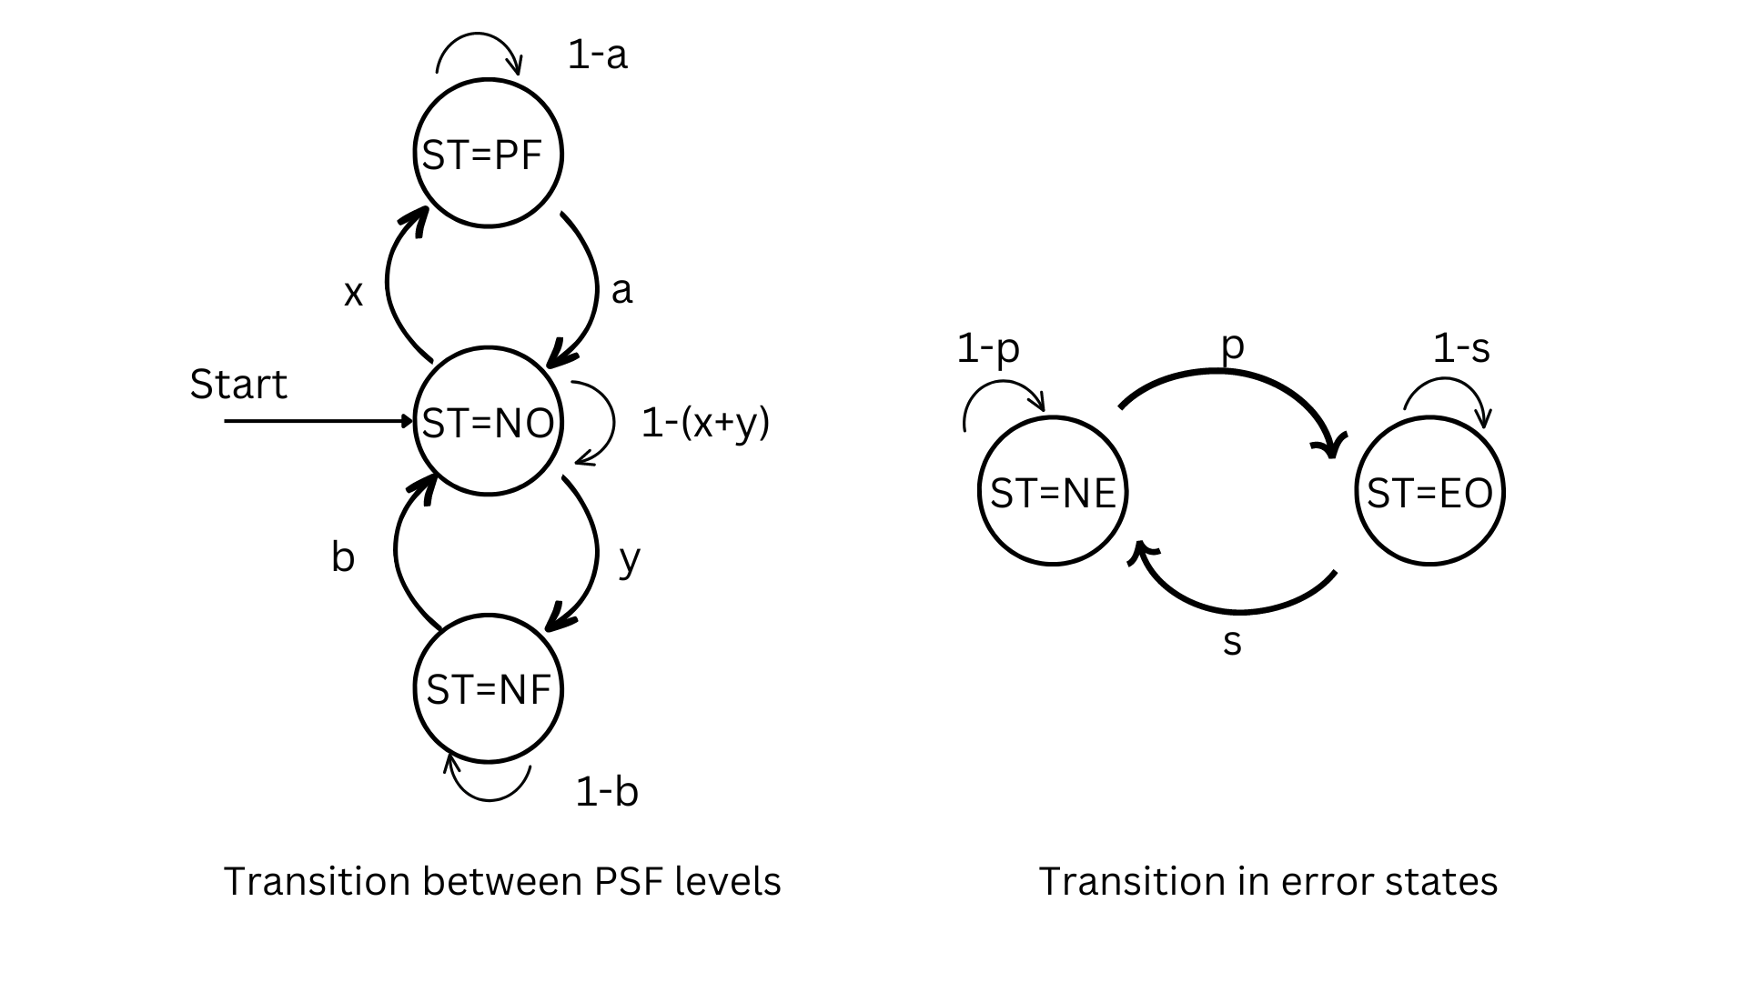
Multiplier Evaluation for the considered PSFs
Continuous Time Markov Chain (CTMC) Model
Image Source : https://link.springer.com/article/10.1007/s40860-021-00146-1

Slide 22
Multiplier Evaluation for the considered PSFs
The multipliers are evaluated in 2 steps:
• Evaluate the probability of the subject of being in one of the defined states or levels of the PSFs.
• Evaluate the probability of the error made by the subject while being in one of the defined states.

Slide 23
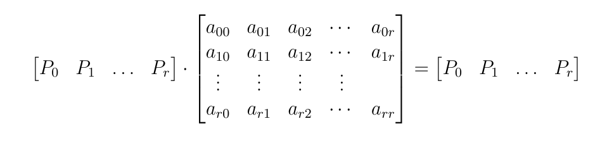
Transition Rate Computation

Slide 24
Human Error Probability Calculation
Hence, the steps are:
Evaluate the Multipliers for all the considered PSFs.
Perform union of all the multipliers to get the error contribution from the factors. HEP = P (M W ) ∪ P (V ) ∪ P (W M ) ∪ P (A)

Slide 25
EXPERIMENT

Slide 26
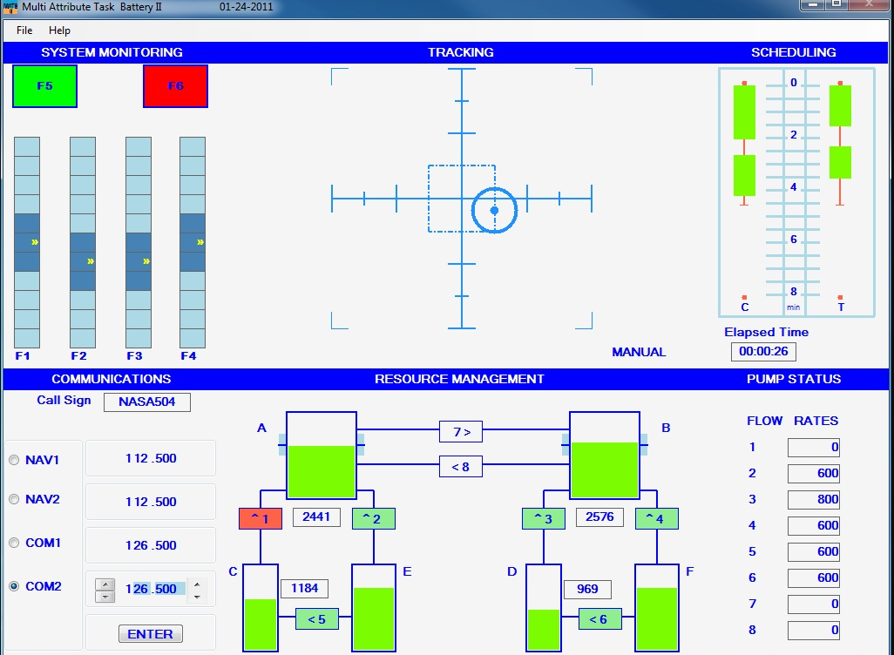
Multiple Attribute Task Battery

Slide 27
CLASSIFICATION
OF
PSFs

Slide 28
Signal Acquisition
Signal Processing - Artefacts Processing - Noise Removal
Feature Engineering - Feature Selection - Dimension Reduction
Modelling

Slide 29
Mental Workload

Slide 30
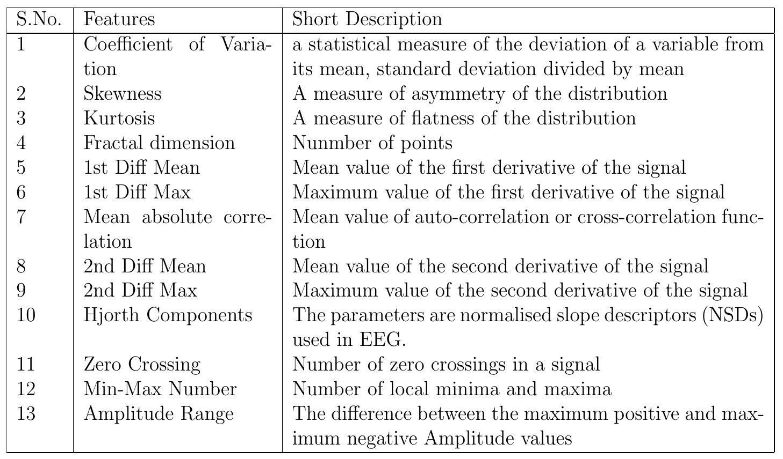
Time Domain Features

Slide 31
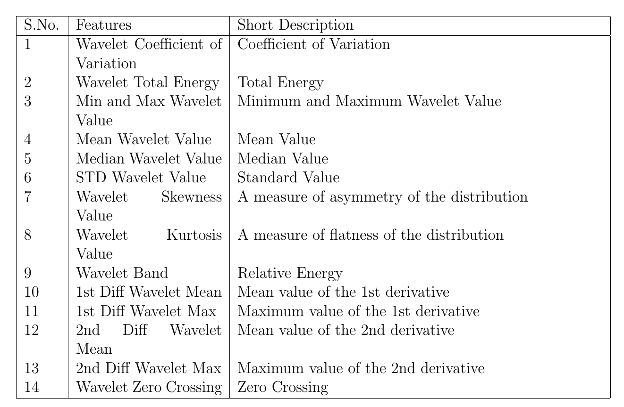
Wavelet Features

Slide 32
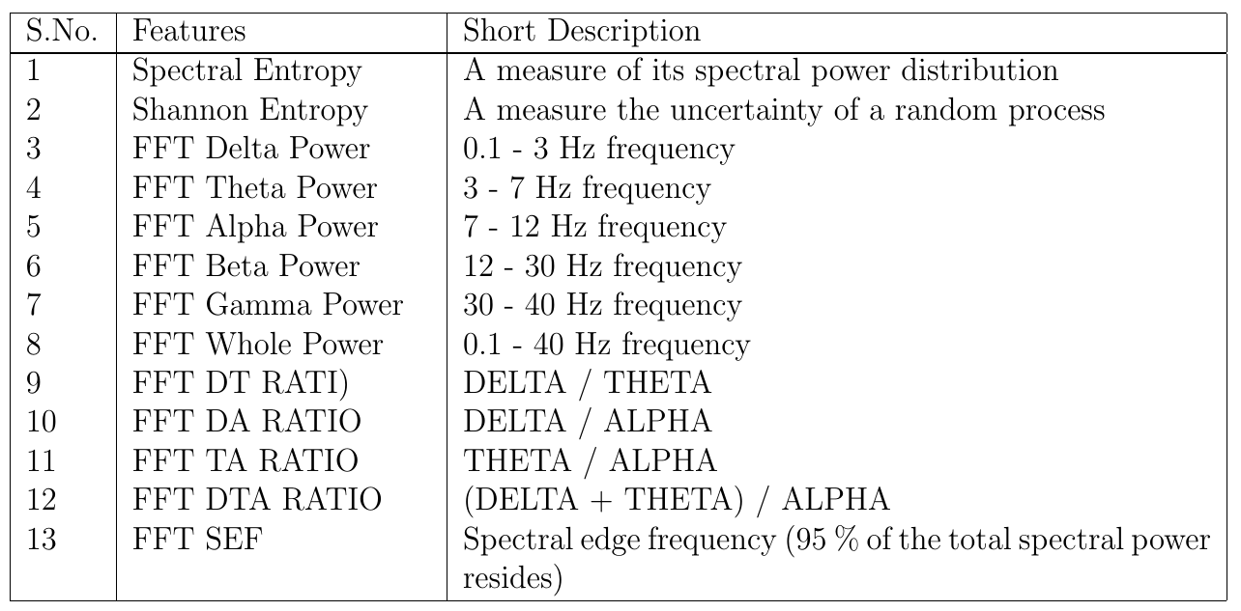
Frequency Domain Features

Slide 33
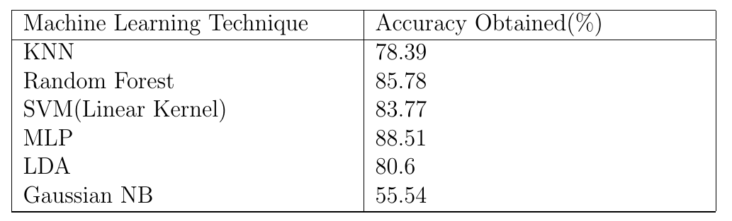
Mental Workload Classification Results

Slide 34
ANXIETY

Slide 35
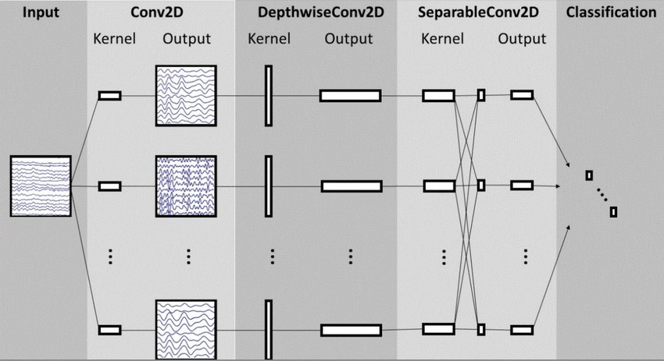
EEGNet

Slide 36
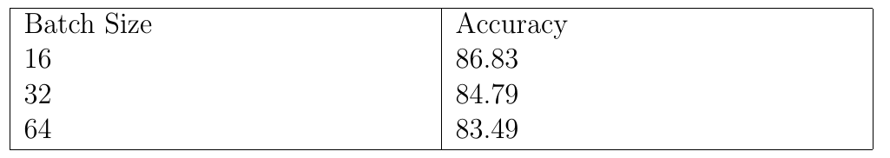
Anxiety Classification Results

Slide 37
FURTHER WORK

Slide 38
Create Classification Models for Vigilance and Working Memory.
Perform the experiment and gather the data.

Slide 39
THANK YOU

