Slide 1
Presentation on “Artificial intelligence Based dietician”

Slide 2
Enrollment no. Name of the students [0114EC171002] Abhishekh vishwakarma [0114EC171009] Harsh yadav [0114EC171004] Aryan beohar [0114EC171017] Nikesh anand
Group members :

Slide 3
Aim
Nowadays, we suffering from many health problems such as fitness problem, maintaining proper diet problem, etc. Therefore, we are developing this AI based dietician for providing special dietician information for normal persons and for handicap people also.
Our aim is to do calclulation of our daily need calories and to plan balanced diet with the help of Artificial intelligence

Slide 4
Introduction
This project “Artificial Intelligence Dietitian” is GUI App with artificial intelligence about human diets.
It acts as a diet consultant similar to a real Dietitian. It take input as person’s daily activity, height and weight.
It stores and processes the above data and then calculates the nutrient value needed to fill up user’s needs.
After all algorithmic calculation, it shows an appropriate diet to the users.

Slide 5
Module and languages used :
Python language
Tkinter module for graphical user interface program
Random module
Math module for complex math calculation

Slide 6
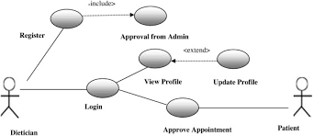
Software Requirements: Windows 10 python 3.X interpreter Visual studio code ide

Slide 7
Working
Input details from the user like - Age, Weight, Height and daily exercise level.
Then in internally Algorithm Calculate Basal Metabolic Rate (BMR) using the Harris-Benedict Equations
Calculate the calorie intake using the internal table
Exercise level Daily Calories Required (Kcal/day) by predefine table in code
Recommend a diet plan based on the above steps. If not interested, look for an alternative plan using the defined rules by clicking on submit.

Slide 8
What affects my BMR?
Anything that results in an increase to your metabolic rate will increase your BMR. This includes exercise, stress, fear and illnesses.
Your BMR is relative to body mass, age, weight and height. It is also affected by your gender; as it widely regarded that men need more calories than women.
BMR formula
There are 2 formulae used to calculate BMR, in [kcal / 24hrs] for men and women respectively:
BMR for Men = 66.47 + (13.75 * weight [kg]) + (5.003 * size [cm]) − (6.755 * age [years])
BMR for Women = 655.1 + (9.563 * weight [kg]) + (1.85 * size [cm]) − (4.676 * age [years])

Slide 9
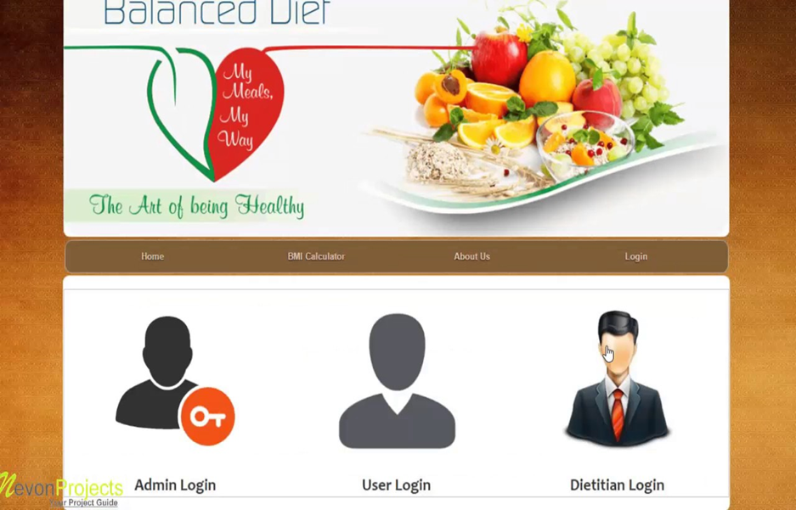

Slide 10
Taking inputs from user by GUI interface
Stored food items
Processed by Algorithm
Food item table
Other internal variables
Show diet plan

Slide 11
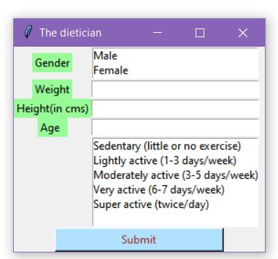
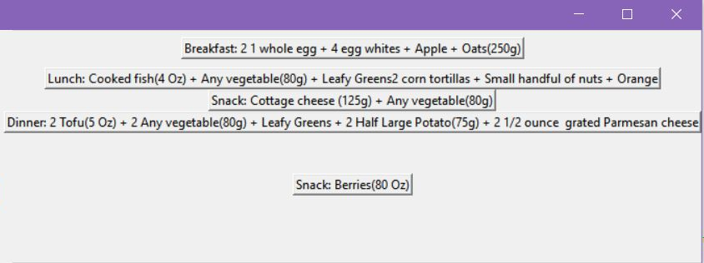
Implementation and live snapshots
This is a generated GUI(graphical user interface)
That take some inputs and after process, it will show diet plan

Slide 12
Advantages
Now people are free to choose diet plans according to their body needs.
This system provides details of the nutrient constitution in body and if required more or not along with the plan by just answering to some queries.
Saves money and very effective and give accurate results as it is coded with keeping diet chart in mind.
There are alternative diet chart provided by the system if the user don't like any then try alternate plan according to their preferences.

Slide 13
Real world applications
Dietitians can use this system to make sure what they recommend patients.
This system can be very well used in medical colleges for teaching and practicing purposes so that student can learn from it.
This system can also be utilized in gym particularly for calculating the customers' calories and diet plans.
Individual can also use this software especially for themselves in home.

Slide 14
Future scope
In future we will create an android app base on this AI based dietician project.
In future we can create web that show as well exercise using AI.
We can track our daily activity as an integration on this project.

Slide 15
Thank you

