Slide 1
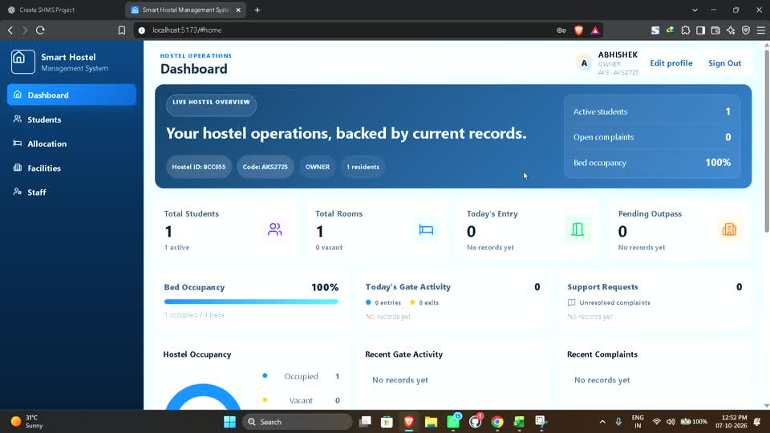
COLLEGE PROJECT PRESENTATION
Smart Hostel
Management System
A MERN-based platform for secure hostel operations, residents, facilities, and gate management
MERN Stack
Multi-hostel
Role-based
Prepared for project review and poster presentation

Slide 2
SMART HOSTEL MANAGEMENT SYSTEM | 02
Introduction
Hostel operations often rely on disconnected registers, calls, and manual follow-up.
Current operational problems
SHMS solution
Manual student, room, and bed records
SHMS centralizes hostel data under verified hostel context and role-based access.
Slow gate verification and movement tracking
Limited role control across hostel staff
The system supports real records, protected tenant data, resident administration, room allocation, photo handling, fee workflows, and QR-based gate activity.
No single view of occupancy and operations
SHMS Project Presentation
02

Slide 3
SMART HOSTEL MANAGEMENT SYSTEM | 03
Project Objectives
The project focuses on operational clarity, data isolation, and secure role-based workflows.
01
Centralize hostel records
02
Secure every hostel
Manage students, staff, parents, rooms, beds, and allocations in one system.
Verify the active hostel context on the backend for tenant-scoped data.
03
Improve daily operations
04
Keep history
Support resident handling, facility management, payments, photos, and gate records.
Use lifecycle states and allocation history instead of removing important records.
SHMS Project Presentation
03

Slide 4
SMART HOSTEL MANAGEMENT SYSTEM | 04
Technology Stack
The application uses a modern web stack with a separate client, API server, and MongoDB data layer.
1
2
3
4
React + Vite
Node.js + Express
MongoDB + Mongoose
JWT + Scrypt
Responsive user interface, component state, forms, dashboard
REST APIs, validation, authorization, secure file handling
Tenant-scoped documents, lifecycle fields, and model relations
Signed access tokens and protected password verification
Supporting libraries: Multer for uploads, Lucide React icons, HTML5 QR scanner, QRCode generator, and Google OAuth integration.
SHMS Project Presentation
04

Slide 5
SMART HOSTEL MANAGEMENT SYSTEM | 05
Role-Based Access Model
Six roles define what each person can access within the platform.
System Admin
Owner
Warden
1
2
3
Platform and hostel oversight
Own hostel administration
Daily resident operations
Guard
Student
Parent
4
5
6
QR verification and gate activity
Own profile, QR, and services
Linked child information
SHMS Project Presentation
05

Slide 6
SMART HOSTEL MANAGEMENT SYSTEM | 06
Implemented Modules
The current build contains working modules backed by API routes, model logic, and automated tests.
01
02
03
04
Authentication
Hostel & Facilities
Students & Parents
Staff
Login, registration, session persistence
Blocks, floors, rooms, beds, lifecycle state
Profiles, accounts, parent linkage
Warden and Guard creation with access control
05
06
07
08
Allocation
Gate & QR
Payments
Uploads
Assign, release, transfer, history
One-time QR token and entry or exit records
Fee payment workflow and receipts
Photo validation, preview, camera capture states
SHMS Project Presentation
06

Slide 7
SMART HOSTEL MANAGEMENT SYSTEM | 07
Entity Relationship Diagram
Core entities use hostelId to keep records within the verified hostel scope.
HOSTEL MEMBERSHIP
HOSTEL
STUDENT
USER
PK _id
PK _id
PK _id
PK _id
FK userId
hostelCode
FK hostelId
role
FK hostelId
accessCode
studentId
status
role
status
ALLOCATION
FK studentId
FK bedId
status
BLOCK
FLOOR
ROOM
BED
PK _id
PK _id
PK _id
PK _id
FK hostelId
FK blockId
FK floorId
FK roomId
status
status
Relationships shown are simplified for presentation clarity. Each operational entity also retains tenant and lifecycle information where applicable.
SHMS Project Presentation
07

Slide 8
SMART HOSTEL MANAGEMENT SYSTEM | 08
Data Flow Diagram: Context Level
SHMS acts as the central process for hostel users, records, and controlled operations.
Owner / Warden
SMART HOSTEL
MANAGEMENT SYSTEM
Guard
Profiles, facility records, allocations, staff, payment actions
QR scan and entry or exit result
Student / Parent
MongoDB Database
QR token requests, profile access, payment status
Tenant-scoped documents and history
SHMS Project Presentation
08

Slide 9
SMART HOSTEL MANAGEMENT SYSTEM | 09
Data Flow Diagram: Operational Flow
A request passes through authentication and tenant checks before the system performs a business operation.
1
2
3
4
5
Authenticate
Authorize
Scope
Operate
Persist
Verify credentials and issue a signed token
Check role and active membership
Bind request to the verified hostel
Create, read, update, archive, or record activity
Write validated data and retain history
This server-side flow prevents a client from selecting another hostel or accessing data outside its membership.
SHMS Project Presentation
09

Slide 10
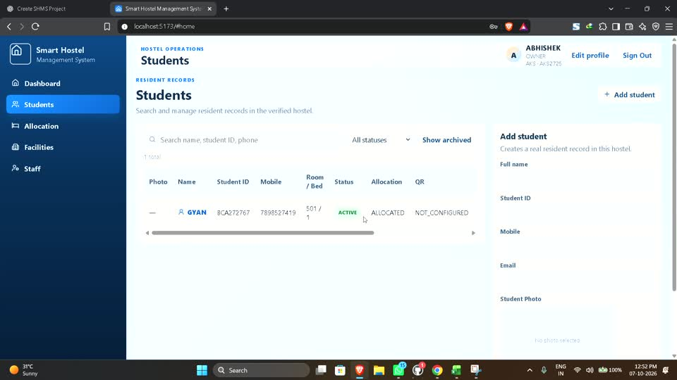
SMART HOSTEL MANAGEMENT SYSTEM | 10
Application Screens
Screens captured from the existing project recording show the dashboard, student management, photo flow, and facilities area.
Dashboard overview
Student management and profile workflow
The current interface uses responsive panels, role-aware navigation, feedback states, and a final animation layer with reduced-motion support.
SHMS Project Presentation
10

Slide 11
SMART HOSTEL MANAGEMENT SYSTEM | 11
Security and Data Integrity
Security controls belong in the backend, not only in the visible navigation.
✓
Authentication
✓
Authorization
Scrypt password hashing and signed JWT verification
Role middleware blocks unsupported operations
✓
Tenant isolation
✓
Data lifecycle
hostelId is derived from verified membership context
Archive and restore preserve important records
✓
Upload safety
✓
QR security
Image type and signature validation with size limits
Single-use short-lived tokens prevent replay
SHMS Project Presentation
11

Slide 12
SMART HOSTEL MANAGEMENT SYSTEM | 12
Verification Evidence
The current project has automated coverage for core security, lifecycle, and API behavior.
Authentication and password security
94
Tenant and cross-hostel rejection
Student, parent, and staff lifecycle
backend tests passed
Facility dependency checks
Frontend production build also passed
Allocation, release, and transfer
QR single-use and gate scan rules
Evidence reflects the most recent local test run performed during the project audit.
SHMS Project Presentation
12

Slide 13
SMART HOSTEL MANAGEMENT SYSTEM | 13
Current Progress and Remaining Scope
The project has a working foundation, with the next modules focused on resident services and reporting.
Implemented foundation
Remaining planned modules
Authentication and tenant context
Outpass approval workflow
Hostel, facility, student, staff, parent modules
Complaints, help, notices, notifications
Allocation and room-bed history
Mess, camera, security events
Photo, payment, QR, and gate workflows
Reports, exports, audit log UI, settings
Current audited estimate: around 40% complete
SHMS Project Presentation
13

Slide 14
SMART HOSTEL MANAGEMENT SYSTEM | 14
Future Enhancements
The next work expands the current foundation without changing the established security model.
Phase 1
Phase 2
Phase 3
Resident services
Operations insights
Final readiness
Outpass, complaints, help contacts, notices, notifications
Mess management, camera events, reports, export
Role dashboards, mobile verification, production deployment
The roadmap keeps tenant boundaries, role checks, lifecycle history, and real database values as non-negotiable rules.
SHMS Project Presentation
14

Slide 15
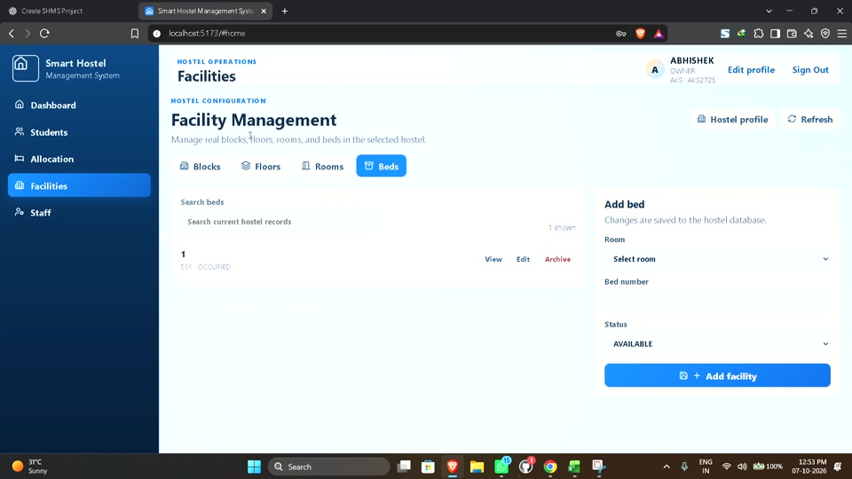
SMART HOSTEL MANAGEMENT SYSTEM
Conclusion
SHMS provides a real, secure foundation for managing hostel operations across people, facilities, and daily activity.
The next development stages will complete resident services, reporting, and all remaining role-specific workflows.
Thank you

Slide 16
SMART HOSTEL MANAGEMENT SYSTEM | 16
Complete Functional Scope
The supplied project plan defines the final SHMS scope. The completed features and planned features remain clearly separated.
Resident services
Hostel operations
Student profile, parent link, QR, entry or exit, outpass, complaints, help
Blocks, floors, rooms, beds, allocation, release, transfer, staff
Management
Security
Fees, mess menu, notices, notifications, reports, audit logs
Access-code control, gate verification, camera monitoring, security events
This scope comes from the provided SHMS feature and access plan. Current build status is shown separately in the progress slides.
SHMS Project Presentation
16

Slide 17
SMART HOSTEL MANAGEMENT SYSTEM | 17
Student QR and Gate Workflow
The final planned flow uses a short-lived, single-use QR token for secure movement records.
1
2
3
4
5
Student
System
Guard
System
Gate log
Generates a QR token
Adds token, expiry, and usage status
Scans and verifies the QR
Checks student, hostel, gate, expiry, and replay
Creates Entry or Exit record and marks QR used
Security rules: valid token, not expired, not already used, active student, matching hostel, and allowed gate.
SHMS Project Presentation
17

Slide 18
SMART HOSTEL MANAGEMENT SYSTEM | 18
Access Summary
Every role receives only the access needed for its hostel responsibilities.
Feature
System Admin
Owner
Warden
Guard
Student
Parent
Hostel data
All
Own
Assigned
Assigned
Own
Linked child
Students
All
Manage
Manage
Verify
Own
Child
Rooms and beds
All
Manage
Manage
View
Own
Child
QR and gate
All
View
View
Scan
Generate
View status
Fees
All
Manage
Authorized
No access
Own
Child
Settings
Platform
Own hostel
No access
No access
No access
No access
SHMS Project Presentation
18

Slide 19
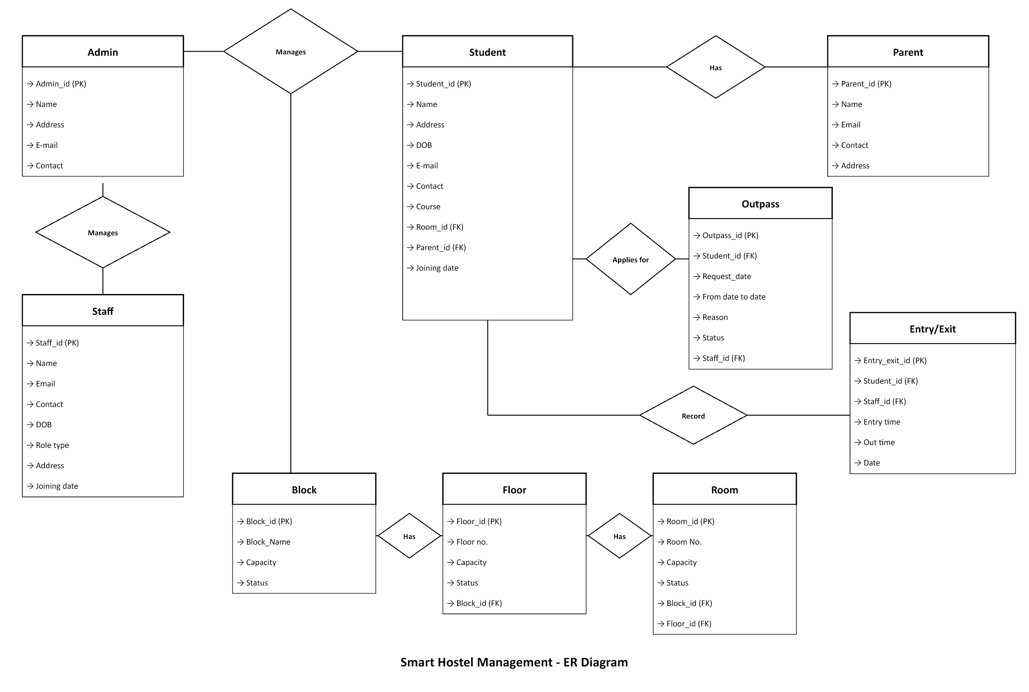
SMART HOSTEL MANAGEMENT SYSTEM | 19
Expanded Data Model
The editable ER diagram source informed the detailed entity coverage in this presentation.
Key entities covered
Users and role memberships
Students and linked parents
Staff and security records
Blocks, floors, rooms, and beds
Allocations and historical releases
Outpass and entry or exit records
The production model also uses hostelId to maintain tenant isolation across major operational records.
SHMS Project Presentation
19

Slide 20
PROJECT POSTER SUMMARY
Smart Hostel Management System
Problem
Solution
Hostel records and daily operations need a secure digital workflow.
A MERN platform with role-aware dashboards, tenant rules, and operational modules.
Current work
Next work
Authentication, facilities, students, staff, parents, allocation, QR gate flow, uploads, and payments.
Outpass, complaints, notices, mess, camera events, reports, audit logs, and final deployment.
Secure hostel operations with real database records and server-side access control

