Slide 1
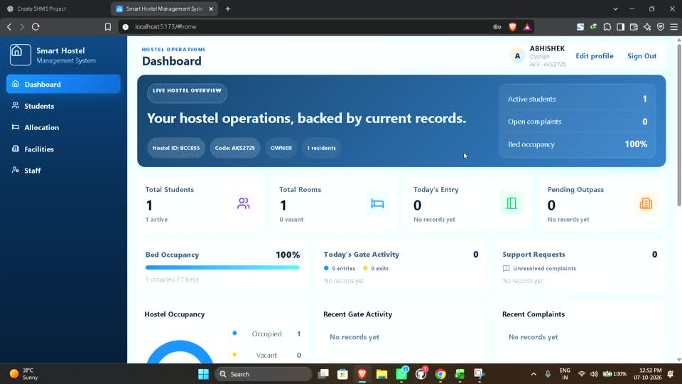
COLLEGE PROJECT PRESENTATION
Smart Hostel
Management System
MERN-based hostel operations with secure access, resident records, facilities, and gate management.
PROJECT OVERVIEW | SYSTEM DESIGN | CURRENT IMPLEMENTATION
Prepared for college presentation

Slide 2
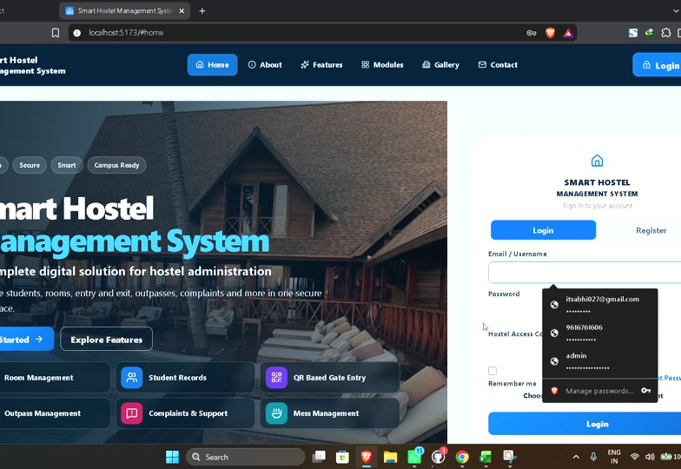
SHMS / 02
Why Smart Hostel Management?
The project replaces disconnected manual work with one controlled digital workspace.
The operational gap
Resident details scattered across registers and spreadsheets
Room and bed status changes are hard to track
Gate movement depends on manual verification
Different roles need different access to hostel data
SHMS brings these workflows together while protecting each hostel's records with verified tenant rules.
SMART HOSTEL MANAGEMENT SYSTEM
02

Slide 3
SHMS / 03
Project Aim and Objectives
A practical system for owners, staff, residents, and parents.
01
Centralize operations
02
Secure access
Keep hostel, student, facility, staff, and allocation information together.
Apply authentication, roles, and verified hostel context on every protected operation.
03
Improve accountability
04
Support growth
Retain lifecycle history for allocations, gate records, and important status changes.
Use a modular MERN structure for the remaining hostel services.
SMART HOSTEL MANAGEMENT SYSTEM
03

Slide 4
SHMS / 04
System Architecture
The deployed structure keeps the user interface, API logic, and data storage separate.
JWT token
Scoped data
React + Vite
Node.js + Express
MongoDB + Mongoose
Responsive pages
Forms and local state
Role-aware navigation
REST APIs
Validation and authorization
File upload middleware
Tenant-scoped records
Lifecycle fields
Model relationships
Supporting components: Multer photo uploads, QR token generation and scanning, Lucide icons, and Google OAuth integration.
SMART HOSTEL MANAGEMENT SYSTEM
04

Slide 5
SHMS / 05
Six User Roles
The access model separates platform oversight from individual hostel responsibilities.
1
System Admin
2
Owner
3
Warden
Platform oversight
Own hostel administration
Daily hostel operations
4
Guard
5
Student
6
Parent
Gate and security work
Own profile and services
Linked child information
SMART HOSTEL MANAGEMENT SYSTEM
05

Slide 6
SHMS / 06
Owner Workspace
The owner dashboard provides a current operational view built from backend data, not hard-coded numbers.
What the owner can manage
Hostel facilities and room capacity
Students, parents, wardens, and guards
Room and bed allocation
Payments and operational summaries
The dashboard refreshes from the current active hostel context.
SMART HOSTEL MANAGEMENT SYSTEM
06

Slide 7
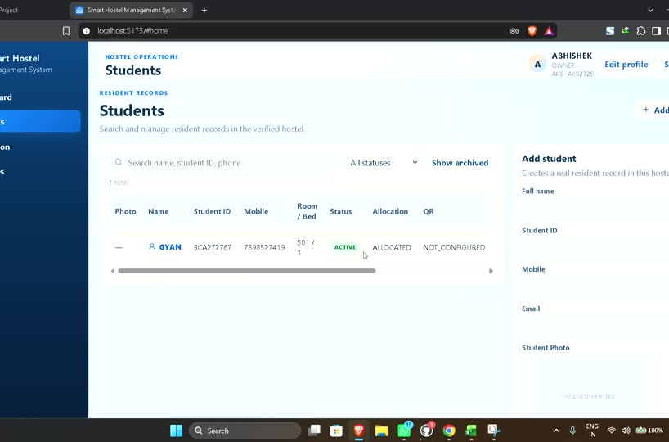
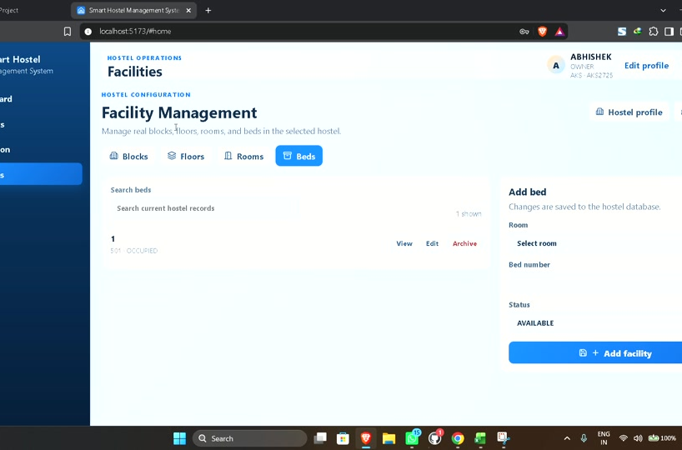
SHMS / 07
Student and Staff Management
The interface supports real CRUD workflows with server-side tenant checks.
Student management
Staff management
Implemented controls include search, status handling, account rules, photo support, and verified hostel ownership.
SMART HOSTEL MANAGEMENT SYSTEM
07

Slide 8
SHMS / 08
Facility and Allocation Flow
The physical hostel hierarchy drives bed availability and resident allocation.
1
2
3
4
5
Block
Floor
Room
Bed
Allocation
Tenant-scoped record
Tenant-scoped record
Tenant-scoped record
Tenant-scoped record
Assign, release, transfer
Allocation rules prevent duplicate active assignments and preserve historical release and transfer records.
Room and bed states: Available, Occupied, Reserved, Maintenance
SMART HOSTEL MANAGEMENT SYSTEM
08

Slide 9
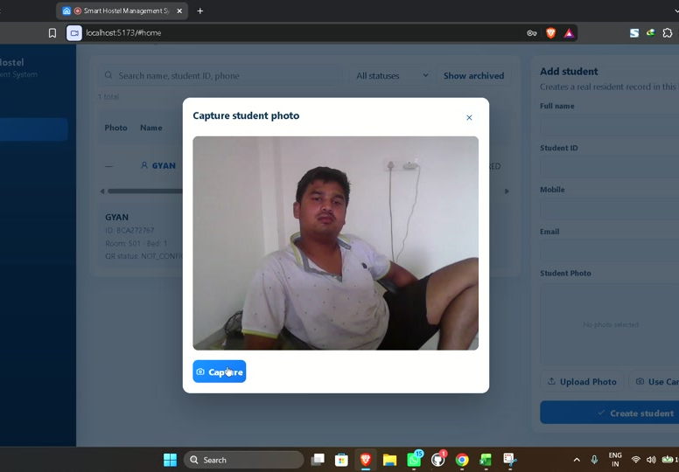
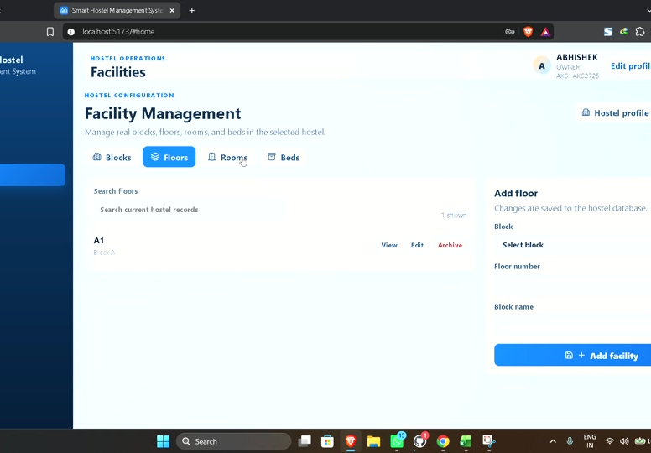
SHMS / 09
Photo Upload and Profile Capture
The profile flow accepts JPEG, PNG, and WebP images with validation before storage.
Image workflow
Select or capture image / Preview / Validate type and size / Upload / Save profile
SMART HOSTEL MANAGEMENT SYSTEM
09

Slide 10
SHMS / 10
QR Gate Security Flow
The planned gate design makes each QR token short-lived and single-use.
1
2
3
4
5
Student
QR Token
Guard
Backend
Gate Log
Generate QR
Expiry + status
Scan QR
Validate
Entry / Exit
Verification checks: token validity, expiry, usage state, active student, same hostel, and correct gate.
After successful scanning, the token is marked used and the system records the guard, gate, date, time, QR reference, and movement type.
SMART HOSTEL MANAGEMENT SYSTEM
10

Slide 11
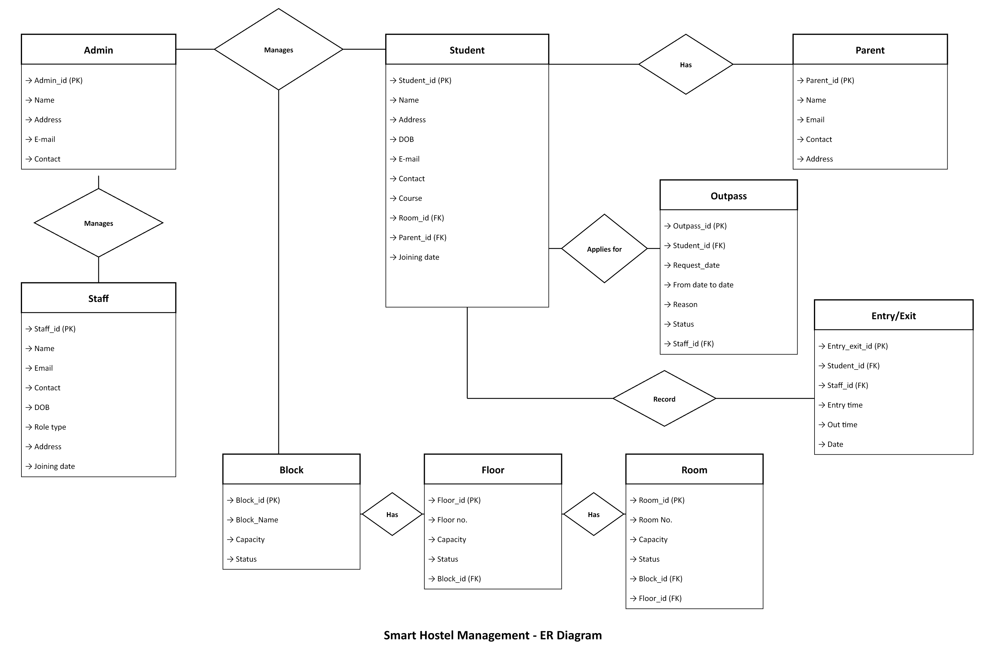
SHMS / 11
Entity Relationship Diagram
The supplied editable ER model covers the core information required across hostel operations.
Reference entities include Admin, Student, Parent, Staff, Outpass, Entry or Exit, Block, Floor, and Room. The current application also adds Hostel Membership, Bed, Allocation, and secure QR token records.
SMART HOSTEL MANAGEMENT SYSTEM
11

Slide 12
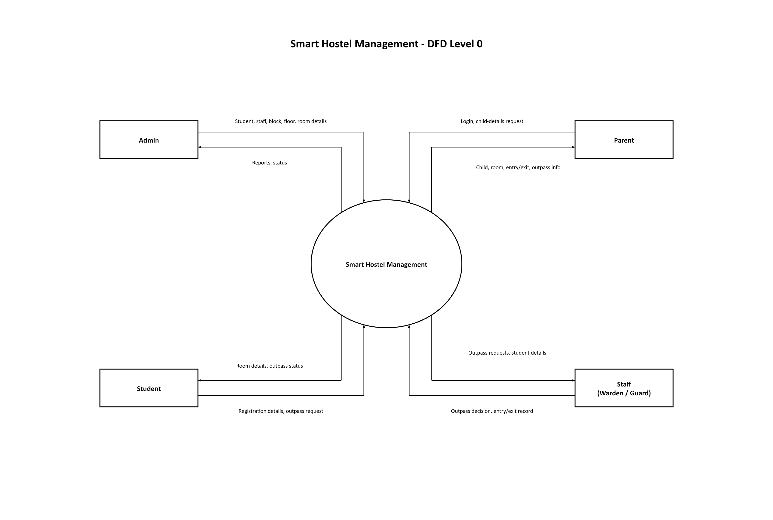
SHMS / 12
Data Flow Diagram: Context Level
The supplied DFD shows how Admin, Student, Parent, and Staff exchange data with the central system.
In the implementation, every protected request also passes through authentication, role authorization, and verified hostel context before data is returned or changed.
SMART HOSTEL MANAGEMENT SYSTEM
12

Slide 13
SHMS / 13
Security and Quality Evidence
The working foundation protects both data access and workflow integrity.
Authentication
Lifecycle safety
✓
✓
Scrypt password hashing and signed JWTs
Archive and restore preserve records
Authorization
Upload safety
✓
✓
Role middleware limits protected routes
Image signature, type, and size checks
Tenant isolation
QR protection
✓
✓
Verified membership determines hostel scope
Replay prevention with one-time tokens
94 backend tests passed in the latest verified run. The frontend production build also passed.
SMART HOSTEL MANAGEMENT SYSTEM
13

Slide 14
SHMS / 14
Current Work and Next Modules
The project has a working operational core. Remaining modules extend that core without weakening security rules.
Current working foundation
Next development modules
Login, registration, and active hostel context
Outpass approval workflow
Hostel facilities, students, staff, and parents
Complaints, help, notices, and notifications
Room and bed allocation with history
Mess, camera monitoring, and security events
Photo handling, payments, QR, and gate flow
Reports, exports, audit logs, settings, deployment
The project uses real database-backed values. It does not depend on dummy dashboard data or frontend-only access rules.
SMART HOSTEL MANAGEMENT SYSTEM
14

Slide 15
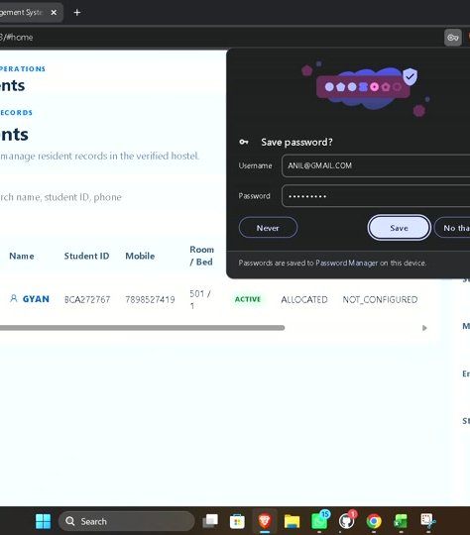
Smart Hostel
Management System
A secure foundation for managing hostel operations with real records, tenant isolation, and role-aware workflows.
Thank You
Questions and Discussion

